Slide 1
Authorization
UT LAW396V
Lecture Notes

Slide 2
Authentication/Authorization
Validating Identity
Permissions Assigned to a Validated Identity

Slide 3
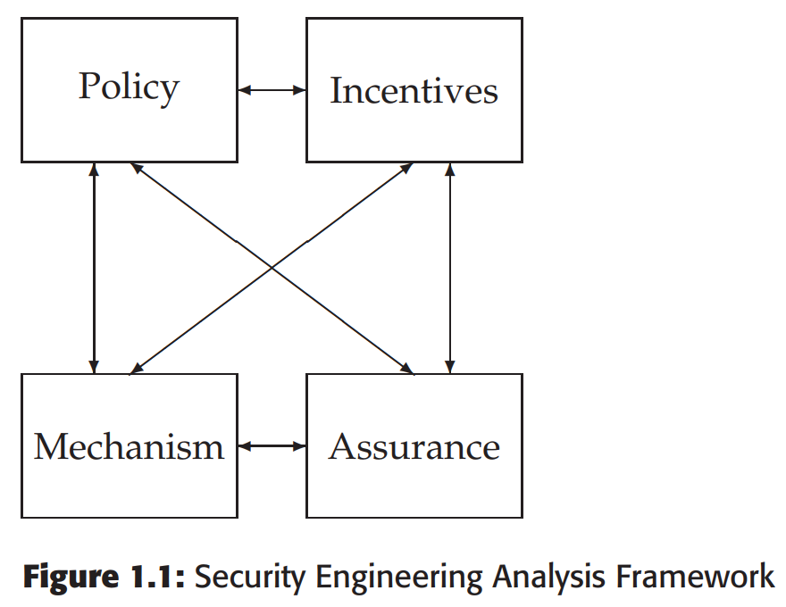
A Framework
Policy
Mechanism
Assurance
Incentives

Slide 4
What a Security Policy is NOT
Generic platitude statements
Butt-covering for legal/regulation
Aspirational, motivational, etc

Slide 5
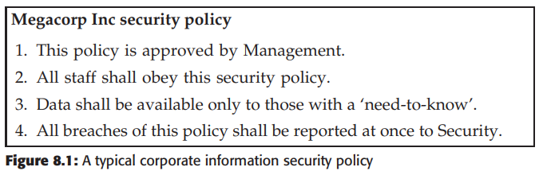
From, Security Engineering, 2nd Ed.,
Ross Anderson, 2008

Slide 6
Ross Anderson’s Observations
1. It dodges the central issue, namely ‘Who determines ‘‘need-to-know’’ and how?’
2. How are breaches to be detected and who has a specific duty to report them?
From, Security Engineering, 2nd Ed.,
Ross Anderson, 2008

Slide 7
What a Security Policy IS
Specific, testable properties
A strategy for security
Example:
“All checks over $10,000 must be signed by two managers.”

Slide 8
Policy vs Policy Model
I prefer “policy” for each statement
I prefer “policy model” for the combination
Anderson uses them interchangeably
There are other formulations

Slide 9
Policy and Authorization
Policy (model) is the security strategy
Testable security statements
Often an authorization model
(Policy defines what is authorized)

Slide 10
What Policy Does/Does Not
Defines a way of measuring/testing security
See previous “signed by 2 managers” example
Does not prevent “something bad happening”
Is not guaranteed to be “right”
If policy is right, bad things can happen
If policy is wrong, bad things will happen

Slide 11
Conceptual Building Blocks
Nothing here is implementation
There are still conceptual components:
Permission Models
User Models
Data Models
Enforcement Models
Objectives

Slide 12
Access Controls
The mechanism by which authorization permissions are managed
Within most information systems, the most common controls:
(C)reate
(R)ead
(U)pdate
(D)elete
Most other controls can be thought of as a form of one of these

Slide 13
Every-day Approaches
Access Control Lists
Capabilities

Slide 14
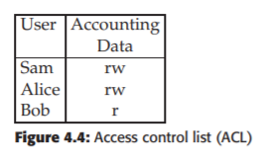
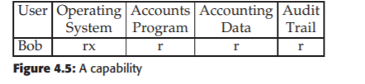
One View of ACL/Capabilities

Slide 15
Broader Concept
A capability is an enabling technology for access
An access control list is a filtering technology for access

Slide 16
Opponents of capabilities argue that you cannot change a file’s status
They just don’t understand capabilities
System Disable
Capability
Façade to File A
File A

Slide 17
MAC vs DAC
Mandatory Access Controls – what is permitted is determined by policy
Discretionary Access Controls – what is permitted is determined by user

Slide 18
Multi-Level Security (MLS)
Users and data are assigned classifications
What users are permitted to do with data depends on both labels
Relationship to MAC:
Some use it interchangeably
Some define parts of such a system as MAC (see next slide)
Anderson does not say the policy is MAC, but the controls that enforce it are
I prefer Anderson’s formulation

Slide 19
Bell Lapadula Model
Design emerged from military document classification
Three protection properties
Simple Security Property: No Read Up (NRU)
*-Property: No Write Down (NWD)
Discretionary Access Controls within the label

Slide 20
No Read Up/No Write Down
The *-property was the big innovation of BLP. It assumed trojans and buggy code!
TOP SECRET
SECRET
WRITE
READ
CONFIDENTIAL

Slide 21
Discretionary Access
Alice
(rw)
TOP SECRET
File A
Bob
(r)
WRITE
SECRET
File B
READ
CONFIDENTIAL

Slide 22
BLP as a Model Security Policy
BLP is a well defined security policy
So… is a system with BLP secure?
BLP itself is relatively easy to understand and enforce, BUT:
Is it the right security policy?
Is it going to work at the edges?

Slide 23
BLP Edge #1: Declassifying Data
What if we do want to write data down?
Original BLP “gets around” this by having trusted subjects
The NWD policy only applies to untrusted subjects
But there is no definition for trusted/untrusted
Trusted subjects introduce two risks:
Risks for any trusted subject
Risks that designers will make too many subjects trusted
Other solutions: security officer, additional policy, etc

Slide 24
BLP Edge #2: Creation of labels
Model does not say how to create data, subjects, or labels
Described by the creators of BLP, but not part of the model
Common solutions are data created by subject at same level
But how do subjects get their level?

Slide 25
Example of Additional Policy
Strong tranquility: security labels never change during operation
Example: put system into offline state to make changes
Weak tranquility: labels never change in a way that violates security policy
As subject accesses info that is higher, their level increases
At any given time, the NWD policy is enforced

Slide 26
BLP Edge #3: Data Doesn’t Flow
The model can “work too well.”
Data becomes compartmentalized
Data flows upward, duplication, etc., etc., etc.
In other words, sometimes even working “right” is “wrong”

Slide 27
Biba model
Upside-down BLP
You can only read up and write down
The goal is integrity not confidentiality
Partially used in Vista. Uses the NoWriteUp.
Most files are “medium” or higher. IE is “low”
So, things downloaded can read most files, but not write to them!
TOP SECRET
SECRET
WRITE
READ
CONFIDENTIAL

Slide 28
Why BLP or Biba?
BLP primarily enforces confidentiality
Biba primarily enforces integrity
Obviously, picking the right model for a system is crucial
Remember: many systems fail because the designers protect the wrong things or protect the right things but in the wrong way.

Slide 29
Domain and Type Enforcement
DTE assigns a “type” to data objects (e.g., files)
DTE assigns a “domain” to subjects (e.g., user processes)
Rules for domain-to-domain and domain-to-type
Used in SE-Linux and Android
Powerful, but can be complicated/hard to use
Perhaps not a real model, but a model framework

Slide 30
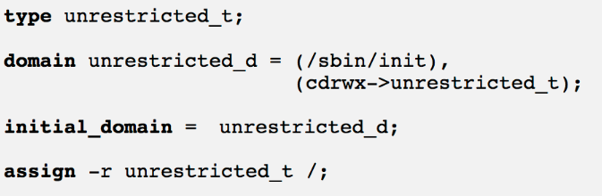
DTE Policy #1
This policy gives all permissions to every file on the system.
From “DOMAIN TYPE ENFORCEMENT” https://acv.cs.mtu.edu/dteTutorial.htm

Slide 31
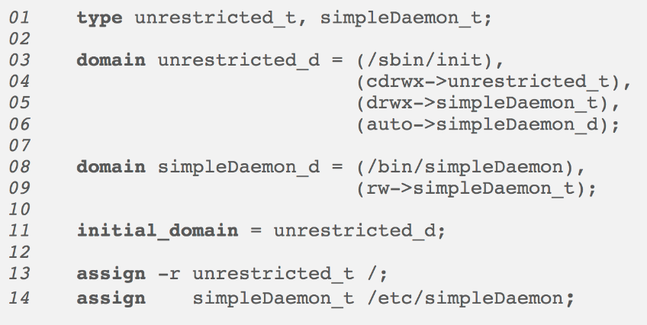
DTE Policy #2
This policy gives restricts “simpleDaemon” to only rw etc/simpleDaemon file.
From “DOMAIN TYPE ENFORCEMENT” https://acv.cs.mtu.edu/dteTutorial.htm

Slide 32
Role-Based Access Controls
RBAC is widely used commercially
Each user of the system has one or more roles
Each role has various permissions (can be MAC or DAC)
Each role’s permissions should be specific/limited
User may switch roles as needed
Problems include role-creep, data rot, etc.

Slide 33
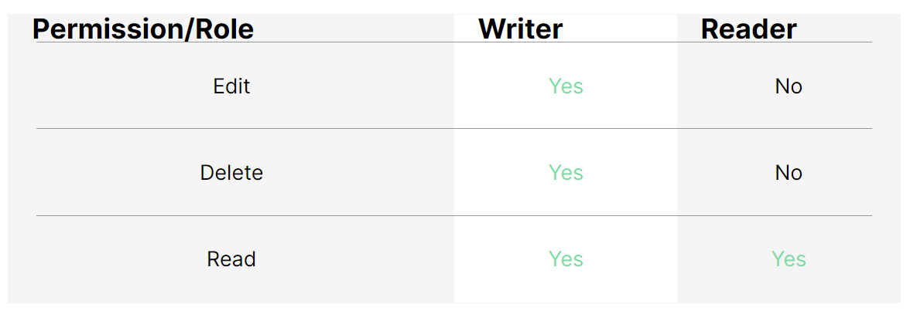
RBAC Example #1
From “What is Role-Based Access Control (RBAC)? Examples, Benefits, and More” https://www.upguard.com/blog/rbac

Slide 34
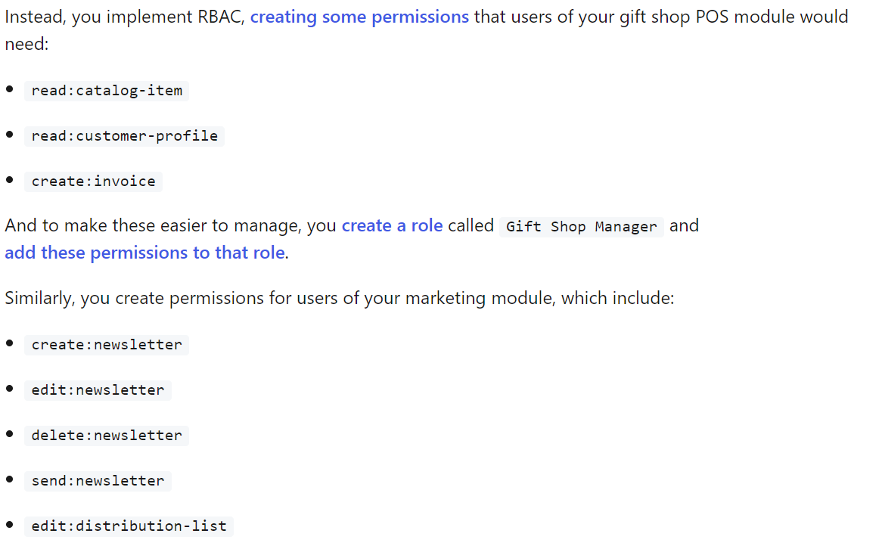
RBAC Example #2
From “Sample Use Cases: Role-Based Access Control”
https://auth0.com/docs/manage-users/access-control/sample-use-cases-role-based-access-control

Slide 35
Attribute-Based Access Controls
ABAC includes all of RBAC but adds additional information
ABAC also includes attributes: time of day, device, etc.
ABAC is seen as being exceptionally expressive
Like DTE, can be very complicated and hard to get right

Slide 36
Access Control Principles
Least privilege
Separation of duties/concerns
Accountability/Auditability
“Conditional” Access

Slide 37
Why Access Controls are Hard
Hard to model all usage
For example “Side Channels”
Another example “Inference Controls”

Slide 38
Inference
Information sharing often involves some kind of “scrubbing”
In MLS, a report is redacted before moving down a security layer
In privacy-preserving systems, data is often anonymized
The problem, of course, is inference
People can often be identified by their medical records even with names removed
And, of course, we’ve seen this with AOL and Google

Slide 39
Inference Control
Characteristic formula – the query instructions to get some set
Query set – the set produced by a characteristic formula
Sensitive Statistics – stats that deanonymize information:
For example, if the set is too small, than we’ve identified an individual by attributes

Slide 40
Query Size
You can limit how small a result is from a query
But you also have to worry about returning N-1!!
Also, you have to deal with using multiple queries to get a smaller than N intersection

Slide 41
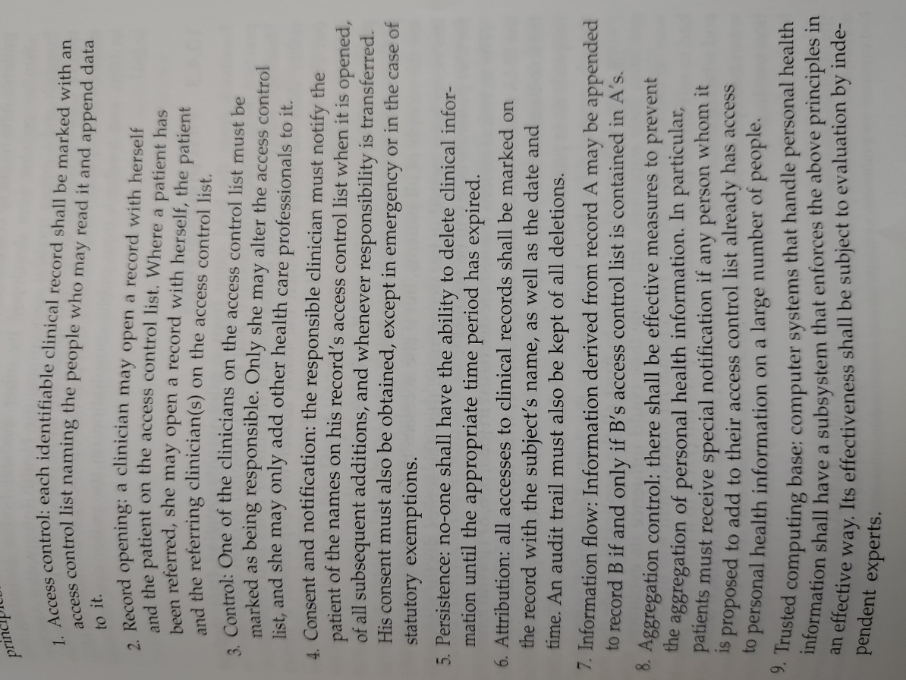
Anderson’s Example Policy

Slide 42
Anderson’s Example Policy

