Slide 1
Asymmetric Cryptography
UT CS361S
Spring 2022
Lecture Notes

Slide 2
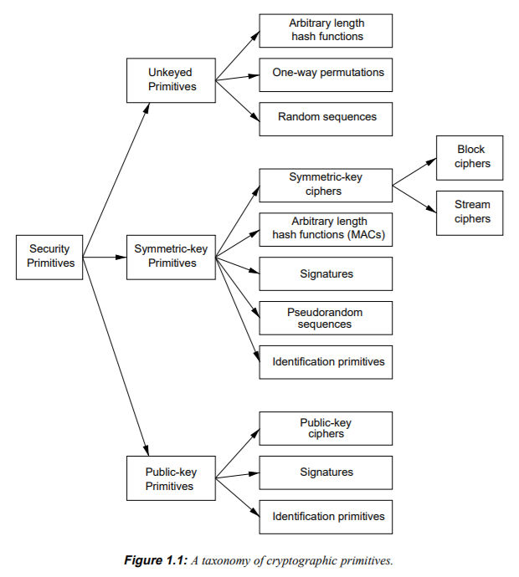
Technology Review

Slide 3
Asymmetric Cryptography
Keys come in pairs
Public key can be shared
Private key MUST be kept secret

Slide 4
Uses of Asymmetric Crypto
Unlike symmetric, what you can DO with asymmetric depends greatly on the algorithm
RSA – encryption (crypto dropbox), signatures
ECDSA/DSA – signatures
Diffie Hellman – key agreement
For today’s class, we will focus on RSA encryption and RSA signature, as well as Diffie Hellman key agreement.

Slide 5
RSA Encryption
Encrypt SHORT MESSAGES with public key, decrypt with private key
Encrypted Communication between A and B
A and B have each other’s public key
A encrypts a message for B under B’s public key
B responds by sending A a response under A’s public key
Works fine but…
It is very slow (asymmetric encryption/decryption is expensive)
Used almost exclusively for Key Transfer (sending a symmetric session key)

Slide 6


RSA Encrypt Visualization
Bob, here’s my public key, K
{some secret}K
Decrypt with K⁻¹

Slide 7
RSA Signatures
RSA encrypts with the PRIVATE KEY for a signature
Step 1: Publisher produces a message M
Step 2: Publisher takes the hash of M h(M)
Step 3: Publisher encrypts the hash with the private key {h(M)}_{k} -1
Step 4: Publisher transmits Message M and {h(M)}_{k} -1 as the signature
Step 5: A verifier decrypts h(M) with Publisher’s public key
Step 6. A verifier computes their own hash of M h’(M)
Step 7: A verifier determines the signature is valid if h’(M) = h(M)

Slide 8
RSA Signature
Bob, here’s my public key, K
M, {h(M)}K⁻¹
Decrypt h(M) with K
h(M) ?= h’(M)

Slide 9
Key Exchange
Asymmetric crypto is not good for “bulk data” encryption
RSA can only encrypt small messages SLOWLY.
Other asymmetric algorithms CANT ENCRYPT AT ALL
So, asymmetric is used to authenticate KEY EXCHANGE
There are two forms:
Key Transfer
Key Agreement

Slide 10
Key Transfer
Requires asymmetric encryption (e.g., RSA)
Create a session key
Send session key encrypted with public key
Only party poessing the private key can decrypt it
(Automatically authenticated)

Slide 11
RSA Key Transport
Bob, here’s my public key, K
{session key sk}K
Decrypt with K⁻¹
{Message 1}sk
{Message 2}sk

Slide 12
RSA Weaknesses
Insecure when NO PADDING IS USED
Encryption padding schemes
PKCS 1.5 (BROKEN!)
OAEP
Signature padding schemes
PKCS 1.5 (BROKEN!)
PSS
Even though there are non-broken versions, RSA is being phased out
Also, key transfer does not have “forward secrecy”

Slide 13
Catastrophic Loss of RSA Key
Assume A and B want to communicate, E is eavesdropping
A and B use RSA key transfer to exchange session keys
E records thousands of sessions between A and B
After 5 years, A disposes her computer and buys a new one
E steals her computer from the junkyard, finds the private key
ALL PREVIOUSLY RECORDED MESSAGES ARE EXPOSED!

Slide 14
Diffie Hellman Key Exchange
The math version has to do with commutative properties.
Using modulo computations over p which is a prime with certain properties:
A → B : g^{RA} (mod p)
B → A : g^{RB} (mod p)
A → B : {M}g^{RAB}
A and B are the DH private keys
Can’t be extracted from g^{RA} (mod p)
But, because commutative, can be combined by either side into g^{RAB}
In short, to create a key, exchange DH public keys + parameters

Slide 15
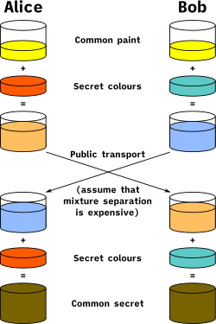
Wikipedia Visualization

Slide 16
DHE and Forward Secrecy
Diffie Hellman Ephemeral (DHE)
New DH Private Key used for EACH KEY AGREEMENT (session)
RSA key is used to SIGN the DH private key
DHE private key never stored outside of RAM
Now if E steals A’s computer, no messages exposed
Compromising a single key exposes only that session
This is “Forward Secrecy”

Slide 17
No DHE Authentication
Next class: how to prove authenticity of a public key
But, spoiler alert!, it HAS to be a long-term key
So, with DHE, you can create keys on the fly (“out of thin air”)
BUT, you have no idea who they’re coming from!!!

Slide 18
Two Asymmetric Steps
You caught that there were TWO asymmetric steps for DHE?
First, the DHE is used for key generation
Second, RSA is used to sign (authenticate) the DH public key
There are two asymmetric steps, algorithms, and public keys

Slide 19
Why not RSA Ephemeral?
Why not have a long-term RSA key for signing
And an ephemeral RSA key for each key transfer?
You could create a new RSA key pair each session, just like DH
The problem is that RSA is slow; DH keys are quickly generated

Slide 20
Other Asymmetric Algorithms
DSA – Just used for signing
ECDH – Elliptic Curve Diffie Hellman (just like DH)
ECDSA – Elliptic Curve DSA (just like DSA)
RSA, DH, DSA, ECDH, ECDSA are the most common I’ve seen

Slide 21
TLS 1.2 Handshake
Goal
Agree on a cipher suite for encryption, authentication, etc.
Goal
Identify the server (and optionally the client)
Goal
Create session keys for bi-directional communication

Slide 22
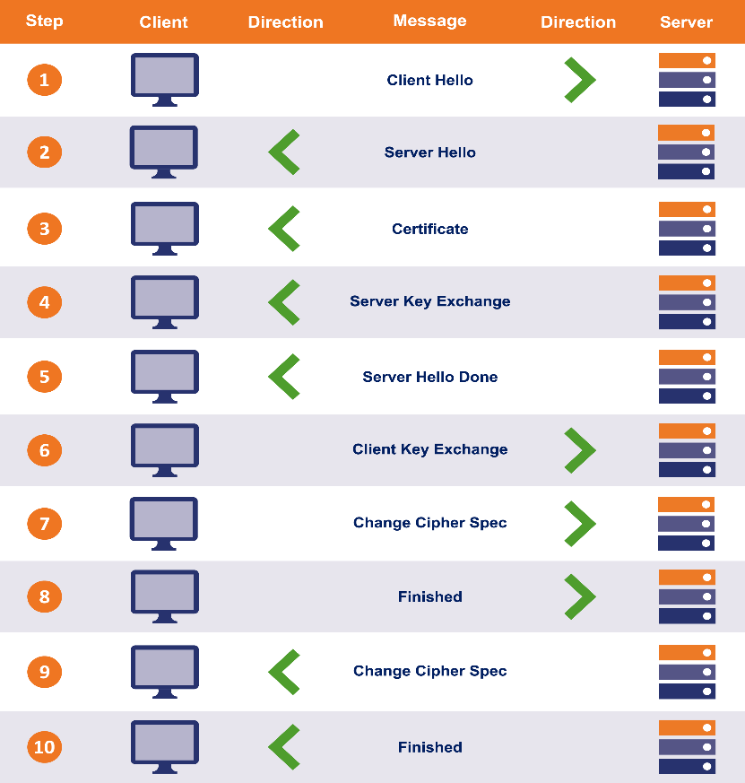
TLS 1.2 Handshake Review

Slide 23
End-to-End Handshake Visualization #2
Client Hellio
WEB BROWSER
Server Hello, Cert, KeyShare, HelloDone
WEB SERVER
KeyShare, Change Cipher Spec, {DONE}
Change Cipher Spec, {DONE}

Slide 24
Authentication
Client Hellio
WEB BROWSER
Server Hello, CERT, KeyShare, HelloDone
WEB SERVER
KeyShare, Change Cipher Spec, {DONE}
Change Cipher Spec, {DONE}
The “Certificate” message includes ONE OR MORE certificates.

Slide 25
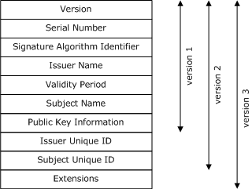
What is a Certificate?
TLS specification (RFC) doesn’t specify cert or cert verification
The most common is X 509

Slide 26
Certificate Verification
CERTIFICATE
-----------------------------
Subject CN: amazon.com
Not Valid Before: 2001
Not Valid After: 2030
Issued By: amazon CA
Signature Blob: <sig>
WEB BROWSER
Verify “amazon.com” is the URL
Verify the validity period
(Other Verification)
Who issued the cert?

Slide 27



Public Key Private Key
Name: yourbank
Issuer: godaddy
**signature**
PUBLIC KEY
PRIVATE KEY

Slide 28
Certificate Chains
Subject CN: amazon CA
…
Issued By: GlobalSign
Signature Blob: <sig>
The certificate for the Host may be signed by an INTERMEDIATE Certificate Authority
Because the web browser probably doesn’t have this intermediate cert, the TLS handshake includes both certificates.
Subject CN: amazon.com
…
Issued By: amazon CA
Signature Blob: <sig>

Slide 29
Proving Identity
Who are you?
CERT
I’m yourbank
In TLS, the “nonce” is just wrapped up with the other data, such as the client hello, which is all included in the final hash in the finished message.
VERIFY CERT:
- sbj = yourbank?
- chain trusted?
Ok, prove it (nonce)
{nonce}private_key
PUBLIC KEY
PRIVATE KEY

Slide 30
Root CA Certificates
Certificate chains MUST have a ROOT
A Root Certificate is SELF SIGNED
Browsers trust a set of root certificates AXIOMATICALLY
Certificate chains must have a trust chain to one of these roots.

Slide 31
Trusting Diffie Hellman
Recall that DH keys are EPHEMERAL
The Server’s cert includes a long-term public key
The Server’s DH key is signed by this key pair
IF the client trusts the cert, THEN it can validate the DH key

Slide 32
TLS Bulk Transport
Both Client and Server derive keys
Encryption keys AND MAC keys
MAC’s ensure continuous authentication

Slide 33
When a TLS message is Received:
The sender is “proved” by the MAC
The MAC is “proved” via MAC key derived from DH
Server’s DH key “proved” authentic by cert signature
Certificate “proved” authentic by chain to trusted root

Slide 34
It All Depends on the Cert
IF a browser trusts MY certificate to be Amazon’s certificate
THEN the browser will trust my DH public key
IF the browser trusts my DH public key
THEN the browser will derive the same MAC key I do
IF the browser derives the same MAC key I do
THEN the browser will believe my messages are from Amazon

