Slide 1
Border Security
LAW 371
Fall 2023
Dr. Seth James Nielson

Slide 2
“Spaces”
Space A
“Space” is not a technical term.
I use it to represent the concept of separation
Space B

Slide 3


Macro Physical Spaces
This Photo by Unknown Author is licensed under CC BY-NC-ND

Slide 4

Micro Physical Spaces

Slide 5
Why do we Separate Physical Things?
CONTEXT
Countries have different
Social Models
Legal Frameworks
Rights and Responsibilities
Binders, bins, and office “spaces”
Importance
Meaning

Slide 6

Access
Most physical spaces try to control the flow
from one space to another

Slide 7
Cyber Spaces
Often tied to a physical space and/or organization
All the people, equipment, data, etc. belonging to an entity
For example, a corporate network
But there are far more conceptual spaces
Media piracy
Hacking communities
Everything in-between

Slide 8
Review: Local Area Networks
What is a LAN?
Generally communicates WITHOUT ROUTING
This is why it is “local”

Slide 9
LAN’s as Natural Spaces
LAN’s have historically created cyber spaces very naturally
Typically tied to an entity, the LAN is
Hosted by the entity in physical space
Provides resources on behalf of the entity in cyber space
Access controls are typically related to physical entity
Insiders have increased access to resources across the LAN
Outsiders have limited access to specific servers/resources

Slide 10
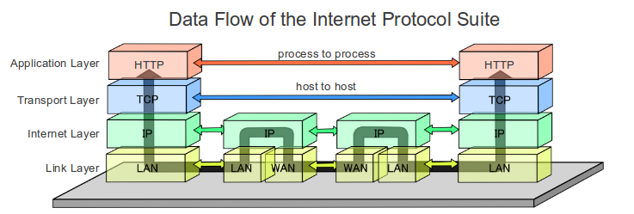
LAN’s create “Borders” on the Internet
This Photo by Unknown Author is licensed under CC BY-SA
ROUTER
(Gateway)
ROUTER
(Gateway)
LAN #1
LAN #2

Slide 11
Gateways: Natural Barriers
Outside data can only get into a LAN via router
We call the routers at the “edges” of a LAN gateways
Gateways are, therefore, natural chokepoints for data

Slide 12
Gateways: Space Transition
SPACE A
(LAN #1)
CONTEXT!
SPACE B
(LAN #2)
CONTEXT!

Slide 13
Context is EVERYTHING
Security is all about context (REPEAT AFTER ME!)
Security has no meaning without context
What is secure in one context may not be in another
Outside data is assumed to have a different context
Reasonable and natural to examine data changing context

Slide 14
Gateways: Context Change
SPACE A
(LAN #1)
CONTEXT!
SPACE B
(LAN #2)
CONTEXT!
CONTEXT CHANGE!

Slide 15
Firewall: Gateway Security
What is a “firewall”?
Informally: any security-enforcement on data transit
(most commonly at the gateway)

Slide 16
Firewall Marketing
Juniper: “control over applications, users, and content to stop advanced cyber-threats”
PAN: “Instantly find and stop attacks with a fully automated platform”
Cisco: “Prevent breaches, get deep visibility to detect and stop threats fast”

Slide 17
Ignore Marketing. Think ENGINEERING
Ross Anderson’s framework from Security Engineering
Policy: WHAT you’re supposed to achieve
Mechanism: HOW you’re supposed to achieve it
Assurance: RELIABILITY of the mechanism
Incentives: MOTIVES of defenders and attackers

Slide 18
Core Concepts: Policy and Mechanism
This is not a security engineering class
But we will use it to help us frame how we look at security
PAY SPECIAL ATTENTION TO POLICY vs. MECHANISM
Policy is WHAT you want
Mechanism is HOW you do it

Slide 19
Firewalls: Policy and Mechanism
Firewalls are MECHANISMS for enforcing certain network security POLICIES
Borders are natural places to want a policy
Borders are also an easy place to enforce some policies
BUT DON’T CONFUSE THE TWO!

Slide 20
“Security” is a Meaningless Word
Firewalls, like other mechanisms, don’t “create security”
Consider the marketing descriptions
What is a “threat”?
What does it mean to “block”?
What is an “attack”?
How would you even evaluate these claims?

Slide 21
Enforcing Policy
Firewalls are ONLY useful to the extent they enforce policy
Corollary: Policies come BEFORE firewalls
What security policies might you like to have?
How well do firewall enforce these?

Slide 22
Sample Policies
Policy #1: Only authorized software can enter the network
Policy #2: Only authorized external network access
Policy #3: Only authorized published resources
Policy #4: Authorized resources remain available
NOTE:
External access means LAN user connecting to Internet
Published resources means Internet connecting to LAN

Slide 23
Early Firewalls: Layer-3 Mechanisms
The first firewalls were LAYER 3 (IP level)
Could only block bad IP addresses!
Layer-3 filtering can only indirectly enforce
Policy #1 by blocking access to probably dangerous computers
Policy #2 by blocking outbound requests to unauthorized IP’s
Policy #3 by blocking inbound requests to unauthorized servers
(Maybe some Policy #4?)

Slide 24
How does Layer-3 Enforcement Work?
Router/Firewall
-> Has to inspect the IP packet for routing
-> Will drop packets from “bad” addresses

Slide 25
Layer-4 Firewall (Packet Filter Only)
People quickly realized that IP-layer was weak enforcement
Examining TCP packets made enforcement better
TCP ports typically represented a specific service
Policy enforcement mechanism improvements:
Policy #2 by blocking access to unauthorized outbound ports
Policy #3 by blocking access to unauthorized inbound ports

Slide 26
Layer-4 Firewall (Stateful)
Layer-4 packets also reveal connection state
Some malicious packets violate TCP rules, for example
Layer-4 firewalls could also keep track of TCP sessions
Better enforcement of policy #4
Block malicious network traffic

Slide 27
Layer-4 Still Layer-3 Routing
Important.
Just because a router is doing L3 routing doesn’t mean it cant look at L4 data
Router/Firewall can examine any data,
not just data used for routing

Slide 28
L7 Firewalls
L7 firewalls examine application data
Specifically look at data, and not just headers!
Can “reassemble” data from more than one packet
Even more “stateful”

Slide 29
Early Motivations for L7
Application firewalls go back to 1991!!
Idea: Firewalls should understand application traffic.
Example: File Transfer Protocol
Scan FTP data for the logged-in user
Scan FTP data for operations (upload/download)
Control which users can upload or download
Fine-grained application controls

Slide 30
Modern Motivation for L7
In the past decades, need for L7 scanning has increased
L3/L4 enforcement is rough guess (e.g., based on IP/port)
What stops an attacker from using a different port number?
L7 scanning can block web traffic even on different port
Can also scan for viruses, malicious data
(Better for all 4 policies!!!)

Slide 31
Tracking Users
Since the 90’s, firewalls also supported their own services
Users could log-in to the firewall
The logging-in process could map a
user-name to an IP address (computer)
Or even a special connection like VPN

Slide 32
L7 Policy Enforcement
User + Application Scanning even more granular
Resource access can now be user specific
User X can connect to specific external website

Slide 33
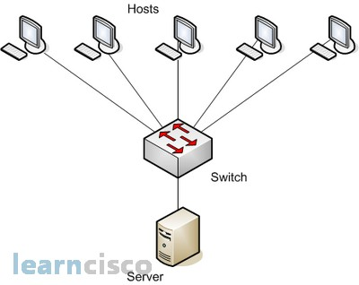
You can Also have an L2 Firewall
Firewalls can go here too!
In this case, L2 refers to the
routing, not the inspection!

Slide 34
Layer 2 Firewalls
But this is REALLY confusing
Has nothing to do with layer used for scanning
Just refers to scanning in a SWITCH instead of a ROUTER
Have some neat defensive properties
If only a switch, HAS NO IP ADDRESS!!! HARDER TO ATTACK!!!
Called “bump in the wire”

Slide 35
Tunnels
In the arms race, bad actors wrap one kind of traffic in another
Unsurprisingly, HTTP is popular
Modern firewalls can unpack the tunnel to see what’s inside.
One exception: encrypted tunnels (TLS/SSH)
Can’t see inside without “visibility”

Slide 36
TLS Visibility
Typically, client MUST have a new root CA installed
Root CA is a self-signed certificate from the firewall
Firewall can now generate ANY cert!!!

Slide 37
TLS Visibility Handshake Visualization
Client Hellio
Client Hellio
Server Hello, FAKE CERT, KeyShare, HelloDone
TLS Visibility
Server Hello, Cert, KeyShare, HelloDone
WEB SERVER
WEB BROWSER
KeyShare, Change Cipher Spec, {DONE}
KeyShare, Change Cipher Spec, {DONE}
Change Cipher Spec, {DONE}
Change Cipher Spec, {DONE}

Slide 38
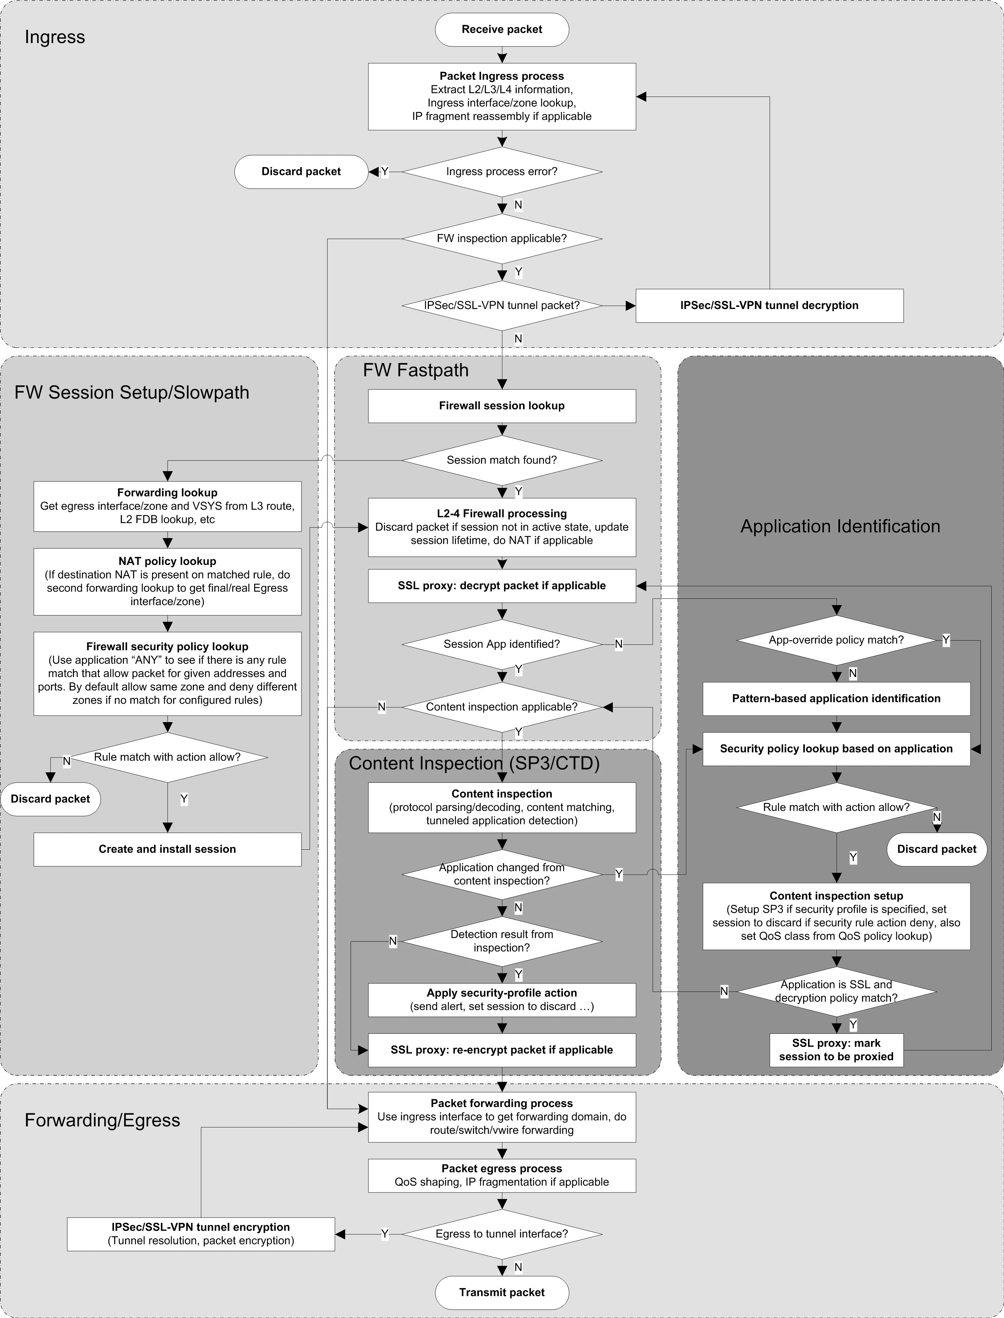
Palo Alto Network Example

Slide 39
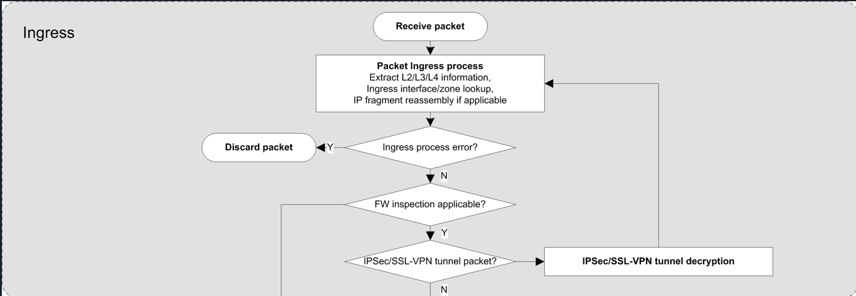
Palo Alto Network Example

Slide 40
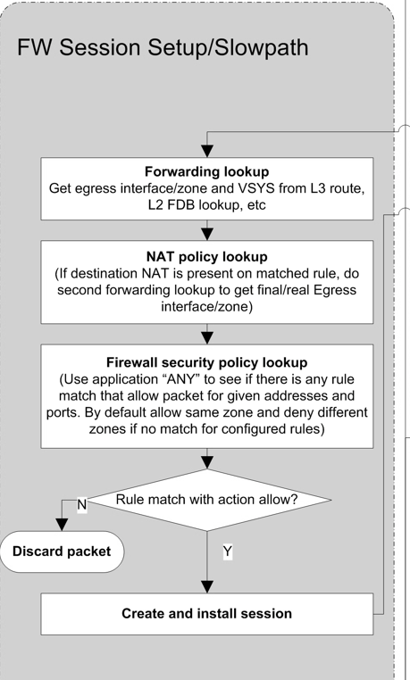
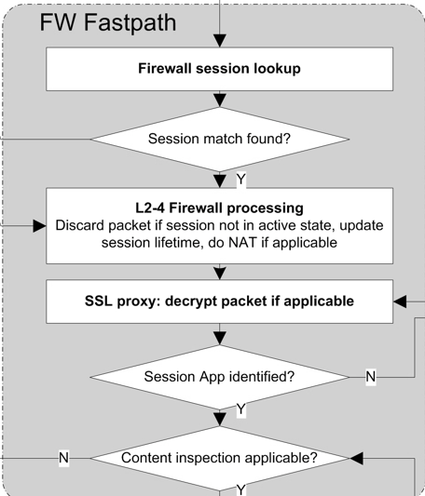
Palo Alto Network Example

Slide 41
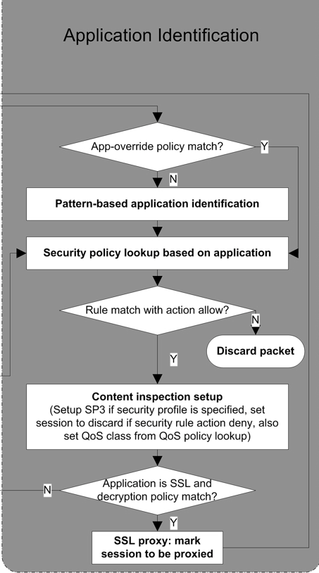
Palo Alto Network Example

Slide 42
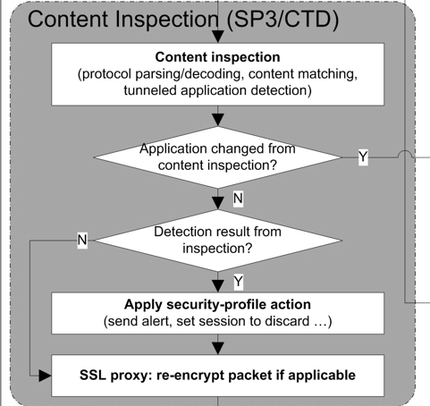
Palo Alto Network Example

Slide 43
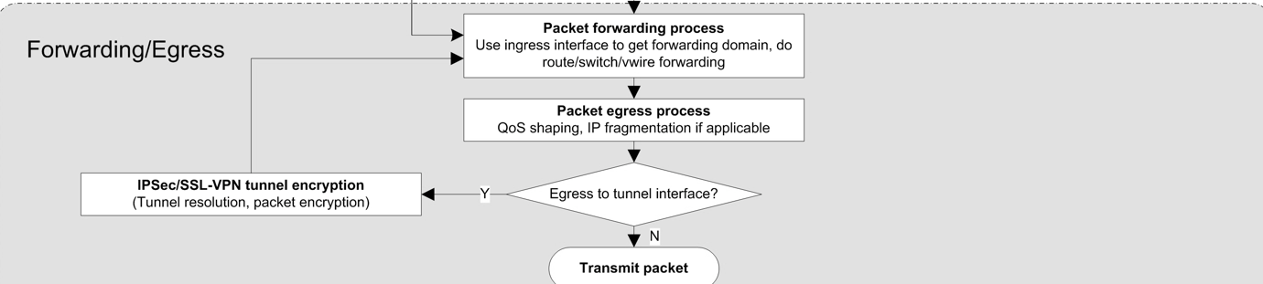
Palo Alto Network Example

Slide 44
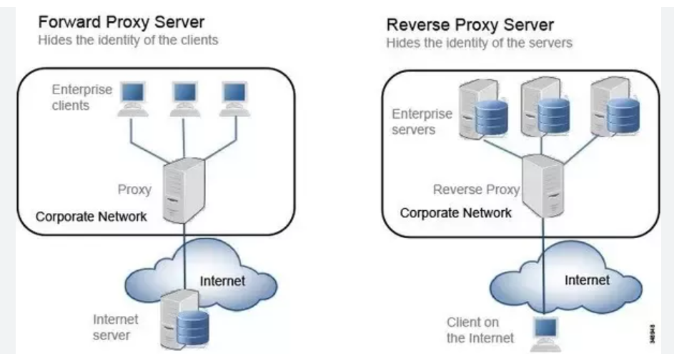
Proxies

Slide 45
IDS: Mitigation and Future Prevention
IDS stands for Intrusion Detection System
IPS is Intrusion Prevention System
IDS is far more common because IPS is just too hard (FP/FN)
IDS assumes the attacker has already won
The attacker has already succeeded in his objective and left (forensics)
The attacker is in the system, but moving to a higher target (mitigation)

Slide 46
Signs of Bad Behavior
Anomalies: unusual network traffic
Port scanning (recon)
Unusually large data transmissions (buffer overflow, etc)
Unexpected traffic between machines
Surprisingly, this is still very much signature based
Many attempts to do statistics modeling but usually too noisy

Slide 47
IDS Types
Network Based IDS (NIDS)
Monitor traffic on the network (often using the gateways/routers)
Host Based IDS (HIDS)
Monitor traffic received at a host, and the effect thereof
Sometimes helpful in simply monitoring the encrypted traffic
Hybrid systems
Deploy host components and network components
Report all data back to a central server/dashboard

Slide 48
Honeypots
An interesting IDS component
Create a fake system to draw attacker attention
Introduces components whose entire operation is an anomaly

Slide 49
Types of Honeypots
Low Interaction – port only, record traffic
Purpose: logging
Medium Interaction – simulated/emulated service
Purpose: delay/confuse
High Interaction – real services on real computers with real OS
Purpose: maximum analysis of attacker behavior
Honeynet – multiple honeypots together on fake network
Specialized variants:
Malware Honeypots
Spam Honeypots

Slide 50
Deploying Honeypots
Now part of larger “Enterprise Deception Operations”
Entire firms dedicated to setting up fake systems
Shockingly useful these days… why?
Use up attacker time
More time to detect attacker
More likely to feed false information to attacker

Slide 51
All-in-One
Most “enterprise” firewalls for sale include extras like IDS
Generally easier to have it all in one

Slide 52
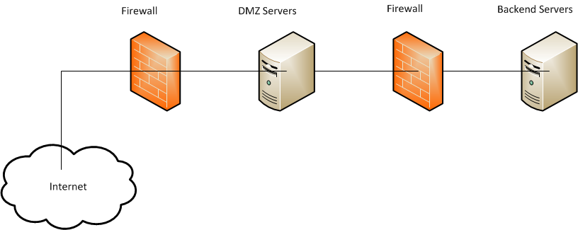
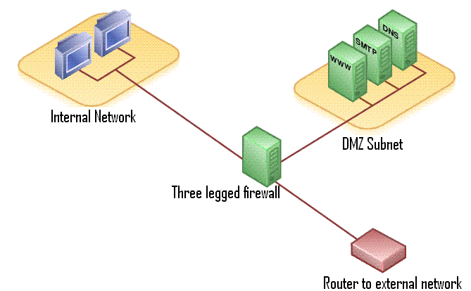
Network Architecture: DMZ
This Photo by Unknown Author is licensed under CC BY-SA
This Photo by Unknown Author is licensed under CC BY-SA
POLICY ENFORCEMENT

Slide 53
The Future
The future? ZERO TRUST NETWORKS
Many say that the “Firewall is Dead”, “DMZ’s are Dead”, etc
I doubt that they die… will probably evolve?

