Slide 1


Slide 2
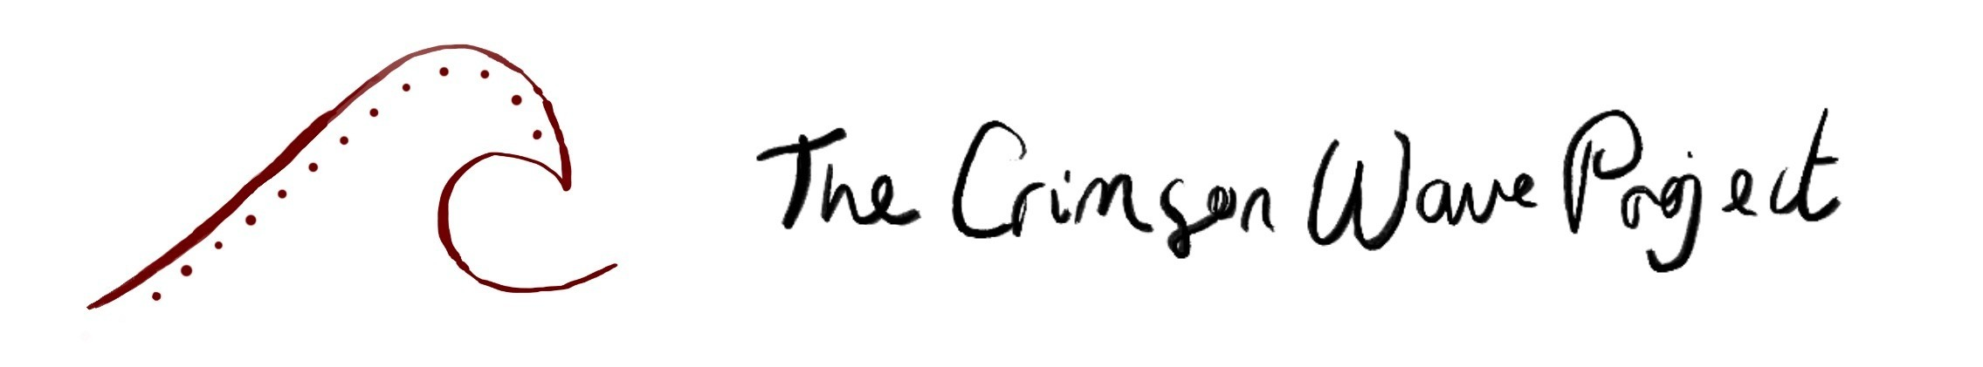



Team
Jane (she/her)
Em (they/them)
Ideas and pioneers fund (£15K) by the
Paul Hamlyn Foundation phf.org.uk/
(£30 million /year for change and socialjustice )
And me

Slide 3

What makes us different from Other
Menstrual-cup makers?
We are A Community interest company with:
Opensource Hard and Software → Decentralized Repreducability
Affordable
Small Scale production (100-1000)
Costumizable Parametric Design
By one → match donation

Slide 4
Bucketlist
Employ Webdeveloper*innen
Forum
Potcast
Desktop Injection Molding Machines
Rocket One 🚀
Ultrasound scanning
AI Design

Slide 5
HOW?
Can we 3DPrint a menstrual cups?
No!
YES!
Silicone, TPE, Latex Resin!
Biocompatibility!
→ Molds (FFF or resinprinted)
labor-intensive
Sustainability Aspect ♻️
$$$ Costs? +-1000euro

Slide 6
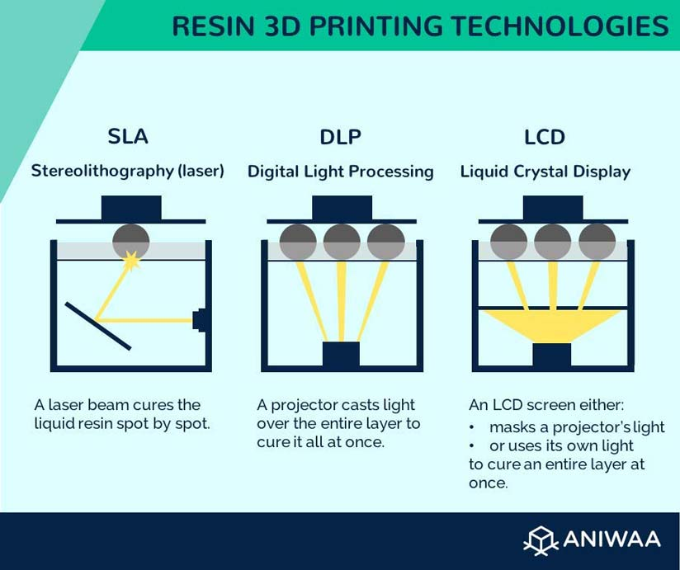
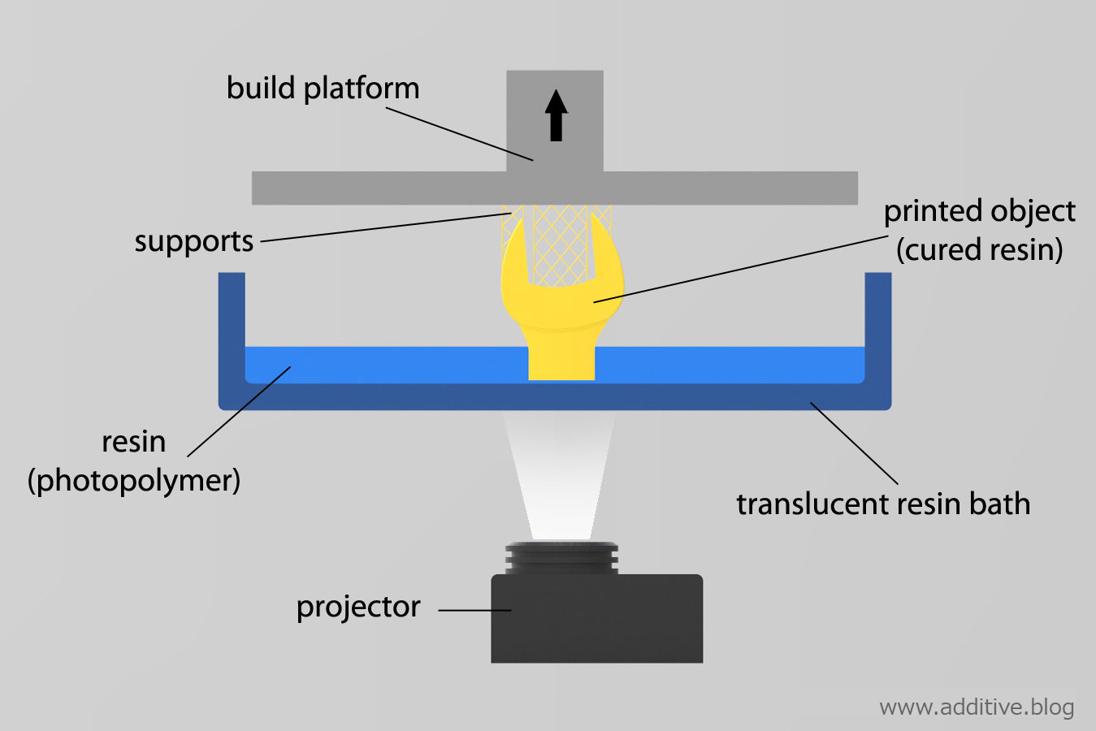

Resin Printing?

Slide 7

The Rocket One 🚀 by Hitry
How ? Why? When?
TOP Down → Faster Better Stronger
0.035mm XY resolution & 0.001mm Z-axis resolution
Kickstarter (Calculated Risk)
Sometime in May or June

Slide 8
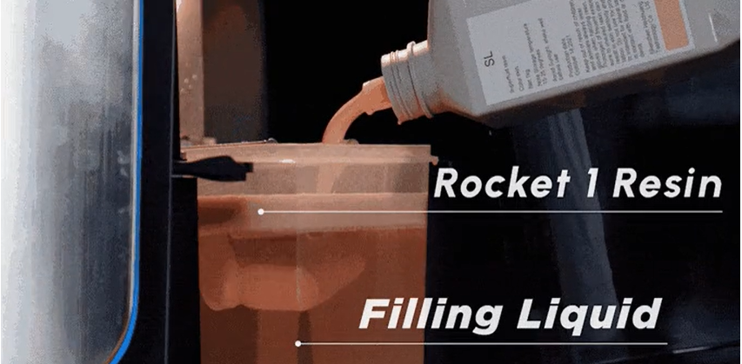
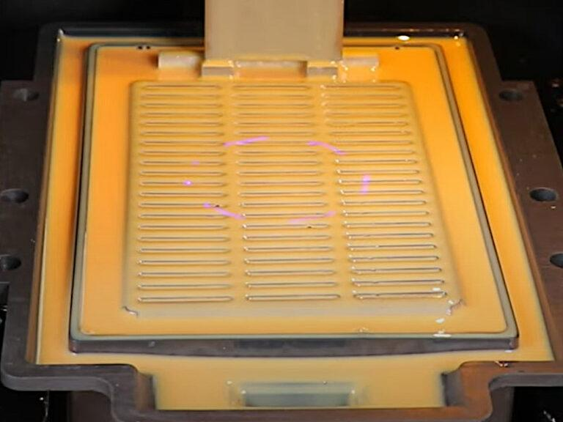
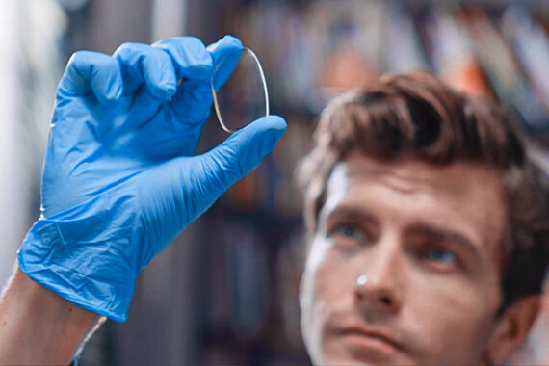

The Rocket One 🚀

Slide 9
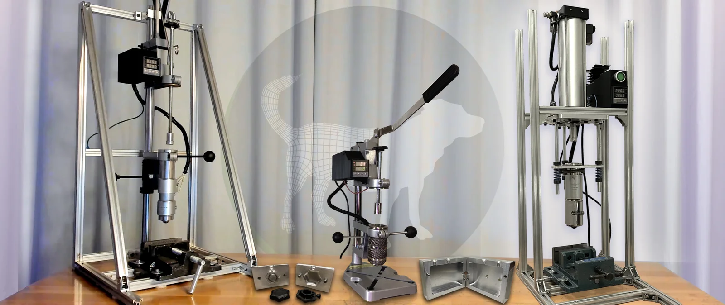
Open-source Desktop Injection Molding Machines
busterbeagle3d.com

Slide 10
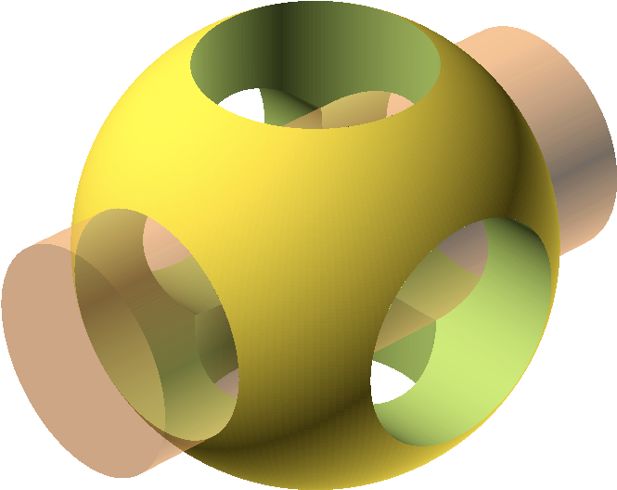

OpenSCAD
Advantages:
Parametric Opensource
& Easy to learn
Dis-advantages
Language Limitations

Slide 11
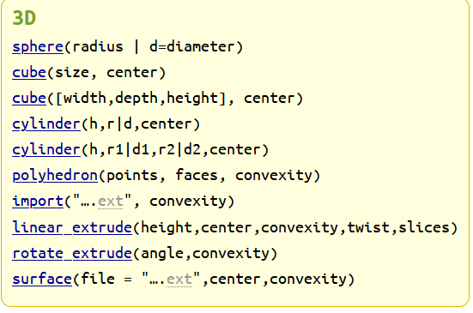
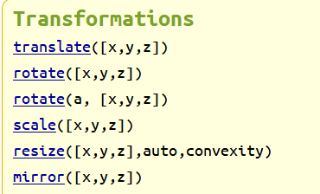
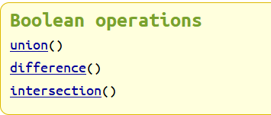

Openscad Basics
https://openscad.org/cheatsheet/

Slide 12
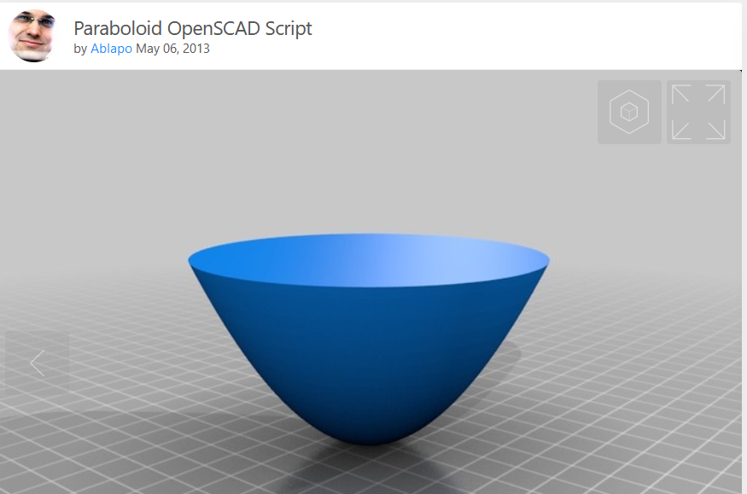
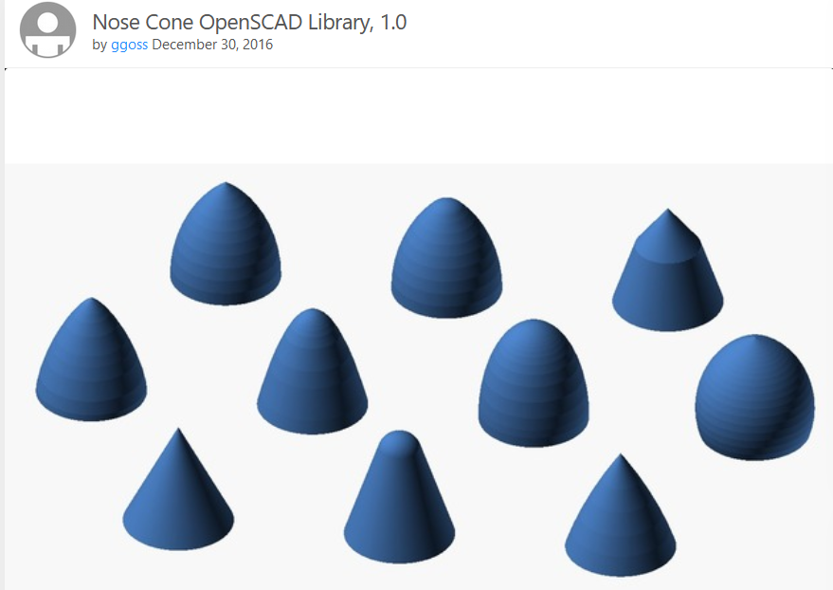
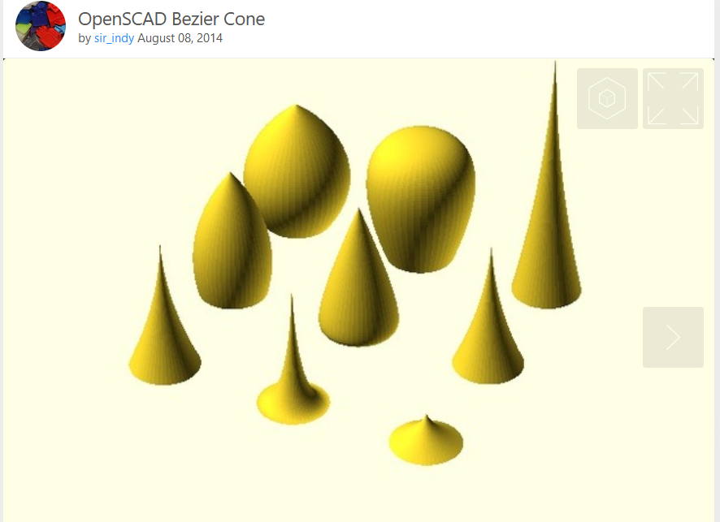

Using Parabloide Libraries

Slide 13
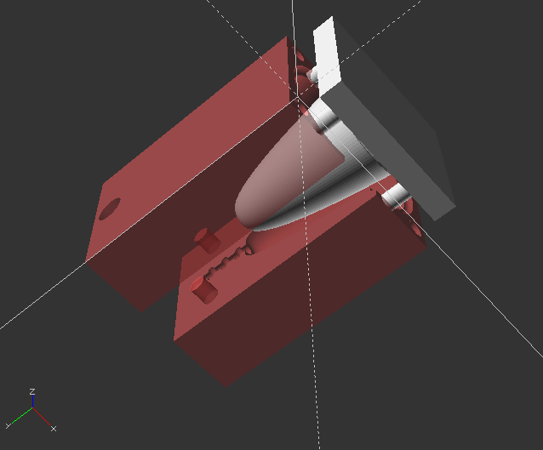
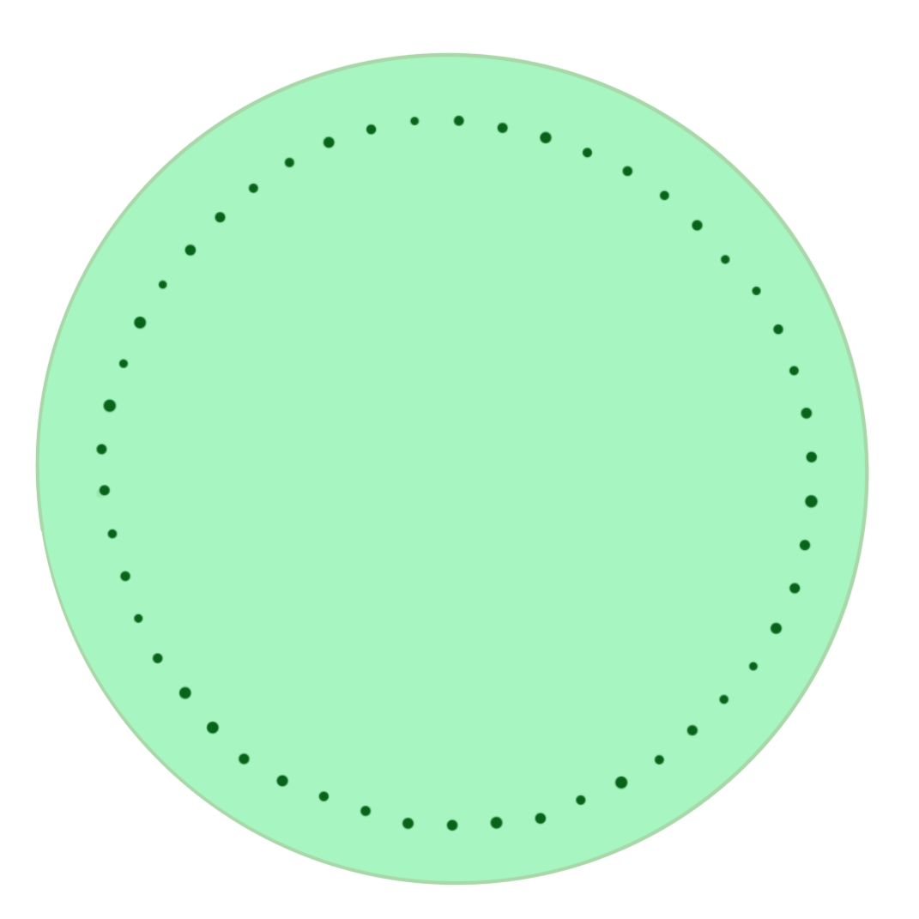
The Menstrual Cup Mold

