Slide 1
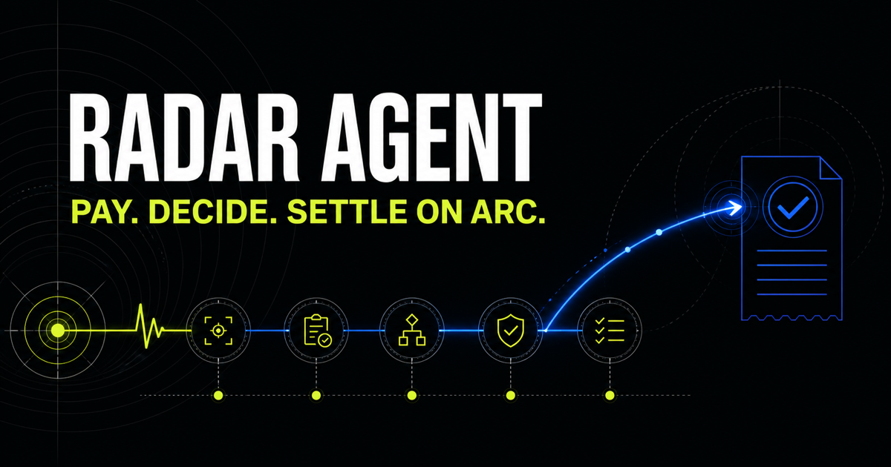
PROGRAMMABLE MONEY
Radar Agent
Agents buy market signals in USDC, then act through a hard safety layer.
AGENTIC ECONOMY · ARC TESTNET
01
Notes:
[Sources]
- https://github.com/CrisChang/radar-agent
- Product screenshot captured from the local working MVP.
[/Sources]

Slide 2
Agents need a payment rail - and custody boundaries.
THE GAP
Calling an API is easy. Letting an agent spend and move money is not.
A useful autonomous agent needs per-request payment, an explainable decision boundary, and controls that cannot be talked around.
Pay per signal
Explain every decision
Cap every spend
Prevent replay
Trace settlement
02
Notes:
[Sources]
- https://github.com/CrisChang/radar-agent
[/Sources]

Slide 3
One closed loop turns information into bounded action.
01 · SELL
02 · BUY
03 · SETTLE
x402 signal API
Recent ETH/BTC movement becomes a $0.001 USDC signal.
Explainable agent
Pay, evaluate the threshold rule, then authorize or hold.
Circle execution
App Kit moves capped USDC between active and reserve wallets.
03
Notes:
[Sources]
- https://github.com/CrisChang/radar-agent/blob/main/docs/ARCHITECTURE.md
[/Sources]

Slide 4
The discipline layer - not the model - controls custody.
Spending caps
Separate daily limits for signal purchases and treasury moves.
Replay safety
Deterministic idempotency keys stop duplicate execution.
Position safety
A reconciled balance and minimum reserve are mandatory.
Breaker + audit
Three failures halt the agent; every step remains traceable.
04
Notes:
[Sources]
- https://github.com/CrisChang/radar-agent/blob/main/lib/discipline.ts
[/Sources]

Slide 5
The MVP is implemented, tested, and funded on testnet.
WORKING PROOF
A real paid signal triggered a real guarded treasury rebalance on Arc Testnet.
$0.001
1 USDC
5 / 5
per x402 signal
treasury transfer
automated tests pass
05
Notes:
[Sources]
- https://github.com/CrisChang/radar-agent
- https://testnet.arcscan.app/tx/0xb552e86788532a48013355c5165e68bd50b56a24e0dd6ec2a5d28b005e687726
[/Sources]

Slide 6
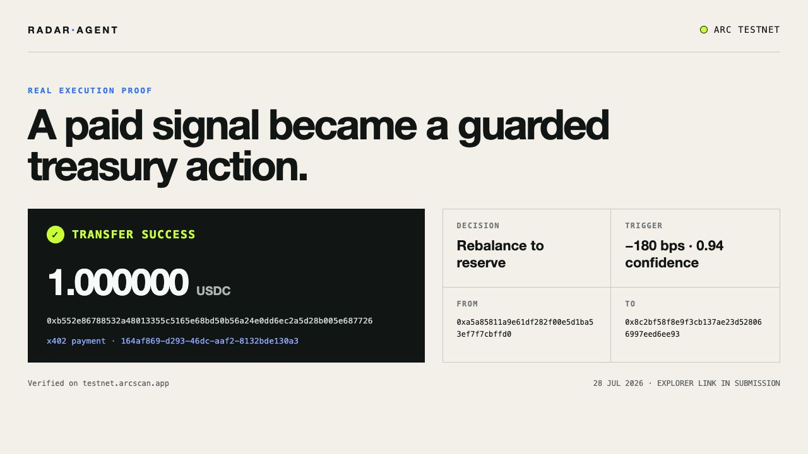
Real execution, not a mock.
A -180 bps signal at 0.94 confidence passed every guard.
x402 payment succeeded. Circle App Kit then moved 1 USDC from the active wallet to reserve. The transaction is public on ArcScan.
06
Notes:
[Sources]
- https://testnet.arcscan.app/tx/0xb552e86788532a48013355c5165e68bd50b56a24e0dd6ec2a5d28b005e687726
- Execution record from agent/state/audit.jsonl.
[/Sources]

Slide 7
The full loop is public, testable, and ready.
BUILD | WALLETS | PAY | ACT | PROVE
MVP + discipline
Circle wallet setup
x402 paid signal
Arc treasury transfer
Verified proof replay
Public demo + video + deck
https://radar-agent-arc-2026.chrischang2026.workers.dev
07
Notes:
[Sources]
- https://github.com/CrisChang/radar-agent
- https://radar-agent-arc-2026.chrischang2026.workers.dev
[/Sources]

Slide 8
RADAR AGENT
Pay. Decide. Settle on Arc.
Live · radar-agent-arc-2026.chrischang2026.workers.dev
Video · /demo
GitHub · CrisChang/radar-agent | ArcScan · 0xb552…7726
Notes:
[Sources]
- https://radar-agent-arc-2026.chrischang2026.workers.dev
- https://github.com/CrisChang/radar-agent
- https://testnet.arcscan.app/tx/0xb552e86788532a48013355c5165e68bd50b56a24e0dd6ec2a5d28b005e687726
[/Sources]

