Slide 1


LOGO
FOSTER CARE UNIT PORTAL
[Dito yung name ng Portal]
SEARCH
Home
Downloads
Analytics
Management
Account Login
Display ng calendar
Calendar
Follow Us on
Username:
FosterCareUnitPortal
Password:
CONTINUE
Office of the President Office of the Vice President Senate of the Philippines House of Representatives Court of Appeals Sandiganbayan Department of Social Welfare and Development Department of Interior and Local Government
Government Links
Dito yung mga news na isesend ng bawat foster care
News

Slide 2
LOGO
FOSTER CARE UNIT PORTAL
[Dito yung name ng Portal]
Dito pede mong I searhc yung municipality na gusto mONG tingnan kung merong naka registered na foster care unit
SINILOAN
SEARCH
Home
Downloads
Analytics
Management
LIST OF FOSTER CARE IN SINILOAN
Municipality | Foster Care Name | Complete Address | Contact Number | Active Status
Siniloan | Adopt Center | #27 Brgy Doon Siniloan, Laguna | 0905******* | Active or Inactive
Sinioan | Yakap Pamilya | #27 Brgy Doon Siniloan, Laguna | 0956******* | Active or Inactive
Eto example if kapag ni search ang siniloan tas may registered na foster care unit.
Dito yung mga news na isesend ng bawat foster care
News

Slide 3
LOGO
FOSTER CARE UNIT PORTAL
[Dito yung name ng Portal]
Dito pede mong I searhc yung municipality na gusto mONG tingnan kung merong naka registered na foster care unit
SINILOAN
SEARCH
Home
Downloads
Analytics
Management
LIST OF FOSTER CARE IN SINILOAN
Municipality | Foster Care Name | Complete Address | Contact Number | Active Status
NO AVAILABLE DATA
Eto example if kapag ni search ang siniloan Tapos walang nakareistered na foster caer unit.
Dito yung mga news na isesend ng bawat foster care
News

Slide 4
LOGO
FOSTER CARE UNIT PORTAL
[Dito yung name ng Portal]
SEARCH
Home
Downloads
Analytics
Management
Follow Us on
Downloads
FosterCareUnitPortal
File name | Download
Adoption Application Form | Download..
Dito yung mga news na isesend ng bawat foster care
News

Slide 5
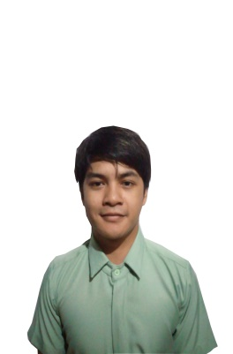

LOGO
FOSTER PARENT NAME
LOGOUT
FOSTER CARE UNIT PORTAL
[Dito yung name ng Portal]
SEARCH
Home
Downloads
Analytics
Management
My Account
NAME: GUIAN ANTHONY N. BAYAN
CONTACT: 0905*******
ADDRESS: #27 BRGY. DOON SINILOAN, LAGUNA
STATUS: TEMPORARY
FOSTER HOME: AOPT CENTER
MANAGE MESSAGE
* View Message
Foster Care Unit
Adopt Center
FOSTER CHILDREN
Rommer
Foster Child A
Foster Child B
Date and Time
Foster Care Unit
Date and Time
Date and Time
Rommer
Date and Time
Type Message…
SEND

Slide 6
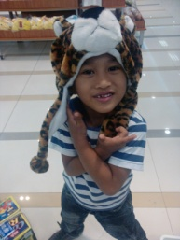
LOGO
FOSTER PARENT NAME
LOGOUT
FOSTER CARE UNIT PORTAL
[Dito yung name ng Portal]
SEARCH
Home
Downloads
Analytics
Management
My Account
NAME: GUIAN ANTHONY N. BAYAN
CONTACT: 0905*******
ADDRESS: #27 BRGY. DOON SINILOAN, LAGUNA
STATUS: TEMPORARY
FOSTER HOME: AOPT CENTER
MANAGE MESSAGE
* View Message
FOSTER CHILDREN
Foster Child A
Foster Child B
Name: Aj Ponce
Birthday: Jan 11, 2009
Attach Photo or Video
Report #1
Date:
Detail:
SEND

