Slide 1


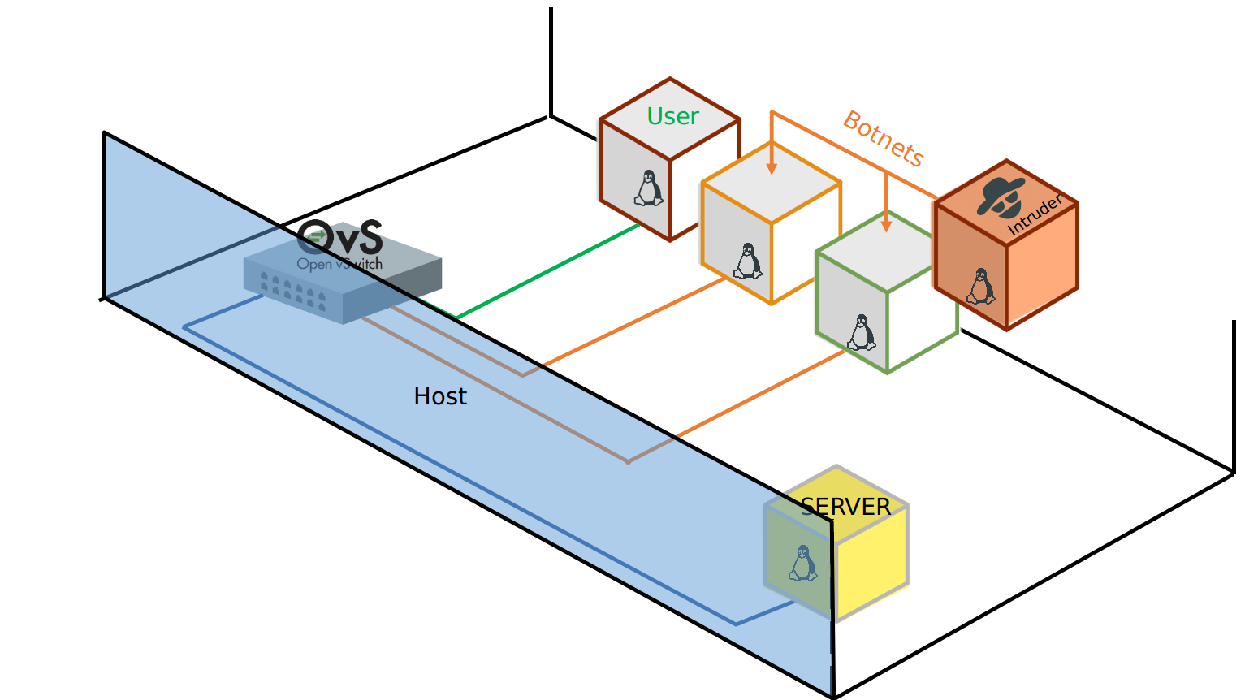
DOS-DDOS attacks, an sligth approach via ML to advanced Intrusion Detection and Prevention(IDP|s) mitigation tactic.*
Computer Security - Project
By, Cristhian andrade

Slide 2

Overview
Dive into DOS-DDOS attacks
Our simulation environment
Models proposal
Model testing
Results and recommendations
Future work
Q&A

Slide 3
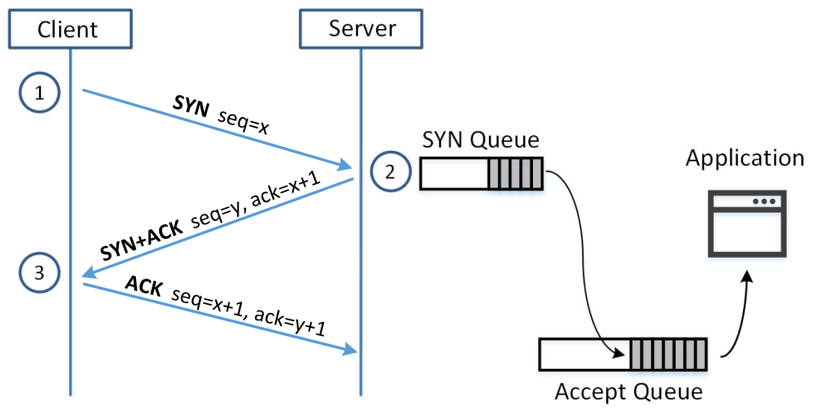
DOS-DDOS attacks
These kind of attacks are characterized by the flooding of traffic network in an host server port where computational resources provided by a server are consummed, which can result in serious interruptions in the provision of web services.
Fig. SYN Queue flooding (SEED labs Scheme)

Slide 4
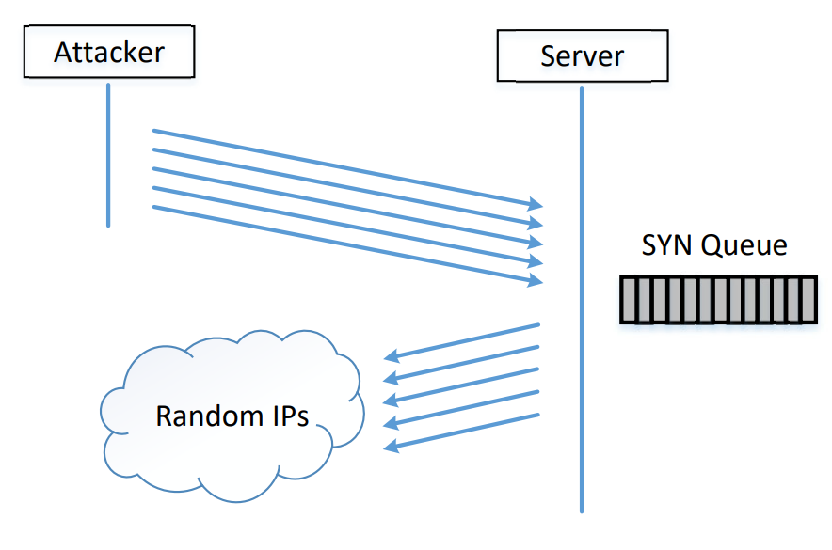
SYN flooding attack
FIG. SYN flood attack via random IP request
(SEED Labs Schema)

Slide 5
Environment setup:For this attemp we will porpose the following schema implemented using Oracle Virtual Box using Open vSwitch to simmulate the virtual Switch
FIG. Network environment

Slide 6





By simplicity the envaronment would be performed using Docker, given that in broad strokes that the virtual interface (Docker0) is similar to a OVS-bridge.
VM
VM
VM
VM
Other Interfaces
…
vNIC
vNIC
vNIC
vNIC
Docker0 - Virtual Switch
pNIC
pNIC
pNIC
Physical Switches & Crosslink Connections
FIG. Docker0 switch environment simmulation

Slide 7
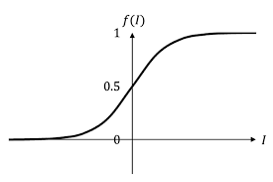
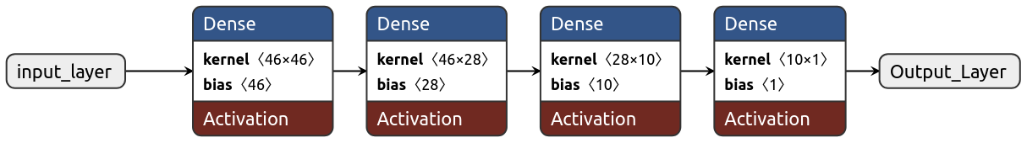
src IP
dst IP
pktcount
FIG. DNN model for DOS-DDOS attacks classification
bytecount
Y
.
.
.
.
.
.
Protocol
.
.
.
.
.
.
.
.
.
.
.
.
tot_kbps

Slide 8

Next packet arrival burst method
Entirely based on the methos for determine the length of the next CPU burst, this approach takes this pseudo-prediction to approximate the followig burst packets size. So the predictor depends on the following:
: smoothing factor 0≤ ≤1
: actual packet count arrival on time (n)
: predicted packet count arrival on time (n) this is equivalent to time (n-1)
: predicted arrival time for the next time cicle

Slide 9
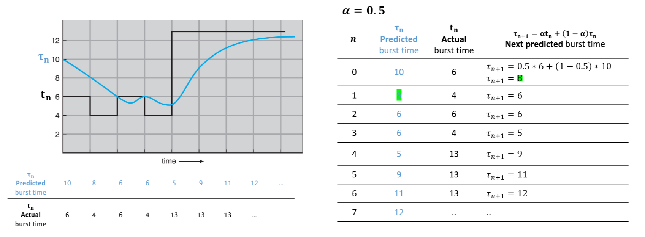
FIG. packets burst prediction on time

Slide 10
Hands on model(NPA) testing

