Slide 1





VM
VM
VM
VM
Other Interfaces
…
vNIC
vNIC
vNIC
vNIC
Virtual Switch
pNIC
pNIC
pNIC
Physical Switches & Crosslink Connections

Slide 2
Route
[1]
[3]
[4]
Route
[2]
[5]

Slide 3
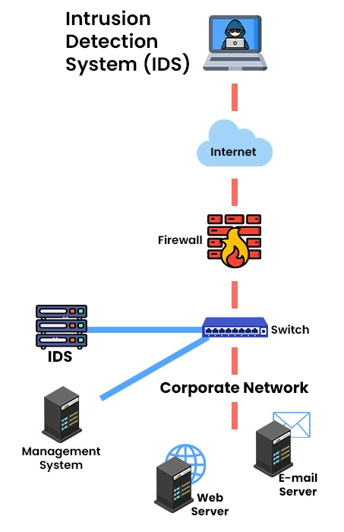
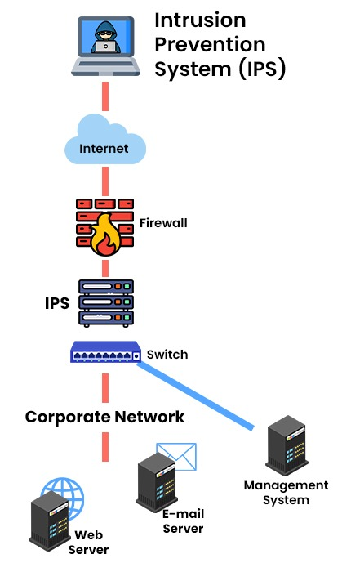
Insecure
side
Border
Security
Internal
Network & Services

Slide 4



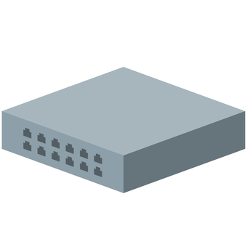



User
Botnets
Intruder
Host
SERVER

Slide 5
Botnets
Physical Switches & Crosslink Connections
VM
VM
VM
VM
User
Intruder
vNIC
vNIC
vNIC
vNIC
Virtual Switch
pNIC
pNIC
VM
vNIC
SERVER
Host

Slide 6

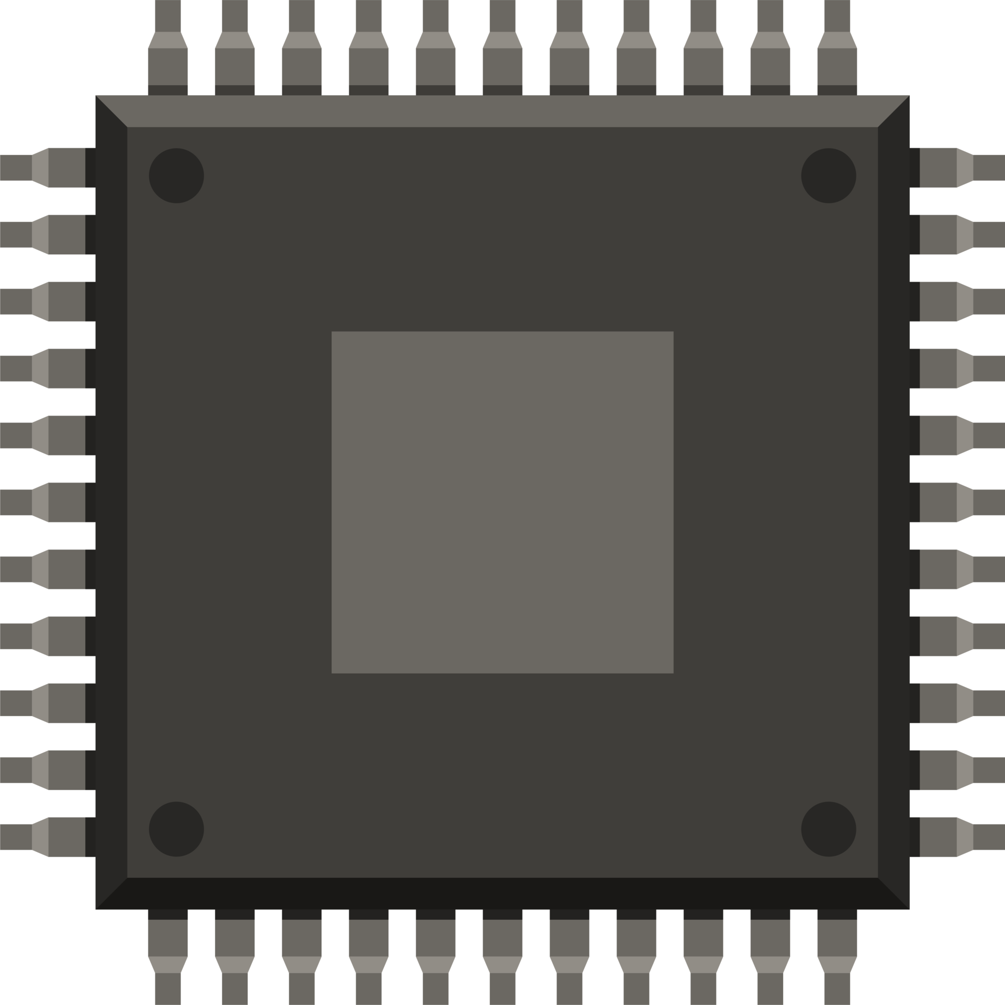
IPD—s Framework
Filter
[SYN, ACK]
vNIC
vNIC
vNIC
vNIC
Virtual Switch
pNIC
Host
pNIC
vNIC

