Slide 1

<Credit Card Fraud Detection And Prevention>
<Cristina Moussoungedi,
Adel Zitouni,
Catherine Maameri>

Slide 2
Credit Card Fraud Detection Hackathon 🕵️‍♀️
The goal of the project is to Analyze the Credit Card Fraud Detection dataset to build a model that accurately identifies fraudulent transactions for a financial institution.
This dataset captures credit card transactions made by European cardholders in September 2013 over a two-day period. Most input features (V1 to V28) are the result of a PCA transformation due to confidentiality;
Key Challenge: The dataset is highly imbalanced (fraud is rare), requiring robust analysis to minimize false positives.

Slide 3
Stack
Tools used for this project:
pandas: For data manipulation and analysis.
numpy: For numerical operations.
matplotlib.pyplot: For creating static, interactive, and animated visualizations.
seaborn: For making statistical graphics based on matplotlib.
sklearn.model_selection: Specifically train_test_split for splitting data into training and testing sets.
sklearn.preprocessing: Specifically StandardScaler for standardizing features.
imblearn.over_sampling: Specifically SMOTE for oversampling the minority class to handle imbalance.
sklearn.linear_model: Specifically LogisticRegression for building a logistic regression model.
sklearn.metrics: For evaluating model performance, including classification_report, confusion_matrix, roc_auc_score, and roc_curve.
scipy.stats: For statistical functions, specifically ttest_ind for independent samples t-tests.

Slide 4
Features list
Data Loading and Initial Exploration: Loaded the credit card transaction data, examined basic information, and checked for duplicates.
Duplicate Handling: Identified and removed duplicate transaction rows.
Data Preprocessing and Scaling: Separated features and the target variable, and standardized the 'Time' and 'Amount' features.
Addressing Class Imbalance: Applied SMOTE to balance the classes.
Data Visualization: Visualized class distribution, Time vs Class, and Amount vs Class.
Statistical Analysis: Performed t-tests and correlation analysis to identify significant features.
Predictive Modeling: Split the data, trained a Logistic Regression model, evaluated it, and analyzed the impact of different probability thresholds.
Visualization of Results: Visualized the confusion matrix, precision-recall curve, and ROC curve.
Bonus: Outlined a fraud prevention strategy.

Slide 5
Difficulties you managed to overcome
Short timing to achieve the project
New ways of working to apprehend (github in collaboration way)
What you are proud of during this hackathon (features or management)
Team work, Agility and resilience
Achieving the project despite technical difficulties
Practice the knowledge acquire in a specific real world topic (Fraud detection)

Slide 6
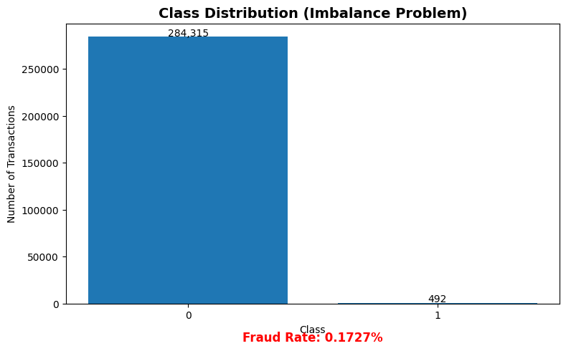
Step 1 : Exploratory Data Analysis (EDA) 1/2

Slide 7
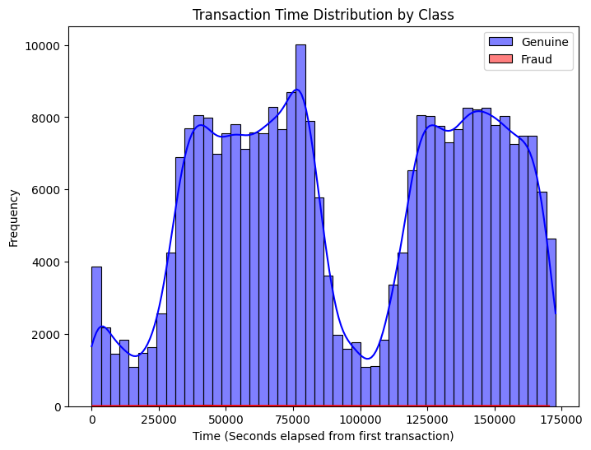
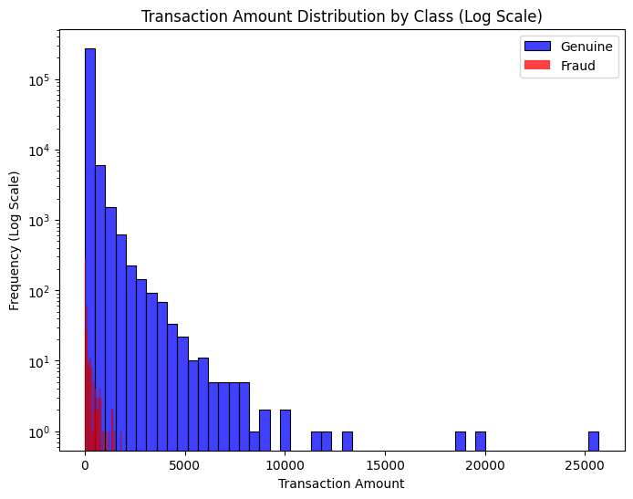
Step 1 : Exploratory Data Analysis (EDA) 2/2

Slide 8
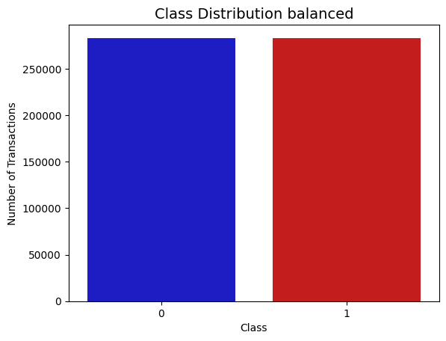
Step 2 : Data Preprocessing

Slide 9
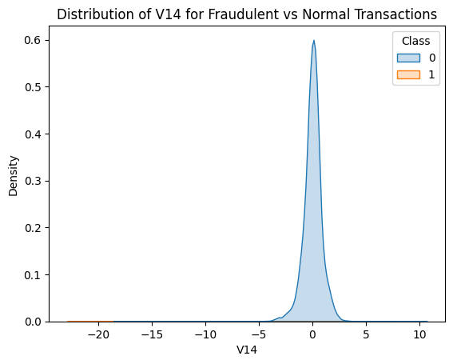
Step 3 : Feature Engineering

Slide 10
Step 4 : Predictive Modeling
Logistic Regression
In summary:
Good fraud detection requires a balance between accuracy and recall, because every false positive or false negative has a cost.
Logistic regression, although simple, can give a good compromise and often serves as a solid baseline.
It is often useful to adjust the classification threshold (by default 0.5) to find this optimal compromise according to company policy.

Slide 11
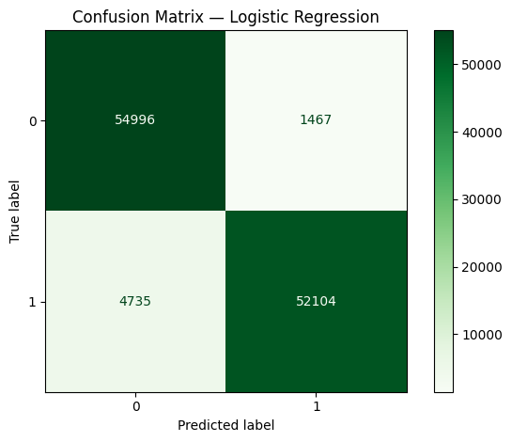
Step 5 : Visualization 1/2

Slide 12
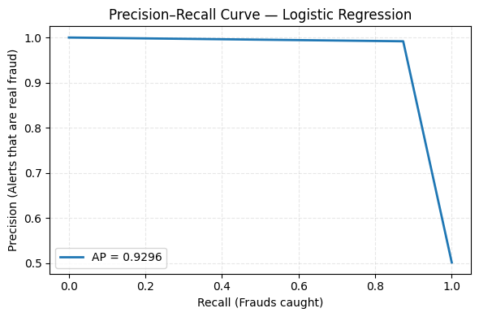
Step 5 : Visualization 2/2

Slide 13
Links
https://github.com/CrisMcode111/fraude-credit-hackathon
2-mn video link (CAN BE 3 or 4 minutes max) - from LOOM or Google Drive (must be public) → to do during the weekend only

