Slide 1
Gender gap in Canada

Slide 2
Introduction
Making reference to the job opportunity that the women have is around 49% globally, meanwhile the men have an opportunity around 75%, 26% of difference according to the International Labor Organization, that in some regions this can be reached to the 50%.

Slide 3
Also the International Labor Organization’s page, give us an interactive map that makes us know that Canada (the country in which I will focused this discussion) has the slowest gap in America having only a gap of 9.2% (60.7% women, 69.8% men).

Slide 4
Use of the data
For this project I will use the data provided by Kaggle called Employment Rate in Canada in which the employment rate is represented in three ways:
1. Employment: person that works the full or part-time?
2. Full-time employment: that works all the 40 hours per week
3. Part-time employment: the person who work less than 40 hours, in some countries this has a limit of 30 hrs per week

Slide 5
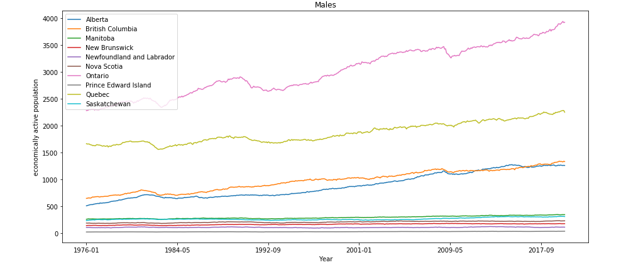
Total employment Males

Slide 6
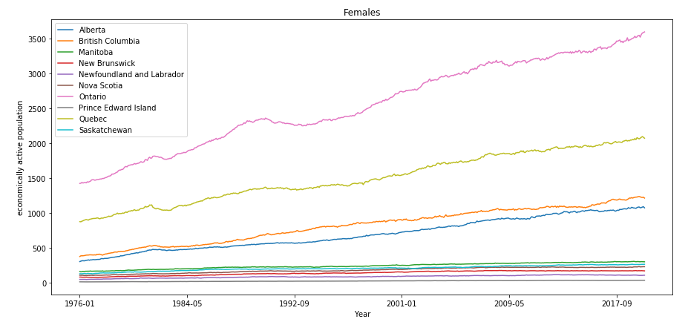
Total employment Females
v

Slide 7
According with the graphs that we can see, there is still a difference around 500 thousand employments consider the Full and part time work.

Slide 8
Methodology
To analyze this in a detailed way, I will display three bar charts in which the percentage gap will be seen in a more friendly way. For that I will keep only the last row in which the actual values will be in the charts

Slide 9
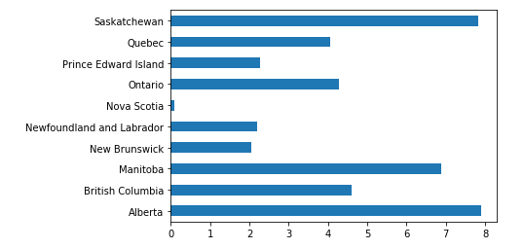
Total employment

Slide 10
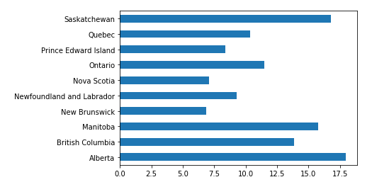
Full-time employment

Slide 11
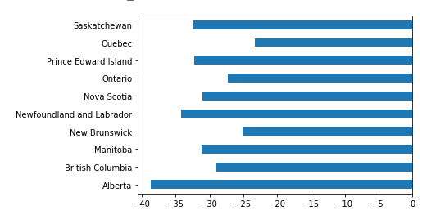
Part-time employment

Slide 12
Result section
We can see in the bar and linear graph that the total employment in the provinces of Alberta, Saskatchewan and Manitoba have a great gender gap even more than 15% of the gap in the regions, and also at first sight we could say that Nova Scotia is the region with almost 0% gap in the Country. But if we see the next two Graph bar we will see that the gender gap is presented around 7.5% in the Total employment.

Slide 13
Conclusion section
We can see with this report that the data can be reflected in many ways that can show that the gender gap doesn't exist at all. But if we drill down we can find it.
But not at all is said, we can stay in the province that fits more to our necessities, I mean, if you are a woman that wants to work part-time a great option could be move out to Alberta, where you can find a job more easily, but if you are looking for a full-time job, you can move out to Nova Scotia or New Brunswick

