Slide 1


Introduction to Machine Learning Part 4: Evolutionary Machine Learning
Jaume Bacardit
Interdisciplinary Computing and Complex BioSystems (ICOS) research group, School of Computing, Newcastle University
Jaume.Bacardit@Newcastle.ac.uk
Twitter: @jaumebp

Slide 2
Evolutionary Machine Learning
Usage of any kind of evolutionary computation methods (list follows) to machine learning tasks
Genetic Algorithms
Genetic Programming
Evolution Strategies
Ant Colony Optimization
Particle Swarm Optimization
Also known as
Genetics-Based Machine Learning (GBML)
Learning Classifier Systems (LCS) (subset of it)

Slide 3
Paradigms and representation
EL involves a huge mix of
Search methods (previous slide)
Representations
Learning paradigms
Learning paradigms: how the solution to the machine learning problem are generated
Representations: rules, decision trees, synthetic prototypes, hyperspheres, etc.

Slide 4
Genetic Algorithm working cycle
Population A
Population B
Evaluation
Mutation
Selection
Population D
Population C
Crossover

Slide 5
Genetic Algorithms: terms
Population
Possible solutions of the problem
Traditionally represented as bit-strings (e.g. each bit associated to a feature, indicating if it is selected or not)
Each bit of an individual is called gene
Initial population is created at random
Evaluation
Giving a goodness value to each individual in the population
Selection
Process that rewards good individuals
Good individuals will survive, and get more than one copy in the next population. Bad individuals will disappear

Slide 6
Genetic Algorithms
Crossover
Exchanging subparts of the solutions
The crossover stage will take two individuals from the population (parents) and with certain probability Pc will generate two offspring
1-point crossover
uniform crossover

Slide 7
Knowledge representations
For nominal attributes
Ternary representation
GABIL representation
For real-valued attributes
Hyperrectangles
Decision tree
Synthetic prototypes
Others

Slide 8
Ternary representation
Used by XCS (Michigan EML system)
Three-letter alphabet {0,1,#} for binary problems
# means “don’t care”, that is, that the attribute is irrelevant
If A₁=0 and A₂=1 and A₃ is irrelevant → class 0
For non-binary nominal attributes:
{0,1, 2, …, n,#}
Crossover and mutation act as in a classic GA
01#|0

Slide 9
GABIL representation
Predicate → Class
Predicate: Conjunctive Normal Form (CNF) (A₁=V₁¹∨.. ∨ A₁=V₁^{n}) ∧.....∧ (A_{n}=V_{n}²∨.. ∨ A_{n}=V_{n}^{m})
A_{i} : ith attribute
V_{i}^{j} : jth value of the ith attribute
The rules can be mapped into a binary string
1100|0010|1001|1
2 Variables:
Sky = {clear, partially cloudy, dark clouds}
Pressure = {Low, Medium, High}
2 Classes: {no rain, rain}
Rule: If [sky is (partially cloudy or has dark clouds)] and [pressure is low] then predict rain
Genotype: “011|100|1”

Slide 10
Knowledge representations for continuous attributes
1
For real-valued attributes
Hyperrectangles (next slides)
Hyperellipsoids (next slides)
Synthetic prototypes
Decision trees
Y
0
1
X
X<0.5
X>0.5
Y
Y<0.5
Y>0.5

Slide 11
Hyper-rectangle representation
The rule’s predicate encodes an interval for each of the dimensions of the domain, effectively generating an hyperrectangle
Simplest way is to specify the lower and upper bound of the side
What if the u<l? That may create an illegal solution, that needs repairing
Flipping them
Declaring the attribute as irrelevant
L1 U2 L2 U2 L3 U3 L4 U5 L5 U5 L6 U6 L7 U7 C
An individual (rule)

Slide 12
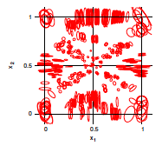
Other representations for continuous problems
Hyperellipsoid representation (XCS)
Each rule encodes an (hyper)ellipse over the search space
Smooth, non-linear, frontiers
Arbitrary rotation
Encoded as
Center
Stretches across dimensions
Rotation angles

Slide 13
Learning Paradigms
Different ways of generating a solution
Is each individual a rule, a rule set?
Is the solution the best individual, or the whole population?
Is the solution generated in a single GA run?
The Pittsburgh approach
The Michigan approach
The Iterative Rule Learning approach
LCS

Slide 14
The Pittsburgh Approach
Each individual is a complete solution to the classification problem
Traditionally this means that each individual is a variable-length set of rules
The final solution is the best individual from the population after the GA run
Fitness function is based on the rule set accuracy on the training set (usually also on complexity)
GABIL [De Jong & Spears, 91] is a classic example

Slide 15
Pittsburgh approach: recombination
Crossover operator
Mutation operator: classic GA mutation of bit inversion
Parents
Offspring

Slide 16
The Michigan Approach
Each individual (classifier) is a single rule
The whole population cooperates to solve the classification problem
A reinforcement learning system is used to identify the good rules
A GA is used to explore the search space for more rules
XCS [Wilson, 95] is the most well-known Michigan LCS

Slide 17
The Michigan approach
What is Reinforcement Learning?
“a way of programming agents by reward and punishment without needing to specify how the task is to be achieved” [Kaelbling, Littman, & Moore, 96]
Rules will be evaluated example by example, receiving a positive/negative reward
Rule fitness will be update incrementally with this reward
After enough trials, good rules should have high fitness

Slide 18
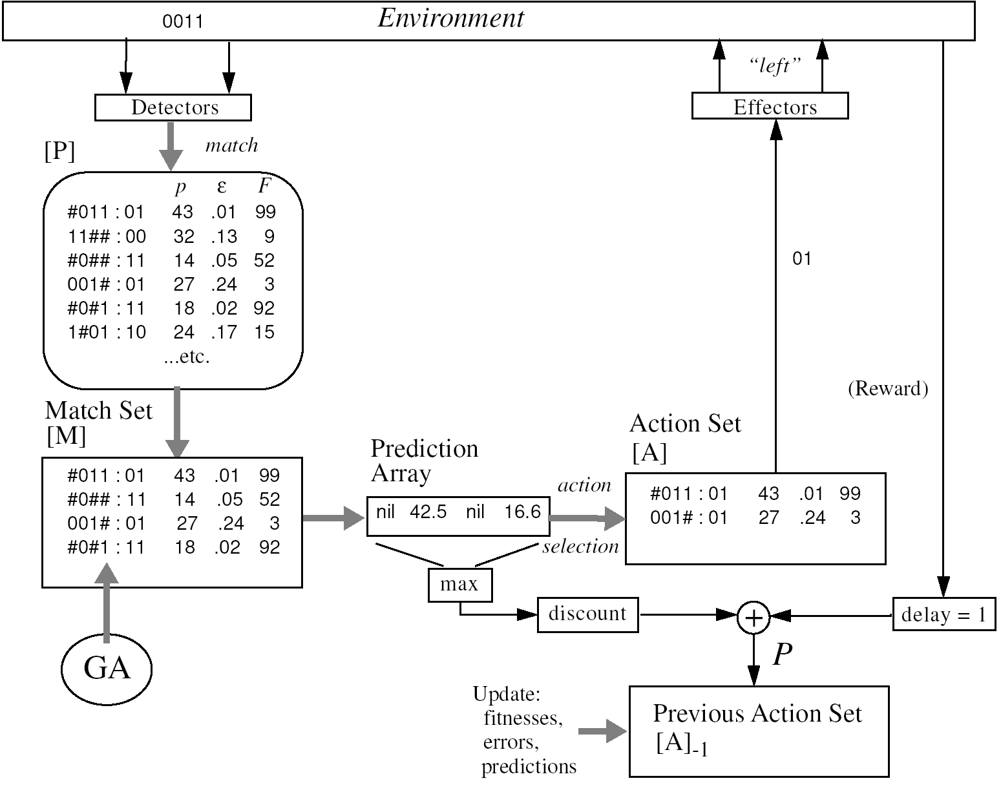
Michigan system’s working cycle
Wilson, Stewart W. "Classifier fitness based on accuracy." Evolutionary computation 3.2 (1995): 149-175.

Slide 19
Iterative Rule Learning approach
This approach implements the separate-and-conquer method of rule learning
Each individual is a rule
A GA run ends up generating a single good rule
Examples covered by the rule are removed from the training set, and process starts again
First used in evolutionary learning in the SIA system [Venturini, 93]
Function IterativeRuleLearning(TrainingSet TR)
Solution = Create empty rule set
While(TR is not empty) {
Rule = Run Genetic Algorithm to generate a rule from TR
Add Rule to Solution
Remove from TR the examples covered by Rule
}
Return Solution

Slide 20
1. Initial training set and no rules
2. The first rule is learnt
1
1
If (Y<0.25) then →
Y
Y
0
1
0
1
X
X
3. The second rule is leant
4. Generating the default rule
1
1
If (Y<0.25) then →
If (Y<0.25) then →
If (X<0.25 and Y>0.75) then →
If (X<0.25 and Y>0.75) then →
Y
Y
Everything else →
0
1
0
1
X
X

Slide 21
The Gassist Pittsburgh LCS [Bacardit, 04]
Genetic clASSIfier SysTem
Designed with three aims
Generate compact and accurate solutions
Run-time reduction
Be able to cope with both continuous and discrete data
Objectives achieved by several components
Explicit default rule mechanism
ILAS windowing scheme for scalability (explained in lecture 9)
MDL-based fitness function (1)
Initialization policies (1)
Rule deletion operator (1)

Slide 22
GAssist: Default Rule mechanism
When we encode this rule set as a decision list we can observe an interesting behavior: the emergent generation of a default rule
Using a default rule can help generating a more compact rule set
Easier to learn (smaller search space)
Potentially less sensitive to overlearning
To maximize this benefits, the knowledge representation is extended with an explicit default rule

Slide 23
GAssist: Default Rule mechanism
What class is assigned to the default rule?
Simple policies such as using the majority/minority class are not robust enough
Automatic determination of default class
The initial population contains individuals with all default classes
Evolution will choose the correct default class
In the first few iterations the different default classes will be isolated: each is a separate subpopulation
Different default classes learn at different rates
Afterwards, restrictions are lifted and the system is freely to pick up the best policy

Slide 24
GAssist: Initialisation policy
Initialization policy
Probability of a rule matching a random instance
In GABIL each gene associated to a value of an attribute is independent of the other values
Therefore the probability of matching an attribute equals to the probability of value 1 when initializing the chromosome
Probability of a rule set matching a random instance

Slide 25
GAssist: Initialisation policy
Initialization policy
How can we derive a formula to adjust P₁ ?
We use an explicit default rule mechanism
If we suppose equal class distribution, we have to make sure that we match all but one of the classes

Slide 26
GAssist: Initialisation policy
Covering operator
Each time a new rule has to be created, an instance is sampled from the training set
The rule is created as a generalized version of the example
Makes sure it matches the example
It covers not just the examples, but a larger area of the search space
Two methods of sampling instances from the training set
Uniform probability for each instance
Class-wise sampling probability

Slide 27
GAssist: MDL-based fitness function
Minimum Description Length principle
Sender
Receiver
Instances + class
Instances
How do we send the class
of each instance?
1) Sending the classes
2) Generating a theory
and sending it plus
its exceptions
Theory description
+

Slide 28
GAssist: MDL-based fitness function
The solution that minimizes the length of sending the theory + its exceptions will be the best one
MDL based fitness function is the minimization of the following formula:
W is domain specific. In order to avoid a manual tuning we have also developed an adaptive heuristic process to tune this parameter

Slide 29
GAssist: MDL-based fitness function
TL depends on the knowledge representation used. We should not select the shortest theory length definition, but a definition that promotes well-generalized solutions
This is the most interesting feature of this fitness function. We can explore more efficiently the search space by guiding the search based on the content of the individuals
TL metric will promote
Individuals with few rules
Individuals with few expressed attributes
TL for nominal attributes (in GABIL): #bits set to 0
TL for continuous attributes: 2-(size_interval/size_domain)

Slide 30
GAssist: Rule deletion operator
Operator applied after the fitness computation
Rules that do not match any training example are eliminated
The operator leaves a small number of ‘dead’ rules in each individual, acting as protective neutral code
If crossover is applied over a dead rule, it does not matter, it will not break a good rule
However, if too many dead rules are present, exploration is inefficient, and the population loses diversity

Slide 31
BioHEL [Bacardit et al, 09]
BIO-inspired HiErarchical Learning
Successor of GAssist, but changing paradigms: uses the Iterative Rule Learning approach
Created to overcome the scalability limitations of GAssist
It still employs
Default Rule (no auto policy)
ILAS windowing scheme (for scalability)
Extended with (to be described in lecture 9)
A scalable sparse knowledge representation (ALKR)
GPU implementation of rule evaluation
Rule editing local search operators

Slide 32
BioHEL: fitness function
Makes mistakes
Optimal
Fitness function definition is trickier than in GAssist, as it is impossible to have a global control over the solution
As in any separate-and-conquer method, the system should favor rules that are
Accurate (do not make mistakes)
General (that cover many examples)
These two objectives are contradictory, specially in real-world problems: the best way of increasing the accuracy is by creating very specific rules
BioHEL redefines coverage as a piece-wise function, which rewards rules that cover at least a certain fraction of the training set
For the description of the actual fitness function see here
Does not cover enough examples

Slide 33
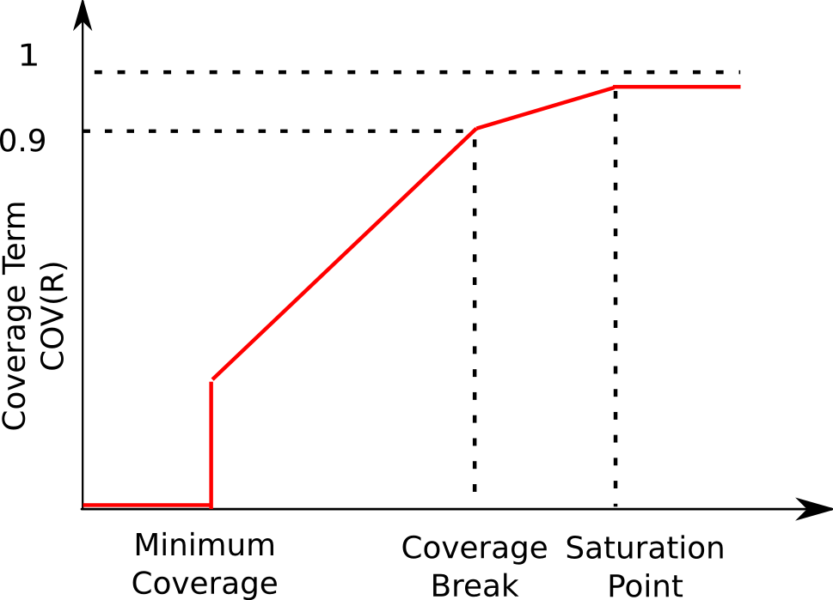
BioHEL: fitness function
Coverage term penalizes rules that do not cover a minimum percentage of examples
Choice of the coverage break is crucial for the proper performance of the system
But we have developed some theory-based methods to tune this parameter

Slide 34
Functional Network Reconstruction for seed germination
Microarray data obtained from seed tissue of Arabidopsis Thaliana
122 samples represented by the expression level of almost 14000 genes
It had been experimentally determined whether each of the seeds had germinated or not
Can we learn to predict germination/dormancy from the microarray data?
[Bassel et al., Plant Cell, 2011]

Slide 35
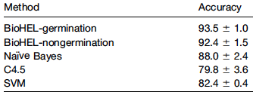
Generating rule sets
BioHEL [Bacardit et al., 2009] was able to predict the outcome of the samples with 93.5% accuracy (10 x 10-fold cross-validation
If At1g27595>100.87 and At3g49000>68.13 and At2g40475>55.96 → Predict germination
If At4g34710>349.67 and At4g37760>150.75 and At1g30135>17.66 → Predict germination
If At3g03050>37.90 and At2g20630>96.01 and At3g02885>9.66 → Predict germination
If At5g54910>45.03 and At4g18975>16.74 and At3g28910>52.76 and At1g48320>56.80 → Predict germination
Everything else → Predict dormancy

Slide 36
Identifying regulators
Rule building process is stochastic
Generates different rule sets each time the system is run
But if we run the system many times, we can see some patterns in the rule sets
Genes appearing quite more frequent than the rest
Some associated to dormancy
Some associated to germination

Slide 37
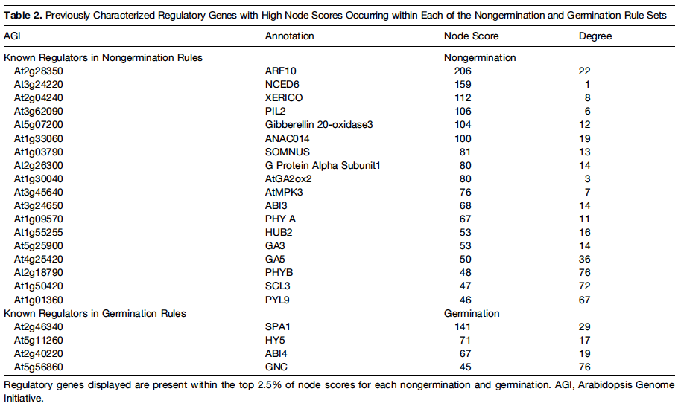
Known regulators appear with high frequency in the rules

Slide 38
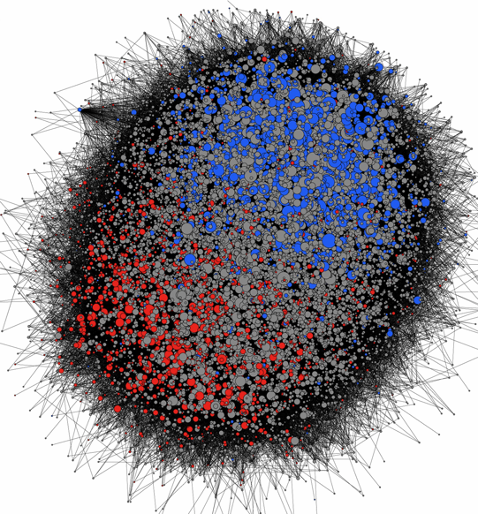
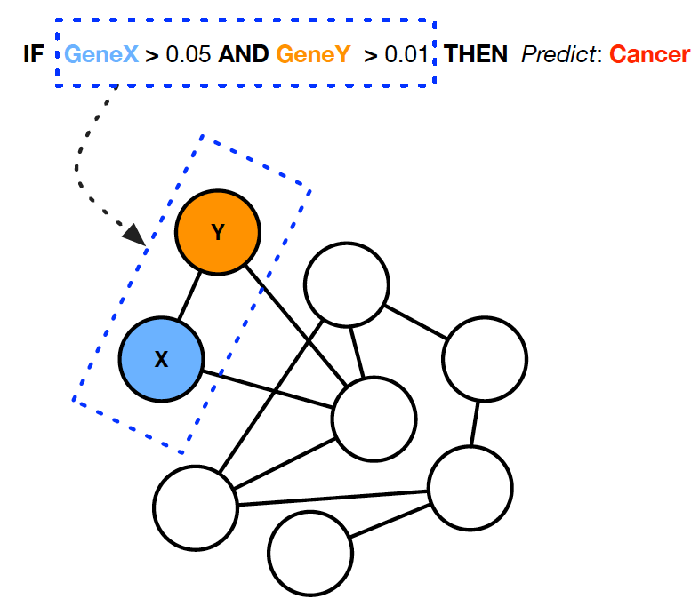
Generating co-prediction networks of interactions
For each of the rules shown before to be true, all of the conditions in it need to be true at the same time
Each rule is expressing an interaction between certain gens
From a high number of rule sets we can identify pairs of genes that co-occur with high frequency and generate functional networks
The network shows different topology when compared to other type of network construction methods (e.g. by gene co-expression)
Different regions in the network contain the germination and dormancy genes
Germination

Slide 39
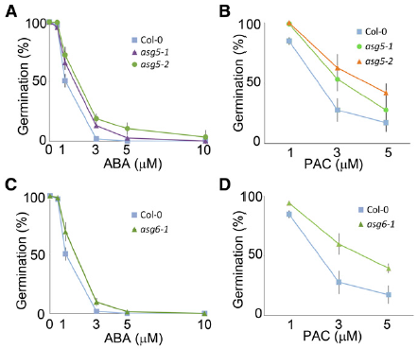
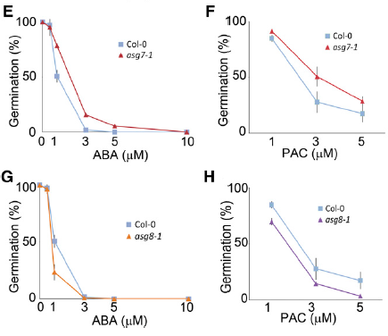
Experimental validation
We have experimentally verified this analysis
By ordering and planting knockouts for the highly ranked genes
We have been able to identify four new regulators of germination, with different phenotype from the wild type

Slide 40
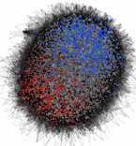
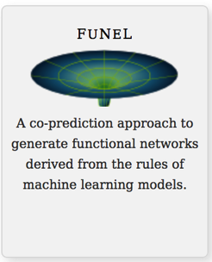
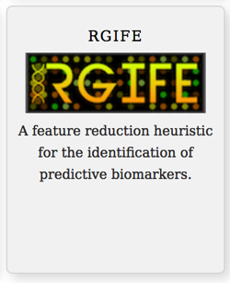
Knowledge extraction from biodata
Functional Network Construction in Arabidopsis Using Rule-Based Machine Learning on Large-Scale Data Sets. The Plant Cell, 23(9):3101-3116, 2011
Systematic algorithmic pipelines to extract knowledge from biomedical data
Heuristics to identify reduced but highly predictive sets of variables (panels of biomarkers)
Lazzarini et al. BMC Bioinformatics 2017 18(1):322
Inference of networks of interactions
Lazzarini et al. BioData Mining 2016, 9:28
Using Rule-Based Machine Learning for Candidate Disease Gene Prioritization and Sample Classification of Cancer Gene Expression Data. PLoS ONE 7(7):e39932. 2012
Panels of biomarkers
Analysis of mass spectrometry data from the secretome of an explant model of articular cartilage exposed to pro-inflammatory and anti-inflammatory stimuli using machine learning. BMC Musculoskeletal Disorders, 14:349, 2013
Dataset
Machine Learning
Ensemble of Models
Mining of models
A machine learning heuristic to identify biologically relevant and minimal biomarker panels from omics data, BMC Genomics, 2015, 16(Suppl 1):S2
Reduced Neonatal Mortality in Meishan Piglets: A Role for Hepatic Fatty Acids? PLoS ONE 7(11):e49101 2012
Notes:
We have developed techniques to systematically analyse the structure of machine learning models and extract useful knowledge: rankings of variables, interactions between variables, identification of reduced biomarker signatures.
These methods are generic so they can be applied to any tabular data, be it clinical data, omics data, as well as both continuous/discrete variables. All is needed is that samples are annotated with some class labels (e.g. phenotypes, study design).
We have successfully applied these techniques across many different types of omics data coming from plants, animals or humans, and focusing on several processes/diseases (e.g. plant germination, cancer, osteoarthitis)

Slide 41
References
A very thorough survey on Evolutionary Machine Learning is available here
My EML algorithms
My thesis, about GAssist (code)
Complete description of BioHEL (code)
Thesis of Martin Butz on XCS, including theoretical models and advanced exploration methods (later a book)

