Slide 1


Introduction to Machine Learning Part 5: Neural Networks
Jaume Bacardit
Interdisciplinary Computing and Complex BioSystems (ICOS) research group, School of Computing, Newcastle University
Jaume.Bacardit@Newcastle.ac.uk
Twitter: @jaumebp

Slide 2
Outline
Motivation
Perceptrons
Multi-layer perceptrons
Self-organising maps
References
Material adapted from the slides created by Peter Andras for the CSC3423 module of Newcastle University

Slide 3
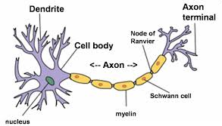
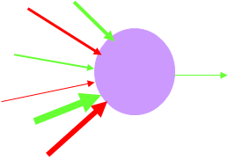
Neurons
Synapses between neurons
Information input, processing, and output
Neurotransmitters, receptors, ion channels
Graded potentials, action potentials

Slide 4
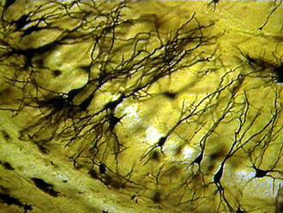
Networks of neurons
Networks of neurons connect sensors to actuators in animals
Spatio-temporal patterns of activity
Computation of the response to the information received through the sensors

Slide 5
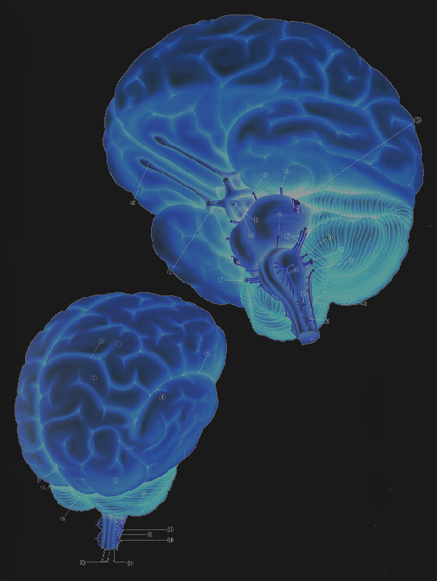
Brains
Higher animals have a large volume of neurons together → brain
High level information processing and decision making

Slide 6
Parallel distributed processing
Brain
Many simultaneous information processing processes
The information is distributed across these parallel processes
Inspiration for connectionist models of cognitive computations in the brain

Slide 7
Connectionist modelling
Nodes
Connections
Nodes may represent specialised brain areas, elementary functional units of such areas (e.g. cortical column), groups of functionally associated neurons, single neurons
Connections represent appropriate interaction connections
Connections from external sensors → Data
NNs are meant for data problems
Classification, regression, control

Slide 8
Perceptron
x₁
x₂
x₃
…
x_{n-1}
x_{n}
w₁
Output
w₂
Inputs
y
w₃
.
.
.
w_{n-1}
Lots of possible functions
w_{n}
The McCulloch-Pitts model, 1943

Slide 9
Perceptron mechanism
Perceptron:
connection strength are translated as connection weights;
excitation means positive product between the incoming signal and the corresponding connection weight;
inhibition means negative product between the incoming signal and the corresponding connection weight;

Slide 10
Perceptron decision – 1

Slide 11
Perceptron decision – 2
Interpretation:
linear combination of multiple features
classification decision
linear classification boundary
recognition of two classes of feature vectors
e.g. recognition of two different phonemes

Slide 12
Limits of the perceptron
Can only solve problems that are linearly separable
E.g. XOR logic gate can’t be solved with a perceptron
I1 | I2 | O
0 | 0 | 0
0 | 1 | 1
1 | 0 | 1
1 | 1 | 0
???
1
0
0
1

Slide 13
Multi-layer perceptron – MLP
Output
Inputs

Slide 14
MLP mechanism
Each unit is a perceptron
Inner layers represent combinations of features
E.g. recognition of phonemes, recognition of combinations of phonemes as words, recognition of context dependent semantics of words

Slide 15
MLP decision

Slide 16
MLP for complex classification

Slide 17
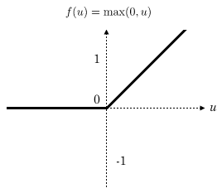
Nonlinear perceptron
Nonlinear generalisation
y is the unit’s output, x is the vector of inputs, and w is the vector of connection weights.
Examples:
sigmoidal unit
Gaussian unit
Rectified linear unit (ReLU)

Slide 18
Decision by non-linear perceptron – 1

Slide 19
Nonlinear MLP
Output
Inputs

Slide 20
Learning potential of nonlinear MLP
Nonlinear MLP with a single hidden layer can learn any continuous function and also any function that can be approximated by continuous functions (e.g. step function)
http://en.wikipedia.org/wiki/Universal_approximation_theorem
Theorem does not say how to set up the topology of the network (number of perceptrons in the hidden layer) nor the learning rate parameters (more later)

Slide 21
How is it applied to ML problems?
If the problem is regression (where the goal is to approximate/reverse-engineer a function), application is direct → The output of the network is the approximation of the function
If the problem is classification
If there are two classes (A and B)
Assign output +1 to training examples of class A
Assign output -1 to training examples of class B
When predicting the class of a new instance, if the output if the network is > 0, predict A, otherwise predict B
If there are more than two classes (A, B and C)
Define a network with multiple neurons in the output layer (one per class)
Training instances of class A will have output (1,0,0), for B (0,1,0), etc.
Predict the class of the output neuron with highest output signal

Slide 22
MLP learning task
Task specification:
Data: set of value pairs: (x_{t}, y_{t})
Objective: find an MLP that represents the input / output transformation (a function) F(x,W) such that
F(x_{t},W) approximates y_{t} for every t

Slide 23
MLP learning – in principle
Optimize the error function
with respect to elements of W
i.e., find the values of the elements of W for which the lowest value of E is achieved

Slide 24
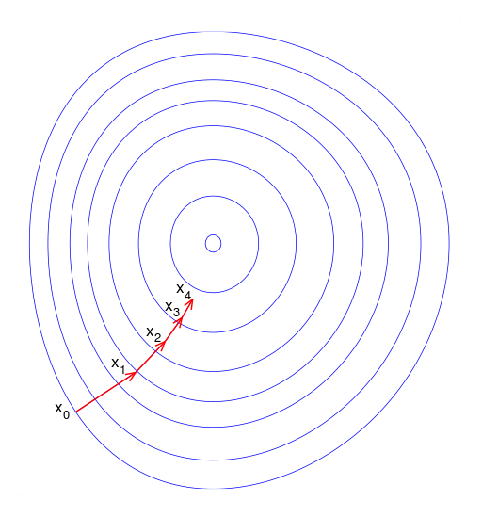
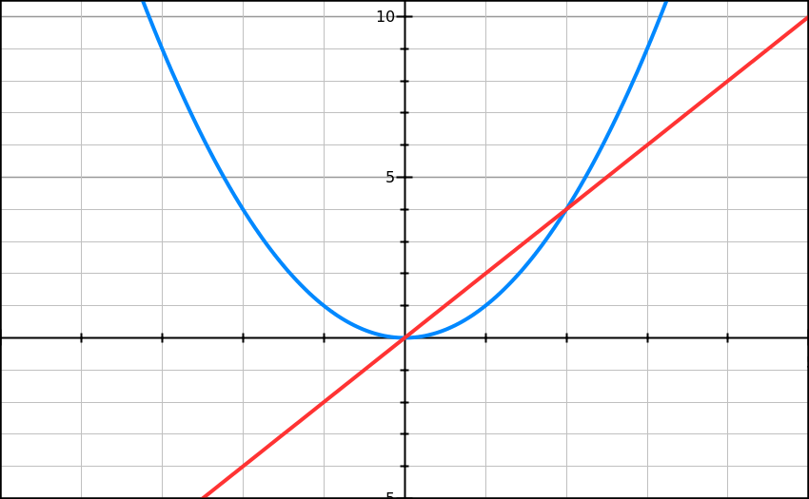
MLP learning – optimisation in principle
Steepest (gradient) descent: compute the gradient (derivative) of the error function
In small increments, modify the weights in the direction that the gradient is telling you
Original function: x^2
Derivative: 2x

Slide 25
Computational difficulty of general optimisation
General optimisation of nested nonlinear functions is difficult
The calculation of the derivatives of such nested functions can get very complicated and error prone

Slide 26
Back-propagation
Classic algorithm for training MLP
Function signals: forward propagating signals
Error signals: backward propagating signals
Hidden neurons: feature detectors

Slide 27
Error signal question
How to calculate the error signal that is propagated backwards ?
Credit assignment problem: given the calculated error signal how to attribute this to the MLP units that contributed to the calculation of the output ?

Slide 28
Backpropagation algorithm
Activation of neuron j in layer i is
And its output is
The error is defined as
The required updates of the weights are
C = learning rate. Parameter that controls the influence of the gradient in the weight updates

Slide 29
Backpropagation algorithm
The value of the update is calculated as

Slide 30
Last layer
If the layer i is the output layer

Slide 31
Intermediate layers
If the layer i is an inner layer

Slide 32
Input layer
If the layer i is the input layer

Slide 33
Summary of backpropagation
The back-propagation algorithm provides an elegant way to calculate the updates of the weights of inner layer neurons using updates of neurons in the next layer towards the output layer
Two pass calculation: forward pass calculates the output, backward pass calculates the updates of the weights in a recursive manner
This is not the only algorithm to train a MLP
Given a fixed topology, you could adjust the weights with a GA!
Or evolve the topology and the weights at the same time → Neuroevolutionary methods
http://en.wikipedia.org/wiki/Neuroevolution

Slide 34
Online demo
http://cs.stanford.edu/people/karpathy/convnetjs/demo/classify2d.html
Simple online (Javascript) NN implementation in which you can interactively define a 2-dimensional dataset, and change the topology of a MLP.
More demos of other types of NN in the same page: http://cs.stanford.edu/people/karpathy/convnetjs/

Slide 35
And many other types of NN
Self-organising maps (unsupervised)
Used often for dimensionality reduction tasks: Transform data characterised by a large number of variables into a different representation with less variables
Radial Basis Function (RBF) NN (supervised)
Use a very different type of activation function than a perceptron
Recurrent NN (topology)
Connections from a neuron to itself, or to neurons from the same layer, neurons from previous layers, etc.

Slide 36
References
Introduction to NN
Chapter 6 of the Han and Kamber data mining book (slides)
Chapters 6 of the Witten, Frank and Hall Data Mining book (slides)
The Elements of Statistical Learning, chapter 11 (heavy maths!) e-book

