Slide 1


Introduction to Machine Learning Part 2: Evaluation protocols
Jaume Bacardit
Interdisciplinary Computing and Complex BioSystems (ICOS) research group, School of Computing, Newcastle University
Jaume.Bacardit@Newcastle.ac.uk
Twitter: @jaumebp

Slide 2
Experimental Evaluation
We have Data Mining methods and datasets
How can we know that the patterns they extract are meaningful?
How can we know how well do they perform and which method is the best?
We need to follow a principled protocol to make sure that the results and conclusions we extract are sound

Slide 3
Verifying that the model is sound
The dataset, before the data mining process, is partitioned into two non-overlapped parts:
Training set. Will be used to generate the model
Test set. Will be used only to validate the model
We can compute the performance metric (more on the next slides) on both sets. If the metric for the training set is much higher than in the test set, we have a case of overlearning
That is, the DM method has not modelled the problem, only the training set

Slide 4

Performance metrics: Classification Problems
Accuracy: C/D
C = number of correctly classified examples. D is size of instance set
Simplest and most widespread metric
But what if some classes got more examples than others? The majority class would get more benefit out of this metric
Cohen’s Kappa
Computes the agreement between two distributions of categorical variables (i.e. real and predicted classes)
Takes into account agreement by chance
Hence, it may be more suitable for multi-class problems
C = number of classes, x_{i}= examples from class I
X_{ii} =examples correctly classified from class i

Slide 5
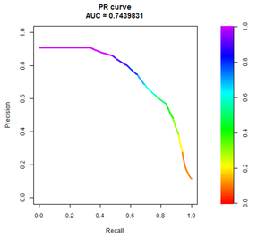
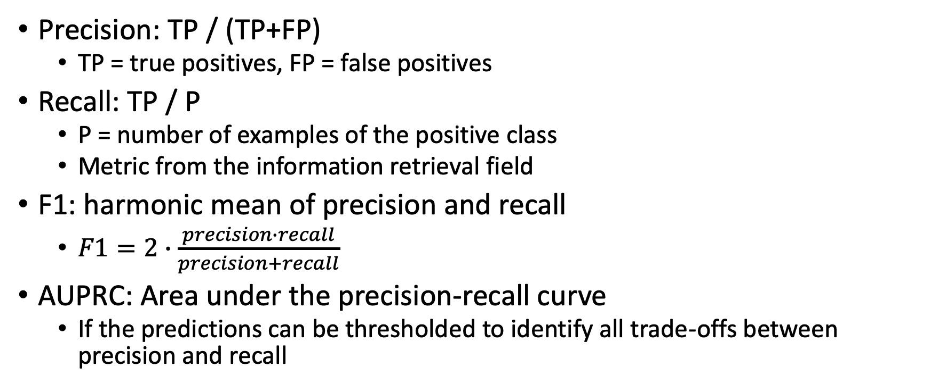
Performance metrics: Classification Problems
Precision: TP / (TP+FP)
TP = true positives, FP = false positives
Recall: TP / P
P = number of examples of the positive class
Metric from the information retrieval field
F1: harmonic mean of precision and recall
$F1=2∙\frac{precision∙recall}{precision+recall}$
AUPRC: Area under the precision-recall curve
If the predictions can be thresholded to identify all trade-offs between precision and recall

Slide 6
Performance metrics
Regression problems
RMSD
Metrics for clustering problems
Association rule mining
Support (percentage of instances covered by the pattern)
Confidence (agreement between predicate and consequent of the rule)

Slide 7
Performance metrics
Classification: Accuracy: C/D
C = number of correctly classified examples. D is size of instance set
Simplest and most widespread metric
But what if some classes got more examples than others? The majority class would get more benefit out of this metric → class imbalance problem
Metrics for clustering problems
Association rule mining
Support (percentage of instances covered by the pattern)
Confidence (agreement between predicate and consequent of the rule)

Slide 8
Performance estimation methodologies
We have to partition the dataset into training and test, but how is this partitioning done?
If this partitioning is wrong we will not obtain a good estimation of the method’s performance

Slide 9
Performace estimation methodologies: Holdout
Simply dividing the dataset into two non-overlaped sets (e.g. 2/3 of the dataset for training, 1/3 of the set for test).
Most simple method and computationally cheap
The performance is computed on the test set
Its reliability greatly depends on how the sets are partitioned

Slide 10
Performace estimation methodologies: K-fold cross-validation
Divide the dataset into K strata
Iterate K times:
Use sets 1.. K-1 for training and the set K for test
Use sets 1..K-2,K for training and the set K-1 for test
etc
Computer the performance estimation as the average of the metric for each of the K test sets
More robust estimator, but computationally more costlier
If each of the K strata has the same class distribution as the whole dataset, this method is called stratified K-fold cross-validation
Test set 1
Test set 2
Test set 3
Test set 4
Dataset
Fold 1
Fold 2
Fold 3
Fold 4
Training set 1
Training set 2
Training set 3
Training set 4

Slide 11
Performance estimation methodologies
Leave-one-out cross-validation
Extreme case of cross-validation, where K=D, the size of the dataset
Training sets will have size D-1 and test sets will have only one instance
Mostly used in datasets of small size
Variant: Leave-one-session-out cross-validation
Bootstrap
Generate a sample with replacement from the dataset with size D. Use it as training set
Use the instances never selected as test set
Repeat this process a high number of times

Slide 12
Performance estimation methodologies
But which method is best?
Two criteria to take into account
Bias: Difference between the estimation and the true error
Variance of the estimation’s sample
Formal and experimental analysis of some of these methods
Evaluation of the robustness of k-fold cross-validation

Slide 13
Who is the best?
At the end of an experimentation we will have tested N methods on D datasets, thus we will have a NxD table of performance metrics
How can we identify the best method?
Highest average performance across the D datasets?
Average, statistically speaking, assumes that data comes from the same distribution, but each dataset is different, so it is not really valid
Highest average rank across the D datasets?
Also, is the best method significantly better than the others?
For this we need statistical test (next slides)
 | N1 | N2 | N3 | N4
D1 | 78% | 75% | 71% | 81%
D2 | 62% | 63% | 68% | 59%
D3 | 93% | 94% | 90% | 78%
D4 | 82% | 85% | 81% | 86%
Ave Acc | 79% | 79% | 78% | 76%
 | N1 | N2 | N3 | N4
D1 | 2 | 3 | 4 | 1
D2 | 3 | 2 | 1 | 4
D3 | 2 | 1 | 3 | 4
D4 | 3 | 2 | 4 | 1
Ave Rank | 2.5 | 2 | 3 | 2.5

Slide 14
Statistical tests
Procedure for making decisions about data
Each test defines an hypothesis (H₀) about the observed data
“The accuracy differences I observe between A and B are just by pure chance and the methods perform equally”
Or in a more statistical way “The two sets of data observations A and B belong to the same distribution”
Then, the probability of H₀ being true given the observed data is calculated
If the probability (p-value) is smaller than a certain threshold, H₀ is rejected and the observed differences are statistically significant

Slide 15
Traditional approach: Student T-test
Tests whether the difference between two distributions is significant or not
Generates a p-value, in this case the probability that the two distributions are not significantly different
P-values of 0.05 or 0.01 are typical thresholds
Can only applied if the distributions have the same variance and are normal. These conditions are hardly ever achieved

Slide 16
Wilcoxon test
Non-parametric tests, which is not affected by the normality of the distribution
It ranks the absolute differences in performance, dataset by dataset
Next, it sums the ranks separately for the positive and negative differences
A p-value will be generated depending on which sum of ranks is smaller and the number of datasets

Slide 17
Multiple pair-wise comparisons?
Both the t-test and the Wilcoxon test are used to compare two methods
What if we have more than two methods in our comparison?
You can hold individually that A is better than B and better than C with 95% confidence and but it is better than both B and C at the same time?
The p-values do not hold anymore
We need to apply a correction for multiple tests (e.g. Bonferroni, Holm, etc.)

Slide 18
The Friedman test
Designed explicitly to compare multiple methods
Based on the average rank of each method across the datasets
This test just says if the performance of the methods included is similar or not
Can be used when having more than 10 datasets and more than 5 methods
Once the test has determined that there are significant performance differences, a post-hoc test is used to spot them

Slide 19
Two types of post-hoc test
Comparing every method to each other (e.g. the Nemenyi test)
Comparing a control method against the others (e.g. the Holm test)
E.g. the best method against the others
This latter kind of test gives less information but are also more powerful (i.e. less conservative)
Both are based on ranks

Slide 20
Evaluation pipeline (summary)
N datasets, M methods
For each of the N datasets
Partition it into training and test sets
For each of the K pairs of (Training_{k}^{n},Test_{k}^{n}) sets
For each of the M methods
model = Train Method M using set Training_{k}^{n}
Metric[N][M][K] = Test model using set Test_{k}^{n}
Metric[N][M] = Average across k pairs
Compute average ranks of each method across datasets
Run statistical tests using Metric matrix
There are overall statistical significant performance differences?
Individual tests one-vs-rest or all-vs-all
Statistical tests tutorial
Best study nowadays on statistical tests

Slide 21
Model selection and parameter setting
In the process of building a machine learning model/pipeline there are many times in which we will need to take decisions
Do I use classifier A or B?
The classifier has some parameters (e.g. the depth of a decision tree). How do I set them up?
Principle: we should take the decisions that we think will lead to models that make better predictions
However: the test set cannot be used for this task
That would be cheating!
Test data can only be used to assess the predictive performance of the trained models

Slide 22
Model selection: data partitioning
Training/Validation/Test
It further subdivides the training set into two non-overlapped sets, one (labelled training) to build the model, one (labelled validation) to take decisions on the model (e.g. stop training, tune parameters)
Nested cross-validation
It takes the training set that has been created by the cross-validation process, and then splits it again into multiple pairs of training and test sets with cross-validation
Using the inner cross-validation it takes decisions about the models
Then it builds a final model using the whole training set. This is the one that will be evaluated on the test set
Costly process: we have to train K² models

Slide 23
Model selection: how to take decisions
Brute force, i.e. grid search
If we have N parameters to test, and each parameter can take M different values
We generate experiments with all possible combinations: M^{N}
Smart exploration: AutoML
TPOT: Based on genetic programming. Each tree specifies the whole machine learning pipeline with choice of algorithms/parameters
Auto-sklearn which uses Bayesian optimization, i.e. defining a probabilistic model to estimate performance based on parameter values, iteratively refined based on running the ML algorithms on selected parameter values

Slide 24
Let’s see some code!
In the next slides I will show some python code that implements all these concepts
I will make use of scikit-learn, the most popular ML library nowadays
In this example I will make use of a very well-known dataset called Iris
This is a toy problem! It should only be used for demonstration purposes
150 instances, 4 attributes, 3 classes
Very small dataset, created in the 1930s.
I will use a decision tree classifier (how it works? Next lecture)
Tuning the maximum depth of the tree
All code is in https://github.com/jaumebp/ML-tutorial

Slide 25
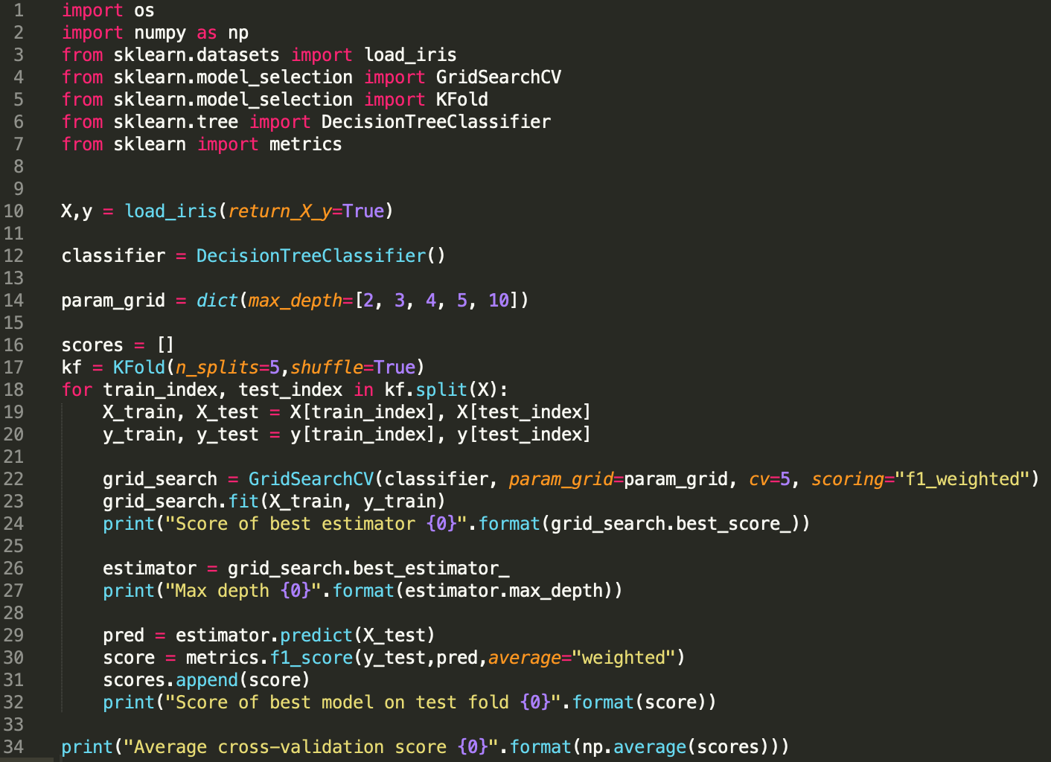

Slide 26
How to set up and run this code?
From the unix command line (Linux/MacOS)
Installing needed packages
sudo pip3 install scikit-learn
Run the code
python3 dt.py
In Windows I recommend to install Anaconda (a distribution of scientific computing packages)

Slide 27
Trace of the code
$ python3 dt.py
Score of best estimator 0.9496015554219888
Max depth 10
Score of best model on test fold 0.9337037037037038
Score of best estimator 0.949408652349829
Max depth 3
Score of best model on test fold 0.966280193236715
Score of best estimator 0.974967320261438
Max depth 3
Score of best model on test fold 0.9335858585858585
Score of best estimator 0.9748987854251012
Max depth 10
Score of best model on test fold 0.9660018993352326
Score of best estimator 0.9493370051574386
Max depth 4
Score of best model on test fold 0.966280193236715
Average cross-validation score 0.953170369619645

