Slide 1


Introduction to Machine Learning Part 8: Preprocessing techniques
Jaume Bacardit
Interdisciplinary Computing and Complex BioSystems (ICOS) research group, School of Computing, Newcastle University
Jaume.Bacardit@Newcastle.ac.uk
Twitter: @jaumebp

Slide 2
Outline
Introduction to data preprocessing
Data complexity metrics
Feature and Prototype selection
Missing values imputation
Dimensionality reduction
Some slides taken from “Jiawei Han, Data Mining: Concepts and Techniques. Chapter 2 “

Slide 3
Why preprocessing?
Lack of quality in the data (for both rows and columns)
Redundant
Irrelevant
Noisy
Scalability issues
Some methods many not be able to cope with a large number of attributes or instances
In general, to help the data mining method learn better

Slide 4
Why Data Preprocessing?
Data in the real world is dirty
incomplete: lacking attribute values, lacking certain attributes of interest, or containing only aggregate data
e.g., occupation=“ ”
noisy: containing errors or outliers
e.g., Salary=“-10”
inconsistent: containing discrepancies in codes or names
e.g., Age=“42” Birthday=“03/07/1997”
e.g., Was rating “1,2,3”, now rating “A, B, C”
e.g., discrepancy between duplicate records

Slide 5
Why Is Data Dirty?
Incomplete data may come from
“Not applicable” data value when collected
Different considerations between the time when the data was collected and when it is analyzed.
Human/hardware/software problems
Noisy data (incorrect values) may come from
Faulty data collection instruments
Human or computer error at data entry
Errors in data transmission
Inconsistent data may come from
Different data sources
Functional dependency violation (e.g., modify some linked data)
Duplicate records also need data cleaning

Slide 6
Major Tasks in Data Preprocessing
Data cleaning
Fill in missing values, smooth noisy data, identify or remove outliers, and resolve inconsistencies
Data integration
Integration of multiple databases, data cubes, or files
Data transformation
Normalization and aggregation
Data reduction
Obtains reduced representation in volume but produces the same or similar analytical results

Slide 7
Complexity metrics for classification methods
Work proposed by (Basu and Ho, 2002).
Implementation of these metrics
A set of metrics that attempts to quantify what makes a dataset difficult to learn by a certain type of KR
Imagine that you got a dataset like this.
How would you classify it?
Linear classifier
Rule learning
Certain problems are easier for some
Knowledge representations than others
Is it possible to generate metrics that quantify these difficulties?

Slide 8
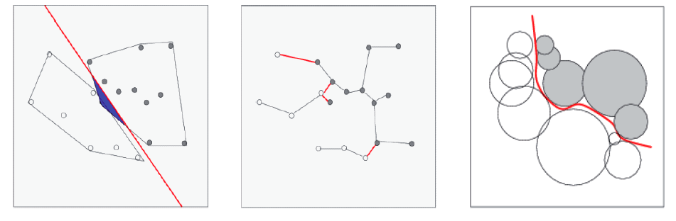
Some of the aspects being quantified
Degree of linear separability
Length of the class boundary by means of spanning trees
Shape of class manifolds
(Luengo, 2011)

Slide 9
Groups of metrics:
Measures of overlap of individual features
Quantifies the discrimination power of individual attributes of a dataset
Measures of separability of classes
Multivariate, considering together all attributes
Measures of geometry, topology and density of manifolds
These metrics analyse the shape of the class boundary using different kind of techniques
In total there are 12 metrics proposed in the original paper from Ho and Basu.

Slide 10
Feature Selection
Transforming a dataset by removing some of its columns
A1 | A2 | A3 | A4 | C
A2 | A4 | C

Slide 11
Prototype Selection
Transforming a dataset by removing some of its rows
I1
I2
I3
I4
I1
I2
I4

Slide 12
Taxonomy of feature/prototype selection methods
Filter methods
The reduction process happens before the learning process
Using some kind of metric that tries to estimate the goodness of the reduction
Dataset
Filter
Classification method

Slide 13
Taxonomy of feature/prototype selection methods
Wrapper methods
Filter methods try to estimate the goodness of the reduced dataset
Why don’t we use the actual data mining method (or at least a fast one) to tell if the reduction is good or bad?
The space of possible reductions will be iteratively explored by a search algorithms
Explore reduction
Dataset
Classification method
Classifier

Slide 14
Taxonomy of feature/prototype selection methods
Embedded methods
Learning methods that incorporate the feature/instance reduction inside their process
Difference between these and wrapper methods is that these methods are aware that they are performing a reduction
We will discuss some of them in a later lecture in the block

Slide 15
Feature selection
Two issues that characterise the FS methods
Feature evaluation (for the filters)
How do we estimate the goodness of a feature subset?
Metric applies to
Feature subset
Individual features (generating a ranking)
Subset exploration (for both filters and wrappers)
How do we explore the space of feature subsets?

Slide 16
Feature evaluation methods
Four types of metrics (Liu and Yu, 2005)
Distance metrics
Feature helps separating better between classes
Information metrics
Quantify the information gain (Information Theory) of a feature
Dependency metrics
Quantify the correlation between attributes and between each attribute and the class
Consistency metrics
Inconsistency: having two equal instances but with different class labels
These metrics try to find the minimal set of features that maintains the same level of consistency as the whole dataset

Slide 17

Relief/ReliefF
Metric for individual features
Given a sample of p instances from the training set, it scores each instance as follow:
d= distance function, f_{t,I} = feature I of sampled instance t. NM(x_{t})= instance closest to x_{t} with different class. NH(x_{t})= instance closest to x_{t} with the same class
Metric for two-class problems (Relief). The formula for multi-class problems (ReliefF) is more complex
Image taken from http://featureselection.asu.edu/featureselection_techreport.pdf

Slide 18

CFS (Correlation-based Feature Selection)
Evaluates subsets of features
Principle: select the subset that has maximal correlation to the class, and minimal correlation between features
r_{cf} = average correlation between features and class
r_{ff} = average correlation between features
For discrete attributes: correlation based on normalised Information Gain (Information Theory)
For continuous attributes: Pearson’s correlation
Image taken from http://featureselection.asu.edu/featureselection_techreport.pdf

Slide 19
Exploration mechanisms
There are 2^{d} possible sub-features of d features
Several heuristic feature selection methods:
Best single features under the feature independence assumption: choose by significance tests
Best step-wise feature selection:
The best single-feature is picked first
Then next best feature condition to the first, ...
Step-wise feature elimination:
Repeatedly eliminate the worst feature
Best combined feature selection and elimination
Optimal branch and bound:
Use feature elimination and backtracking
Slide taken from Han & Kamber

Slide 20
RFE (Recursive Feature Elimination)
A heuristic FS exploration mechanism
Requires for its use a classifier that can generate feature rankings from its training process
Decision Trees
Random Forest
Logistic Regression
SVM using a linear kernel
Original algorithm called SVM-RFE because it was paired to SVM, but the procedure is general
Procedure RFE (TS, num_feat_to_select, block_size)
While TS contains more than num_feat_to_select features
Model = train Classifier on TS
Ranking = extract a feature
ranking from Model
features = set of features of
size block_size at the
bottom of Ranking
Remove features from TS
EndWhile
Return set of features remaining in TS
Guyon, I., Weston, J., Barnhill, S., & Vapnik, V., “Gene selection for cancer classification using support vector machines”, Mach. Learn., 46(1-3), 389–422, 2002.

Slide 21
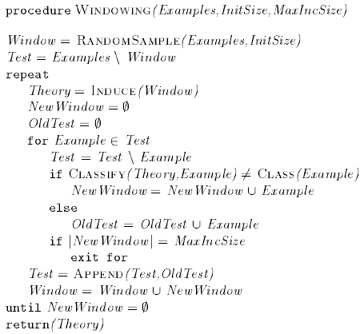
Prototype selection: wrapper methods
Heuristic search: Windowing method
Start with a small set
Iterate through:
Learning
Testing theory with examples not in the window
All misclassified examples (up to MaxIncSize) will be added to the window
www.jair.org/media/487/live-487-1704-jair.pdf

Slide 22
Prototype selection: filter methods
Instance-based methods
Based on the family of nearest-neighbour classifiers.
Could be considered wrapper/embedded, but because of their simplicity they are used as filters
Greatly depend on the definition of distance
Two types of methods
Those that start with an empty subset and add examples to it
Those that start with the complete set and remove examples

Slide 23
Dimensionality reduction
Dimensionality reduction methods take an original dataset and convert every instance from the original R^{d} space to a R^{d’} space, where d’<d
For each instance x in the dataset X:
y=f(x), where x={x₁,x₂,…,x_{d}} and y={y₁,y₂,…,y_{d’}}
The definition of f is computed from X (the training set), and it is what determines each of the different reduction methods
In general we find two main classes of dimensionality reduction methods: linear and non-linear

Slide 24
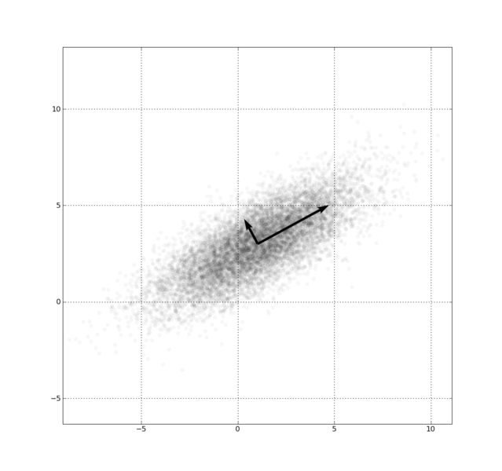
Principal Component Analysis
Classic linear dimensionality reduction method (Pearson, 1901)
Given a set of original variables X₁ … X_{p} (the attributes of the problem)
PCA finds a set of vectors Z₁ … Z_{p} that are defined as linear combinations of the original variables and that are uncorrelated between them, the principal components
The PC are also sorted such as Var(Z₁)≥Var(Z₂)≥…≥Var(Z_{p})

Slide 25
Applying the PCs to transform data
Using all PCs
Using only 2 PCs

Slide 26
Non-linear dimensionality reduction
Alternative algorithms to PCA have emerged in recent years
These are less sensitive to nuances of the original data (e.g. outliers, non-normal distributions) than PCA
t-SNE (t-Distributed Stochastic Neighbourhood Embeddings) https://lvdmaaten.github.io/publications/papers/JMLR_2008.pdf
UMAP (Uniform Manifold Approximation and Projection https://arxiv.org/abs/1802.03426

Slide 27
What is a missing values?
A missing value (Mv) is an empty cell in the table that represents a dataset
Attributes
 | ?
Instances

Slide 28
Why missing values are important?
Three reasons
Loss of efficiency: less patterns extracted from data or conclusions statistically less strong
Complications in handling and analyzing the data. Methods are in general not prepared to handle them
Bias resulting from differences between missing and complete data. Data Mining methods generate different models
(Barnard and Meng, 99)

Slide 29
Strategies for missing values handling (Farhangfar et al., 08)
Discarding examples with missing values
Simplest approach. Allows the use of unmodified data mining methods
Only practical if there are few examples with missing values. Otherwise, it can introduce bias
Convert the missing values into a new value
Use a special value for it
Add an attribute that indicates if value is missing or not
Greatly increases the difficulty of the data mining process
Imputation methods
Assign a value to the missing one, based on the rest of the dataset
Use the unmodified data mining methods
In the next slides a few methods will be described. All references to the original papers presenting them (and many others) are available at http://sci2s.ugr.es/MVDM/index.php

Slide 30
Most Common (MC) value
If the missing value is continuous
Replace it with the mean value of the attribute for the dataset
If the missing value is discrete
Replace it with the most frequent value of the attribute for the dataset
Simple and fast to compute
Assumes that each attribute
presents a normal distribution
 | ?
Ave

Slide 31
Imputation with k-Nearest Neighbour (KNNI)
k-NN machine learning algorithm
Given an unlabeled new instance
Select the k instances from the training set most similar to the new instance
What is similar? E.g. an euclidean distance
Predict the majority class from these k instances
k-NN for MV imputation
Select the k nearest neighbours
Replace the MV with the most frequence/mean value from these k instances

Slide 32
Resources
A review of feature selection techniques in bioinformatics
Survey of instance-based reduction techniques
Bibliography on missing values
http://sci2s.ugr.es/MVDM/biblio.php
Good lecture slides about PCA and SVD

