Slide 1


Introduction to Machine Learning Part 9: Scalability of ML algorithms
Jaume Bacardit
Interdisciplinary Computing and Complex BioSystems (ICOS) research group, School of Computing, Newcastle University
Jaume.Bacardit@Newcastle.ac.uk
Twitter: @jaumebp

Slide 2
Outline
Scalability challenges
How to handle effectively and efficiently the processing of large datasets
Challenges
Challenge 1: Dealing with large training sets
Challenge 2: Dealing with complex problems
Challenge 3: Dealing with large attribute space
Challenge 4: Tackling the uncertainty of EML

Slide 3
Challenge 1: dealing with large training sets
Computational cost is alleviated by using a windowing mechanism called Incremental Learning with Alternating Strata (ILAS) [Bacardit et al., PPSN2004]
Avoids a (potentially biased) static prototype selection
Training set is divided into strata, each GA iteration just uses one of the stratum
This mechanism also introduces some generalisation pressure
0
Ex/n
2·Ex/n
3·Ex/n
Ex
Training set
Iterations
0
Iter

Slide 4
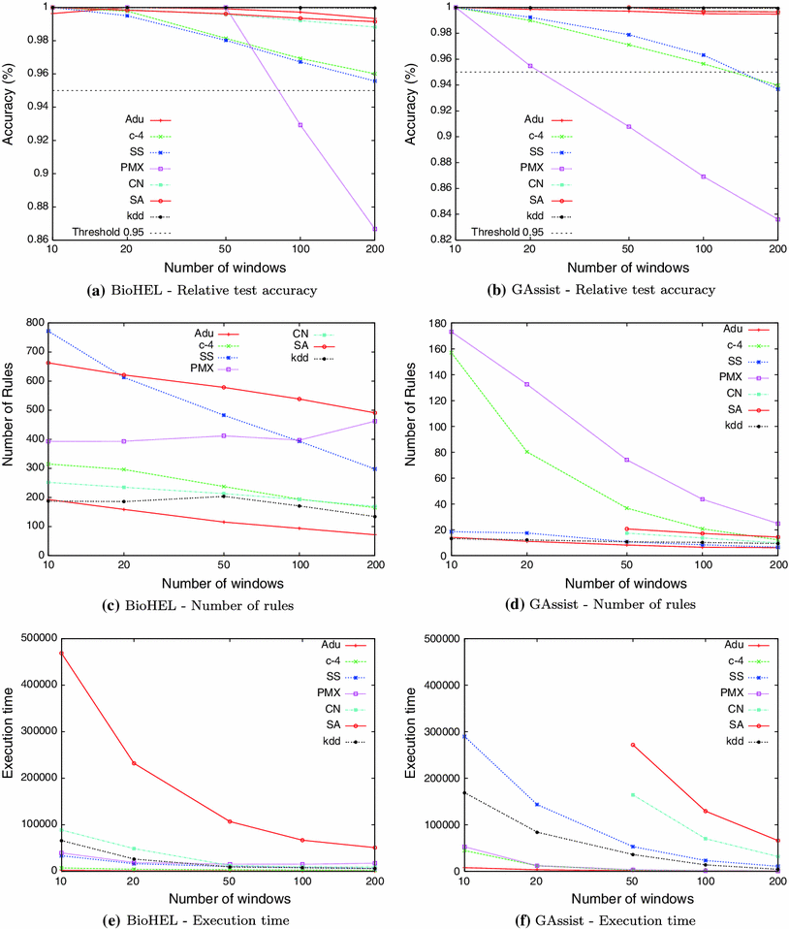
Behaviour of ILAS in large datasets
[Franco et al., Soft Computing, 2013]

Slide 5
GPU-based fitness computation
NVIDIA’s Computer Unified Device Architecture (CUDA) is a parallel computing architecture that exploits the capacity within NVIDIA’s Graphic Processor Units
CUDA runs thousands of threads at the same time → Single Program, Multiple Data paradigm
In the last few years GPUs have been extensively used in the evolutionary computation field
Many papers and applications are available at http://www.gpgpgpu.com
The use of GPGPUs in Machine Learning involves a greater challenge because it deals with more data but this also means it is potentially more parallelizable

Slide 6
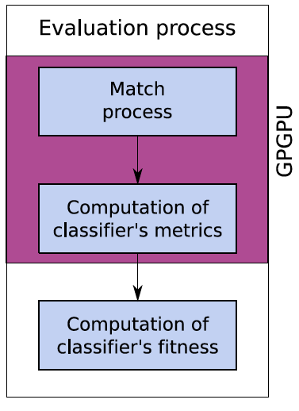
CUDA for matching a set of rules
The match process is the stage computationally more expensive
However, performing only the match inside the GPU means downloading from the card a structure of size O(NxM) (N=population size, M=training set size)
In most cases we don’t need to know the specific matches of a classifier, just how many (reduce the data)
Performing the second stage also inside the GPU allows the system to reduce the memory traffic to O(N)
[Franco et al., GECCO2010]

Slide 7
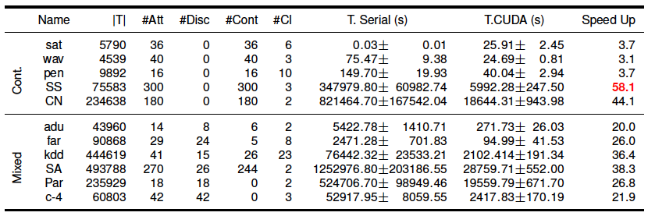
GPU rule evaluation
We used NVIDIA’s CUDA in a Tesla C1060 card with 4GB of global memory, and compared the run-time to that of Intel Xeon E5472 3.0GHz processors
Biggest speedups obtained in large problems (|T| or #Att), specially in domains with continuous attributes
Run time for the largest dataset reduced from 2 weeks to 8 hours

Slide 8
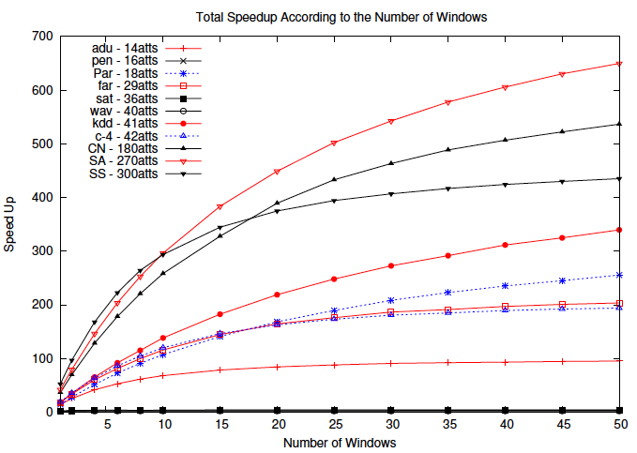
CUDA fitness in combination with ILAS
The speedups of CUDA and ILAS are cumulative
From hours to minutes

Slide 9
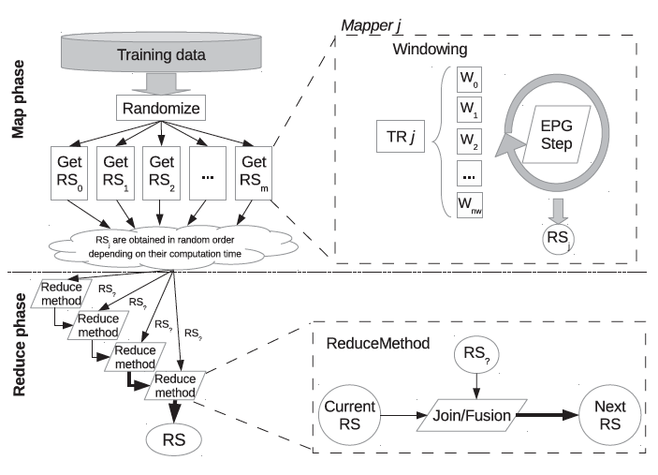
Windowing and MapReduce
I. Triguero, D. Peralta, J. Bacardit, S. Garcia and F. Herrera, A Combined MapReduce-Windowing Two-Level Parallel Scheme for Evolutionary Prototype Generation, Proceedings of the IEEE World Congress on Computational Intelligence 2014, pp. 3036—3043
MapReduce: the dominant distributed computing paradigm of the big data frameworks
Two stages algorithm
Map: Split data, process it independently of other mappers, sent outputs to one of N reducers
Reduce: each reducer is in charge of integrating the results it has been sent
To parallelise algorithms that are iterative in nature MapReduce is called multiple times, with considerable overhead each time the process starts
In this case, the windowing is able to accelerate the work of the mappers without affecting the quality of the solutions or the flow of information from mappers to reducers

Slide 10
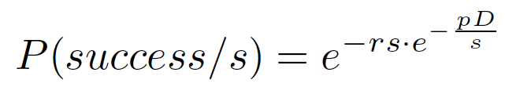
Challenge 2: Generating complex solutions
Evolving a complete rule set of many rules and attributes is difficult, chromosome size is enormous
Success model of ILAS
ILAS does not help if the strata are not representative of the whole training set
Good rules in the individuals can disappear if the current stratum does not use them
r = #rules in solution, s = #strata,
p = prob. rule represented in strata,
D = size of the training set
S=150

Slide 11
Effective exploration in complex problems
How can we improve on the exploration capacity of the classic crossover and mutation of GAs?
Hybridising them with local search
The LS operators use information extracted from the evaluation process
After evaluating a rule set we know
Which rules are good and which rules are bad
Which parts of each rule are good and which parts are bad

Slide 12
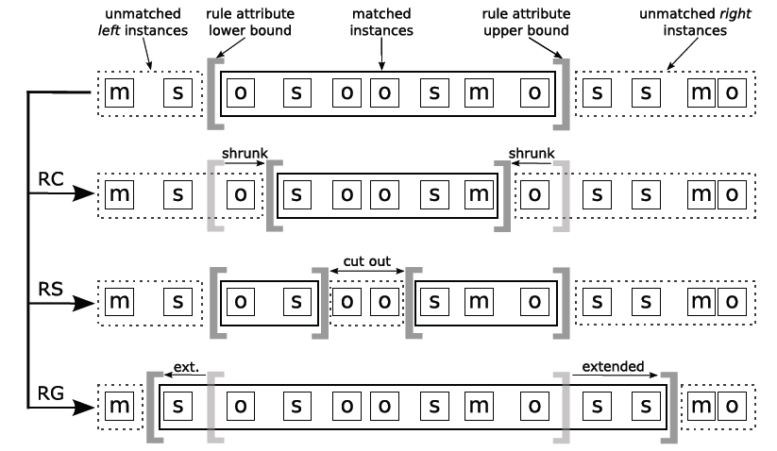
Two kinds of local search operators
Rule set-wise operator
Takes N parents (N can be > 2) and generates a single offspring with the best rules of all of them
Takes a single rule set and re-orders it to optimise the decision list
Rule-wise operators
Rule cleaning – drop conditions that fail
Rule splitting – divide rule so it can be cleaned
Rule generalizing –extend a rule so it can correctly classify more examples

Slide 13
Where to apply LS?
Hybridised with genetic search. For discrete attributes [Bacardit & Krasnogor, Evolutionary Computation, 2009]
Hybridised with genetic search. For continuous attributes [Calian & Bacardit, Memetic Computing, 2013]
As post-processing operators [Franco et al., GECCO2012]

Slide 14
Challenge 3: Datasets with large number of attributes
Learning from datasets with hundreds of attributes is extremely slow
Can we find an alternative way of reducing this cost?
Example of a rule for predicting Secondary Structure:
Att Leu₋₂ ∈ [-0.51,7] and Glu ∈ [0.19,8] and
Asp₊₁ ∈ [-5.01,2.67] and Met₊₁∈ [-3.98,10] and
Pro₊₂ ∈ [-7,-4.02] and Pro₊₃ ∈ [-7,-1.89] and
Trp₊₃ ∈ [-8,13] and Glu₊₄ ∈ [0.70,5.52] and
Lys₊₄ ∈ [-0.43,4.94] → alpha
9 attributes out of 300 were expressed in the rule
This means that while evolving this rule 291 out of the 300 attribute match operations were irrelevant

Slide 15
The Attribute List Knowledge Representation (ALKR)
[Bacardit et al., Memetic Computing, 2009]
What if we only keep in the rule the relevant attributes? → In this way match operations will be much faster in domains with high number of attributes
ALKR automatically identifies which are the relevant/specific attributes for each rule, and only tracks information about them
In ALKR two operators (specialize and generalize) add or remove attributes from the list with a given probability, hence exploring the rule-wise space of the relevant attributes
Also, as we only keep the relevant attributes, the representation can potentially explore the search space more efficiently → learning better

Slide 16
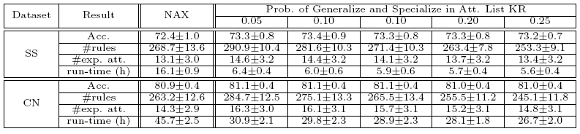
ALRK in Bioinformatics datasets
In these datasets, the new representation learns better and is much faster

Slide 17
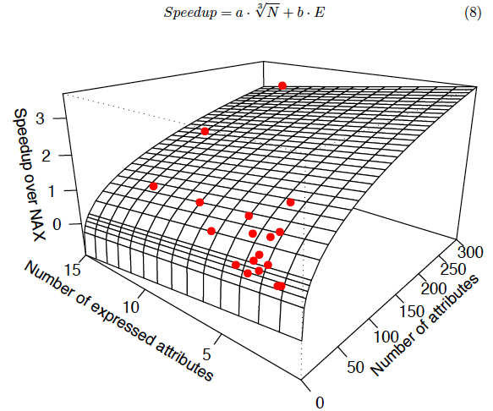
Speedup of ALKR

Slide 18
Challenge 4: The uncertainty of evolutionary machine learning
Evolutionary machine learning, because of its use of GAs, is an stochastic algorithm
How certain can we be of the solutions it provides?
How to turn this weakness into a strength
Exploiting the stochasticity with ensemble learning
Ensemble learning
Ensemble learning is a quite well established family of techniques that provides performance boost and robustness to the learning process
In general these techniques integrate the collective predictions of a set of models in some principled fashion
We have integrated some simple ensemble methods with our Evolutionary Learning methods [Bacardit & Krasnogor, LNAI 4998, 2008]

Slide 19
Ensemble for consensus prediction
The EML method is run N times on the original training set, each of them with a different random seed.
These runs are independent, so they can be parallelised!
From each of the N runs, a rule set is extracted: the best individual at the end of the training process
Exploitation stage: for each new instance, the N models produce a prediction. The majority class is used as the ensemble prediction
Protein structure prediction dataset with 90K examples

Slide 20
Case study: Protein Structure Prediction

Slide 21
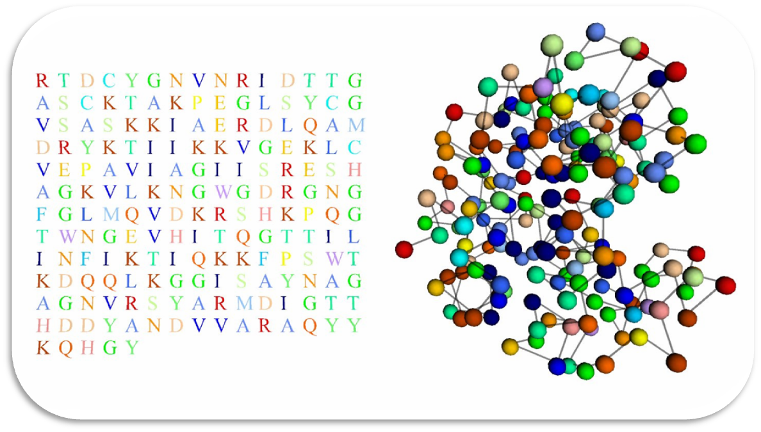
Protein Structure Prediction
PSP aims to predict the 3D structure of a protein based on its primary sequence
Primary Sequence
3D Structure

Slide 22
Data Mining side of PSP
Beside the overall 3D PSP (an optimization problem), several structural aspects can be predicted for each protein residue
Coordination number
Solvent accessibility
Etc.
These problems can be modelled in may ways:
Regression or classification problems
Low/high number of classes
Balanced/unbalanced classes
Adjustable number of attributes
Ideal ML benchmarks !!
http://ico2s.org/datasets/psp_benchmark.html
R_{i-5}
SS_{i-5}
R_{i-4}
SS_{i-4}
R_{i-3}
SS_{i-3}
R_{i-2}
SS_{i-2}
R_{i-1}
SS_{i-1}
R_{i}
SS_{i}
R_{i+1}
SS_{i+1}
R_{i+2}
SS_{i+2}
R_{i+3}
SS_{i+3}
R_{i+4}
SS_{i+4}
R_{i+5}
SS_{i+5}
R_{i-1} R_{i} R_{i+1} → SS_{i}
R_{i} R_{i+1} R_{i+2} → SS_{i+1}
R_{i+1} R_{i+2} R_{i+3} → SS_{i+2}

Slide 23
Challenges of these datasets
There are 160K+ structures deposited in the Protein Data Bank
Avoiding near-identical proteins (in sequence or structure), it is easy to compile protein training sets of 2K-5k structures
With a median of ~150 AAs/protein you can easy get training sets with 100K+ instances
Number of attributes could range, depending on the representation, from 10-20 to hundreds (if not thousands)

Slide 24
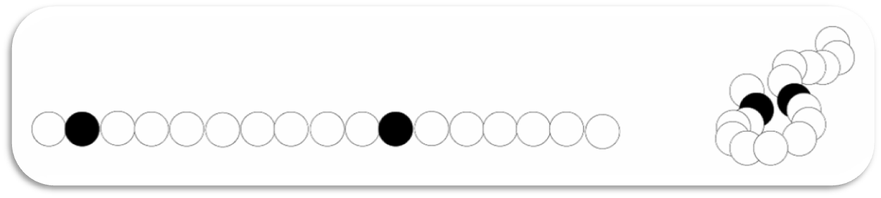
PSP Challenge: Contact Map Prediction
Two amino acids of a chain are said to be in contact if their distance is less than a certain threshold
Contact Map (CM): binary matrix that contains a 1 for a cell if the residues at the row & column are in contact, 0 otherwise
This matrix is very sparse, in real proteins there are less than 2% of contacts
Highly unbalanced dataset
Primary
Sequence
Contact
Native State

Slide 25
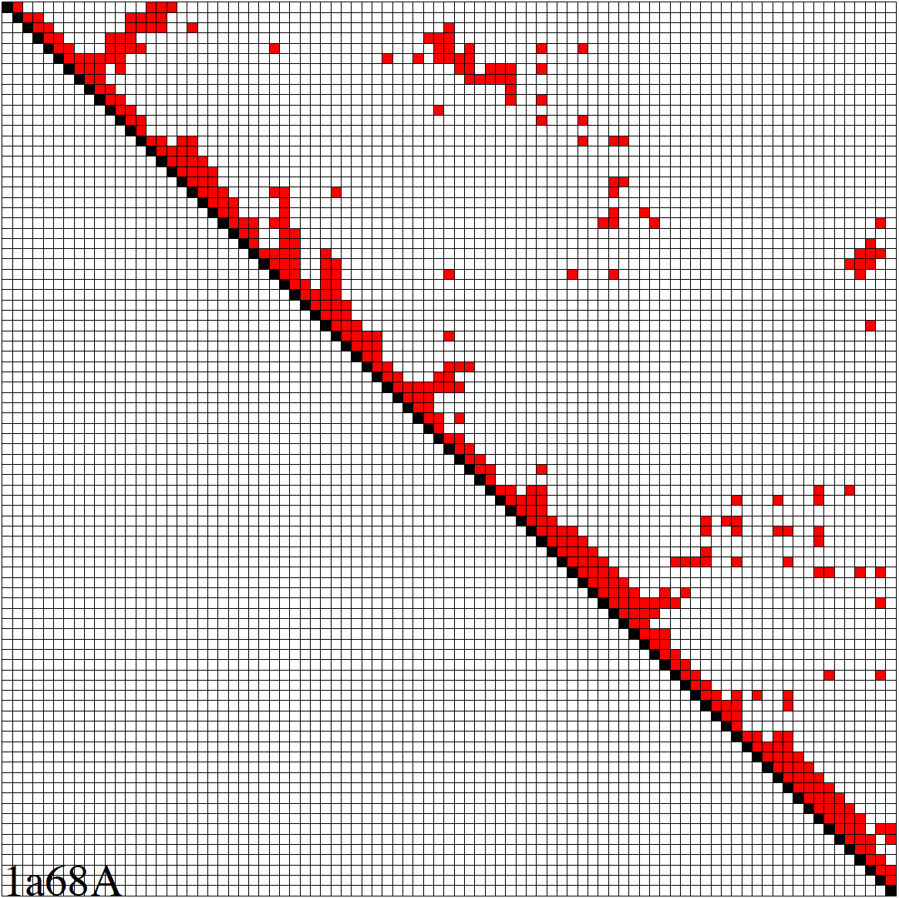
Contact Map prediction
Prediction, for each pair of residues in a protein, whether these residues are in contact (have a small distance between them in the 3D structure) or not
This problem can be represented by a binary matrix. 1= contact, 0 = non contact. Plotting this matrix reveals the main traits in the protein structure
Very sparse characteristic: Less than 2% of contacts in native structures
Training sets easily reach millions of residue pairs
Our method was one of the top predictors in the 8th and 9th editions of the CASP competition (actually, the best sequence-based predictor in CASP9)
helices
sheets
(Bacardit et al., Bioinformatics (2012) 28 (19): 2441-2448)

Slide 26
Steps for CM prediction
Prediction of
Secondary structure (using PSIPRED)
Solvent Accessibility
Recursive Convex Hull
Coordination Number
Integration of all these predictions plus other sources of information
Final CM prediction (using BioHEL)
Using BioHEL

Slide 27
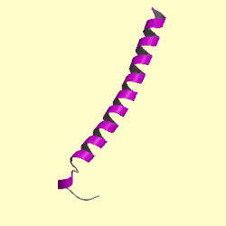
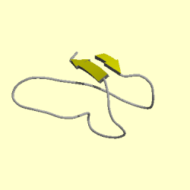
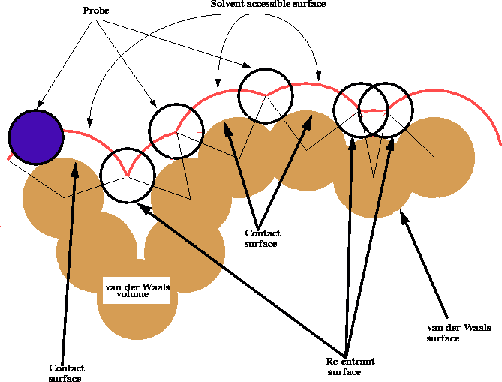
Subpredictions
Secondary Structure (SS): Recurrent patterns of structure within a protein due to the local interactions (with the neighbours in the chain)
Solvent accessibility (SA): Amount of surface of each residue that is exposed to solvent
Recursive Convex Hull (RCH): We model a protein as a series of nested layers, assigning each residue to a different layer. Each layer is a convex hull of points [Stout et al., Bioinformatics, 2008]
Contact number (CN): rather than predicting each individual contact, the CN of a residue is the count of the number of contacts it is involved in

Slide 28
Characterisation of the contact map problem
Three types of input information were used
Detailed information of three different windows of residues centered around
The two target residues (2x)
The middle point between them
Subpredictions plus evolutionary information
Information about the connecting segment between the two target residues and
Global protein information
1
3
2

Slide 29
Samples and ensembles
Training set
Training set contained 32 million pairs of AA and 631 attributes (+60GB of disk space)
50 samples of 660K examples are generated from the training set with a ratio of 2:1 non-contacts/contacts
BioHEL is run 25 times for each sample
Prediction is done by a consensus of 1250 rule sets
Confidence of prediction is computed based on the votes distribution in the ensemble.
Whole training process took about 25K CPU hours (severa, times faster in a modern multi-core machine)
x50
Samples
x25
Rule sets
Consensus
Predictions

Slide 30
Results of Contact Map prediction
The subset of the most difficult target (Free Modelling targets) of CASP9 were used to evaluate CM
Out predictor obtained an average specificity of 23.6%
It is more than 11 times higher than a random prediction
The predictor was the best sequence-based method in the competition
(now these results are obsolete, but this dataset has remained as a big data challenge)
Overall, tackling this problem has forced us to address a broad range of bottlenecks in DM methods
Code bottlenecks
Memory footprint bottlenecks
Scalability bottlenecks

Slide 31
Machine Learning coursework
The specification is simple, take a dataset (more in the next slide), do the best you can with it
Choose the right classifier
Choose the right feature representation
Choose the right preprocessing pipeline
How you make these choices? Through a proper data-driven process of model construction and selection
Evaluating your models using appropriate methodologies
What does it mean to “do the best you can”?
Predictive performance
Efficiency of the model selection and training process
Extracting knowledge from the models (to a much lesser extent)

Slide 32
Dataset choices
One of the datasets of our PSPbencharks suite
~160000 instances, 180 attributes, 2 classes
https://ico2s.org/data/instances/psp_benchmark/classification/PSSM-based/Uniform-Length/2Classes/Window4.tar.gz
Dataset is already partitioned into training and test sets using cross-validation
File format is ARFF (extension of CSV). You can easily load these files in python using the liac-arff python module.
If you feel brave, the 60GB contact map dataset
Pick a dataset from Kaggle
Bonus: participate in an actual competition ☺

Slide 33
Report
Your report should address the following points:
Description and justification of your ML pipeline
Evidence of the experiments you have done to construct your pipeline
Thorough evaluation of the predictive capacity of your model(s)
Use plots/tables of results to report the performance of your models
Reflection: what have you learnt from this exercise?

