Slide 1


A machine learning strategy for the recruitment of participants in clinical studies
Jaume Bacardit
Interdisciplinary Computing and Complex BioSystems (ICOS) research group, School of Computing, Newcastle University
Jaume.Bacardit@Newcastle.ac.uk
Twitter: @jaumebp

Slide 2
Context: The APPROACH project
Large European interdisciplinary project focusing on a particular disease for which no cure exist: Osteoarthitis, the degeneration over time of the cartilage in the joints
The aim of the projects are:
recruit patients for a new clinical study
observe the disease progression (collecting data) over two years
discover mechanisms behind progression

Slide 3
Recruitment for a clinical study
What makes APPROACH different is how this recruitment took place
Often clinical studies fail because they do not recruit the right people
Heterogenous population (e.g. diseases for which there are multiple causes or paths of progression) → more difficult to extract signal from the data
People that would not respond no matter if they get the treatment or the placebo → waste $$$ in generating data from uninteresting people
To focus the population of the approach cohort we decided to
First, focus on fast progressors, people that would generate in the disease within two years
Use ML to rank the candidates to be selected in the study based on predicting their progression outcome from the data known before the start of the study

Slide 4
Recruitment centers
Five hospitals across Europe
Each of them had historical data on the set of candidate participants to the study
In some cases these had been followed for many years
In others for just a few, or just once

Slide 5
From patients to periods
To make the best possible use of the cohorts with years of longitudinal data
Input variables: What is known at the start of the period
Outcome variable: change from the start to the end of the period

Slide 6
Class definitions: fast progressors

Slide 7
Recruitment idea

Slide 8
Challenges that have to be faced
cohorts other than CHECK cannot be used in model training (not enough data to define progression)
Very few (2) common variables across cohorts
the date of last visit differs across cohorts and patients
model prediction confidence gets worse for older data

Slide 9
Data harmonisation

Slide 10
Baseline shift

Slide 11
Multi-model prediction

Slide 12
Ranking based on model confidence

Slide 13
Ranking functions

Slide 14
Ranking based on model confidence

Slide 15
Two-stage recruitment process

Slide 16
Recruitment data flow

Slide 17
Decision support and progress monitoring

Slide 18
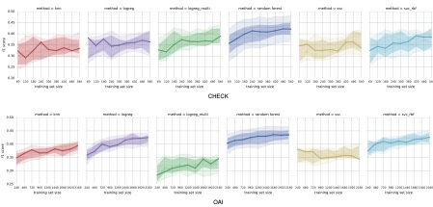
But what are the models? Random Forest
Comparison with other ML algorithms

Slide 19
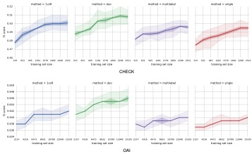
Multi-class approach
Rather than training a single model with 4 classes, we train two models (duo classifier) to predict P and S separately and combine their outputs to generate the four possible outcomes
Full details of model construction and tuning: https://arxiv.org/abs/1909.13408

Slide 20
How does it work?
Internal simulation using CHECK data based on cross-validation
Could we do better with more patients/better features?
How has this process worked for real? We will know in two years time

Slide 21
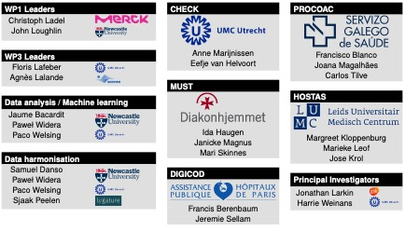
Acknowledgements

Slide 22
Acknowledgements
Paweł Widera
The research leading to these results has received support from the Innovative Medicines Initiative Joint Undertaking under grant Agreement no. 115770, resources of which are composed of financial contribution from the European Union’s Seventh Framework Programme (FP7/2007-2013) and EFPIA companies’ in kind contribution. See: https://www.imi.europa.eu.
Disclaimer: This communication reflects the views of the APPROACH consortium and neither IMI nor the European Union and EFPIA are liable for any use that may be made of the information contained herein.

