Slide 1
MA:TG (Mouse Accuracy: The Game)
Abhijith Settipalli
Andrew Morris
Dustin Tsui

Slide 2
3D Game
Objective of the game
Reach the blue box, which is the end.
How to play
Use mouse to play

Slide 3
Live Demo
jump4r.com

Slide 4
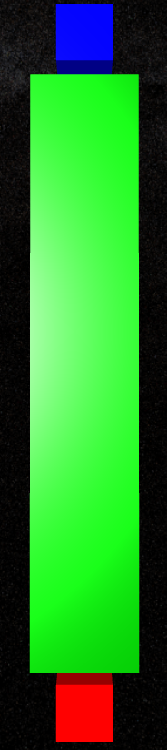
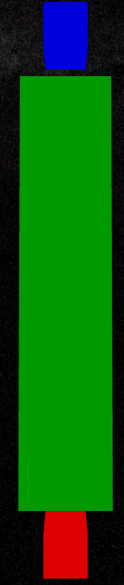
Phong Shading

Slide 5

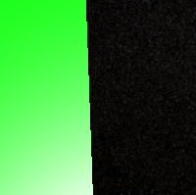
Antialising

Slide 6
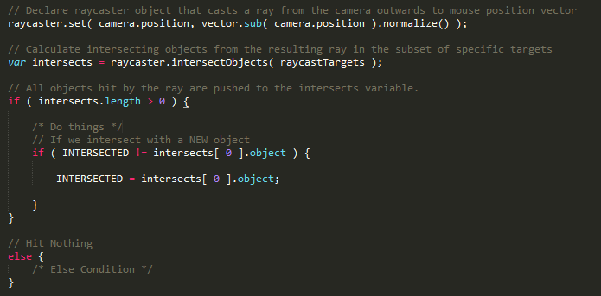
Ray Casting

Slide 7
Closing Thoughts

