Slide 1
Clinically Relevant

Slide 2
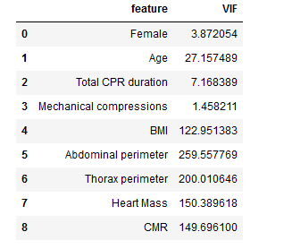
VIF analysis Checking multi collinearity among independent variable
Collinearity among the variables are high. Variables with high VIF means that variables can be predicted by other variables in the in the frame as well.
We should drop the variable with high VIF, so that model can generalize the coefficient better.
Heart Mass and CMR are highly corelated because CMR is a derived feature from heart mass
Abdominal perimeter and thorax perimeter. During breathing the perimeter of thorax and abdomen kind of depends of diaphragm contraction and relaxation.
BMI depends on the age as well

Slide 3
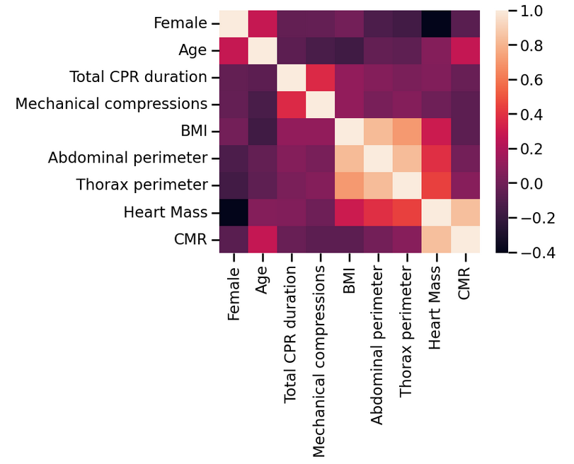
Pearson correlation among variables

Slide 4
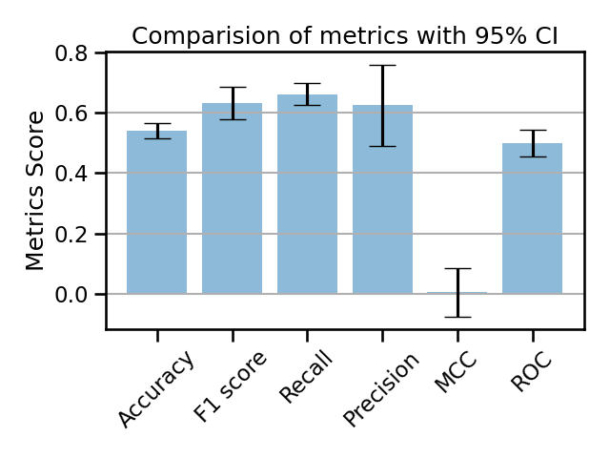
With Heart mass
3 Fold cross validation
Metrics | Train | Test
Accuracy | 0.73 | 0.54
F1 | 0.79 | 0.63
Recall | 0.78 | 0.66
Precision | 0.81 | 0.62
MCC | 0.41 | 0.005
ROC | 0.71 | 0.49

Slide 5
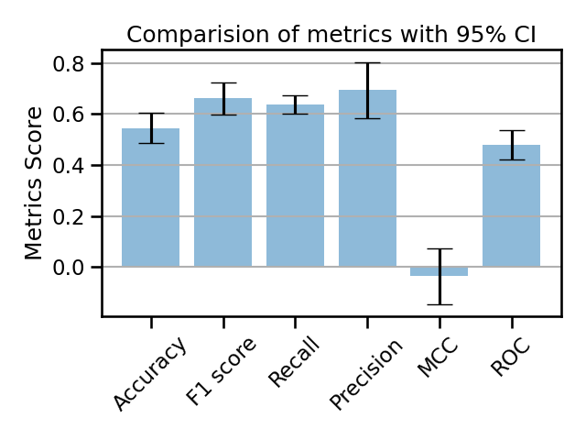
With CMR
3 Fold cross validation
Metrics | Train | Test
Accuracy | 0.74 | 0.545
F1 | 0.81 | 0.66
Recall | 0.78 | 0.63
Precision | 0.85 | 0.69
MCC | 0.42 | -0.03
ROC | 0.72 | 0.47

Slide 6
Significant variable

Slide 7
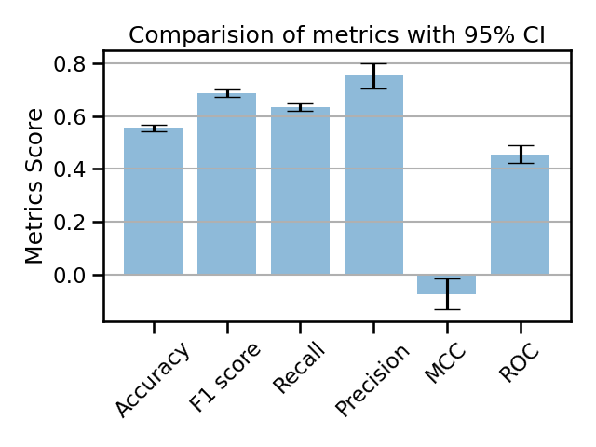
CMR
3 Fold cross validation
Metrics | Train | Test
Accuracy | 0.72 | 0.55
F1 | 0.80 | 0.68
Recall | 0.76 | 0.63
Precision | 0.85 | 0.75
MCC | 0.37 | -0.07
ROC | 0.70 | 0.45

Slide 8
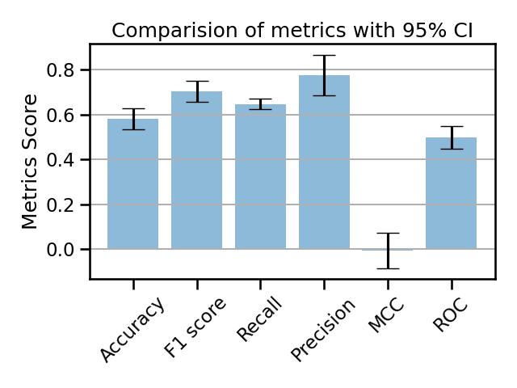
Heart Mass
3 Fold cross validation
Metrics | Train | Test
Accuracy | 0.72 | 0.58
F1 | 0.80 | 0.70
Recall | 0.74 | 0.64
Precision | 0.88 | 0.77
MCC | 0.36 | -0.006
ROC | 0.71 | 0.49

Slide 9
Automatically selected

Slide 10
Automated Feature selection Methods
Pearson correlation
CHI2
Recursive feature elimination
Lasso logistic Regressor
Random Forest Regressor

Slide 11
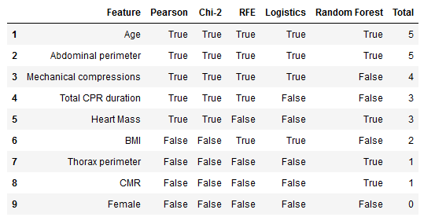
Automated selected feature table

Slide 12
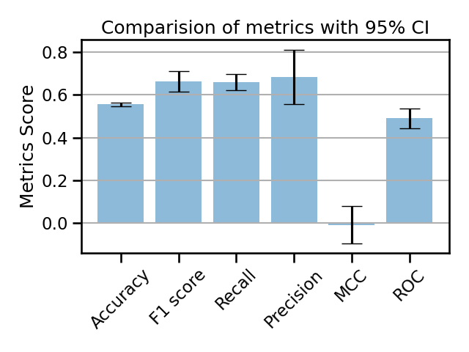
3 Fold cross validation
Metrics | Train | Test
Accuracy | 0.73 | 0.55
F1 | 0.79 | 0.66
Recall | 0.77 | 0.65
Precision | 0.83 | 0.68
MCC | 0.4 | -0.008
ROC | 0.71 | 0.49

