Slide 1
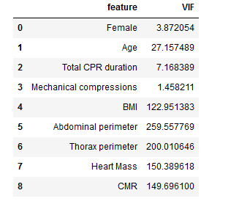
VIF analysis Checking multi collinearity among independent variable
Collinearity among the variables are high. Variables with high VIF means that variables can be predicted by other variables in the in the frame as well.
We should drop the variable with high VIF, so that model can generalize the coefficient better.
Heart Mass and CMR are highly corelated because CMR is a derived feature from heart mass
Abdominal perimeter and thorax perimeter. During breathing the perimeter of thorax and abdomen kind of depends of diaphragm contraction and relaxation.
BMI depends on the age as well

Slide 2
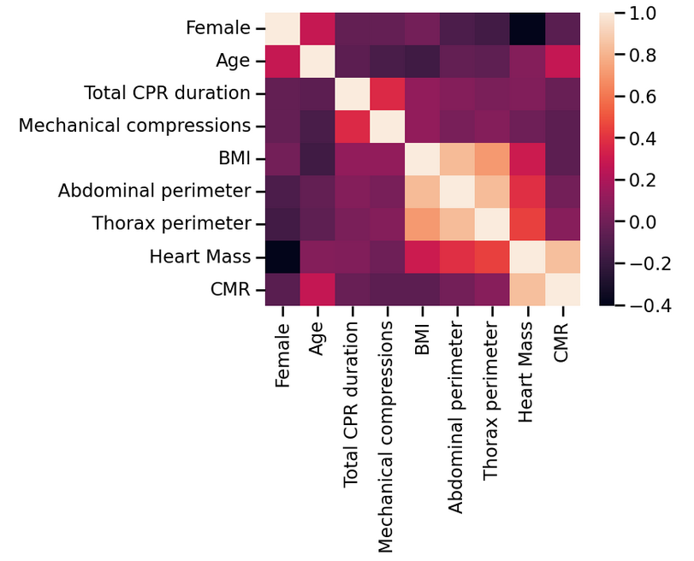
Pearson correlation among variables

Slide 3
With Decision Tree
CMR is not considered in decision tree for prediction as by the splitting criteria

Slide 4
Clinically Relevant

Slide 5
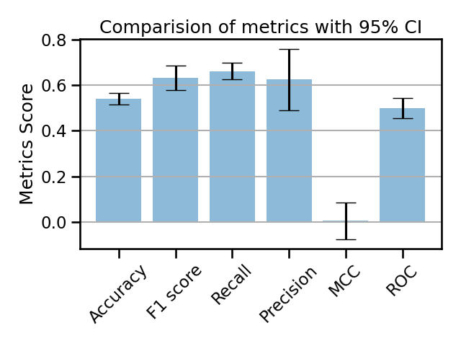
With Heart mass
3 Fold cross validation
Metrics | Train | Test
Accuracy | 0.73 | 0.54
F1 | 0.79 | 0.63
Recall | 0.78 | 0.66
Precision | 0.81 | 0.62
MCC | 0.41 | 0.005
ROC | 0.71 | 0.49

Slide 6
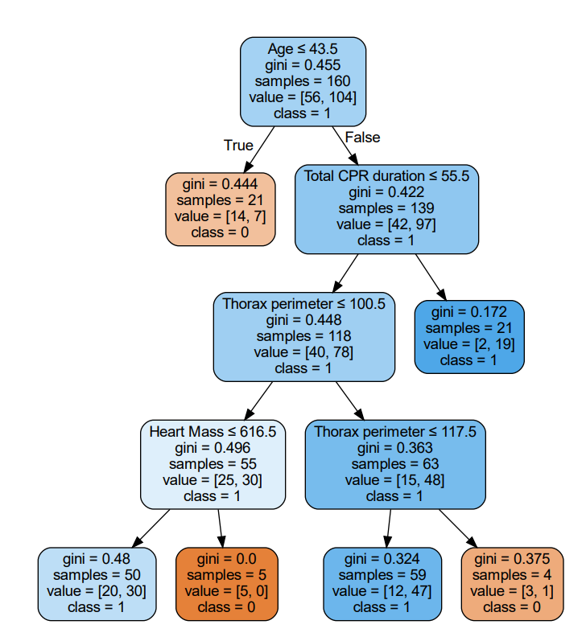
Clinical relevant with Heart Mass

Slide 7
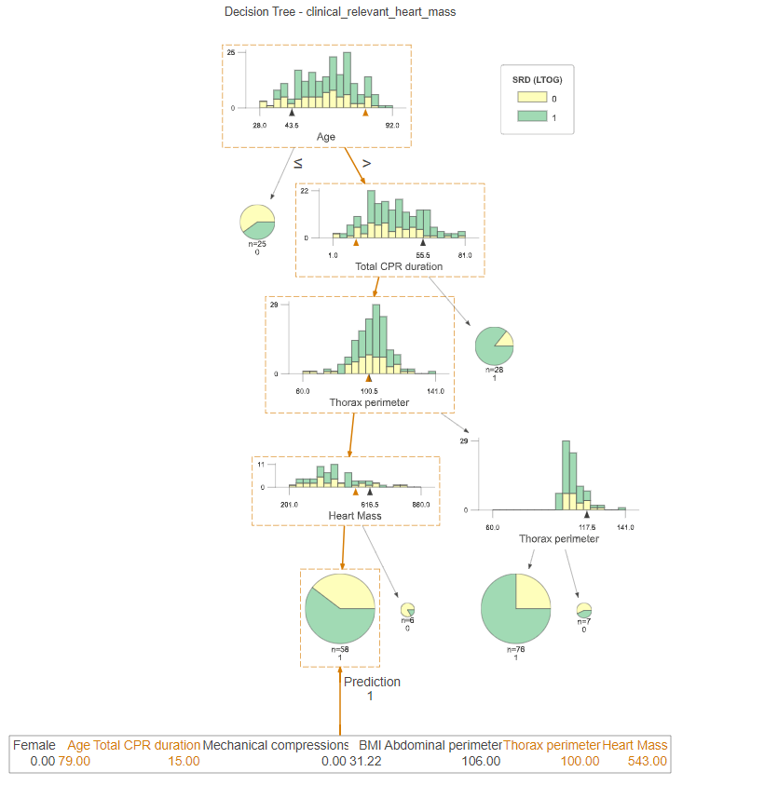
Clinical relevant with Heart Mass
Correct prediction

Slide 8
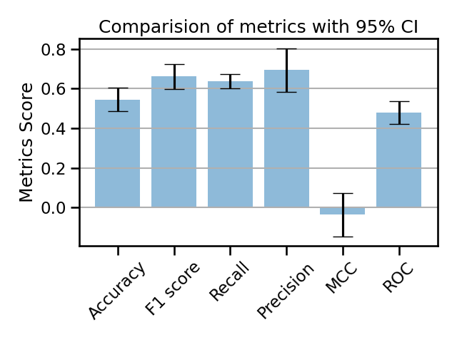
With CMR
3 Fold cross validation
Metrics | Train | Test
Accuracy | 0.74 | 0.545
F1 | 0.81 | 0.66
Recall | 0.78 | 0.63
Precision | 0.85 | 0.69
MCC | 0.42 | -0.03
ROC | 0.72 | 0.47

Slide 9
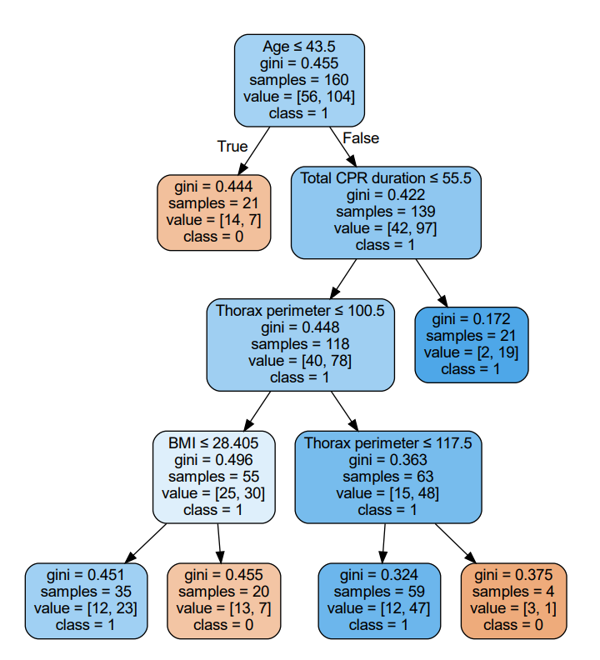
Clinical relevant with CMR

Slide 10
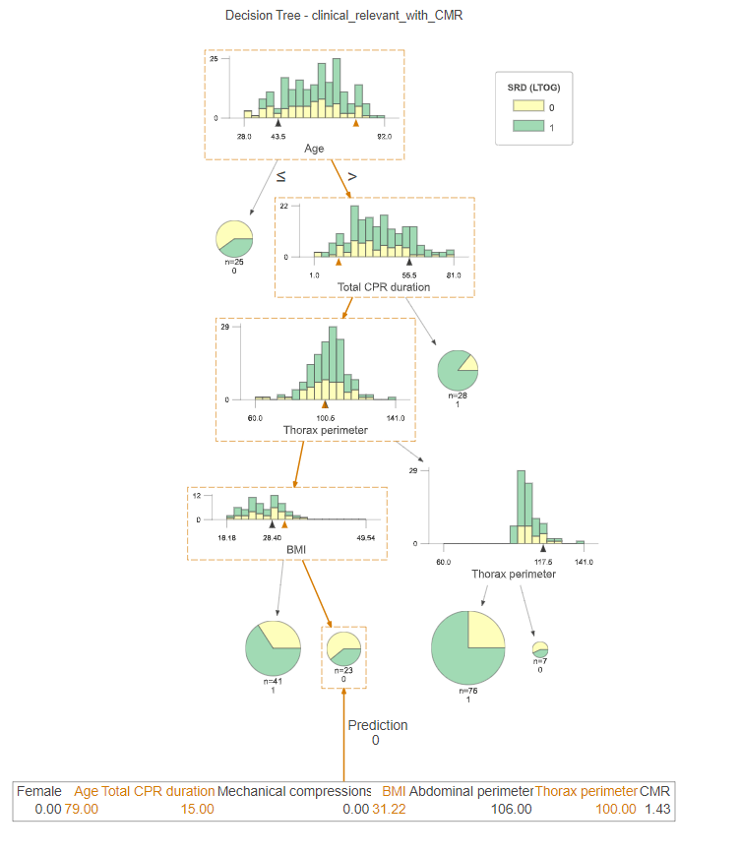
Clinical relevant with CMR
Wrong Prediction

Slide 11
Significant variable

Slide 12
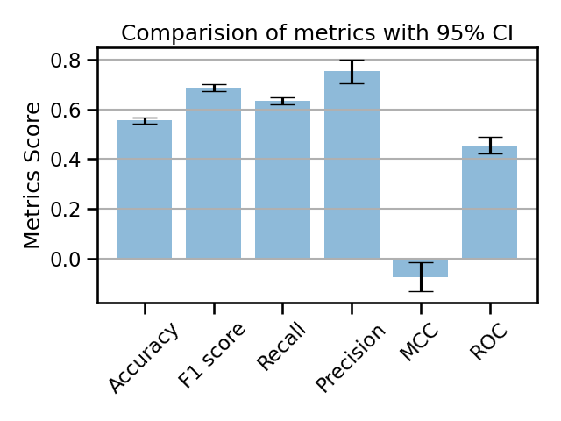
CMR
3 Fold cross validation
Metrics | Train | Test
Accuracy | 0.72 | 0.55
F1 | 0.80 | 0.68
Recall | 0.76 | 0.63
Precision | 0.85 | 0.75
MCC | 0.37 | -0.07
ROC | 0.70 | 0.45

Slide 13
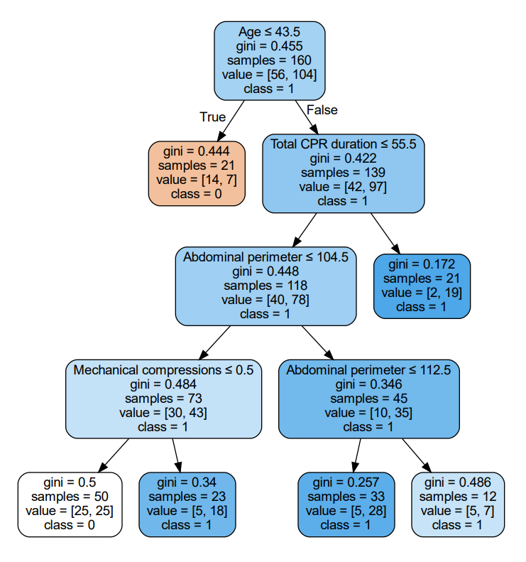
Significant variable with CMR

Slide 14
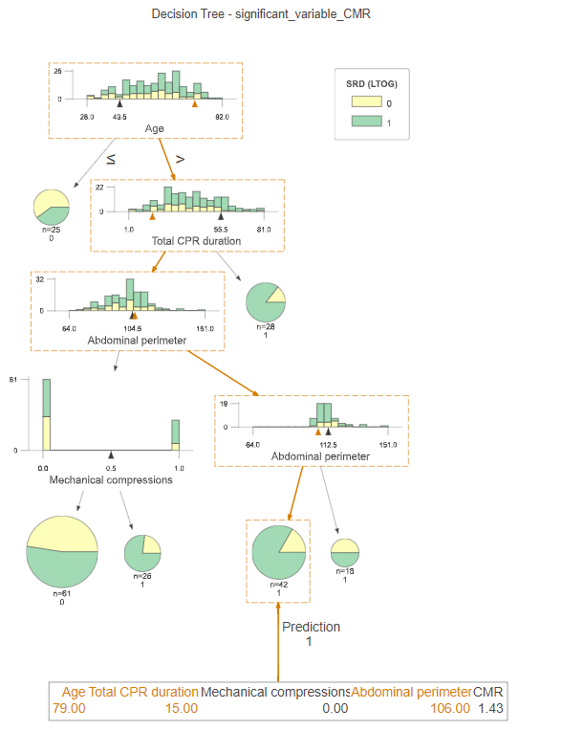
Significant variable with CMR
Correct Prediction

Slide 15
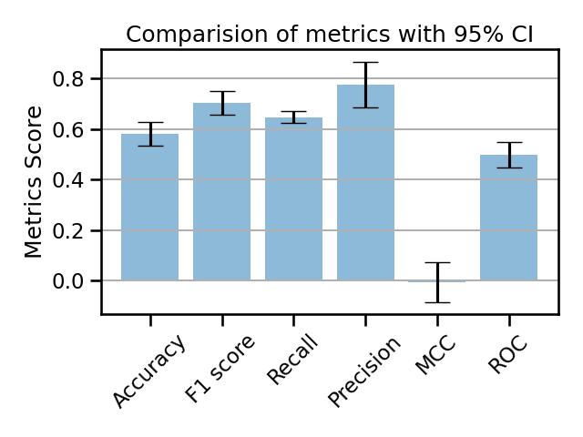
Heart Mass
3 Fold cross validation
Metrics | Train | Test
Accuracy | 0.72 | 0.58
F1 | 0.80 | 0.70
Recall | 0.74 | 0.64
Precision | 0.88 | 0.77
MCC | 0.36 | -0.006
ROC | 0.71 | 0.49

Slide 16
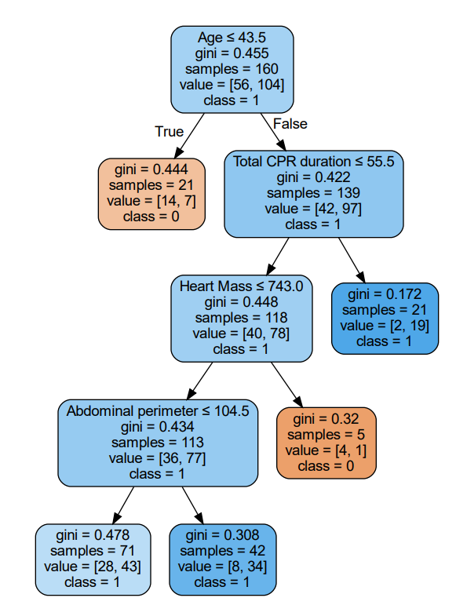
Significant variable with Heart Mass

Slide 17
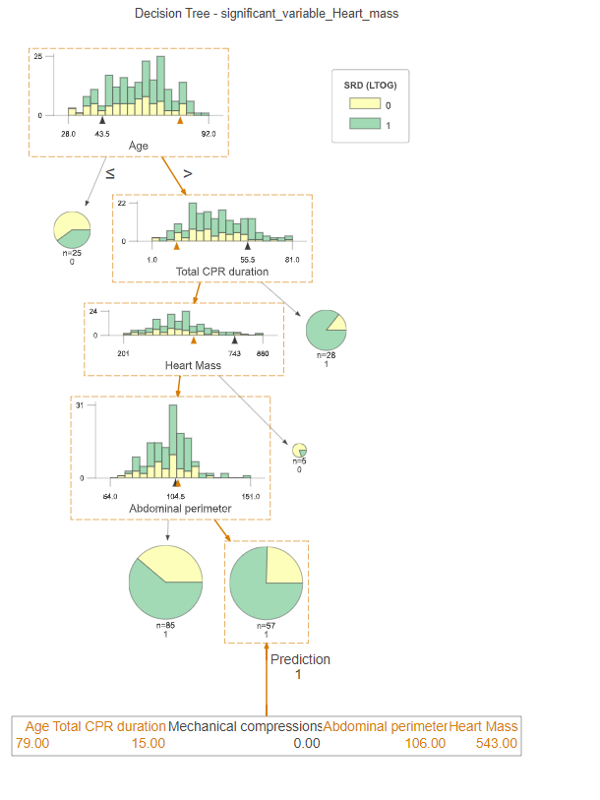
Significant variable with Heart Mass
Correct Prediction

Slide 18
Automatically selected

Slide 19
Automated Feature selection Methods
Pearson correlation
CHI2
Recursive feature elimination
Lasso logistic Regressor
Random Forest Regressor

Slide 20
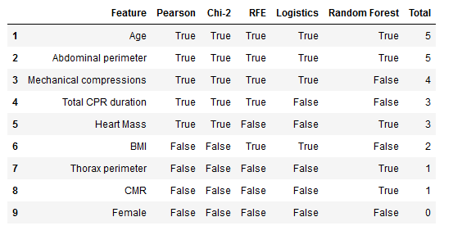
Automated selected feature table

Slide 21
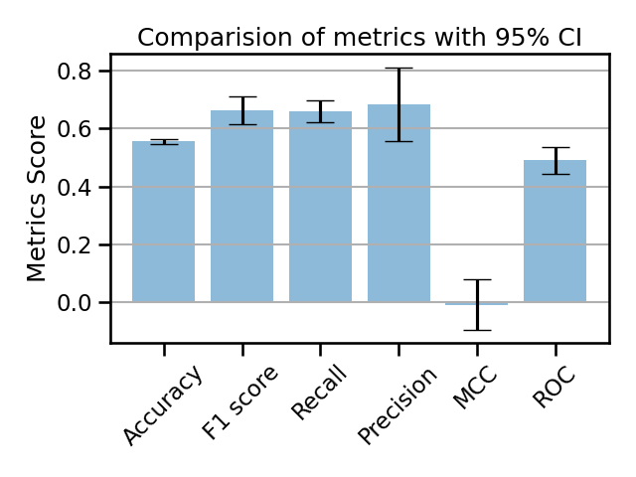
3 Fold cross validation
Metrics | Train | Test
Accuracy | 0.73 | 0.55
F1 | 0.79 | 0.66
Recall | 0.77 | 0.65
Precision | 0.83 | 0.68
MCC | 0.4 | -0.008
ROC | 0.71 | 0.49

Slide 22
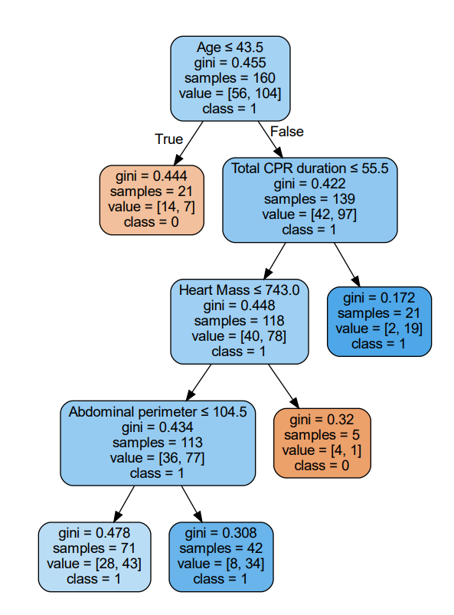
Automated

Slide 23
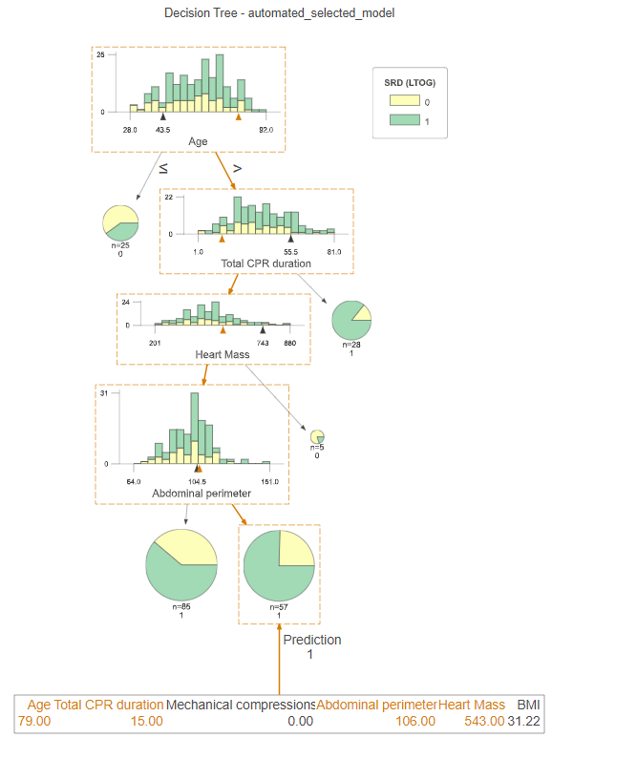
Automated
Correct Prediction

