Slide 1
ITC 122
WEB DESIGN
Part II & III

Slide 2
HTML - FONTS
Set Font Size
You can set content font size using size attribute. The range of accepted values is from 1(smallest) to 7(largest). The default size of a font is 3.
<!DOCTYPE html>
<html>
<head>
<title>Setting Font Size</title>
</head>
<body>
<font size = "1">Font size = "1"</font><br />
<font size = "2">Font size = "2"</font><br />
<font size = "3">Font size = "3"</font><br />
<font size = "4">Font size = "4"</font><br />
<font size = "5">Font size = "5"</font><br />
<font size = "6">Font size = "6"</font><br />
<font size = "7">Font size = "7"</font>
</body>
</html>

Slide 3
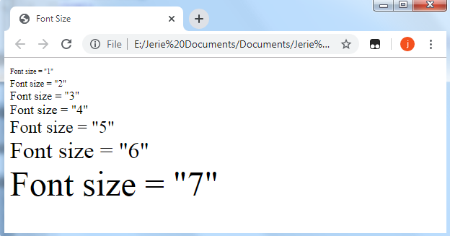
OUTPUT: Act10FontSize.html

Slide 4
HTML - FONTS
Setting Font Face
You can set font face using face attribute but be aware that if the user viewing the page doesn't have the font installed, they will not be able to see it.
<!DOCTYPE html>
<html>
<head>
<title>Font Face</title>
</head>
<body>
<font face = "Times New Roman" size = "5">Times New Roman</font><br>
<font face = "Verdana" size = "5">Verdana</font><br>
<font face = "Comic sans MS" size =" 5">Comic Sans MS</font><br>
<font face = "WildWest" size = "5">WildWest</font><br>
<font face = "Angels" size = "5">Angels</font><br>
</body>
</html>

Slide 5
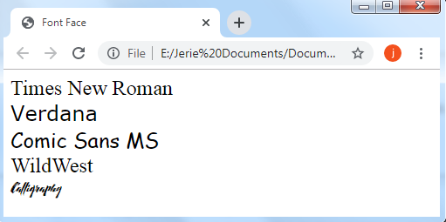
OUTPUT: Act11FontFace.html

Slide 6
HTML - FONTS
Setting Font Color
You can set any font color you like using color attribute. You can specify the color that you want by either the color name or hexadecimal code for that color.
<!DOCTYPE html>
<html>
<head>
<title>Setting Font Color</title>
</head>
<body>
<font color = "#FF00FF">This text is in pink</font><br>
<font color = "red">This text is red</font>
</body>
</html>

Slide 7
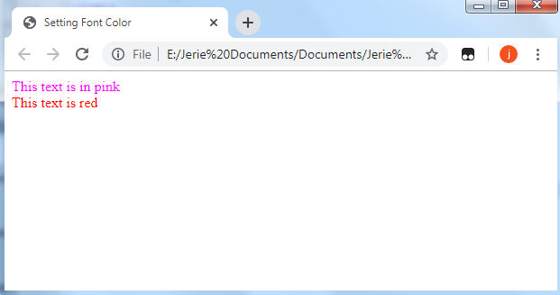
OUTPUT: Act12FontColor.html

Slide 8
HTML - PHRASE TAGS
Emphasized Text
Anything that appears within <em>...</em> element is displayed as emphasized text.
<!DOCTYPE html>
<html>
<head>
<title>Emphasized Text Example</title>
</head>
<body>
<p>The following word uses an <em>emphasized</em> typeface.</p>
</body>
</html>

Slide 9
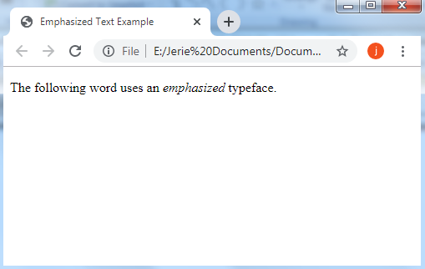
OUTPUT: Act13Emphasized.html

Slide 10
HTML - PHRASE TAGS
Marked Text
Anything that appears with-in <mark>...</mark> element, is displayed as marked with yellow ink.
<!DOCTYPE html>
<html>
<head>
<title>Marked Text Example</title>
</head>
<body>
<p>The following word has been <mark>marked</mark> with yellow</p>
</body>
</html>

Slide 11
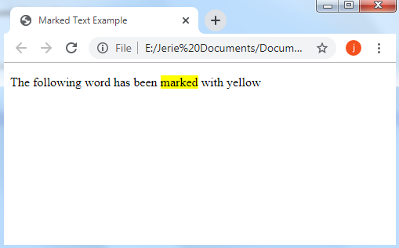
OUTPUT: Act14MarkedText.html

Slide 12
HTML - PHRASE TAGS
Text Direction
The <bdo>...</bdo> element stands for Bi-Directional Override and it is used to override the current text direction.
<!DOCTYPE html>
<html>
<head>
<title>Text Direction Example</title>
</head>
<body>
<p>This text will go left to right.</p>
<p><bdo dir = "rtl">This text will go right to left.</bdo></p>
</body>
</html>

Slide 13
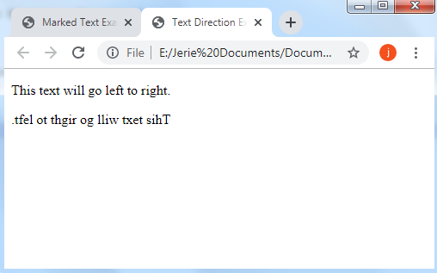
OUTPUT: Act15BDO.html

Slide 14
HTML - PHRASE TAGS
Short Quotations
The <q>...</q> element is used when you want to add a double quote within a sentence.
<!DOCTYPE html>
<html>
<head>
<title>Double Quote Example</title>
</head>
<body>
<p>Amit is in Spain, <q>I think I am wrong</q>.</p>
</body>
</html>

Slide 15
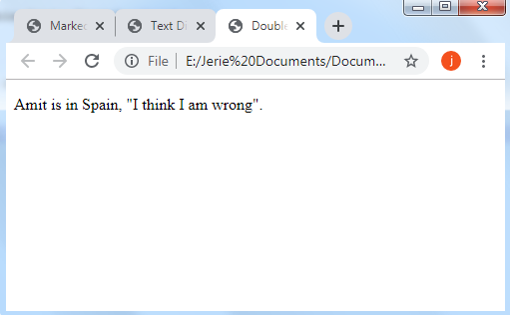
OUTPUT: Act16Qoute.html

Slide 16
HTML - PHRASE TAGS
Computer Code
Usually the content of the <code>...</code> element is presented in a monospaced font, just like the code in most programming books.
<!DOCTYPE html>
<html>
<head>
<title>Computer Code Example</title>
</head>
<body>
<p>Regular text. <code>This is code.</code> Regular text.</p>
</body>
</html>

Slide 17
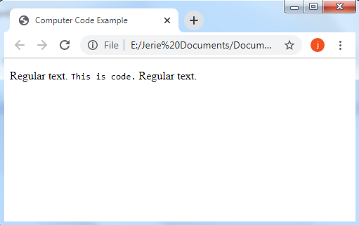
OUTPUT: Act17Code.html

Slide 18
HTML - PHRASE TAGS
Address Text
The <address>...</address> element is used to contain any address.
<!DOCTYPE html>
<html>
<head>
<title>Address Example</title>
</head>
<body>
<address>388A, Road No 22, Jubilee Hills - Hyderabad</address>
</body>
</html>

Slide 19
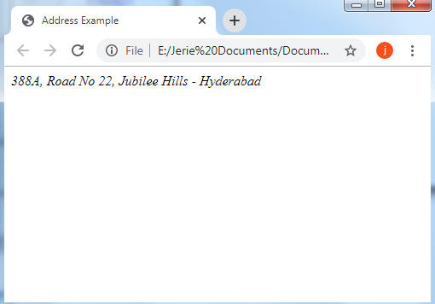
OUTPUT: Act18Address.html

Slide 20
HTML - IMAGES
Insert Image
You can insert any image in your web page by using <img> tag.
<img src = "/html/images/test.png" alt = "Test Image" />
The <img> tag is an empty tag, which means that, it can contain only list of attributes and it has no closing tag.
The alt attribute is a mandatory attribute which specifies an alternate text for an image, if the image cannot be displayed.

Slide 21
HTML - IMAGES
<!DOCTYPE html>
<html>
<head>
<title>Using Image in Webpage</title>
</head>
<body>
<p>Simple Image Insert</p>
<img src = "chiefs.jpg" alt = "will show if the image is not found" />
</body>
</html>

Slide 22

OUTPUT: Act19Image.html

Slide 23
HTML - IMAGES
Set Image Width/Height
You can set image width and height based on your requirement using width and height attributes.
<!DOCTYPE html>
<html>
<head>
<title>Set Image Width and Height</title>
</head>
<body>
<p>Setting image width and height</p>
<img src = "chiefs.jpg" alt = " Arellano Chiefs" width = "150" height = "100"/>
</body>
</html>

Slide 24
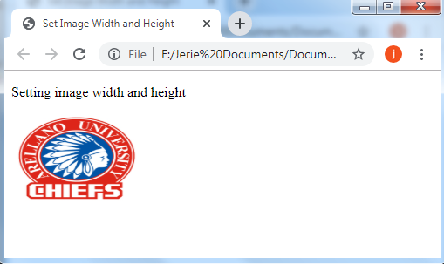
OUTPUT: Act20ImageSize.html

Slide 25
HTML - IMAGES
Set Image Border
By default, image will have a border around it, you can specify border thickness in terms of pixels using border attribute. A thickness of 0 means, no border around the picture.
<!DOCTYPE html>
<html>
<head>
<title>Set Image Border</title>
</head>
<body>
<p>Setting image Border</p>
<img src = chiefs.jpg " alt = "Arellano Chief" border = "3"/>
</body>
</html>

Slide 26
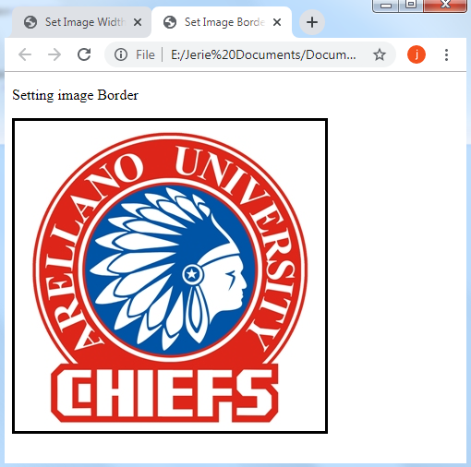
OUTPUT: Act21ImageBorder.html

Slide 27
HTML - IMAGES
Set Image Alignment
By default, image will align at the left side of the page, but you can use align attribute to set it in the center or right.
<!DOCTYPE html>
<html>
<head>
<title>Set Image Alignment</title>
</head>
<body>
<p>Setting image Alignment</p>
<img src = "chiefs.jpg" alt = "Arellano Chief" border = "3" align = "right"/>
</body>
</html>

Slide 28

OUTPUT: Act22ImageAlignment.html

Slide 29
HTML - IMAGE LINKS
<!DOCTYPE html>
<html>
<head>
<title>Image Hyperlink Example</title>
</head>
<body>
<p>Click following link</p>
<a href = "https://www.arellano.edu.ph/" target = "_self">
<img src = "chiefs.jpg" alt = "Arellano University" border = "0"/>
</a>
</body>
</html>

Slide 30

OUTPUT: Act23ImageLink.html

Slide 31
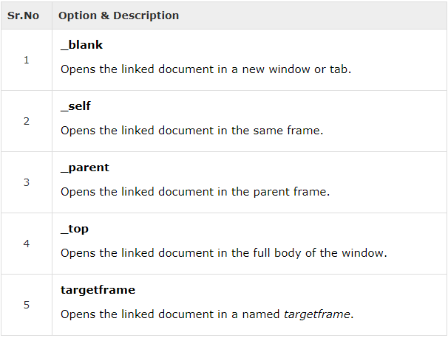
HTML - LINKS
The target Attribute
We have used target attribute in our previous example. This attribute is used to specify the location where linked document is opened. Following are the possible options −

Slide 32
HTML – LINKS
Act23links.html
<!DOCTYPE html>
<html>
<head>
<title>Hyperlink Example</title>
<base href = "www.arellano.edu.ph//">
</head>
<body>
<p>Click any of the following links</p>
<a href = "https://www.arellano.edu.ph/" target = "_blank">Opens in New</a> |
<a href = "https://www.arellano.edu.ph/" target = "_self">Opens in Self</a> |
<a href = "https://www.arellano.edu.ph/" target = "_parent">Opens in Parent</a> |
<a href = "https://www.arellano.edu.ph/" target = "_top">Opens in Body</a>
</body>
</html>

Slide 33
HTML - MARQUEES
An HTML marquee is a scrolling piece of text displayed either horizontally across or vertically down your webpage depending on the settings.
Act24Marquee.html
<!DOCTYPE html>
<html>
<head>
<title>HTML marquee Tag</title>
</head>
<body>
<marquee>This is basic example of marquee</marquee>
</body>
</html>

Slide 34
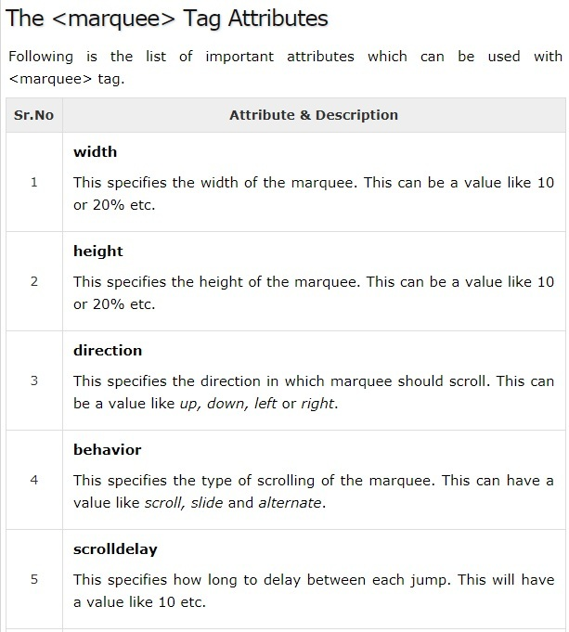

Slide 35
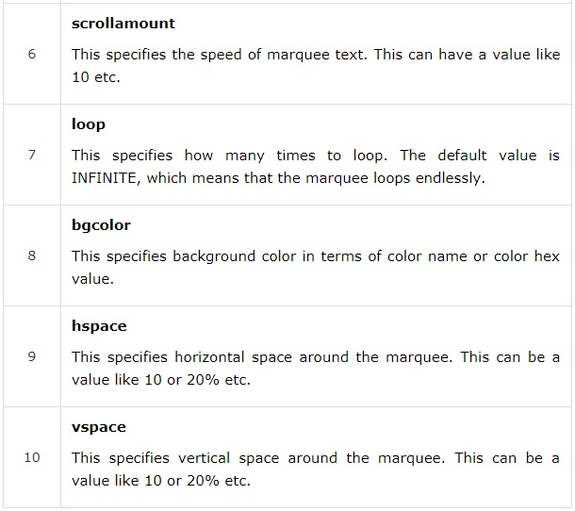

Slide 36
HTML - MARQUEES
Act25MarqBehavior.html
<!DOCTYPE html>
<html>
<head>
<title>HTML marquee Tag</title>
</head>
<body>
<marquee behavior="scroll" direction="left" scrollamount="3">Slow speed scroll speed</marquee>
<marquee behavior="scroll" direction="right" scrollamount="10">Medium speed scroll speed</marquee>
<marquee behavior="scroll" direction="up" scrollamount="17">Fast speed scroll speed</marquee>
</body>
</html>

Slide 37
HTML - MARQUEES
Act26MarqBgcolor.html
<!DOCTYPE html>
<html>
<head>
<title>HTML marquee Tag</title>
</head>
<body>
Arellano University<marquee bgcolor=YELLOW>Chiefs</marquee>
Arellano University<marquee VSPACE=50 bgcolor=RED>Chiefs</marquee>
Arellano University<marquee HSPACE=50 bgcolor=RED>Chiefs</marquee>
</body>
</html>

Slide 38
END OF LESSON II

