Slide 1
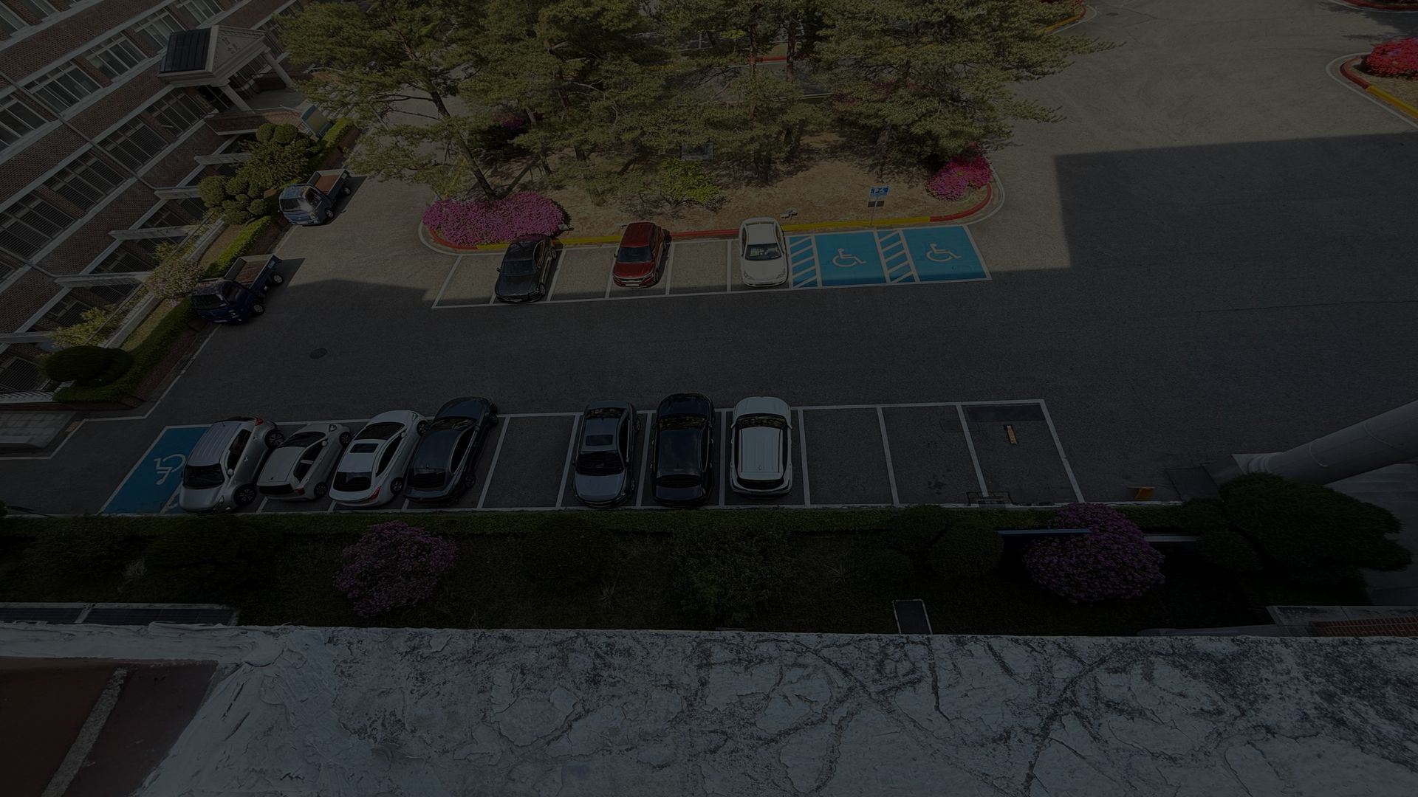

SMART PARKING
Monitoring & Prediction System
KDU Global Campus
Real-time vehicle detection using
Computer Vision & YOLOv8
Department of Smart Computing | Spring 2026 | Supervisor: Dr. Ghulam Sarwar

Slide 2

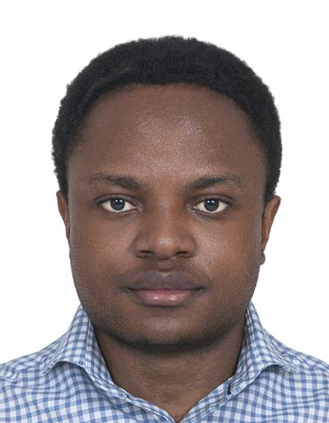

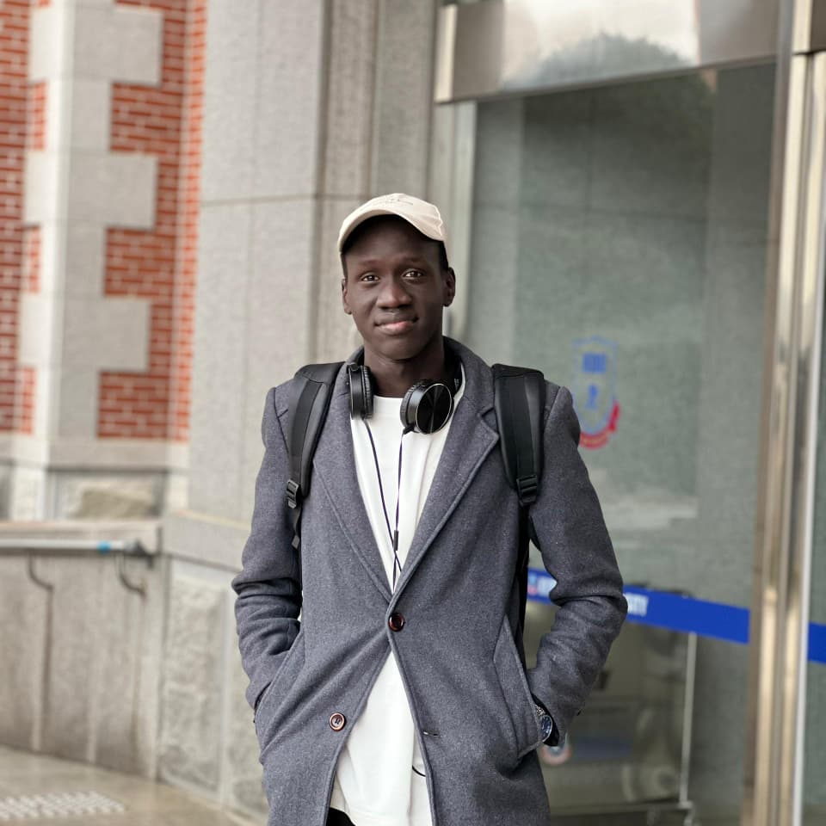



Meet Our Team
Alingilya Crispin
Njewa
Rai Chhenwi
Hang
Agot John
Ngor Majok
Team Lead
Designer
Developer
2517116
2517104
2517047
Hellah
Audrey
Le Tri
Thanh
Tharu
Roshan
Text editor
Developer
Developer
2417263
2517105
2517120

Slide 3
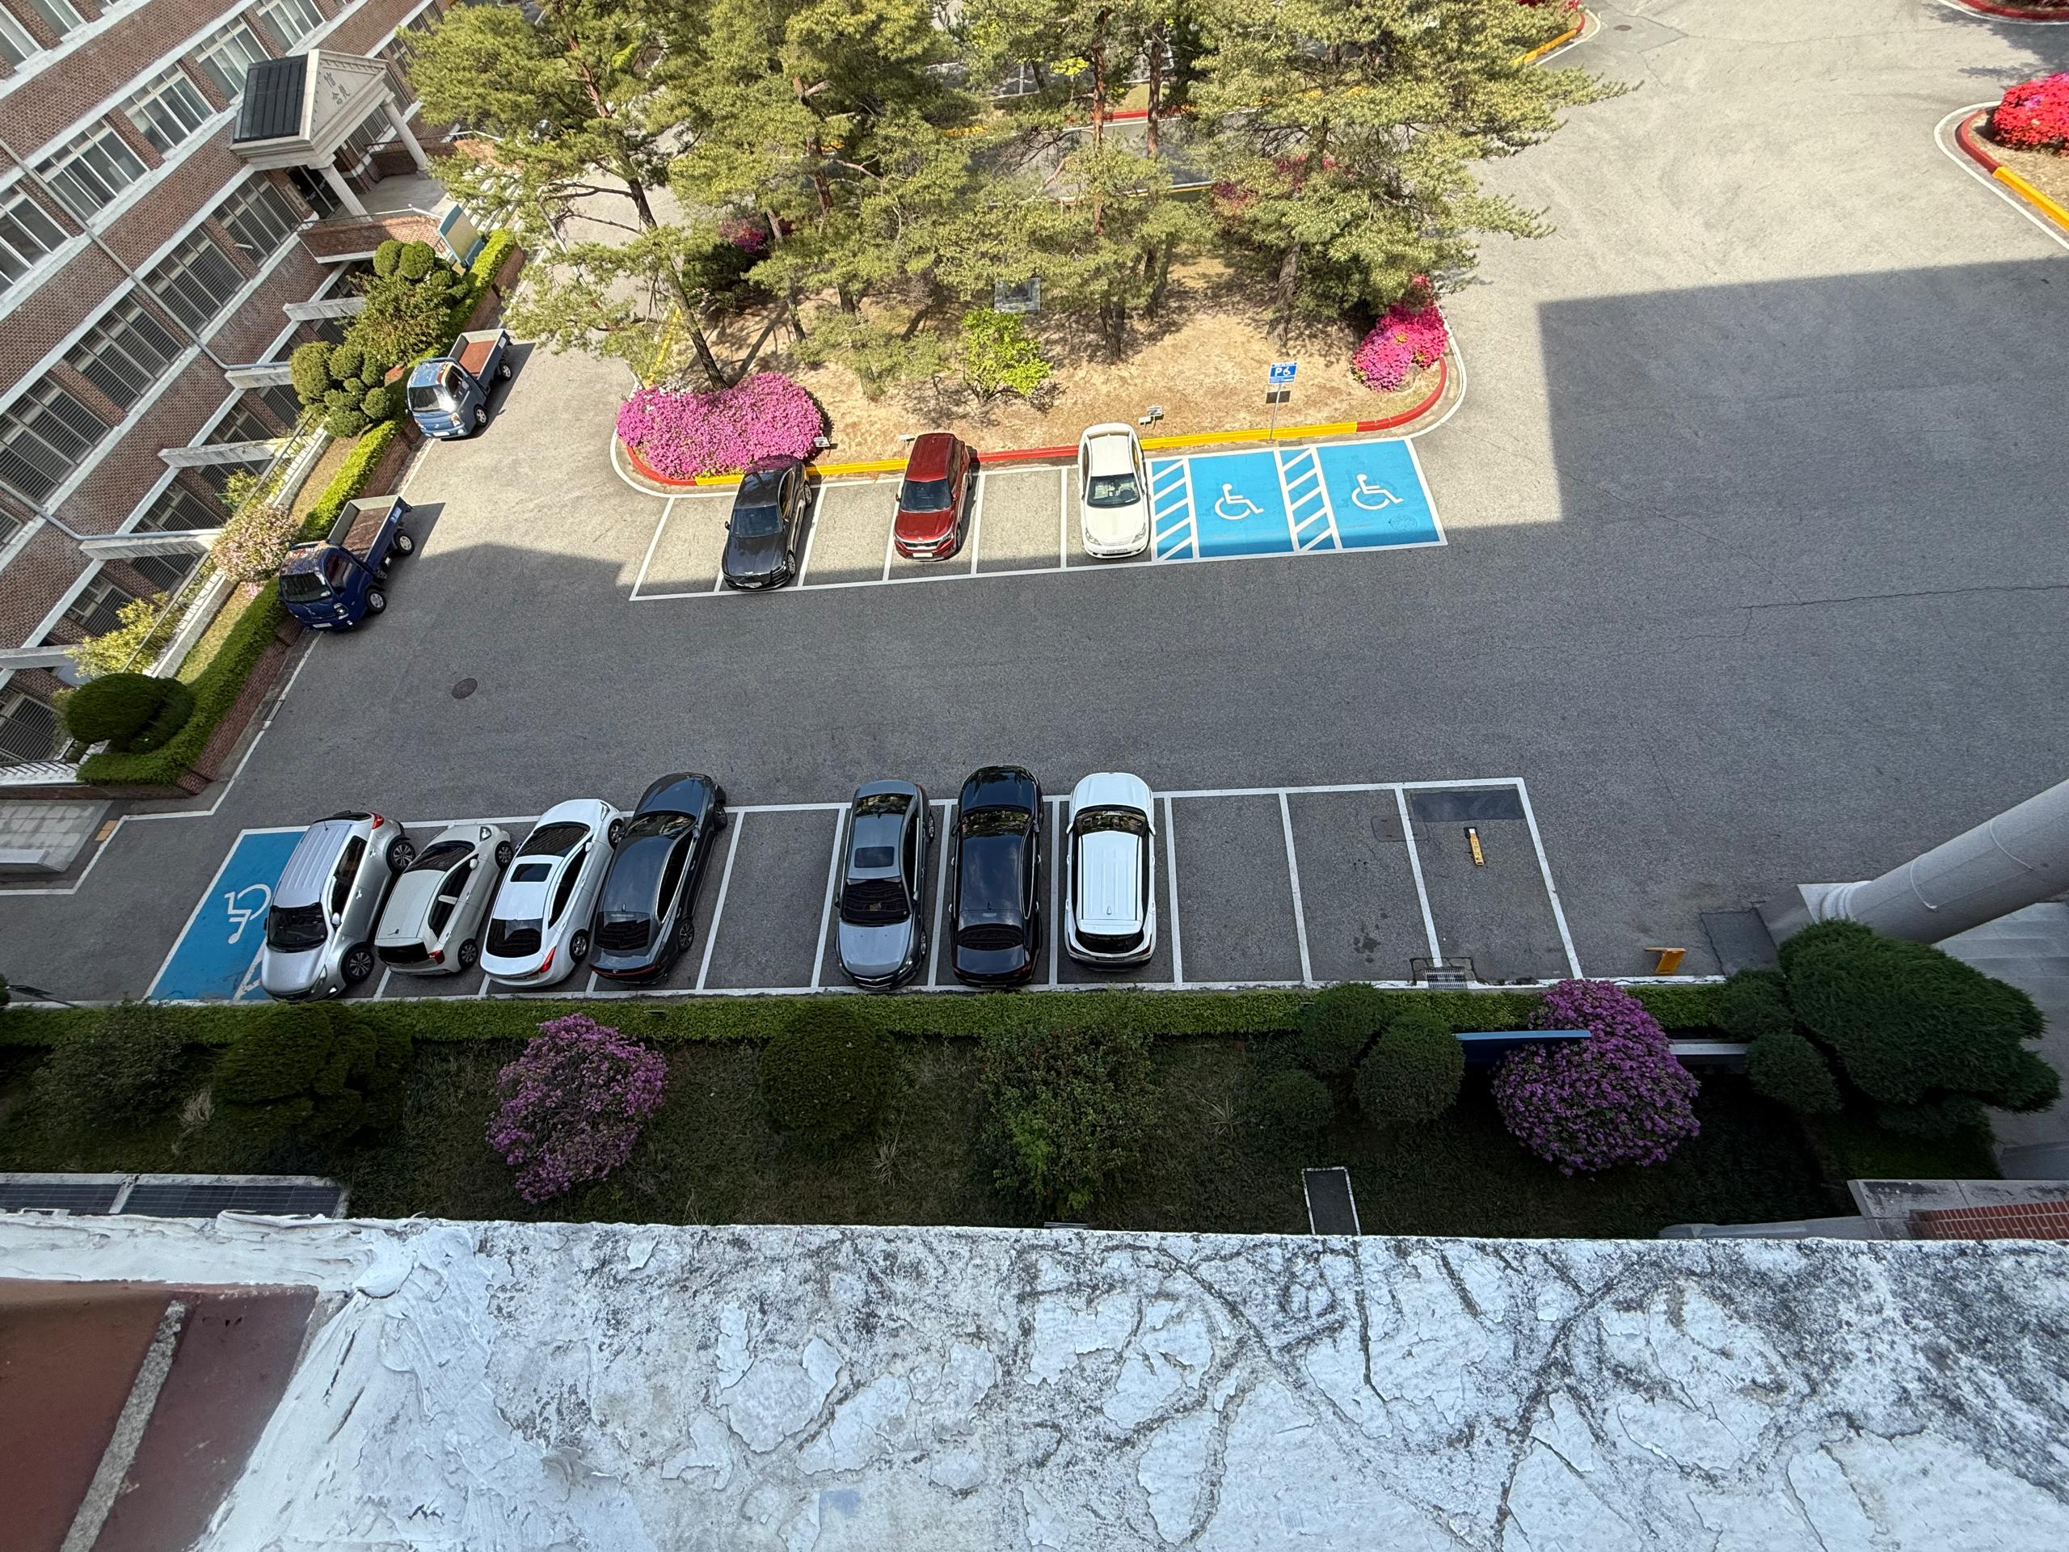





The Problem
Time Wasted
Drivers spend 10+ min searching for available spots
No Real-Time Data
No system to show current parking availability
Finding parking
should not be
this hard
No Predictions
Cannot forecast when spaces will become free
Costly Sensors
Traditional sensor systems are expensive to install

Slide 4




Our Solution
A complete vision-based intelligent parking management system
Camera
Input
YOLOv8
Detection
Smart
Predictions
Live
Dashboard
Uses existing
cameras — no
expensive sensors
Real-time AI
vehicle detection
with 90%+ accuracy
ML forecasting
of future parking
availability
Web interface
showing real-time
slot status

Slide 5







Technology Stack
Python 3.12
OpenCV 4.10
YOLOv8
NumPy / Pandas
Core language
Video processing
Object detection
Data handling
scikit-learn
Streamlit
Git / GitHub
VS Code
ML predictions
Dashboard UI
Version control
IDE

Slide 6



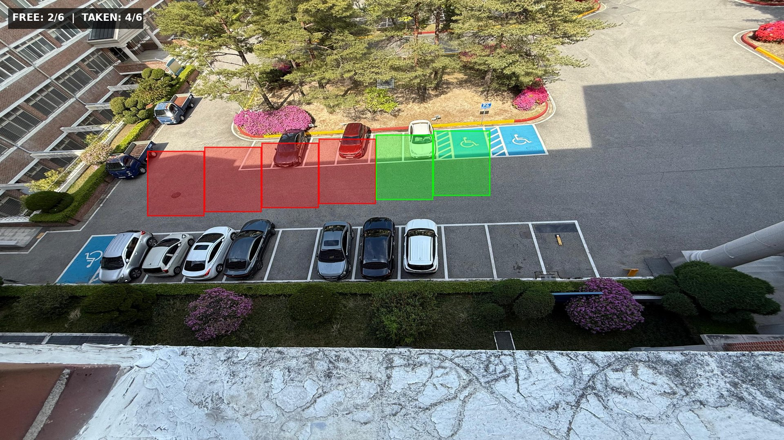
How It Works
1
2
3
4
5
Capture
Frame
YOLOv8
Detect
Overlap
Check
Stability
Filter
Display
Result
Detection Output Preview
= FREE slot
= OCCUPIED slot
= Vehicle detected

Slide 7



Key Numbers
17
30
1080p
0.4+
Parking Slots
Defined
Frames Per
Second
Video
Resolution
Confidence
Threshold
5
YOLOv8m
33s
3
Stability
Buffer Frames
Detection
Model
Video
Duration
Vehicle Classes
(car/bus/truck)

Slide 8

Progress Tracker
1
2
3
4
5
6
7
Environment Setup
Data Collection
Slot Definition (17)
YOLOv8 Detection
Prediction Module
Dashboard UI
Testing
57% Complete — 4 of 7 steps done
Completed: Python environment, video frame extraction, 17 parking slot ROIs defined, YOLOv8 real-time vehicle detection with stability buffer

Slide 9
Challenges & Solutions
OpenCV GUI not supported
Switched to full OpenCV 4.10
NumPy 2.x version conflict
Matched OpenCV to NumPy 2
Detection flickering
5-frame stability buffer
Slow video processing
Process every 3rd frame
Camera shake/instability
Fixed camera recommended

Slide 10


What's Next
5
Prediction Module
Log occupancy timestamps to CSV, train Random Forest model to predict future parking availability based on time-of-day and historical patterns
6
Dashboard UI
Build Streamlit web app with real-time parking map, occupancy charts, and prediction visualizations accessible from any device
7
Testing & Evaluation
Unit tests, detection accuracy metrics (mAP, precision, recall), manual testing tables, and final project report documentation

Slide 11
Thank You!
Questions & Discussion
KDU Global Campus | Smart Computing | Spring 2026

