Slide 1
1st ASP.NET Core App
IIS
dotnet .\app
w3wp.exe
HTTP
Kestrel Web Server port: 12344
http://site1.com:80
HTTP
AspNetCoreModule
2nd ASP.NET Core App
dotnet .\app.dll
Kestrel Web Server port: 12345
w3wp.exe
HTTP
HTTP
http://site2.com:80 http://site3.com:80
3rd ASP.NET Core App
AspNetCoreModule
HTTP
dotnet .\app.dll
Kestrel Web Server port: 12346

Slide 2
1st ASP.NET Core App
IIS
dotnet .\app
w3wp.exe
HTTP
Kestrel Web Server port: 12344
http://site1.com:80
HTTP
AspNetCoreModuleV2
2nd ASP.NET Core App
dotnet .\app.dll
Kestrel Web Server port: 12345
w3wp.exe
HTTP
HTTP
http://site2.com:80 http://site3.com:80
3rd ASP.NET Core App
AspNetCoreModule
HTTP
dotnet .\app.dll
Kestrel Web Server port: 12346

Slide 3
IIS
w3wp.exe (Application Pool)
port :80 or :443
1st ASP.NET App
2nd ASP.NET App
HTTP
YourWebApp.dll
YourWebApp2.dll
w3wp.exe (Application Pool)
port :80 or :443
HTTP
3rd ASP.NET App
4th ASP.NET App
YourWebApp3.dll
YourWebApp4.dll

Slide 4
.NET today—app models and libraries
.NET FRAMEWORK
.NET CORE
XAMARIN
APP
MODELS
ASP.NET Core
WPF
Windows Forms
iOS
Android
ASP.NET
Universal Apps
OS X
BASE
LIBRARIES
Base Class Library
.NET Core Library
Mono Class Library
COMMON INFRASTRUCTURE
Compilers
Languages
Runtime components
Command Line

Slide 5
.NET tomorrow
.NET FRAMEWORK
.NET CORE
XAMARIN
WPF
Windows Forms
ASP.NET Core
iOS
Android
ASP.NET
OS X
Universal Apps
.NET STANDARD LIBRARY
One library to rule them all
COMMON INFRASTRUCTURE
Compilers
Languages
Runtime components
Command Line

Slide 6
ASP.NET Core Build 2016 Updates
Jeff Fritz
Program Manager .NET
@csharpfritz

Slide 7
Exciting times ahead for .NET
Multi-purpose, comprehensive framework for desktop and web applications
Modern DEVICE EXPERIENCES
Universal Windows platform
Unified development across Windows devices
XAMARIN
Extend your reach to any device with .NET
.NET FRAMEWORK
Modern CLOUD EXPERIENCES
.NET CORE
Cross-platform, high performance .NET
ASP.NET Core
Cloud optimized framework for micro services

Slide 8
.NET today—the family gets bigger
.NET CORE
.NET FRAMEWORK
XAMARIN
Platform for .NET applications on Windows
Cross-platform and open source Mono-based runtime for iOS, OS X, and Android devices
Cross-platform and open source framework optimized for modern app needs and developer workflows
Distributed with
Windows
Distributed with app
Distributed with app

Slide 9
.NET today—reusing code
.NET FRAMEWORK
.NET CORE
XAMARIN
APP
MODELS
My code
BASE
LIBRARIES
Implementation 3
Reference implementation
Implementation 2
Implementation 1
PCL reference assemblies
COMMON INFRASTRUCTURE
Compilers
Languages
Runtime components

Slide 10
.NET today—challenges
Developers
Key API’s are not present on all platforms
Different implementations on each platform
Need to target a small common denominator to reuse code
Need to master 3+1 base class libraries
Platforms
Need implementations of new capabilities on each platform
Need to align with different ship cycles (e.g., Windows for .NET Framework)

Slide 11
.NET tomorrow—reusing code
.NET FRAMEWORK
.NET CORE
XAMARIN
Reference implementations
Full implementations
My code
COMMON INFRASTRUCTURE
Compilers
Languages
Runtime components

Slide 12
.NET standard libraries—advantages
Developers
Same API’s available on all platforms
Master one library not a platform
Big surface area—no small common denominator
Platforms
.NET Standard can grow without updating platforms
Fast innovation on libraries, common infrastructure, and tools

Slide 13

.NET future innovation
App Model Innovation
.NET FRAMEWORK
.NET CORE
XAMARIN
TOOLS
WPF
Windows Forms
UWP
iOS
Android
ASP.NET
ASP.NET Core
OS X
*
Visual Studio
.NET Innovation
.NET STANDARD LIBRARY
One library to rule them all
Visual Studio
Code
COMMON INFRASTRUCTURE
Compilers
Languages
Runtime components

Slide 14
.NET Standard Library
1.0
.NET Core
.NET 4.5+
UWP
Win Store
Win Phone
WinPhone SL
Xamarin
Mono
1.1
.NET Core
.NET 4.5+
UWP
Win Store
Win Phone
Xamarin
Mono
1.2
.NET Core
.NET 4.5.x+
UWP
Win Store 8.1
Win Phone
WinPhone SL
Xamarin
Mono
1.3
.NET Core
.NET 4.6+
UWP
Xamarin
Mono
1.4
.NET Core
.NET 4.6.1+
UWP
Xamarin
1.5
.NET Core
.NET 4.6.2

Slide 15

Developed in the open
Fully open development process
Open Source
Open to community contributions
Open process: roadmap, design docs, standups…
+ Great community momentum
175 repositories
24,061 forks
4,297 contributors
http://dotnet.github.io
= Amazing results
1.15 Million requests/second!
New performance record for .NET Core
6x node.js performance
~40% performance gains contributed by community

Slide 16




.NET Compiler Platform ("Roslyn")
MVVM Light Toolkit
MSBuild
ASP.NET MVC
IdentityManager
ASP.NET Core
MEF
.NET Core
.NET SDK for Hadoop
.NET Micro Framework
Kudu
Cecil
Mimekit
Mono
Mailkit
Xamarin.Auth
Umbraco
Open Live Writer
NuGet
WorldWide Telescope
Couchbase Lite for .NET
ASP.NET Web Pages
Microsoft Azure SDK for .NET
ASP.NET SignalR
WCF
Openness
Community
Rapid innovation
LLILC
Xamarin SDK
Entity Framework
Open XML SDK
IdentityServer
Microsoft Azure WebJobs SDK
Microsoft Web Protection Library
OWIN Authentication Middleware
Orchard CMS
ProtoBuild
ASP.NET Web API
System.Drawing
Orleans
ASP.NET AJAX Control Toolkit
Prism
Xamarin.Mobile
Salesforce Toolkits for .NET
Protection
Practices
Visibility
Support
Licenses
Copyrights
Trademarks
Patents
Mentorship
Governance
Feedback
Co-ordination
Media
Branding
Events
Hosting
Code signing
CLA Management
Swag

Slide 17



ASP.NET 4.6 and ASP.NET Core 1.0
ASP.NET 4.6 System.Web
ASP.NET Core 1.0
.NET Framework 4.6
.NET Core 1.0
Full .NET Framework for any scenario and
library support on Windows
Modular libraries & runtime optimized for server and cloud workloads
Compilers and runtime components
(.NET Compiler Platform: Roslyn, C#, VB, F#, RyuJIT, SIMD)

Slide 18


ASP.NET Core and the Modern Web
Totally Modular
Faster Development Cycle
Seamless transition from on-premises to cloud
Choose your Editors
and Tools
Open Source with Contributions
OSS
Cross-Platform
Fast

Slide 19
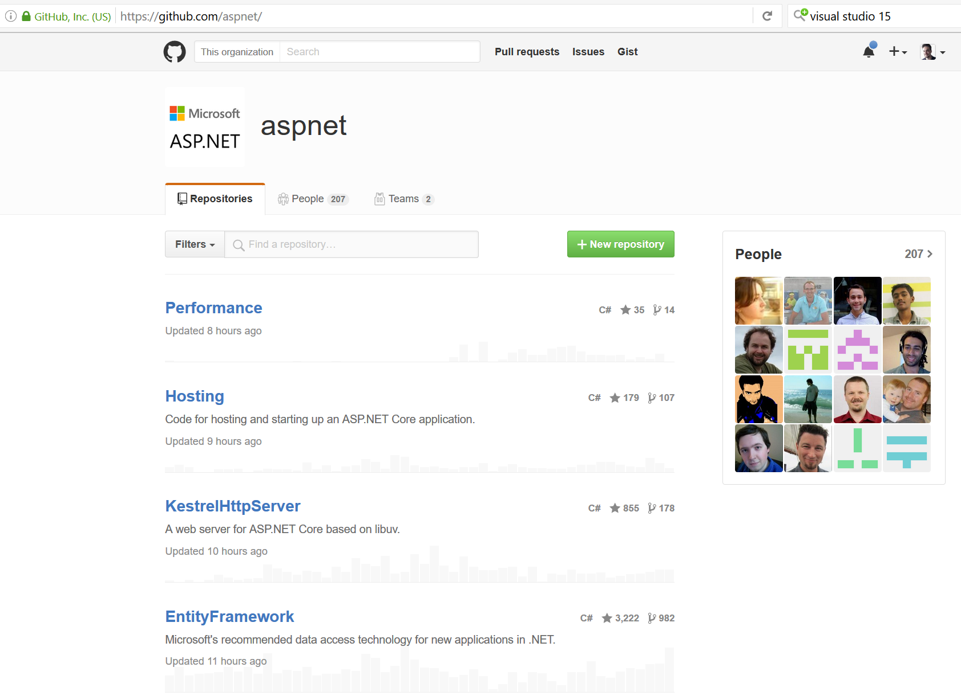
Open Source…. No really!

Slide 20
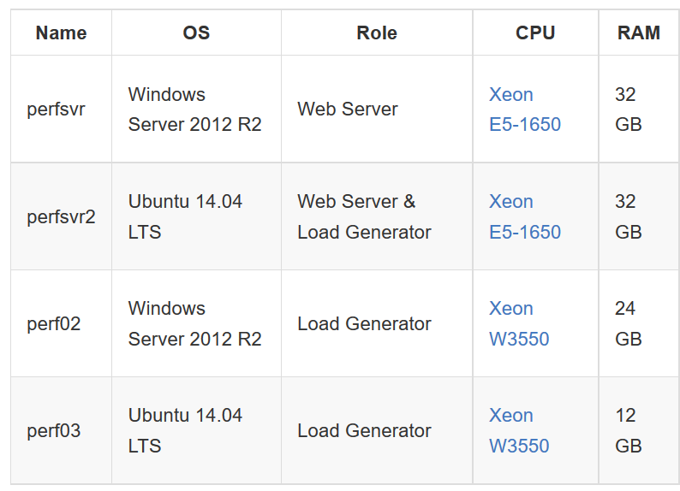
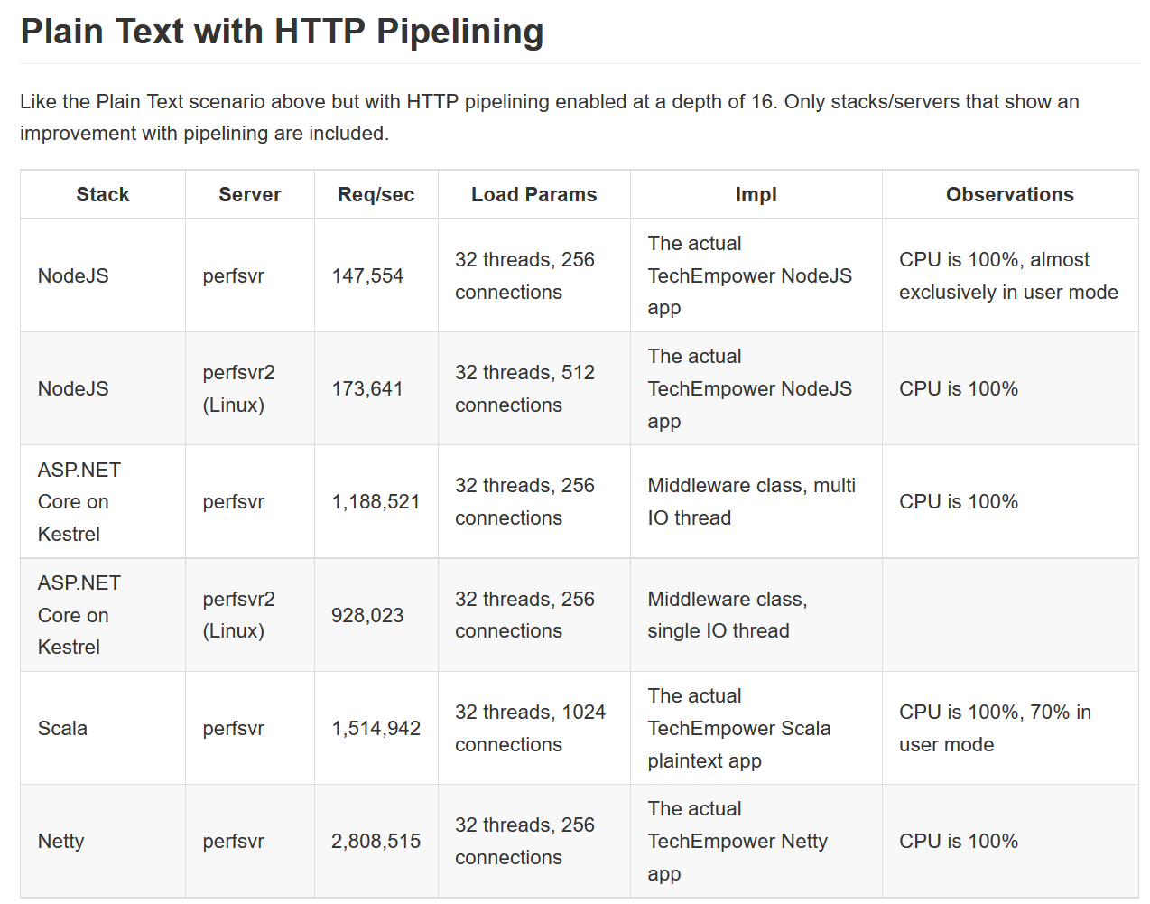
Performance that matters
Source: github.com/aspnet/benchmarks

Slide 21
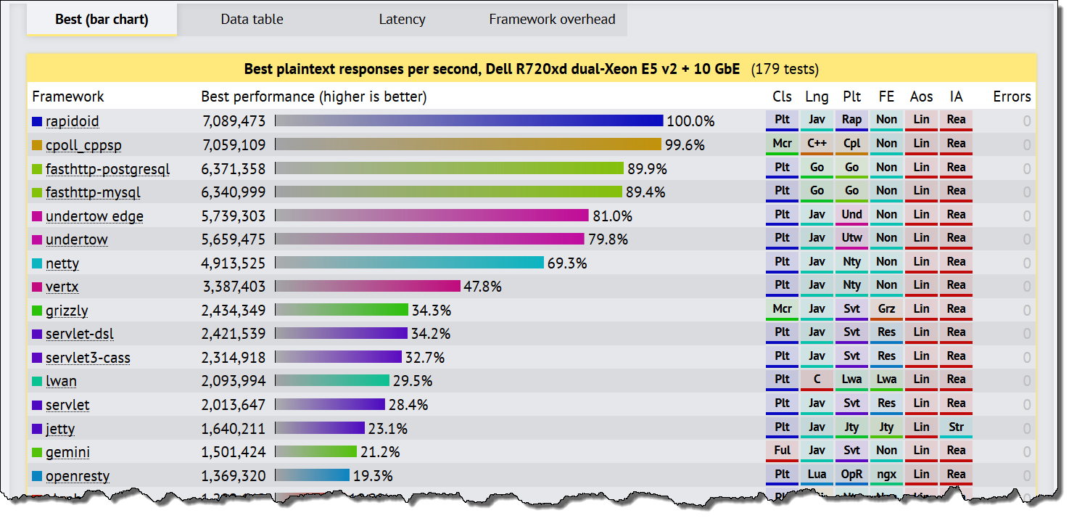
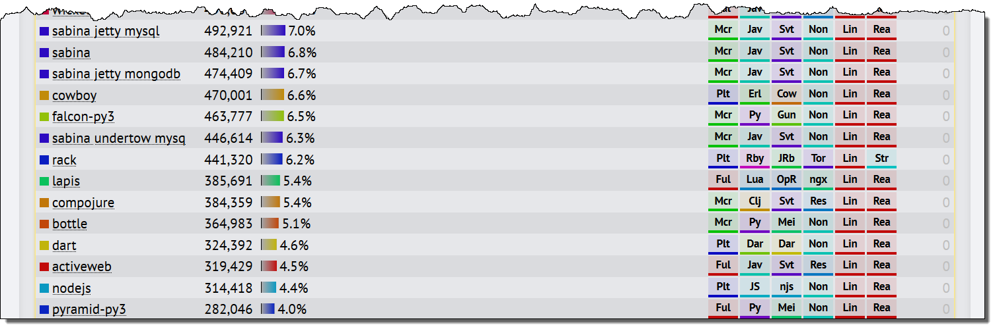
TechEmpower Benchmarks

Slide 22
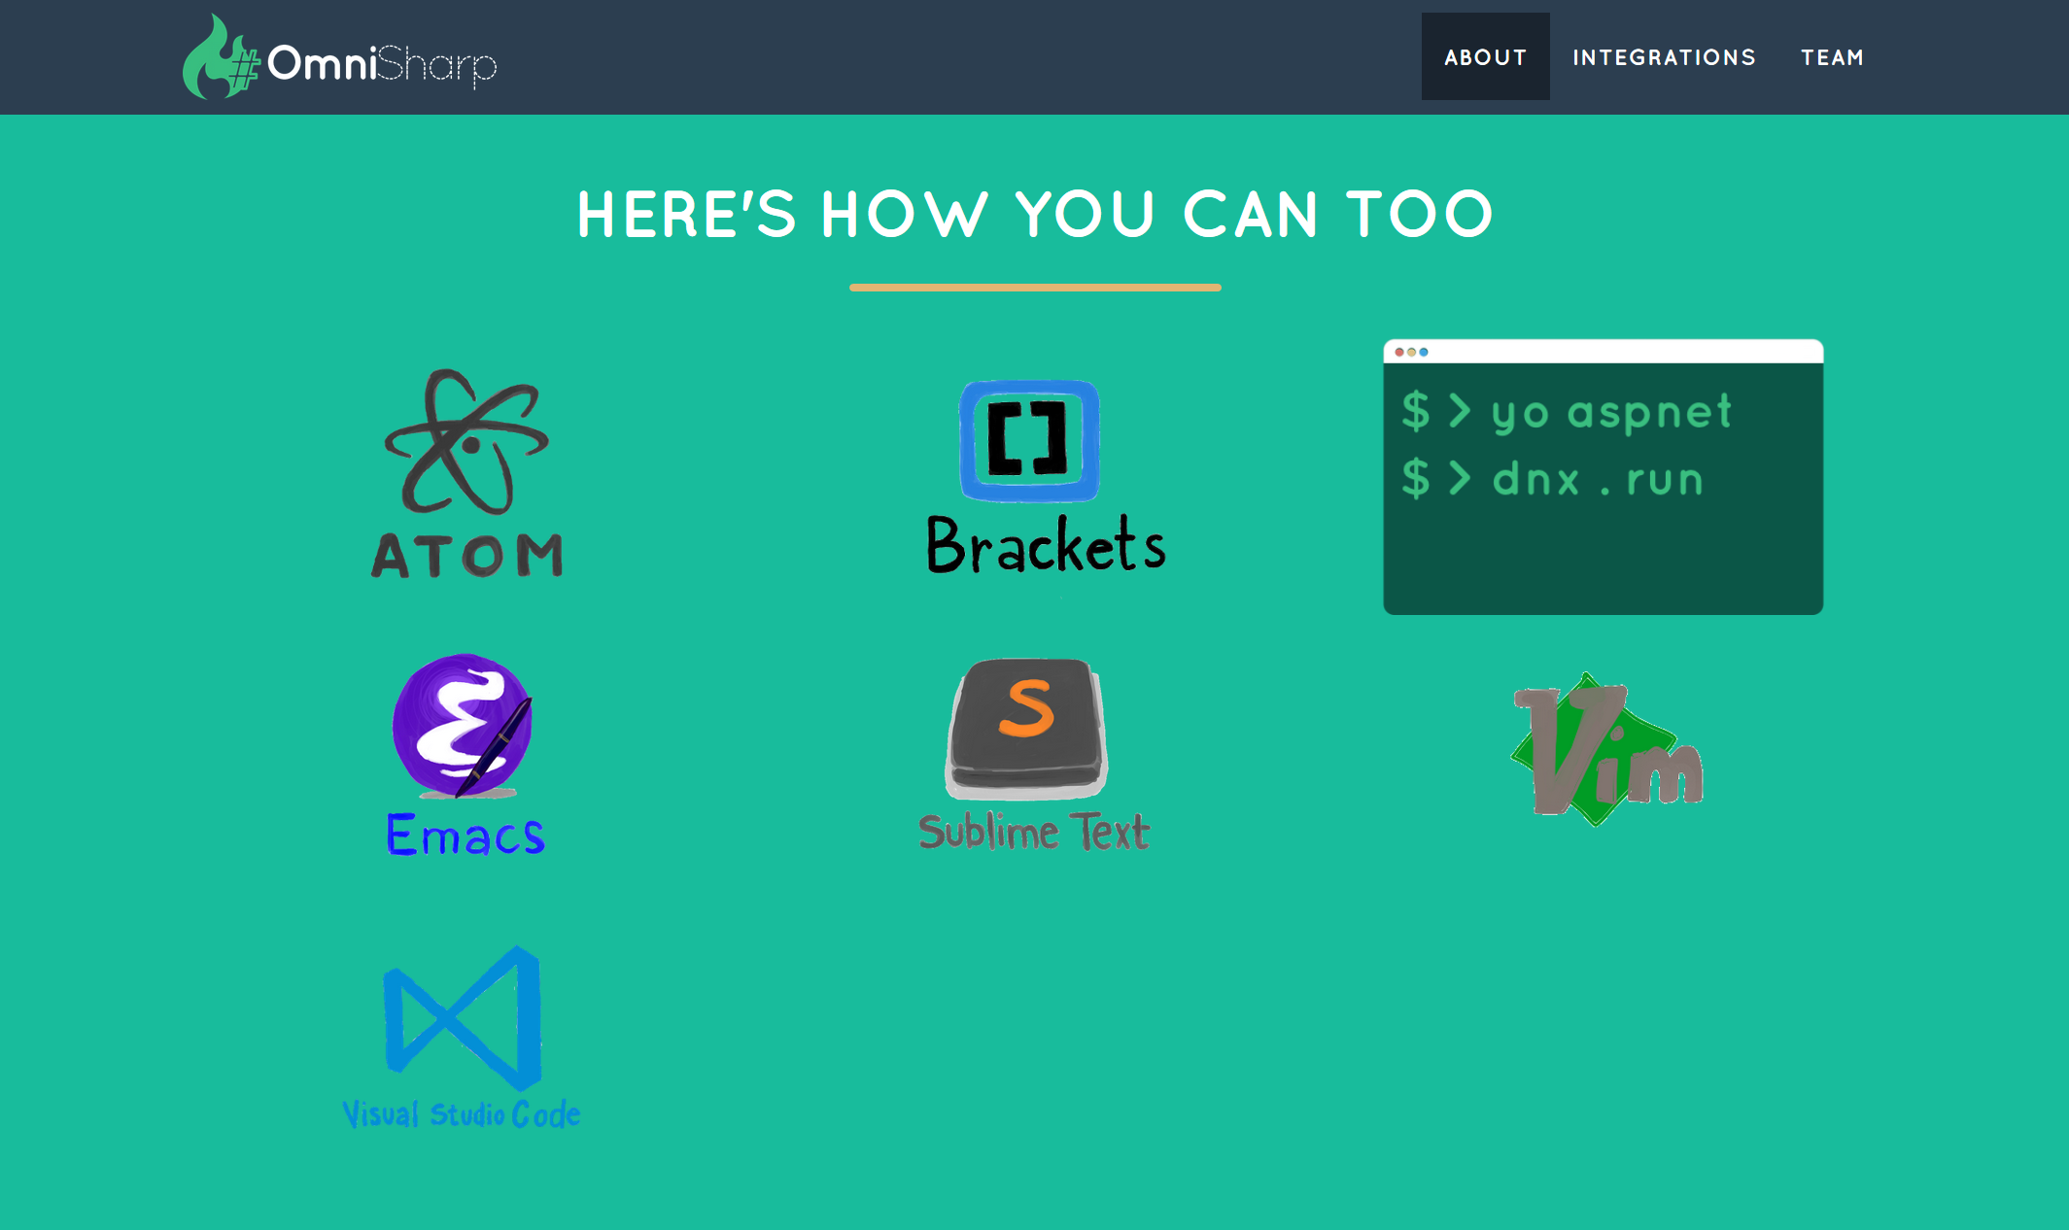

Slide 23
.NET Core
New OSS and x-plat .NET runtime and library
Introducing NET Standard
“.NET Core CLI”—for compiling and publishing apps
Supports app-local, shared framework, and Docker deployment
High performance, including native compilation

Slide 24
ASP.NET Core
ASP.NET Core builds on top of .NET Core
Single framework, for web, services, and microservices
Middle-ware pipeline, enabling you to inject as little or much functionality as needed
Fully integrates with CLI tooling and the shared framework
Takes advantage of .NET Core performance and include a very high performance web server, built on LibUV

Slide 25
Demo
.NET Core

Slide 26
Recap
Great time to be a .NET Developer
With .NET you can build (ANYTHING)
Windows Desktop Applications (Win 7, Win 8, Win 8.1, Win 10+)
Windows Universal Apps (Desktop, Tablet, Mobile)
Server Applications (Windows, Linux)
Device Application (iOS and Android)

Slide 27
Resources
Get it NOW! get.asp.net
Learn more: docs.asp.net
Open source: github.com/aspnet/home
Watch: live.asp.net
Blog: blogs.msdn.com/webdev
Jeff: twitter.com/csharpfritz
jeffreyfritz.com
Learn at wintellectnow.com CODE: FRITZ-2016

