Slide 1


Slide 2
Agenda
What is PureScript?
Why PureScript?
Examples

Slide 3
What is PureScript?
A small strongly typed programming language with expressive types that compiles to Javascript, written in and inspired by Haskell.
www.purescript.org

Slide 4
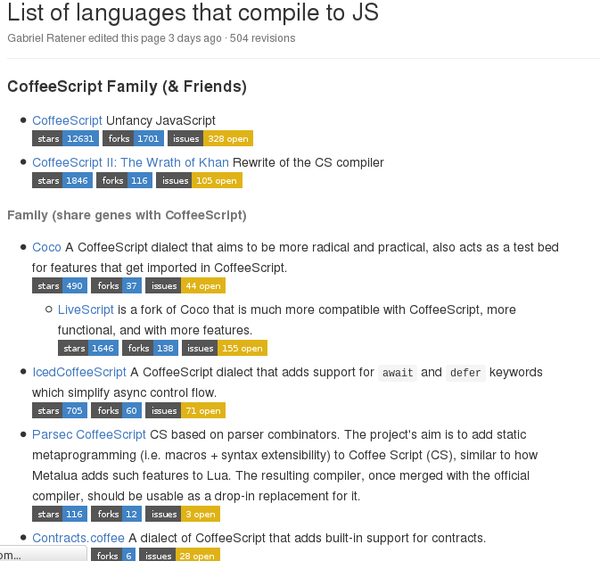
What is PureScript?
Another Language that compile to JS
List of languajes that compile to JS

Slide 5
Why PureScript?
Functional
Food
Happiness
data Food = Coffe | Pork
data Happiness =
Happy
| Neutral
| Unhappy
maskeMe :: Food → Happinness
maskeMe Coffe = Happy
makesMe Pork = Unhappy
Coffe
Pork
Happy
Neutral
Unhappy

Slide 6
Why PureScript?
Haskell Like
data Food = Coffe | Pork
data Happiness =
Happy
| Neutral
| Unhappy
maskeMe :: Food → Happinness
maskeMe Coffe = Happy
makesMe Pork = Unhappy
data Food = Coffe | Pork
data Happiness =
Happy
| Neutral
| Unhappy
maskeMe :: Food → Happinness
maskeMe Coffe = Happy
makesMe Pork = Unhappy

Slide 7
High Order Functions

Slide 8
Currying

Slide 9
Pattern Matching

Slide 10
Kinds (Types of types)

Slide 11
Type Classes

Slide 13
Examples
Some external examples:
Games
http://bodil.lol/purescript-is-magic/
http://david-peter.de/cube-composer/
Tools for analysis
http://slamdata.com/

Slide 14
Resources
Book:
https://leanpub.com/purescript/read
WebSite:
http://purescript.org/
Libraries:
https://pursuit.purescript.org/

