Slide 1
AUTOMATED HOUSE SYSTEMS
BY
LORDAIN BONAVENTURE
CRISTHIAN SURIEL

Slide 2

CET_4811 Capstone Project

Slide 3
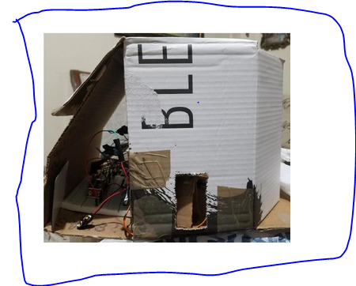

Slide 4
Objective
Build an Arduino Project
INPUTS
Push Button controls the Servo
PIR Sensor controls Speaker, Light
Potentiometer controls volume of Speaker
Keypad controls the Servo

Slide 5
OUTPUTS
Servo
Speaker
Light(Relay)

Slide 6
Real-World Application
Lighting Systems
Security Control
HVA Regulation
Lawn Irrigation Systems
LPWA Network
WI-FI, Bluetooth, Smart, ZigBee
Welcome Visitors

Slide 7
List of Components Used
Arduino UNO Board
Push Button
PIR(Passive Infrared) Sensor
10K Potentiometer
Keypad (4x4 matrix)
Speaker
Relay(5V)
NPN Transistor (Amplifier)
Servo Motor
Resistor

Slide 8
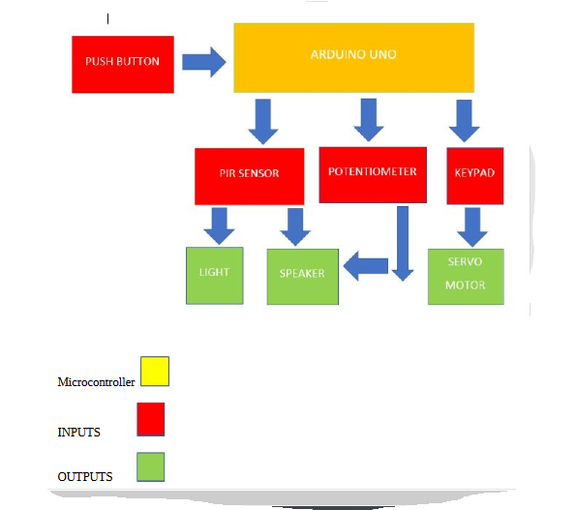
Block Diagram

Slide 9
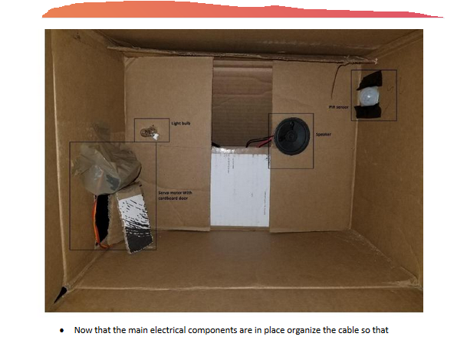
Mechanical Design Electrical components organized inside a cardboard house

Slide 10
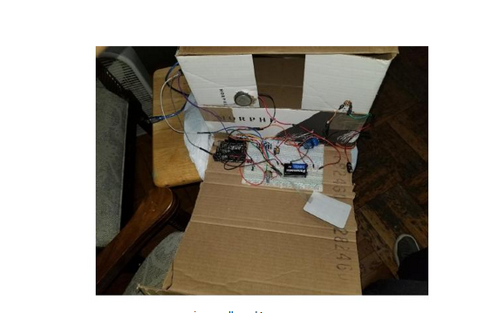
Mechanical Design continued

Slide 11
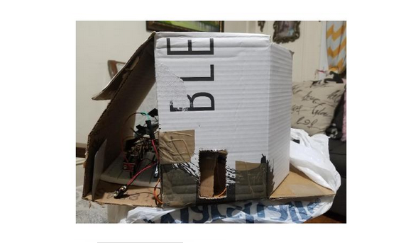
Mechanical Design continued

Slide 12
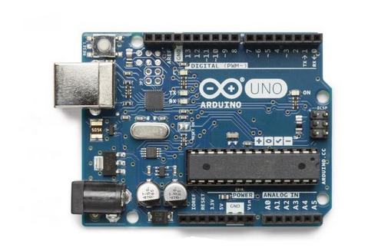
Electrical Design Microcontroller Arduino UNO

Slide 13
Electrical Design continued
The Arduino is used as Embedded Control for this project of
“Automated House Systems”
Arduino UNO is a microcontroller board based on ATmega 328(datasheet)
It has 14 digital input/output pins
6 pins can be used as PWM outputs
6 analog inputs, 16 MHz ceramic resonator, a reset button, a USB connection, a power jack etc

Slide 14
Other Electrical Specifications
Operating Voltage: 5V Input Voltage (Recommended)
Input Voltage (limits): 6-20V
DC Current per I/O pin: 40mA
DC Current for 3.3V pin: 50mA
Flash Memory: 32KB
SRAM: 2KB
EEPROM: 1 KB
Clock Speed: 16KHz

Slide 15
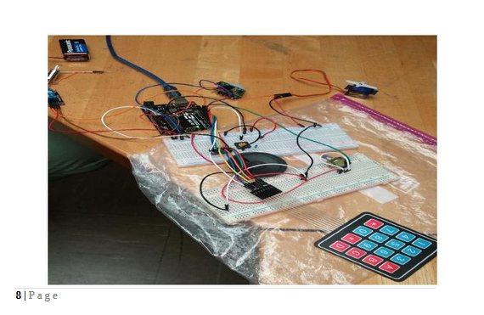
Electrical Design continued

Slide 16
Electrical Design / Input Sensors
A push button is used with a pull-down resistor to control the servo.
The push button is always On until it is pressed
A 10K potentiometer is used to control the volume of a speaker. The potentiometer is used as voltage divider.

Slide 17
Electrical Design continued
A Keypad is used as an input to control the servo(simulated as entry door).
The keypad is a 4x4 matrix, but the last column is not used. The pins 2, 3, 4, 5, 6, 7, 8 are used as interface to the Arduino.
A code is entered in the keypad to make the servo turn.

Slide 18
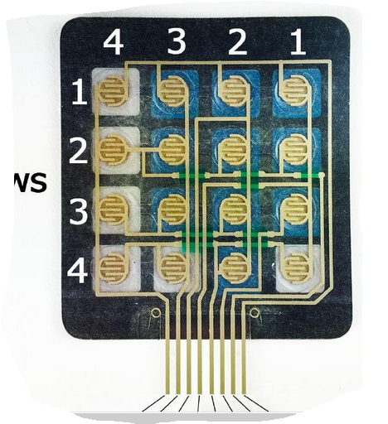
Electrical Design continued

Slide 19
Electrical Design continued Output Actuators and Devices
A Servo motor is used as output to simulate an entry door
A Servo is a small device that incorporates a three wire DC
Motor, a gear train, a potentiometer, an integrated circuit and an output shaft bearing for power, ground and Signal.
Servos are controlled by sending them a pulse of variable width.

Slide 20
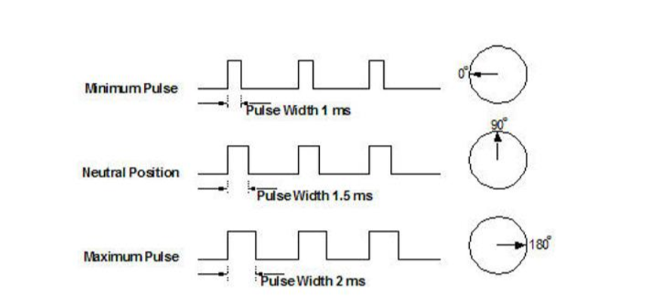
Electrical Design continued

Slide 21
Output Actuators and Devices cont.
A speaker is used as output to emit a sound whenever a motion is detected by the PIR sensor.
A speaker is an electroacoustic transducer that converts an electrical audio signal into a corresponding sound.
When connected directly to the Arduino, the speaker is weak, but with an NPN transistor, the sound is audible.

Slide 22
Output and actuators devices cont.
A light bulb is used as an output to turn ON whenever a motion is detected by the PIR sensor.
A 5V relay is used with the light.
An 9VDC battery is used in addition.

Slide 23
Light Relay
NO: Normally Open connection
NC: Normally closed connection
COM: Common connection

Slide 24
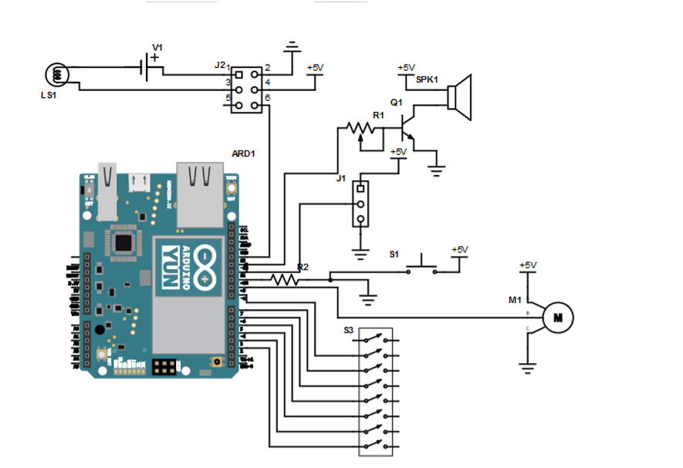
Schematic Diagram

Slide 25
Power Systems
Arduino has 5VDC and 3.3VDC power supply.
Any adapter 7-9VD can be used.
Maximum output current:0.5mA

Slide 26
Data Communication and Network Interface
The following pins are used as SPI: 10,11,12, 13.
The push button is connected to pin 10 Slave Select.
The PIR is connected to pin 11, Master Out and Slave IN(MOSI.
The potentiometer is connected to 12 Master IN Slave Out(MISO).
The relay/light is connected to pin 13 to provide 5V to the relay.

Slide 27
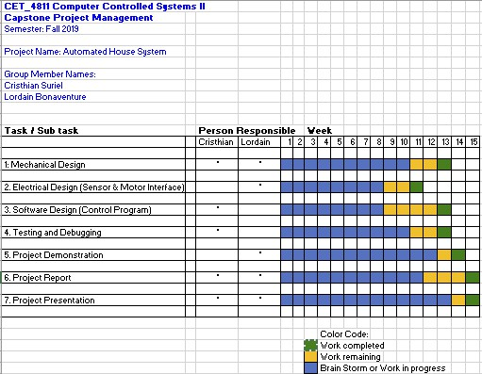
Project Management

Slide 28
Software Design

Slide 29
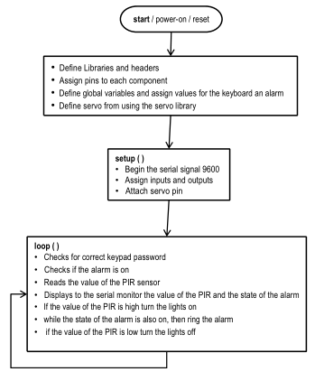
Flow-Chart

Slide 30

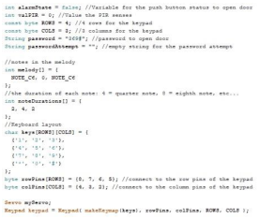

Analysis

Slide 31
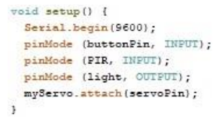
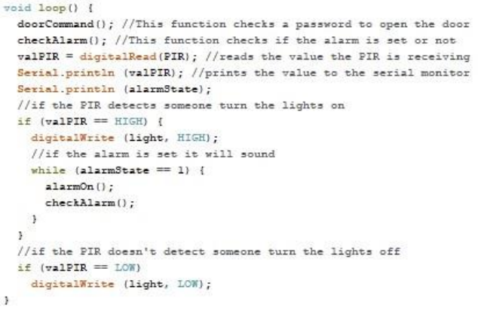
Analysis Continued

Slide 32
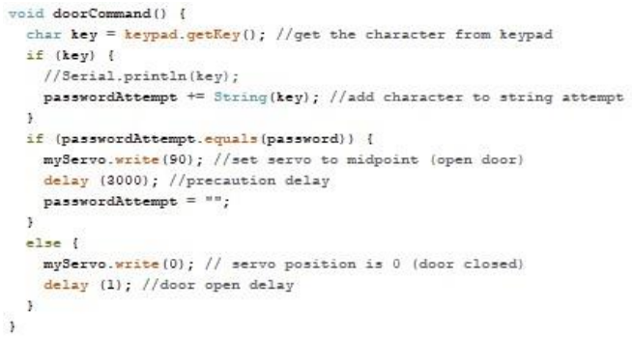
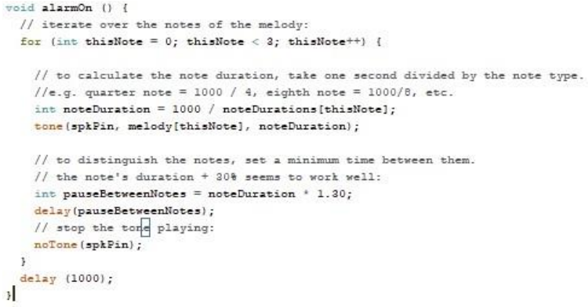
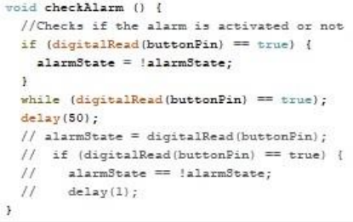
Analysis Continued

Slide 33
Bugs and Solutions
PIR always reading high or not reading on time
Speaker not ringing loud enough
Arduino not powerful enough to power light bulb
We adjusted the sensitivity and the delay to fix this issue
We added a transitor and a potentiometer
We used a relay to add power to the 6.3v bulb

Slide 34
Conclusion
This was a fun experience, we learned how to use pitches as well as how to use a keyboard to match a set password.
Some possible improvements would be to add a component that would allow the user to receive an email or notify in any way the owner, to make it so that all possible exits in the house are locked and an alternate code inside the house to disarm the alarm.

Slide 35
THANK YOU

