Slide 1
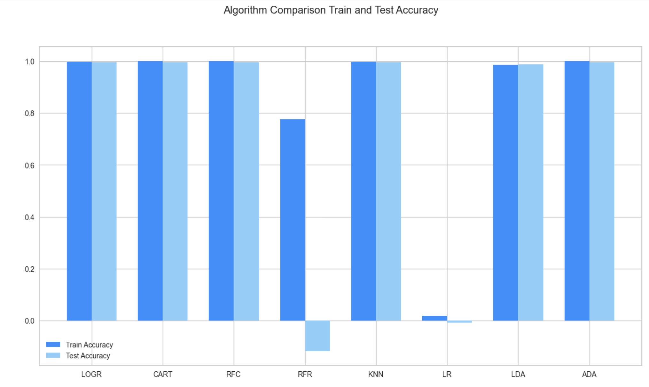

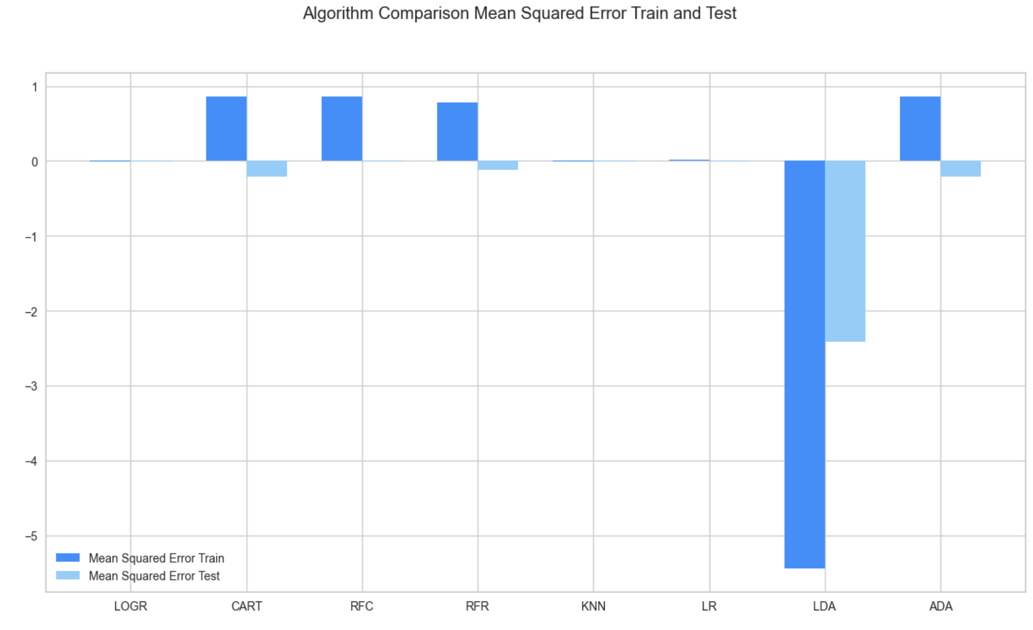
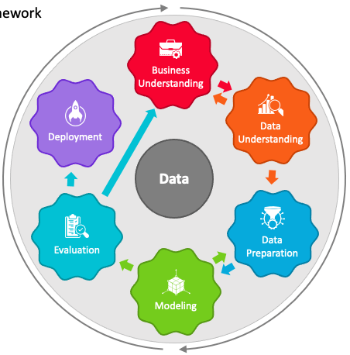
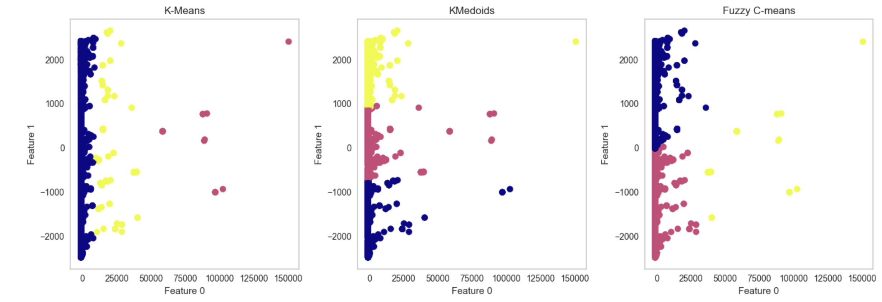
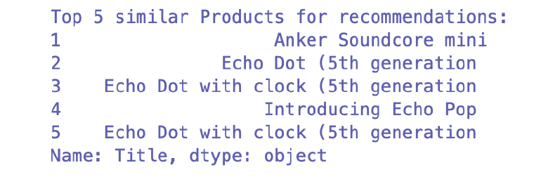
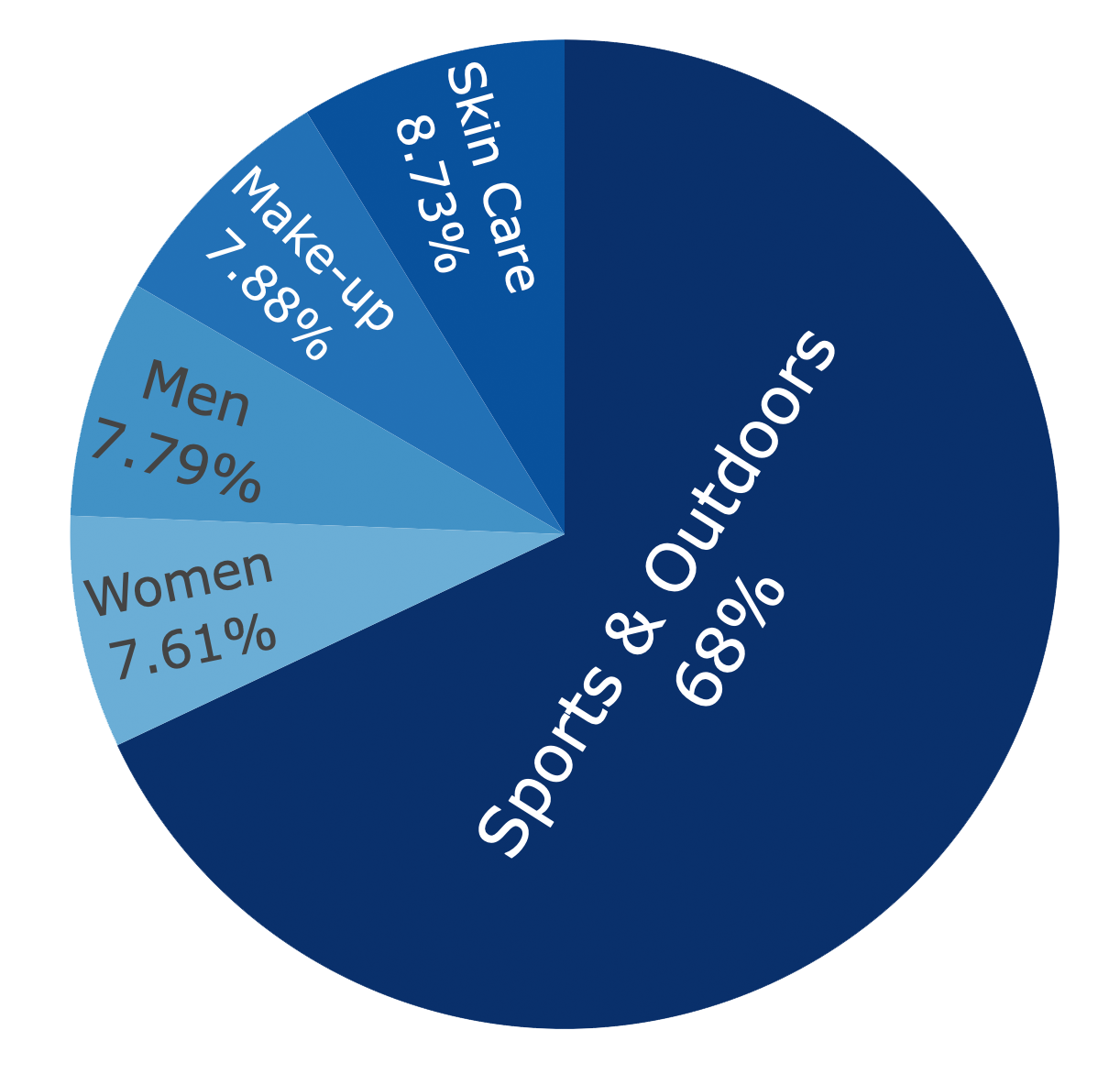

AMAZON UK PRODUCTS
INCREASING COMPANY SALES
Author
Cristhian Macedo - 2024104
06 Machine Learning - Supervised
Logistic Regression
Decision Tree Classifier
Random Forest Classifier
Random Forest Regressor
K Neighbors Classifier
Higher Diploma in Science in Data Analytics for Business
Strategic Thinking (STDA)
Lecturer
James Garza | Neil Doyle
CCT College Dublin
Dublin, Ireland
2024
In the Machine Learning Supervised 5 models were implemented as a main analyses as shown above.
Also add three more modules to compare "Linear Regression, Linear Discriminant Analysis and Ada Boost Classifier”, from the 8 models it were compared Train and Test Accuracy, also Mean Squared Error Train and Test the best performer, could choose "Logistic Regression, K Neighbors Classifier, Linear Regression".
Also 10 more models were used in the analyses, they are: SVC, MLP Classifier, Linear Regression, Lasso, Elastic Net, K Neighbors Regressor, Decision Tree Regressor, SVR, Linear Discriminant Analysis and Ada Boost Classifier.
01 Introduction
04 Methodology
This Capstone Project carried out a case study to understand and use a large dataset with over 2.2 million observations from one of the most popular online retailers around the world Amazon, the dataset used here was last updated in October of 2023, and it will be used to conduct the objects of this project using exploratory data analysis and machine learning to aim increasing company sales.
07 Machine Learning - Unsupervised
PCA (Principal Component Analysis)
K-Means Clustering
K-Medoids Clustering
Fuzzy C-Means Clustering
02 Objectives
Analysing customer ratings with stars obtained from the products to show the best products by category and which niches are the easiest to make sales.
Figuring out trending products by category and their sales performance getting an idea of which products have the best sales performance.
Present possible recommendations to customers through the best-seller products with higher sales.
Train a model to predict and improve sales.
Attempt to train a generator of optimised titles with a short product name.
08 Content-Based Recommender System
Phase 1 - Business Understanding / Project Plan.
Phase 2 - Data Understanding.
Phase 3 - Data Preparation.
Phase 4 - Modeling - Machine Learning Implementation.
Phase 5 - Evaluation Updates/Analysis and Repeating previous phases, Production of Report and Presentation.
10 Analysis
Analysing Customer ratings
Trending products by categories
Most popular Category by Reviews
Best Seller
09 Conclusions
05 Libraries
The results are plausible for the type of data that is being used, unfortunately it takes a long time to use 2 million lines for analysis, however in the small sample that was defined, good results were obtained, using Supervised and Unsupervised Machine Learning, when using Grid Search CV and Randomized Search CV it did not obtain good results with hyperparameters, using Content-Based Recommender System good results was obtained and after balancing the database using Random Over Sampler the results of the Linear regression algorithms have improved significantly.
Pandas
Numpy
Missingno
Sklearn
Matplotlib
Seaborn
Plotly Express
Nltk
Scipy
Yellowbrick
Lime
Shap
Mglearn
Imblearn
References
SketchBubble.com (2024). Crisp DM. [online] www.sketchbubble.com. Available at: https://www.sketchbubble.com/en/presentation-crisp-dm.html [Accessed 6 Nov. 2024].
CCT College Library (2023). Library: Academic Posters: Home. [online] Library.cct.ie. Available at: https://library.cct.ie/Posters/home [Accessed 6 Nov. 2024].
03 Technologies
Anaconda Navigator
Jupyter Notebook 7.0.8 version
Python Language
GitHub

