Slide 1
Facial recognition camera
Detect the features of someone's face
Students:
Cristian-Nicolae Birla
Carla-Alexandra Olaru
Instructor:
Claudiu Groza
Date:
June 2018

Slide 2
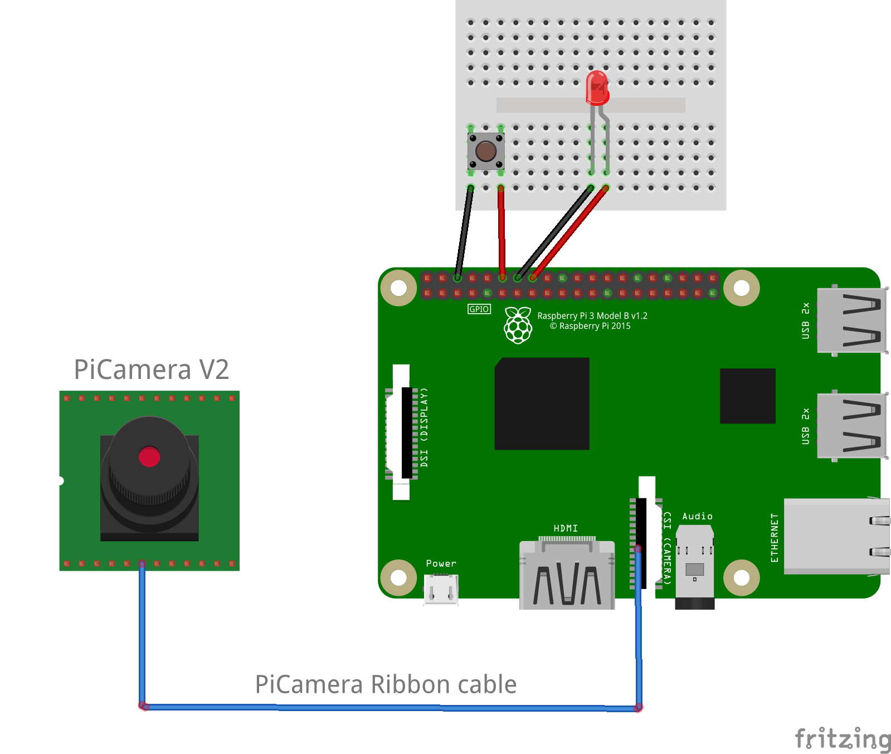
Hardware components
Raspberry Pi 3 model B+
Raspberry Pi camera: Picamera V2
Push button
LED
Wires

Slide 3
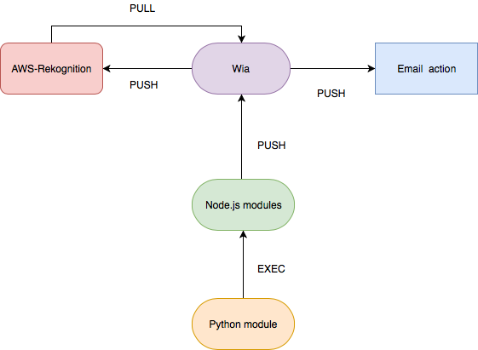
Software components
Python 2.7
Node.js
Wia
Amazon-Web-Services
Valid Email

Slide 4
About Wia
Wia is a cloud platform.
It offers device management.
Events collections, in our case photos.

Slide 5
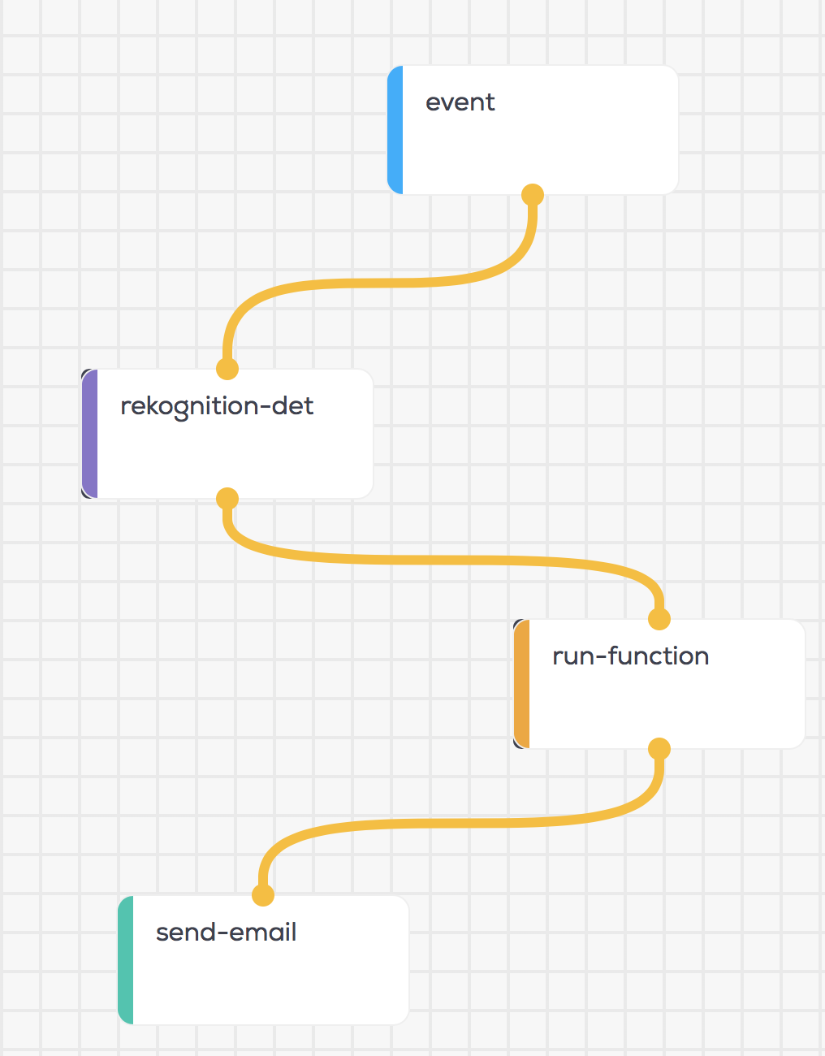
Building the flow
After the button is pushed, an photo is published on Wia as an event
The photo is then sent to AWS-rekognition for analysis
The features that were recognised are sent back and are selected in the run-function
An email is transmitted with the significant data to the user.

Slide 6
Highly customisable
The solution is highly customisable
You can select exactly which features you want to know
You can select how many faces to be analysed
You can select the features of each face that has been analysed
You can send the email to a different user

Slide 7
Lets see how it works

Slide 8
Thank you!

