Slide 1
Welcome to
Intro to R for Biologists We’ll start at 10:00am, please ask if you have any questions about what we learnt so far
Bea & Cristian
Trinity 2025

Slide 2
Intro to R for Biologists Session 2 Data exploration
Bea & Cristian
Trinity 2025

Slide 3
Intro to R for biologists
Data exploration
Conditional execution (if-else)
Performing repetitive tasks (loops)
Basic plots to visualize data
Basic statistics
Installing and loading packages

Slide 4
Math operations
Add, subtract, divide, multiply
+ - / *
Modulo (remainder of division)
%%
Exponent
^
Rounding
round(), floor(), ceiling()

Slide 5
Conditionals if statement
?
if(CONDITION) {
Do something
}
x <- 4
condition
TRUE
print(“Positive number”)
statement
x <- 4
if(x > 0) {
print("Positive number")
}
Positive number

Slide 6
Conditionals if … else statement
if (condition) {
do something if condition is true, this happens (TRUE branch)
} else {
do something else if condition is false, this happens (FALSE branch)
}
x <- 4
if (x > 0) {
print(“Positive number”)
}else{
print(“Negative number”)
}
?
x <- 4
condition
FALSE
TRUE
print(“Negative number”)
print(“Positive number”)
statement B
statement A
else block (FALSE BRANCH)
If block (TRUE BRANCH)
Notes:
A Boolean expression is an expression used in programming that produces a Boolean value when evaluated, being Boolean values true or false

Slide 7
Chained conditionals if … else if … else
if (condition A is TRUE) {
do something (statement A)
} else if (condition B is TRUE) {
do something else (statement B)
} else {
do something else (statement C)
}
If first condition is true, statement A is executed
New condition to test if previous one was false
False branch.
Executed if none of the conditions above are true
x = 0
if (x > 0) {
print(“Positive number”)
}else if (x < 0){
print(“Negative number”)
} else {
print(“Zero”)
Notes:
A Boolean expression is an expression used in programming that produces a Boolean value when evaluated, being Boolean values true or false

Slide 8
Chained conditionals if … else if … else
if (condition A is TRUE) {
do something (statement A)
} else if (condition B is TRUE) {
do something else (statement B)
} else {
do something else (statement C)
}
Condition A
TRUE
statement A
FALSE
Condition B
TRUE
statement B
FALSE
x = 0
if (x > 0) {
print(“Positive number”)
}else if (x < 0){
print(“Negative number”)
} else {
print(“Zero”)
statement C
Notes:
A Boolean expression is an expression used in programming that produces a Boolean value when evaluated, being Boolean values true or false

Slide 9
Loops for
For each item in sequence
Statements
- Used to iterate over a sequence.
- Perform same action for each item in a list of things.
- Syntax:
Last item reached?
for (val in sequence)
{
statement
}
No
Yes
Exit loop
for (year in c(2011,2012,2013,2014,2015,2016))
{
print(paste("The year is", year))
}
[1] "The year is 2011"
[1] "The year is 2012"
[1] "The year is 2013"
[1] "The year is 2014"
[1] "The year is 2015"
[1] "The year is 2016"

Slide 10
Loops for
For each item in sequence
genes = c(“PI3K”, “FOXO”, “VLDL”, ”LIPC”)
for (val in genes)
{
print(val)
}
Statements
Last item reached?
[1] "PI3K”
[1] "FOXO"
[1] "VLDL"
[1] "LIPC"
No
Yes
Exit loop

Slide 11
Loops while
Enter while loop
- Used to iterate indefinitely as long as certain logical condition is TRUE.
- Syntax:
Test condition
FALSE
while (test_expression)
{
statement
}
TRUE
Statements
i <- 1
while (i < 6)
{
print(i)
i = i+1
}
[1] 1
[1] 2
[1] 3
[1] 4
[1] 5
Exit loop

Slide 12
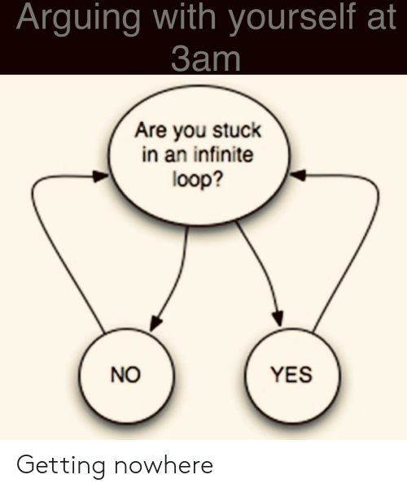
Infinite loops
x <- 1
while (x==1){
print(“Let’s move on!”)
}
Something to keep in mind!
*break and next statements might help –
advanced level

Slide 13

Let’s explore practically

Slide 14
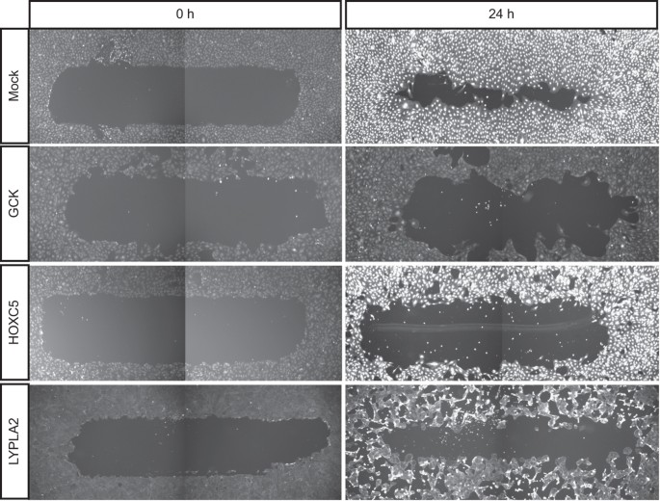

Migration and morphology data
Table 1: Migration data
col1: reagent_id
col2: gene_symbol
col3: migration
Table 2: Morphology data
col1: reagent_id
col2: gene_symbol
col3: elongatedness

Slide 15
Basic statistics
Correlations – cor(), cor.test()
T-test (parametric):
Unpaired 2-group t-test
t.test(y~x) # where y is numeric and x is a binary factor
t.test(y1,y2) # where y1 and y2 are numeric
Paired 2-group t-test
t.test(y1,y2, paired=TRUE) # where y1 & y2 are numeric
Non-parametric tests:
Unpaired 2-group Mann-Whitney U Test
wilcox.test(y~A) # where y is numeric and A is A binary factor
wilcox.test(y,x) # where y and x are numeric
Paired 2-group Wilcoxon Signed Rank Test
wilcox.test(y1,y2, paired=TRUE) # where y1 and y2 are numeric
More than 2 groups - analysis of variance (ANOVA, parametric)
aov(), anova()

Slide 16
Useful functions for summarisation
Center: mean(), median()
Spread: sd(), IQR()
Range: min(), max(), quantile()

Slide 17
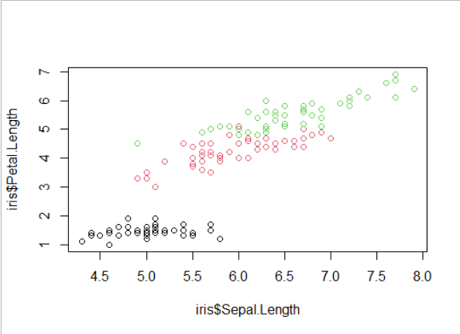
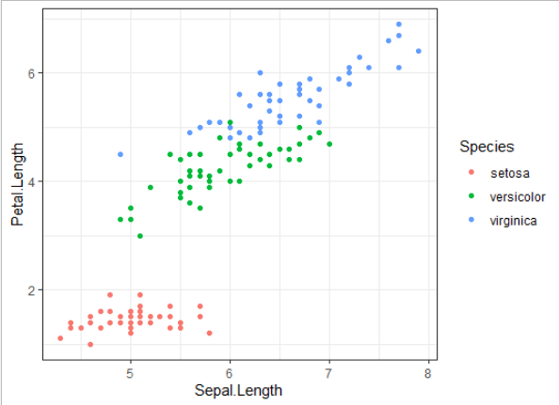
Visualising data
Base R plotting
Great for initial exploration
Quick
Simple syntax – many things can be plotted with just plot()
Not easy to modify colours, aesthetics, etc.
ggplot2 package
Modular – graphs can be built element-by-element
Need to remember a few different functions
Possible to produce publication quality figures with relative ease

Slide 18
Let’s explore practically

Slide 19
Packages/libraries
A package is a collection of R functions, data and compiled code. The location where the packages are stored is called the library.
Package extends basic R functionality and standardizes the distribution of code. For example, a package can contain a set of functions relating to a specific topic or tasks.

Slide 20
Where to get the libraries/packages?
CRAN (https://cran.r-project.org)
Install:
install.packages("dplyr")
Activate:
library("dplyr")
Bioconductor (https://bioconductor.org)
if (!requireNamespace("BiocManager", quietly = TRUE))
install.packages("BiocManager”)
BiocManager::install("limma")
Github (https://github.com)
install.packages("devtools")
library(devtools)
install_github("hadley/dplyr”)

Slide 21
Functions
Functions are created using the function() directive and are stored as R objects just like anything else. In particular, they are R objects of class “function”.
f <- function(<arguments>) {
## Do something interesting
}
Note: majority of the functions you would try to create already exist in the libraries!

Slide 22
Loop functions
lapply() – perform an action on each element of a vector: returns list
sapply() – as above, returns a simplified object (variable)
apply() – loop over rows or columns of a matrix or df
tapply() – loop over a vector, split based on a factor
mapply() – loop over more than one vector
> my_list = list(a = c(1, 2, 3), b = c(4, 5, 6), c = c(7, 8, 9))
> lapply(my_list, mean)
$a
[1] 2
$b
[1] 5
$c
[1] 8

Slide 23
Resources
R Programming for Data Science (Roger Peng) – Ch. 3, 4, 5, 9
Swirl – Interactive learning
https://www.tidyverse.org/
https://www.r-graph-gallery.com/
Advanced R course for data analysis and visualisation – on MSD skills training every term

