Slide 1
Multiple background images

Slide 2
CSS allows you to add multiple background images for an element, through the background-image property.
The different background images are separated by commas, and the images are stacked on top of each other, where the first image is closest to the viewer.

Slide 3
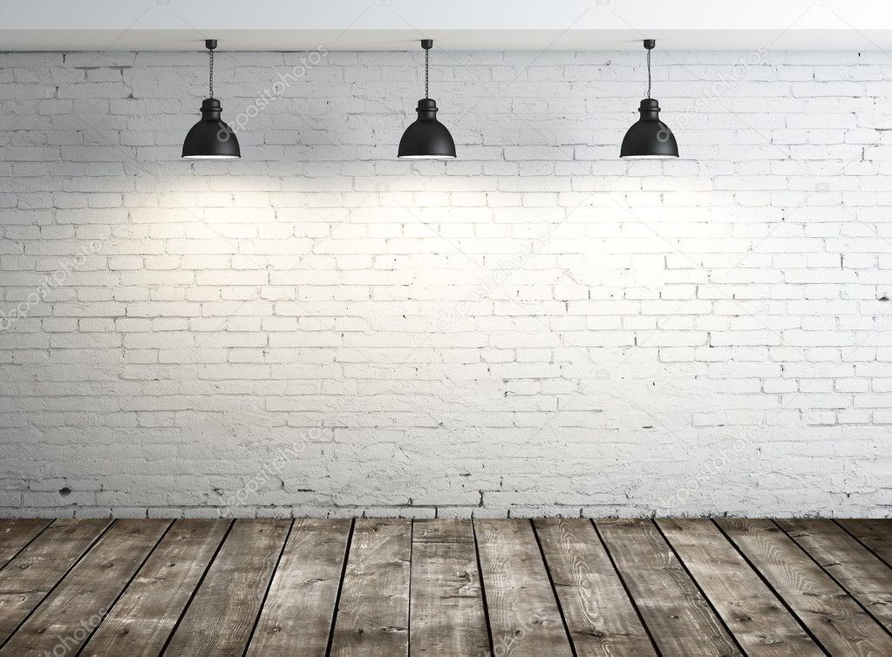
Example 1:

Slide 4
What can we use?
We can change the position of the images.
We can change the size.
We can change the order as they are presented.

