Slide 1
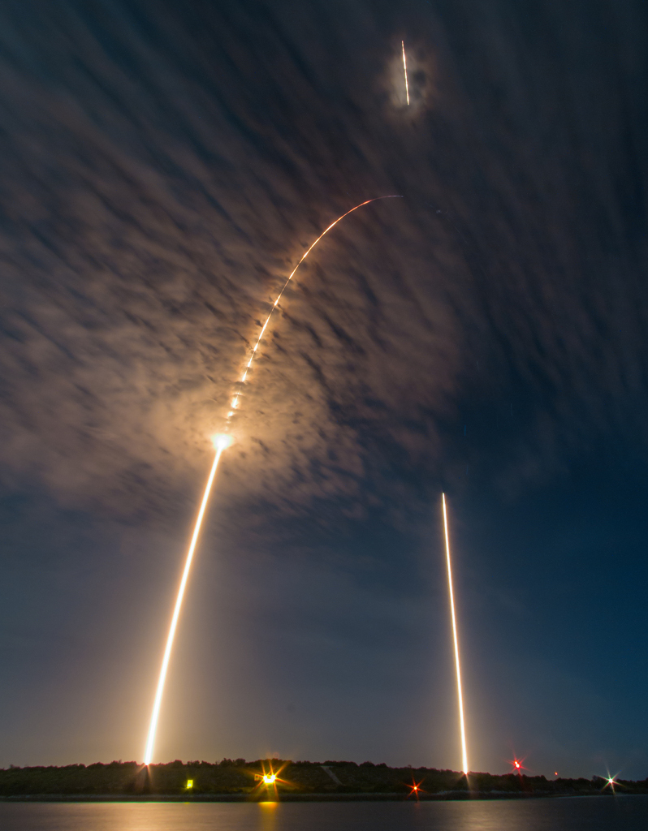
IBM APPLIED DATA SCIENCE CAPSTONE
Falcon 9
First-stage
Landing Prediction
From launch records to geographic insights
and classification models
Cristian / Technical project report / September 2026
Photo: Michael Seeley / NASA APOD
Notes:
Prepared from the user’s seven completed IBM capstone notebooks and two dashboard screenshots. Project repository: https://github.com/Cristian210600/SpaceX-Falcon9-Landing-prediction . Cover photograph: Michael Seeley, NASA Astronomy Picture of the Day, 21 July 2016, https://apod.nasa.gov/apod/ap160721.html . Historical laboratory snapshots, not current operational performance.

Slide 2
EXECUTIVE SUMMARY
Executive summary: findings and model performance
The strongest conclusion is a testable workflow, with clear limits on generalization.
Finding | Evidence | Interpretation
Landing outcomes vary | 60 / 90 Class 1 outcomes | Payload, orbit, site and time matter jointly.
Three models tie on test data | 83.33% accuracy; 15 / 18 correct | LR, SVM and KNN outperform the 66.67% baseline.
KSC leads the dashboard sample | 10 / 13 Class 1; 76.92% | This is a separate 56-record cohort.
Reported model scores are laboratory results: scaling before the split introduces leakage.
https://github.com/Cristian210600/SpaceX-Falcon9-Landing-prediction
02
Notes:
Source: supplied EDA / wrangling notebooks; IBM dataset_part_2.csv (n=90). Source: saved outputs in supplied SpaceX_Machine Learning Prediction_Part_5 (2)(2).ipynb. Source: supplied dashboard screenshots; IBM spacex_launch_dash.csv (n=56). LR=logistic regression; SVM=support vector machine; KNN=k-nearest neighbors. Tree test accuracy is 77.78% in the attached notebook. Baseline predicts Class 1 for every test record.

Slide 3
INTRODUCTION
Can launch information predict a landing outcome?
Business context: first-stage recovery is relevant to launch economics and reuse.
01
Define a binary target from the recorded first-stage landing outcome.
02
Explore payload, orbit, launch site, booster history and time.
03
Compare interpretable baselines with tuned classification models.
04
Use the evidence to guide further validation before operational decisions.
https://github.com/Cristian210600/SpaceX-Falcon9-Landing-prediction
03
Notes:
The lab models a binary outcome, not launch mission success or actual dollar savings. Class 1 includes successful ocean landings in the supplied wrangling logic; recovery and economic reuse are therefore not identical to this label. No cost estimate is inferred.

Slide 4
DATA SCOPE
Three snapshots answer different questions
Keep denominators and outcome definitions explicit when comparing results.
Analysis | Records / labels | Coverage
Python EDA + ML | 90 launches • 3 site labels | 4 Jun 2010–5 Nov 2020
SQL exercises | 101 launches • 4 site labels | 4 Jun 2010–6 Dec 2020
Folium + Dash | 56 launches • 4 site labels | Separate course snapshot
Do not transfer a percentage from one snapshot to another.
https://github.com/Cristian210600/SpaceX-Falcon9-Landing-prediction
04
Notes:
Counts and date ranges recomputed from the exact IBM CSV URLs referenced by the notebooks. CCAFS LC-40 and CCAFS SLC-40 are distinct dataset labels; this report retains source labels rather than silently merging historical naming variants. Dash data contains no date column. The repeated uploads are byte-identical to the earlier versions.

Slide 5
METHODOLOGY / COLLECTION
SpaceX API: build one record per eligible launch
The notebook uses a fixed API snapshot and enriches nested identifiers.
01
Load launch JSON; flatten the records with pandas.json_normalize.
02
Keep single-core, single-payload launches; parse the UTC date.
03
Resolve rocket, launchpad, payload and core IDs through helper calls.
04
Filter to Falcon 9; reset flight numbers and export dataset_part_1.csv.
https://github.com/Cristian210600/SpaceX-Falcon9-Landing-prediction
05
Notes:
Source: jupyter-labs-spacex-data-collection-api (1)(2).ipynb. SpaceX API v4 launches/past and the course API_call_spacex_api.json snapshot. Notebook cutoff is <=2020-11-13; the downloaded snapshot’s last eligible date is 2020-11-05. Enrichment includes payload mass/orbit, coordinates, booster flight count and reuse-related fields. This slide describes the supplied code, not a new live API crawl.

Slide 6
METHODOLOGY / COLLECTION
Web scraping provides a second historical view
A fixed Wikipedia revision makes the intended source reproducible.
01
Fetch the Falcon 9 / Falcon Heavy launch-list HTML with requests.
02
Use BeautifulSoup to identify launch tables and clean their headers.
03
Parse date, booster, payload, customer, site and outcome fields.
04
Export spacex_web_scraped.csv for tabular inspection.
https://github.com/Cristian210600/SpaceX-Falcon9-Landing-prediction
06
Notes:
Source: jupyter-labs-webscraping (1)(2).ipynb. URL: https://en.wikipedia.org/w/index.php?title=List_of_Falcon_9_and_Falcon_Heavy_launches&oldid=1027686922 . No executed row-count output is saved in this notebook. The supplied workflow does not demonstrate merging the scraped table into the 90-record ML cohort; this report does not claim such a merge.

Slide 7
METHODOLOGY / WRANGLING
The target definition controls the interpretation
Mean-impute payload; retain meaningful missing landing-pad identifiers.
Recorded landing outcome | Records | Class
True ASDS / True RTLS / True Ocean | 41 + 14 + 5 = 60 | 1
False or unknown / no attempt | 30 | 0
LandingPad is missing | 26 / 90 | Retain
Payload mean used for imputation | 6,104.96 kg | Numeric input
Five Class 1 records are ocean landings: the label is broader than recovered boosters.
https://github.com/Cristian210600/SpaceX-Falcon9-Landing-prediction
Source: supplied EDA / wrangling notebooks; IBM dataset_part_2.csv (n=90).
07
Notes:
Source: API and wrangling notebooks, dataset_part_1.csv and dataset_part_2.csv. Class 0 = None None (19), False ASDS (6), False Ocean (2), None ASDS (2), False RTLS (1). ASDS is a drone ship; RTLS means return to launch site. The downloaded part_1 file already contains imputed payload values. Missing pad IDs are not necessarily data errors.

Slide 8
METHODOLOGY / ANALYTICS
Use each analytical tool for a distinct question
Combine quantitative comparisons with interactive geographic and mission views.
Tool | Method | Question
Python / pandas | Group by site, orbit, year; visualize | Where do Class 1 rates differ?
SQLite | Filter, aggregate, rank and compare | What do detailed launch records show?
Folium | Markers, clusters, distance lines | How are sites positioned geographically?
Plotly Dash | Site selector + payload range + callbacks | How do filtered outcomes change?
https://github.com/Cristian210600/SpaceX-Falcon9-Landing-prediction
08
Notes:
Source: supplied EDA, SQL and Folium notebooks and dashboard screenshots. SQL results were rerun against the course CSV. EDA figures are rebuilt from the notebook’s dataset. Folium images are regenerated from supplied coordinates. Dash screenshots are user-supplied; no dashboard Python file was attached for execution testing.

Slide 9
RESULTS / EDA
Payload alone does not separate the two classes
Later flights include many Class 1 outcomes across a wide payload range.
Class 0 (n=30)
Class 1 (n=60)
Flight number also represents time: apparent payload effects may reflect operational evolution.
https://github.com/Cristian210600/SpaceX-Falcon9-Landing-prediction
Source: supplied EDA / wrangling notebooks; IBM dataset_part_2.csv (n=90).
09
Notes:
Source: supplied EDA / wrangling notebooks; IBM dataset_part_2.csv (n=90). Native editable scatter plot rebuilt from all 90 records. Class 0 is shown in orange and Class 1 in teal. No causal payload effect is estimated. Some identical mean-imputed masses repeat.

Slide 10
RESULTS / EDA
Flight number by launch site
Site codes: 1 = CCAFS SLC 40; 2 = KSC LC 39A; 3 = VAFB SLC 4E.
Class 0 (n=30)
Class 1 (n=60)
Sites serve different periods of the launch program. Compare site rates with time in view.
https://github.com/Cristian210600/SpaceX-Falcon9-Landing-prediction
Source: supplied EDA / wrangling notebooks; IBM dataset_part_2.csv (n=90).
10
Notes:
Source: supplied EDA / wrangling notebooks; IBM dataset_part_2.csv (n=90). All 90 input rows appear across the two panels. Integer codes represent categorical site names, not quantitative distances. Repeated payload values can overlap.

Slide 11
RESULTS / EDA
Payload mass (kg) by launch site
Site codes: 1 = CCAFS SLC 40; 2 = KSC LC 39A; 3 = VAFB SLC 4E.
Class 0 (n=30)
Class 1 (n=60)
Both classes span multiple sites and payload ranges. Site alone does not separate outcomes.
https://github.com/Cristian210600/SpaceX-Falcon9-Landing-prediction
Source: supplied EDA / wrangling notebooks; IBM dataset_part_2.csv (n=90).
11
Notes:
Source: supplied EDA / wrangling notebooks; IBM dataset_part_2.csv (n=90). All 90 input rows appear across the two panels. Integer codes represent categorical site names, not quantitative distances. Repeated payload values can overlap.

Slide 12
RESULTS / EDA
Flight number by orbit
Orbit codes identify categories, not ordered orbital distances.
Class 0
Class 1
Code | Orbit
1 | ES-L1
2 | GEO
3 | GTO
4 | HEO
5 | ISS
6 | LEO
7 | MEO
8 | PO
9 | SO
10 | SSO
11 | VLEO
The orbit mix changes across flight numbers, so time can confound orbit comparisons.
https://github.com/Cristian210600/SpaceX-Falcon9-Landing-prediction
Source: supplied EDA / wrangling notebooks; IBM dataset_part_2.csv (n=90).
12
Notes:
Source: supplied EDA / wrangling notebooks; IBM dataset_part_2.csv (n=90). Native scatter charts display each record. Orbit codes map to the named table at right and carry no numerical-distance meaning. Categories with n=1 cannot support stable success-rate claims.

Slide 13
RESULTS / EDA
Payload mass (kg) by orbit
Orbit codes identify categories, not ordered orbital distances.
Class 0
Class 1
Code | Orbit
1 | ES-L1
2 | GEO
3 | GTO
4 | HEO
5 | ISS
6 | LEO
7 | MEO
8 | PO
9 | SO
10 | SSO
11 | VLEO
Payload distributions depend on orbit. Marginal payload rates combine different mission types.
https://github.com/Cristian210600/SpaceX-Falcon9-Landing-prediction
Source: supplied EDA / wrangling notebooks; IBM dataset_part_2.csv (n=90).
13
Notes:
Source: supplied EDA / wrangling notebooks; IBM dataset_part_2.csv (n=90). Native scatter charts display each record. Orbit codes map to the named table at right and carry no numerical-distance meaning. Categories with n=1 cannot support stable success-rate claims.

Slide 14
RESULTS / EDA
The largest success count is not the highest rate
CCAFS has more Class 1 records; KSC and VAFB have higher observed rates.
Site | Class 1 / total
CCAFS | 33 / 55
KSC | 17 / 22
VAFB | 10 / 13
KSC (77.27%) and VAFB (76.92%) differ by only 0.35 percentage points.
https://github.com/Cristian210600/SpaceX-Falcon9-Landing-prediction
Source: supplied EDA / wrangling notebooks; IBM dataset_part_2.csv (n=90).
14
Notes:
Source: supplied EDA / wrangling notebooks; IBM dataset_part_2.csv (n=90). The small difference between KSC and VAFB should not be interpreted as evidence that geography causes better landing performance. Site, mission type and time are correlated.

Slide 15
RESULTS / EDA
Orbit rates need their sample sizes
SSO and VLEO show high observed rates; several 100% groups contain only one launch.
GTO: 14 / 27 = 51.85% • SSO: 5 / 5 • VLEO: 12 / 14 = 85.71%
https://github.com/Cristian210600/SpaceX-Falcon9-Landing-prediction
Source: supplied EDA / wrangling notebooks; IBM dataset_part_2.csv (n=90).
15
Notes:
Source: supplied EDA / wrangling notebooks; IBM dataset_part_2.csv (n=90). Rates = mean(Class). n=1 for ES-L1, GEO, HEO and SO. Do not infer stable operational rates for these groups. All denominators are shown in the category labels.

Slide 16
RESULTS / EDA
Performance improves over time, but not monotonically
The late-period gains coexist with a visible decrease in 2018.
2019: 9 / 10 = 90% • 2020 snapshot: 16 / 19 = 84.21%
https://github.com/Cristian210600/SpaceX-Falcon9-Landing-prediction
Source: supplied EDA / wrangling notebooks; IBM dataset_part_2.csv (n=90).
16
Notes:
Source: supplied EDA / wrangling notebooks; IBM dataset_part_2.csv (n=90). Categories are observed years, not a continuous time axis. There are no 2011 observations. 2020 ends on 5 November and is not a full calendar year. Changes in booster version, orbit and recovery attempts can confound this descriptive trend.

Slide 17
METHODOLOGY / SQL
EDA with SQL: queries and definitions
SQLite supports auditable filters, aggregates and rankings.
Operation | Implementation | Purpose
Import and inspect | pandas.read_csv; to_sql; PRAGMA | 101 launch records with 10 fields
Clean text | TRIM(Mission_Outcome) | Merge the trailing-space Success label
Aggregate | SUM, AVG, MIN, MAX, GROUP BY | Payload statistics and first landing date
Rank and filter | ORDER BY; WHERE; strftime | Site comparisons and historical events
SQL landing success here means TRIM(Landing_Outcome) LIKE 'Success%'.
https://github.com/Cristian210600/SpaceX-Falcon9-Landing-prediction
Source: supplied SQL notebook; queries rerun on IBM Spacex.csv (n=101).
17
Notes:
Source: supplied SQL notebook; queries rerun on IBM Spacex.csv (n=101). Additional queries in sql/11_report_rates_and_ranking.sql. Unknown, no-attempt and ocean outcomes stay in the all-launch denominator. This definition is separate from Class in the ML snapshot. Repository: https://github.com/Cristian210600/SpaceX-Falcon9-Landing-prediction

Slide 18
RESULTS / SQL
SQL turns launch records into auditable facts
Aggregation results from the 101-row SQL snapshot.
Question / operation | Verified result
SUM(payload) for NASA (CRS) | 45,596 kg
AVG(payload) for F9 v1.1 variants | 2,534.67 kg
MIN(date) for successful ground-pad landing | 22 December 2015
MAX(payload) across the SQL snapshot | 15,600 kg
COUNT of distinct launch-site labels | 4
https://github.com/Cristian210600/SpaceX-Falcon9-Landing-prediction
Source: supplied SQL notebook; queries rerun on IBM Spacex.csv (n=101).
18
Notes:
Source: supplied SQL notebook; queries rerun on IBM Spacex.csv (n=101). Exact predicates in the supplied notebook: Customer = NASA (CRS); Booster_Version LIKE F9 v1.1%; Landing_Outcome = Success (ground pad). Dates use the CSV’s UTC dates. All ten exercise queries were rerun with sqlite3. The maximum payload is a mass result, not a landing-success claim.

Slide 19
RESULTS / SQL
Filtering reveals specific boosters and failure events
Successful drone-ship landings with 4,000 < payload < 6,000 kg.
Query | Returned boosters
Landing_Outcome = Success (drone ship) AND payload > 4000 AND payload < 6000 | F9 FT B1022 F9 FT B1026 F9 FT B1021.2 F9 FT B1031.2
2015 drone-ship failures
January: B1012 • April: B1015 • Both at CCAFS LC-40
https://github.com/Cristian210600/SpaceX-Falcon9-Landing-prediction
Source: supplied SQL notebook; queries rerun on IBM Spacex.csv (n=101).
19
Notes:
Source: supplied SQL notebook; queries rerun on IBM Spacex.csv (n=101). These are launch-level query results. Booster strings are whitespace-normalized for display only. The date filter uses strftime year=2015 and Landing_Outcome=Failure (drone ship). Query uses strict payload bounds.

Slide 20
RESULTS / SQL
Mission success and landing success are different
A payload can reach its mission objective even when first-stage landing fails.
Mission outcome after TRIM | Records
Success | 99
Success (payload status unclear) | 1
Failure (in flight) | 1
A small cleaning issue matters
The raw SQL output separates “Success” and “Success ”.
Trimming merges 98 + 1 rows without changing the other outcome labels.
Do not substitute Mission_Outcome for the first-stage classification target.
https://github.com/Cristian210600/SpaceX-Falcon9-Landing-prediction
Source: supplied SQL notebook; queries rerun on IBM Spacex.csv (n=101).
20
Notes:
Source: supplied SQL notebook; queries rerun on IBM Spacex.csv (n=101). Additional validation: GROUP BY TRIM(Mission_Outcome) combines one trailing-space Success value with 98 clean Success values. The unclear-payload row is retained separately. The landing-outcome ranking query covers only 2010-06-04 through 2017-03-20 inclusive (31 records), not the full 101.

Slide 21
RESULTS / SQL
KSC leads the SQL landing-success rate
All 101 SQL records. Numerator: landing outcomes beginning with Success.
Launch site | Success / launches | Landing success rate
KSC LC-39A | 20 / 25 | 80.00%
CCAFS SLC-40 | 25 / 34 | 73.53%
VAFB SLC-4E | 10 / 16 | 62.50%
CCAFS LC-40 | 6 / 26 | 23.08%
CCAFS SLC-40 has the largest success count (25). KSC has the highest rate (80%).
https://github.com/Cristian210600/SpaceX-Falcon9-Landing-prediction
Source: supplied SQL notebook; queries rerun on IBM Spacex.csv (n=101).
21
Notes:
SELECT Launch_Site, COUNT(*) AS launches,
SUM(CASE WHEN TRIM(Landing_Outcome) LIKE 'Success%' THEN 1 ELSE 0 END) AS successes,
ROUND(100.0*SUM(CASE WHEN TRIM(Landing_Outcome) LIKE 'Success%' THEN 1 ELSE 0 END)/COUNT(*),2) AS rate_pct
FROM SPACEXTBL GROUP BY Launch_Site ORDER BY rate_pct DESC; Rates include every launch in each denominator. Historical site labels remain separate. These SQL rates differ from the 90-record ML target and 56-record dashboard rates.

Slide 22
RESULTS / SQL
Historical outcome ranking and launch growth
The ranking uses the lab date window. Annual counts use the full SQL snapshot.
Landing outcome | Count
No attempt | 10
Failure (drone ship) | 5
Success (drone ship) | 5
Controlled (ocean) | 3
Success (ground pad) | 3
Failure (parachute) | 2
Uncontrolled (ocean) | 2
Precluded (drone ship) | 1
Year | Launches | Success landings
2010 | 2 | 0
2012 | 2 | 0
2013 | 3 | 0
2014 | 6 | 0
2015 | 7 | 1
2016 | 8 | 5
2017 | 18 | 14
2018 | 20 | 10
2019 | 11 | 10
2020 | 24 | 21
4 Jun 2010 to 20 Mar 2017
https://github.com/Cristian210600/SpaceX-Falcon9-Landing-prediction
Source: supplied SQL notebook; queries rerun on IBM Spacex.csv (n=101).
22
Notes:
SELECT TRIM(Landing_Outcome) AS outcome, COUNT(*) AS launches
FROM SPACEXTBL WHERE Date BETWEEN '2010-06-04' AND '2017-03-20'
GROUP BY TRIM(Landing_Outcome) ORDER BY launches DESC, outcome;
SELECT substr(Date,1,4) AS year, COUNT(*) AS launches,
SUM(CASE WHEN TRIM(Landing_Outcome) LIKE 'Success%' THEN 1 ELSE 0 END) AS successes
FROM SPACEXTBL GROUP BY substr(Date,1,4) ORDER BY year; The historical window contains 31 records. 2020 ends on 6 December in this SQL snapshot. Mission mix and recovery attempts change over time.

Slide 23
METHODOLOGY / INTERACTIVE ANALYTICS
Folium and Dash: implementation and controls
Geography and launch filtering answer complementary questions.
Component | Implementation | Result
Folium locations | Map + CircleMarker + labels | Four source site labels
Folium outcomes | MarkerCluster + green/red Marker | 56 records; green=1, red=0
Folium proximity | Haversine + PolyLine | Distances to four selected points
Dash dropdown + callback | site-dropdown → success-pie-chart | All-site counts or site outcome split
Dash range + callback | payload-slider + site-dropdown | Payload / outcome by booster
https://github.com/Cristian210600/SpaceX-Falcon9-Landing-prediction
23
Notes:
Notebook: notebooks/06_folium_launch_sites.ipynb. App: app/spacex_dash_app.py. The companion HTML implements the map. The dashboard app was reconstructed from the supplied requirements and screenshots. Repository: https://github.com/Cristian210600/SpaceX-Falcon9-Landing-prediction

Slide 24
RESULTS / FOLIUM
Folium inputs: launch sites on two coasts
Coordinate overview. The companion HTML contains the interactive basemap.
Geographic interpretation
All labels lie near a coast.
Latitudes are about 28–35° N: these sites are not on the Equator.
Ocean-facing trajectories are consistent with a safety rationale.
https://github.com/Cristian210600/SpaceX-Falcon9-Landing-prediction
Source: supplied Folium notebook; IBM spacex_launch_geo.csv (n=56).
24
Notes:
Source: supplied Folium notebook; IBM spacex_launch_geo.csv (n=56). Static coordinate view of the supplied Folium map data, rebuilt as an editable scatter chart; this is not a screenshot of a live basemap. Notebook uses Circle, Marker and DivIcon for sites; MarkerCluster for 56 outcomes. Coordinates are lab reference points, not survey-grade launch-pad positions. Florida labels overlap at this scale. Ocean safety rationale is an interpretation, not a causal test. Interactive Folium HTML is supplied separately.

Slide 25
RESULTS / FOLIUM
Folium proximity results: selected reference points
CCAFS SLC-40. Coordinate diagram below; interactive basemap in companion HTML.
Selected feature | Distance
Highway point | 0.583 km
Coastline point | 0.863 km
Railway point | 1.285 km
City point | 51.434 km
Manual points, not verified nearest features or driving routes.
https://github.com/Cristian210600/SpaceX-Falcon9-Landing-prediction
Source: supplied Folium notebook; IBM spacex_launch_geo.csv (n=56).
25
Notes:
Source: supplied Folium notebook; IBM spacex_launch_geo.csv (n=56). Haversine formula with R=6373 km, origin [28.563197,-80.576820]. Coast [28.56334,-80.56799]; highway [28.56335,-80.57085]; rail [28.57206,-80.58525]; city [28.10473,-80.64531]. Local map omits the distant city line for readability. Road/rail labels follow notebook selections and were not independently classified. These observations cannot establish a minimum urban buffer for every site.

Slide 26
RESULTS / FOLIUM
Launch records and geographic interpretation
56 records use clustered markers. Identical coordinates expand on cluster selection.
Site label | Class 1 | Class 0 | Total
CCAFS LC-40 | 7 | 19 | 26
CCAFS SLC-40 | 3 | 4 | 7
KSC LC-39A | 10 | 3 | 13
VAFB SLC-4E | 4 | 6 | 10
Proximity interpretation
Selected road, rail and coastline points are within 1.3 km of the example origin.
The selected city point is 51.4 km away. This does not prove the nearest-city distance for all sites.
Interactive map: reports/SpaceX_Folium_Interactive.html
The PDF includes coordinate diagrams; a rendered basemap capture is still needed.
https://github.com/Cristian210600/SpaceX-Falcon9-Landing-prediction
Source: supplied Folium notebook; IBM spacex_launch_geo.csv (n=56).
26
Notes:
Source: supplied Folium notebook; IBM spacex_launch_geo.csv (n=56). The green/red MarkerCluster implements all 56 records without jittering geographic coordinates. A static browser capture could not be obtained in the authoring environment. Companion HTML requires internet for Leaflet and OpenStreetMap tiles. Selected points are manual notebook references, not validated nearest road, railway, coast or urban boundary.

Slide 27
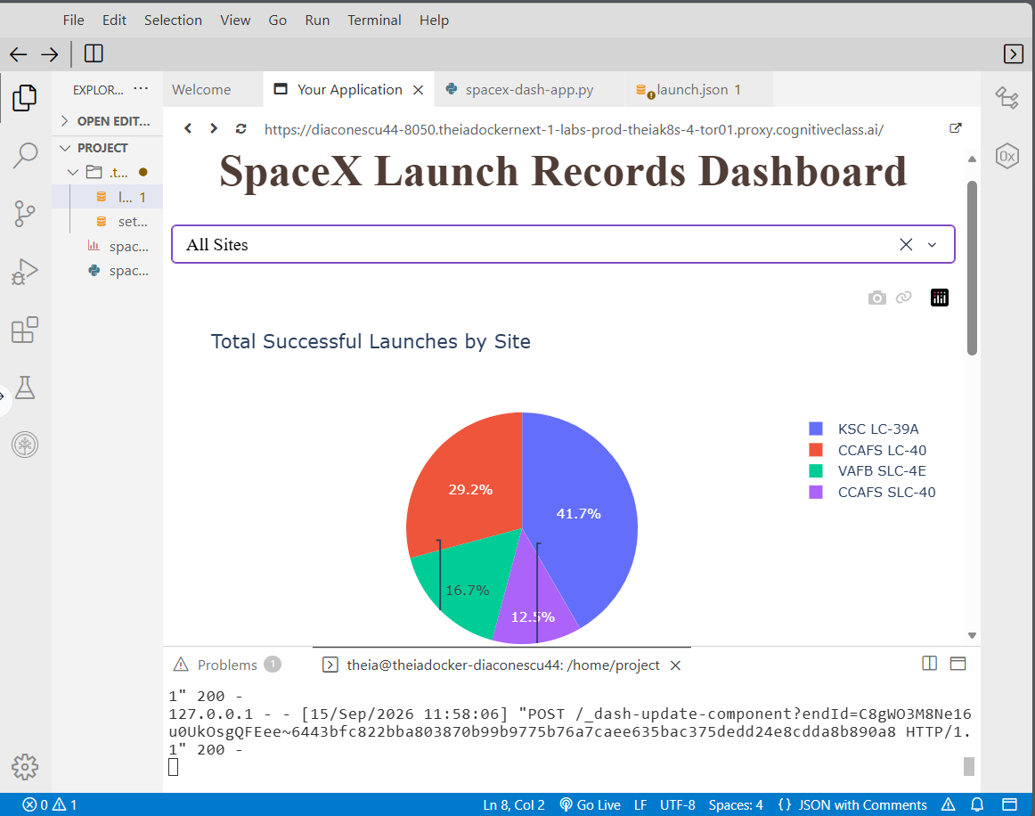
RESULTS / PLOTLY DASH
KSC leads the 56-record dashboard sample
The all-sites pie shows the distribution of Class 1 counts.
Two different percentages
41.7% = 10 / 24
KSC share of all Class 1 records
76.9% = 10 / 13
Class 1 rate within KSC
https://github.com/Cristian210600/SpaceX-Falcon9-Landing-prediction
Source: supplied dashboard screenshots; IBM spacex_launch_dash.csv (n=56).
27
Notes:
Source: supplied dashboard screenshots; IBM spacex_launch_dash.csv (n=56). Original user screenshot preserved. Recomputed site counts: KSC LC-39A10/13; CCAFS LC-40 7/26; VAFB SLC-4E4/10; CCAFS SLC-40 3/7. Pie shares use denominator24; within-site rates use each site’s launch count. Screenshots demonstrate the interface, not a live callback execution test performed for this report.

Slide 28
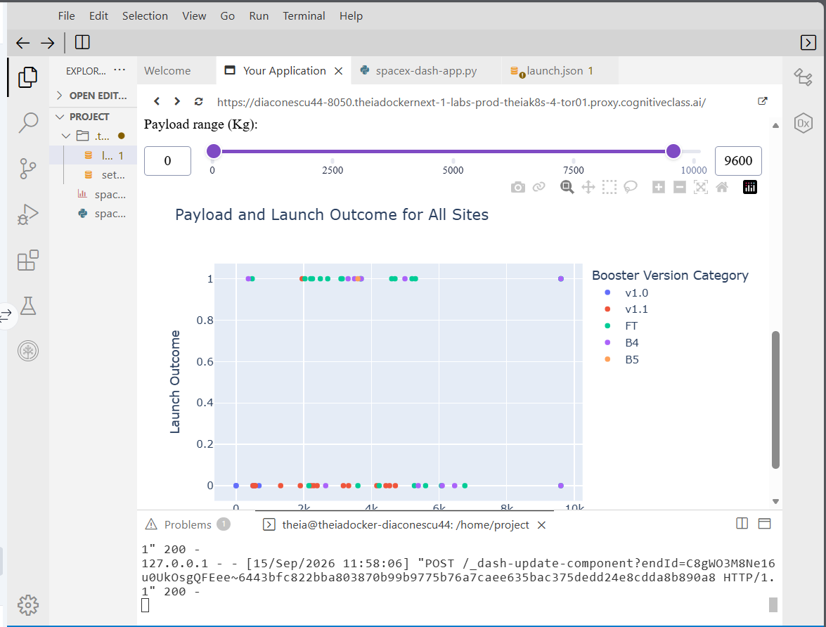
RESULTS / PLOTLY DASH
Payload filtering makes comparisons interactive
Site selection and a payload range control the scatter plot.
01
X: payload mass (kg).
Y: outcome class, 0 or 1.
02
Color: booster version category.
03
Filters help inspect subsets; they do not establish causation.
https://github.com/Cristian210600/SpaceX-Falcon9-Landing-prediction
Source: supplied dashboard screenshots; IBM spacex_launch_dash.csv (n=56).
28
Notes:
Source: supplied dashboard screenshots; IBM spacex_launch_dash.csv (n=56). Screenshot displays ALL sites and range0–9600kg. Intended callbacks: site-dropdown→success-pie-chart; site-dropdown and payload-slider→success-payload-scatter-chart. The screenshot is direct user evidence. The companion app implements the two callbacks from the supplied requirements. The original screenshot demonstrates the user interface.

Slide 29
RESULTS / DASHBOARD ANALYSIS
Payload-band rates are sensitive to the denominator
Recomputed fixed 2,000 kg bands for the dashboard’s 56 records.
Highest: 2,000–<4,000 kg (13 / 21). Lowest: 6,000–<8,000 kg (0 / 4).
https://github.com/Cristian210600/SpaceX-Falcon9-Landing-prediction
Source: supplied dashboard screenshots; IBM spacex_launch_dash.csv (n=56).
29
Notes:
Source: supplied dashboard screenshots; IBM spacex_launch_dash.csv (n=56). Additional report calculation, not an existing screenshot. Bins are left-closed, right-open, [0,2000),[2000,4000),[4000,6000),[6000,8000),[8000,10000). Rates:3/13,13/21,5/13,0/4,3/5. Rankings depend on bin boundaries and small sample sizes; the result does not imply a monotonic payload effect.

Slide 30
RESULTS / DASHBOARD ANALYSIS
B5 has 100% from one observed launch
FT provides the largest body of positive outcomes in this dashboard snapshot.
Booster category | Class 1 / total | Observed rate
v1.0 | 0 / 5 | 0.00%
v1.1 | 1 / 15 | 6.67%
FT | 16 / 24 | 66.67%
B4 | 6 / 11 | 54.55%
B5 | 1 / 1 | 100.00%
https://github.com/Cristian210600/SpaceX-Falcon9-Landing-prediction
Source: supplied dashboard screenshots; IBM spacex_launch_dash.csv (n=56).
30
Notes:
Source: supplied dashboard screenshots; IBM spacex_launch_dash.csv (n=56). Recomputed rates: v1.0 0/5;v1.1 1/15;FT16/24;B4 6/11;B5 1/1. B5 is the maximum empirical rate, but n=1 does not support a stable ranking or a superiority claim. Booster categories track historical development and are confounded with time and mission selection.

Slide 31
METHODOLOGY / PREDICTION
Tune four classifiers on an 80/20 split
90 labels • 83 encoded input features • 72 train records • 18 test records
01
One-hot encode categorical inputs and convert the design matrix to float.
02
Standardize X; split with test_size=0.2 and random_state=2.
03
Use GridSearchCV with 10-fold cross-validation for each model.
04
Evaluate the selected estimator on test accuracy and a confusion matrix.
Lab limitation: the scaler is fitted before the split. Future work must fit it inside training folds.
https://github.com/Cristian210600/SpaceX-Falcon9-Landing-prediction
Source: saved outputs in supplied SpaceX_Machine Learning Prediction_Part_5 (2)(2).ipynb.
31
Notes:
Source: saved outputs in supplied SpaceX_Machine Learning Prediction_Part_5 (2)(2).ipynb. Models: LogisticRegression, SVC, DecisionTreeClassifier, KNeighborsClassifier. The source notebook fits preprocessing.StandardScaler().fit_transform(X) before train_test_split. This leaks held-out distribution information. Use a Pipeline after splitting, then cross-validate the full pipeline. Reference: https://scikit-learn.org/stable/common_pitfalls.html .

Slide 32
RESULTS / CLASSIFICATION
Three models tie at 83.33% test accuracy
The tree wins cross-validation, but has the lowest saved test score.
Test baseline: 66.67% (always predict Class 1). One test record changes accuracy by 5.56 points.
https://github.com/Cristian210600/SpaceX-Falcon9-Landing-prediction
Source: saved outputs in supplied SpaceX_Machine Learning Prediction_Part_5 (2)(2).ipynb.
32
Notes:
Source: saved outputs in supplied SpaceX_Machine Learning Prediction_Part_5 (2)(2).ipynb. Stored values are preserved rather than replaced with a new run. CV best scores:LR0.8464285714,SVM0.8482142857,Tree0.875,KNN0.8482142857. Test:15/18 for LR,SVM,KNN;14/18 for Tree. A higher CV score is not a guarantee of stronger holdout performance.

Slide 33
RESULTS / CLASSIFICATION
Best hyperparameters from the saved grid searches
These settings describe the submitted laboratory run.
Model | Selected hyperparameters
Logistic regression | C=0.01; penalty=l2; solver=lbfgs
SVM | kernel=sigmoid; C=1; gamma≈0.03162
Decision tree | criterion=gini; max_depth=6; max_features=sqrt min_samples_leaf=4; min_samples_split=10; splitter=random
KNN | n_neighbors=10; p=1 (Manhattan); algorithm=auto
https://github.com/Cristian210600/SpaceX-Falcon9-Landing-prediction
Source: saved outputs in supplied SpaceX_Machine Learning Prediction_Part_5 (2)(2).ipynb.
33
Notes:
Source: saved outputs in supplied SpaceX_Machine Learning Prediction_Part_5 (2)(2).ipynb. Tree has no fixed random_state in the source. Its grid includes an invalid max_features=auto value in the execution environment, producing3,240 failed fits out of6,480. Valid candidates still yielded the reported selected estimator. Removing invalid settings and seeding the tree is recommended for a reproducible rerun, but not represented as already performed here.

Slide 34
RESULTS / CLASSIFICATION
Errors are optimistic predictions of Class 1
Rows are actual classes; columns are predicted classes.
LR / SVM / KNN
Decision tree
Actual ↓ / predicted → | 0 | 1
0 | 3 | 3
1 | 0 | 12
Actual ↓ / predicted → | 0 | 1
0 | 2 | 4
1 | 0 | 12
Class 1 precision: 80%
Class 1 recall: 100% • specificity: 50%
https://github.com/Cristian210600/SpaceX-Falcon9-Landing-prediction
Source: saved outputs in supplied SpaceX_Machine Learning Prediction_Part_5 (2)(2).ipynb.
34
Notes:
Source: saved outputs in supplied SpaceX_Machine Learning Prediction_Part_5 (2)(2).ipynb. Confusion matrices were transcribed from saved plots. LR,SVM,KNN share [[3,3],[0,12]]. Tree:[[2,4],[0,12]]. For the three tied models:precision12/(12+3)=0.8;recall12/12=1;specificity3/6=0.5;balancedaccuracy0.75. These are small-sample estimates. A false positive predicts Class1 for an actual Class0 record, potentially overstating landing capability.

Slide 35
MODEL CHOICE
Best model: a tie on the holdout sample
LR, SVM and KNN each classify 15 of 18 test records correctly.
Selection criterion | Evidence | Decision
Holdout accuracy | LR / SVM / KNN: 83.33% | No unique winner on this split
Cross-validation score | Tree: 87.50% | CV leader, but test score is 77.78%
Error profile | Tied models: 3 false positives | All have specificity of only 50%
Practical starting model | Logistic regression | Simple reference model for a clean rerun
Prefer LR provisionally for simplicity. Confirm selection after leakage-free validation.
https://github.com/Cristian210600/SpaceX-Falcon9-Landing-prediction
Source: saved outputs in supplied SpaceX_Machine Learning Prediction_Part_5 (2)(2).ipynb.
35
Notes:
Source: saved outputs in supplied SpaceX_Machine Learning Prediction_Part_5 (2)(2).ipynb. This is a practical recommendation, not proof of statistical superiority. Threshold tuning, calibration, grouped validation and time-based evaluation were not performed. Reported hyperparameters and scores retain the original saved run.

Slide 36
VALIDATION / LIMITATIONS
Before deployment, strengthen the evaluation
The next evaluation must remove leakage and test future-launch performance.
Observed limitation | Next validation step
Scaling before train/test split | Fit StandardScaler inside a cross-validated Pipeline.
Repeated booster serials; time trends | Add grouped and chronological holdouts.
18 test records; tied model scores | Report uncertainty and repeat validation on new launches.
Invalid tree grid option; no tree seed | Remove auto; set random_state; save versions and outputs.
Some fields may be updated after launch | Audit feature availability at prediction time.
https://github.com/Cristian210600/SpaceX-Falcon9-Landing-prediction
36
Notes:
Source: source code and stored warnings in the ML notebook; dataset_part_2.csv has53uniqueSerials across90rows. Reference for leakage/Pipeline:https://scikit-learn.org/stable/common_pitfalls.html . Fields such as ReusedCount should be checked for as-of timing. Grouped/chronological validation are recommendations, not reported results.

Slide 37
ADDITIONAL INSIGHTS
Better definitions can improve decisions more than a leaderboard
Three distinctions prevent misleading conclusions.
01
Prediction target: separate landing, recovered hardware and reusable hardware before modeling economics.
02
Comparison unit: keep cohort, sample size and site naming consistent before ranking locations.
03
Decision risk: false positives dominate the saved errors; evaluate their cost before selecting a threshold.
https://github.com/Cristian210600/SpaceX-Falcon9-Landing-prediction
37
Notes:
Derived insights from the report, not causal claims. Target insight is supported by five True Ocean Class1 rows. Comparison insight follows the90/101/56cohorts and pie-share versus within-site rate. Risk insight follows three false positives and zero false negatives for the three tied models on18testrecords. Threshold optimization and economic loss modeling are proposed, not performed.

Slide 38
CONCLUSION
The project connects collection, geography and prediction
A reproducible analytical story matters as much as the final score.
01
EDA reveals associations with orbit, site and operational history; none is established as causal.
02
Folium and Dash make geographic context and filtered outcomes easier to explore.
03
LR, SVM and KNN reach 83.33% in the saved test run; tree reaches 77.78%.
04
Next priority: remove leakage, validate across time and align the label with the intended decision.
https://github.com/Cristian210600/SpaceX-Falcon9-Landing-prediction
38
Notes:
Source: supplied EDA / wrangling notebooks; IBM dataset_part_2.csv (n=90). Source: supplied Folium notebook; IBM spacex_launch_geo.csv (n=56). Source: supplied dashboard screenshots; IBM spacex_launch_dash.csv (n=56). Source: saved outputs in supplied SpaceX_Machine Learning Prediction_Part_5 (2)(2).ipynb. Conclusions are restricted to the course data snapshots.

Slide 39
REPRODUCIBILITY
Project repository and accompanying files
The code package preserves the supplied notebooks and adds runnable companion scripts.
GitHub repository
https://github.com/Cristian210600/SpaceX-Falcon9-Landing-prediction
Directory | Contents
notebooks/ | Seven supplied project notebooks
app/ and sql/ | Dashboard script; original SQL exercises; report queries
data/ | Six course CSV snapshots with source information
reports/ | Revised PDF / PowerPoint; interactive Folium HTML
https://github.com/Cristian210600/SpaceX-Falcon9-Landing-prediction
39
Notes:
The URL identifies the user-provided target repository. Remote visibility and uploaded file contents were not verified. The accompanying ZIP contains the listed local files. Several notebooks contain environment-specific installation cells. No claim is made that every notebook was rerun in this environment.

Slide 40
REPORT GUIDE
Submission requirements and evidence
The presentation separates methods, observed results and recommendations.
Rubric area | Evidence in this presentation
Summary and introduction | Executive findings; target definition; project motivation
Collection and wrangling | API, scraping, cleaning and target-mapping slides
EDA visualization and SQL | Scatter, site/orbit bars, annual trends; queries and results
Interactive analytics | Folium inputs/results + companion map; supplied Dash screenshots
Classification and conclusion | Four models, CV/test scores, confusion matrices, model choice
Reproducibility | Repository URL on methodology/result slides and in code package
Remaining evidence gap: add actual Folium basemap screenshots to the geographic slides.
https://github.com/Cristian210600/SpaceX-Falcon9-Landing-prediction
40
Notes:
The browser blocked local HTML capture. This evidence gap is disclosed rather than presenting a coordinate scatter plot as a rendered Folium map. The full interactive HTML is included for opening in an ordinary browser.

Slide 41
REFERENCES
Sources and evidence trail
Every quantitative result is tied to a course snapshot or saved notebook output.
Primary project evidence
Seven uploaded notebooks and two dashboard screenshots.
SQL and descriptive rates were recalculated; ML results retain the saved run.
IBM course datasets
scikit-learn: common pitfalls and data leakage
Cover photo: Michael Seeley / NASA APOD
https://github.com/Cristian210600/SpaceX-Falcon9-Landing-prediction
41
Notes:
Full source URLs:
https://cf-courses-data.s3.us.cloud-object-storage.appdomain.cloud/IBM-DS0321EN-SkillsNetwork/datasets/dataset_part_1.csv
https://cf-courses-data.s3.us.cloud-object-storage.appdomain.cloud/IBM-DS0321EN-SkillsNetwork/datasets/dataset_part_2.csv
https://cf-courses-data.s3.us.cloud-object-storage.appdomain.cloud/IBM-DS0321EN-SkillsNetwork/datasets/dataset_part_3.csv
https://cf-courses-data.s3.us.cloud-object-storage.appdomain.cloud/IBM-DS0321EN-SkillsNetwork/datasets/spacex_launch_geo.csv
https://cf-courses-data.s3.us.cloud-object-storage.appdomain.cloud/IBM-DS0321EN-SkillsNetwork/datasets/spacex_launch_dash.csv
https://cf-courses-data.s3.us.cloud-object-storage.appdomain.cloud/IBM-DS0321EN-SkillsNetwork/labs/module_2/data/Spacex.csv
Wikipedia revision: https://en.wikipedia.org/w/index.php?title=List_of_Falcon_9_and_Falcon_Heavy_launches&oldid=1027686922
scikit-learn: https://scikit-learn.org/stable/common_pitfalls.html
Cover: https://apod.nasa.gov/apod/ap160721.html
Companion basemap: OpenStreetMap contributors. Uploaded files and checksums are preserved in the private build evidence.json. Exact ML notebook outputs are the authority for the displayed model scores.

