Slide 1

CNN MODEL
For German Traffic Dataset and CIFAR

Slide 2
01
02
INTRODUCTION
GERMAN TRAFFIC
DATASET
03
CIFAR DATASET

Slide 3
PROCEDURE
We tried with simple CNN models
We started using ResNet, as the state of the art in networks. (worst performance)
Finally decided to use AlexNet.

Slide 4
ALEXNET
Size Reduction
We reduced the size of the network, removing intermediate layers.
Different activation function
We used LeakyRelu instead of RELU for the first model and ELU for the second.
Data augmentation
We used the data augmentation capabilities with Keras.

Slide 5
01. German traffic DATASET

Slide 6
SELECTED ARCHITECTURE
Adam optimizer
Epochs: 20 (100 steps / epoch)
Conv 2D
512
Kernel: 11x11
LeakyRELU
MaxPooling 3x3
Conv 2D
256
Kernel: 5x5
LeakyRELU
MaxPooling 3x3
Conv 2D
256
Kernel: 3x3
LeakyRELU
Conv 2D
128
Kernel: 3x3
LeakyRELU
MaxPooling 3x3
Dense
1028
LeakyRELU
Dropout 0.5
Dense
1028
LeakyRELU
Dropout 0.5

Slide 7
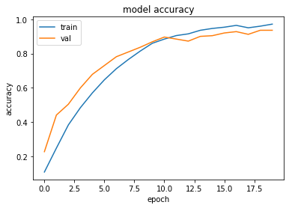
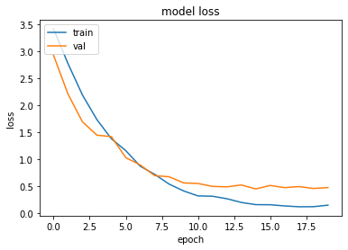
RESULTS
ACCURACY
LOSS
0.9667
0.1441

Slide 8
02. CIFAR DATASET

Slide 9
SELECTED ARCHITECTURE
Adam optimizer
Epochs: 20 (100 steps / epoch)
Conv 2D
32
Kernel: 3x3
ELU
Conv 2D
32
Kernel: 3x3
ELU
MaxPooling 2x2
Dropout 0.5
Conv 2D
64
Kernel: 3x3
ELU
Conv 2D
64
Kernel: 3x3
ELU
MaxPooling 2x2
Dropout 0.5
Conv 2D
128
Kernel: 3x3
ELU
Conv 2D
128
Kernel: 3x3
ELU
MaxPooling 2x2
Dropout 0.5
Dense
1028
ELU
Dropout 0.55

Slide 10
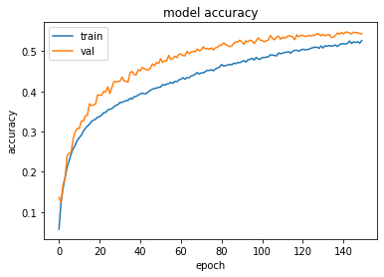
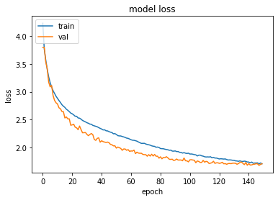
RESULTS
ACCURACY
LOSS
0.5502
1.6939

Slide 11
REFERENCES
Krizhevsky, Alex, et al. «ImageNet Classification with Deep Convolutional Neural Networks»
He, Kaiming, et al. «Deep Residual Learning for Image Recognition»
https://keras.io/

Slide 12
THANKS!
Does anyone have any questions?
Rodrigo Pueblas
Carlos Sánchez
Cristian Abrante

