Slide 1
Deep Learning model
For German traffic dataset and CIFAR

Slide 2
TABLE OF CONTENTS
01
02
German traffic dataset
Architecture, hyperparameters and results
CIFAR 100 dataset
Architecture, hyperparameters and results

Slide 3
Procedure
For training the neural network we tried several approaches
EarlyStopping.
Different activation functions.
Different optimization techniques.
Parameters grid.
Some of them failed, due to lack of computational resources and time

Slide 4
Parameters grid
For defining the hyperparameters, we defined all the combinations with a fixed architecture.
Num. units 1 | 300 | 500 | 1000
Num. units 2 | 250 | 500 | 1000
Dropout | 0.1 | 0.15 | 1.16
Learning rate | 0.001 | 0.0001
Optimizer | sgd | adam
First layer
Second layer
Input
output

Slide 5
01
German traffic dataset

Slide 6
SELECTED ARCHITECTURE
relu
Dropout 0.1
350 neurons
Tanh
Regularizer
Dropout 0.3
250 neurons
Tanh
Regularizer
Dropout 0.3
43 neurons
softmax
150 epochs
SGD optimizer
Lr = 0.0001
Input
First layer
Second layer
output

Slide 7
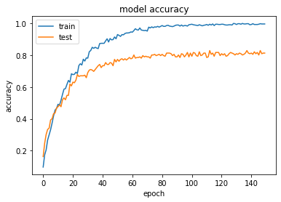
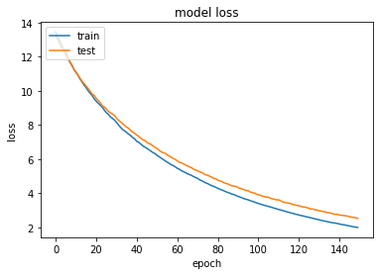
RESULT
Accuracy: 0.8975
Loss: 2.2976

Slide 8
02
CIFAR 100 dataset

Slide 9
SELECTED ARCHITECTURE
relu
Dropout 0.2
1024 neurons
Tanh
Dropout 0.2
43 neurons
softmax
512 neurons
relu
Dropout 0.2
512 neurons
relu
Dropout 0.2
100 epochs
SGD optimizer
Input
First layer
Second layer
Third layer
output

Slide 10
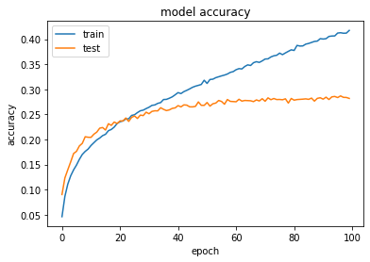
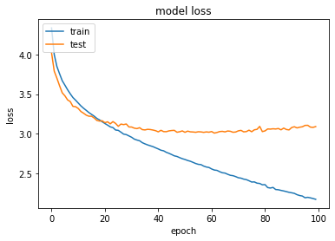
RESULT
Accuracy: 0.2952
Loss: 3.0581

Slide 11
THANKS
v
Do you have any questions?
Rodrigo Pueblas
Carlos Sánchez
Cristian Abrante

