Slide 1
Control Strategies for the Unicycle Model

Slide 2
Application Context
The Challenge: "The Pac-man Challenge" using a unicycle robot.
Navigation: Driving the robot through a maze-like scenario to reach a central parking area.
Technical Scope: Combining continuous trajectory tracking with a final regulation task (parking in the box).

Slide 3
Motivation
Real-World Relevance: Simulating autonomous navigation for constrained environments, such as automated warehouse logistics or self-parking vehicles.
Algorithmic Validation: Bridging theoretical control models with practical applications by testing tuning and stability across different navigation phases.

Slide 4
Main Issues Addressed
Nonlinear system dynamics
Nonholonomic constraint
Trajectory tracking vs pose regulation
Stability guarantees

Slide 5
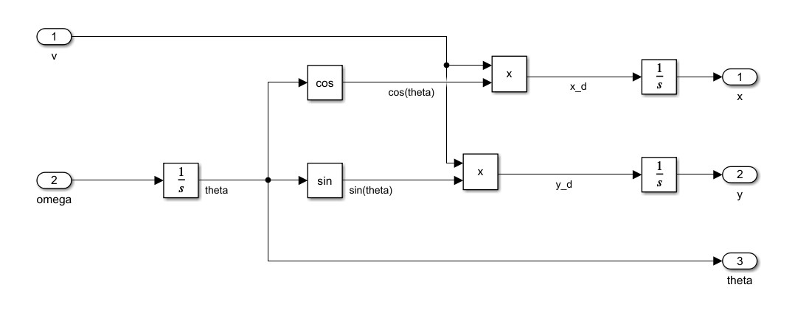
Unicycle Kinematic Model
State: x, y, theta

Slide 6
Overview of Proposed Approaches

Slide 7
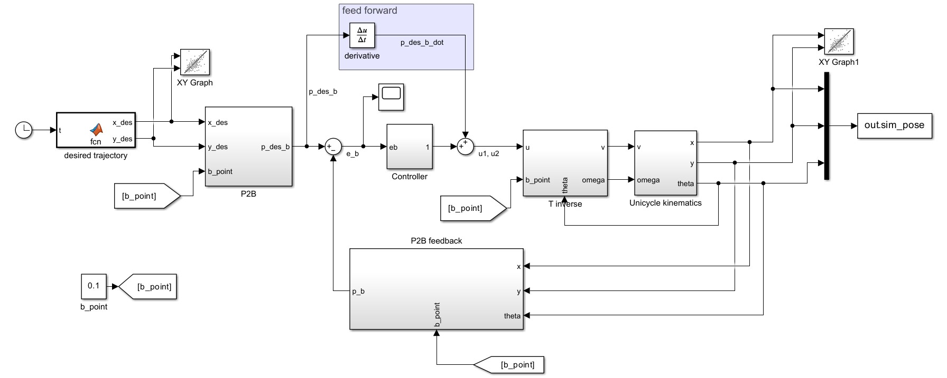
B-Point control

Slide 8
B-Point Method – Objective
Trajectory tracking via virtual point
Simplifies nonlinear control problem
Geometric transformation approach

Slide 9
B-Point Method – Theory
Definition of virtual point ahead of robot
Coordinate transformation
Linearizable structure

Slide 10
B-Point – PROS & CONS
PROS
Easy to implement
It works great in smooth trajectory
CONS
Tipically local stability
Dependency on the b point distance

Slide 11
B-Point – Results
Plot: desired vs actual trajectory (x-y)
Plot: tracking error over time
Plot: control inputs v(t), omega(t)

Slide 12
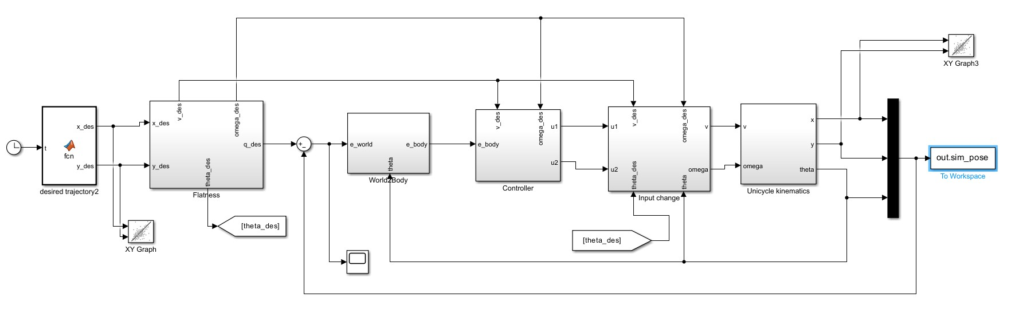
State Error Feedback Linear – Objective
Trajectory tracking
Feedback linearization
Differential flatness property

Slide 13
State Error Feedback Linear Method – Theory
Differential flatness property
Feedback linearization of error dynamics

Slide 14
State Error Feedback Linear Method – PROS & CONS
PROS
Systematic control design
Linear error dynamics
CONS
Model accuracy dependent
Local stability guarantees

Slide 15
State Error Feedback Linear Method – Results
Plot: tracking error over time
Plot: desired vs actual trajectory
Comparison with B-point method

Slide 16
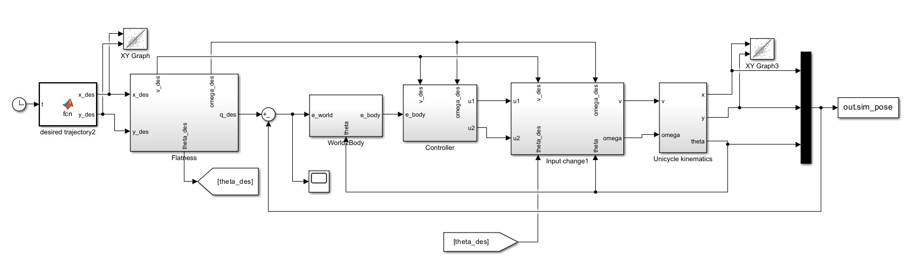
State Error Feedback Nonlinear – Objective
Full nonlinear feedback design
Improved robustness potential

Slide 17
State Error Feedback Nonlinear – Theory
Nonlinear error dynamics shaping
Lyapunov-based stability design

Slide 18
State Error Feedback Nonlinear – PROS & CONS
PROS
Improved global stability properties
Better nonlinear behaviour handling
CONS
More complex controller design
Harder stability analysis

Slide 19
State Error Feedback Nonlinear – Results
Plot: tracking error
RMS error comparison
Control effort comparison

Slide 20
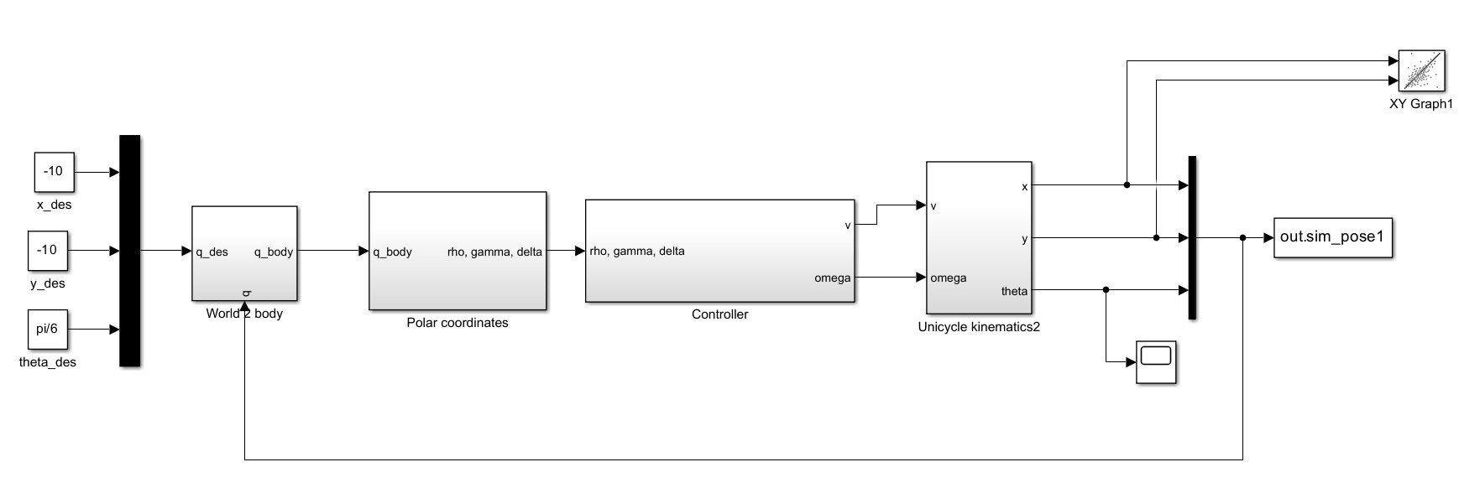
Pose Regulation – Objective
Stabilize robot to target pose
Fixed point regulation problem

Slide 21
Pose Regulation - Theory
Polar coordinate error transformation
Nonlinear feedback stabilization

Slide 22
Pose Regulation – difficulties
Nonholonomic motion constraints
Singularities in polar coordinates

Slide 23
Pose Regulation – Results
Plot: rho(t), alpha(t), beta(t)
Plot: trajectory convergence (x-y)
Plot: theta(t) convergence

Slide 24
Comparative Analysis
Complexity comparison
Stability properties
Tracking precision
Robustness differences

Slide 25
Discussion
Trade-off simplicity vs performance
Sensitivity to gains
Practical applicability

Slide 26
Conclusions
Summary of all approaches
Performance comparison
Best performing strategy (based on results)

