Slide 1

Lung Cancer Detection

Slide 2
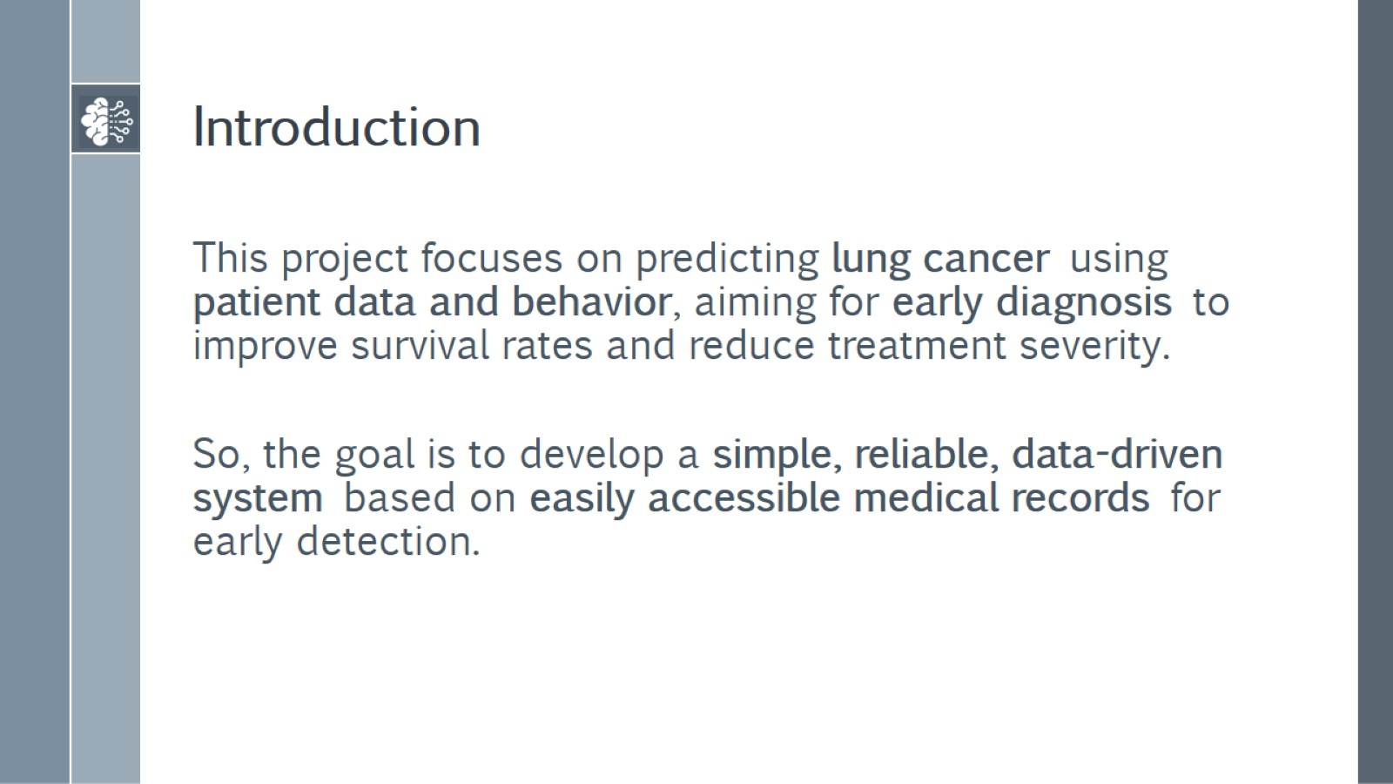
Introduction

Slide 3
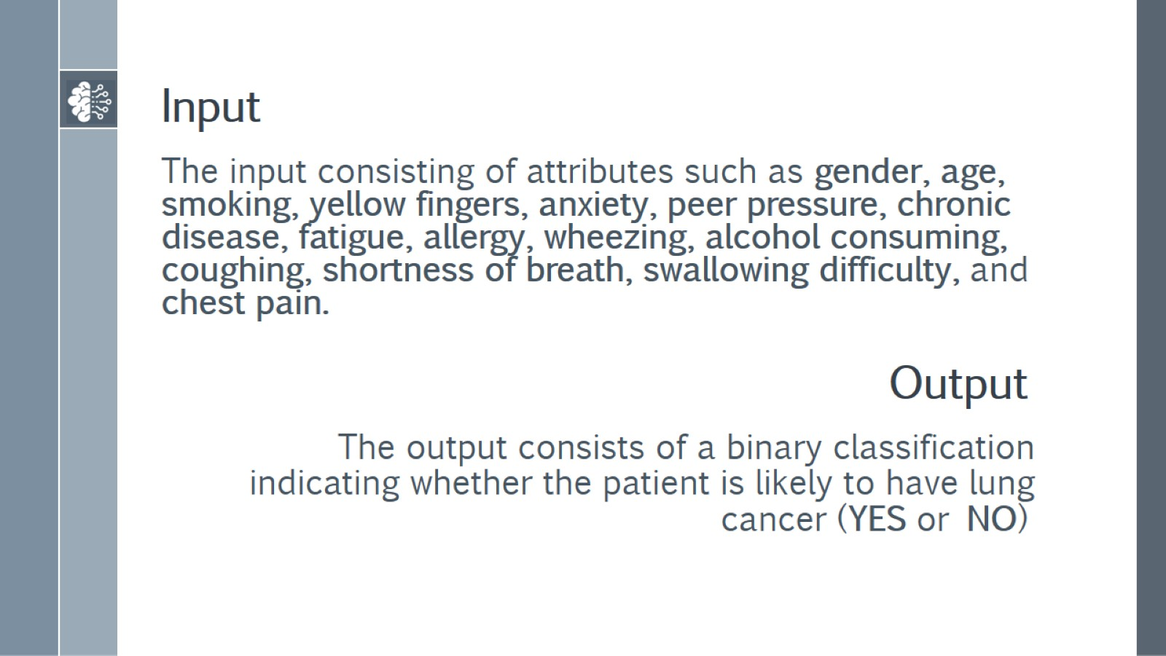
Input

Slide 4
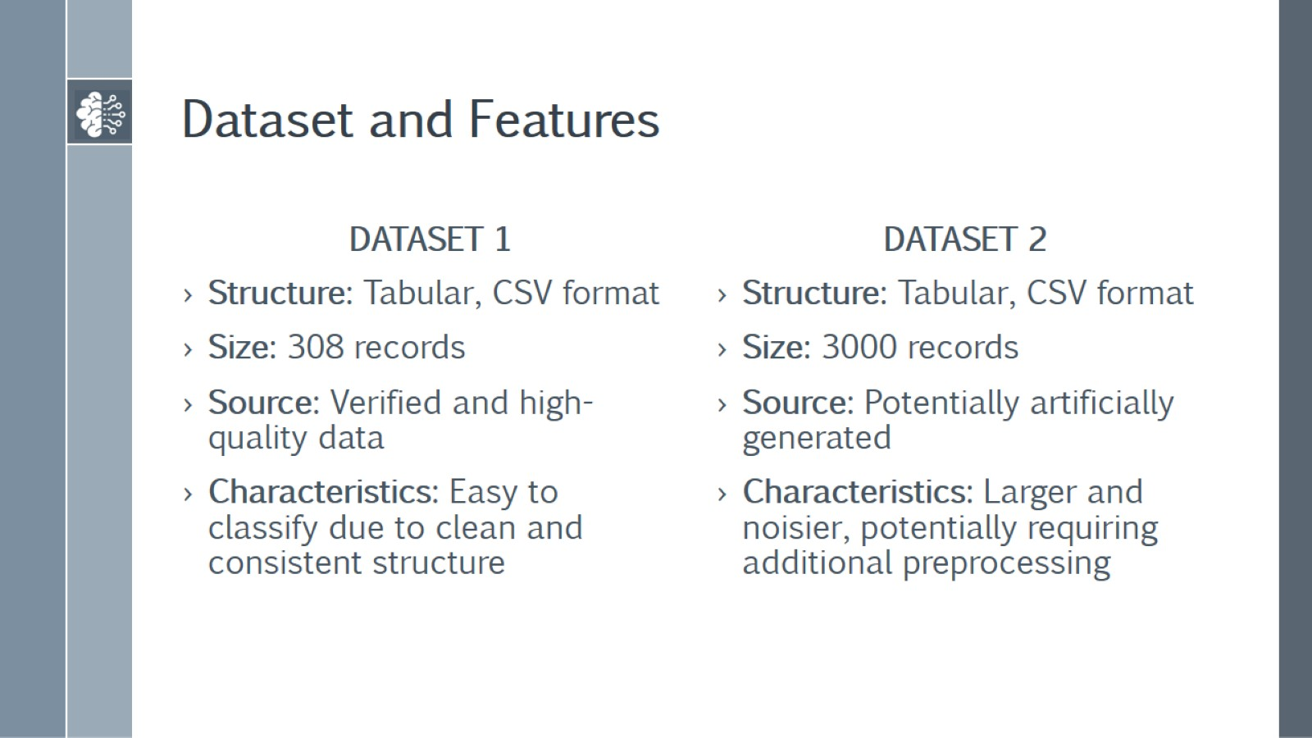
Dataset and Features

Slide 5
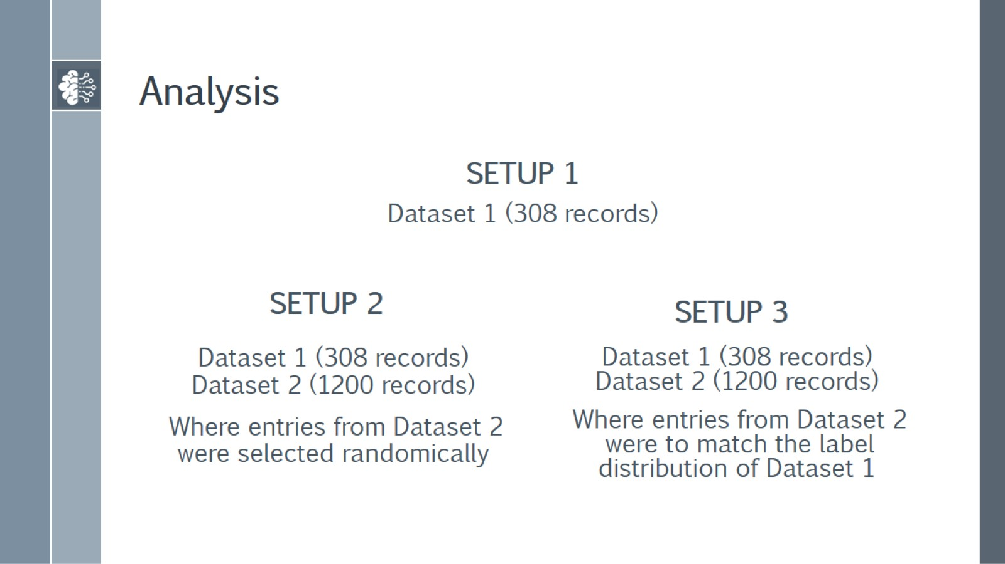
Analysis

Slide 6
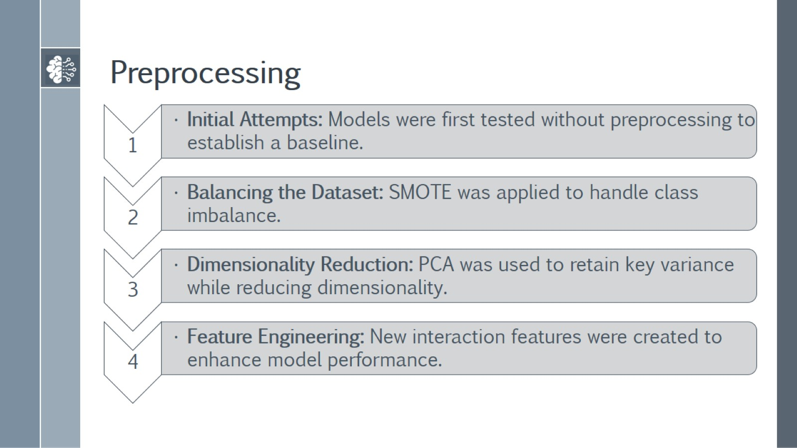
Preprocessing

Slide 7
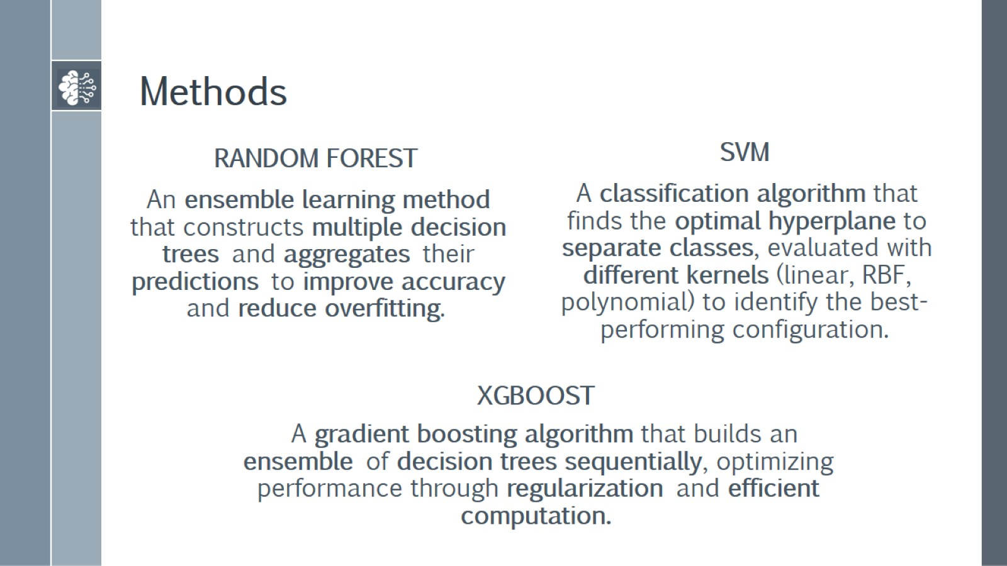
Methods

Slide 8
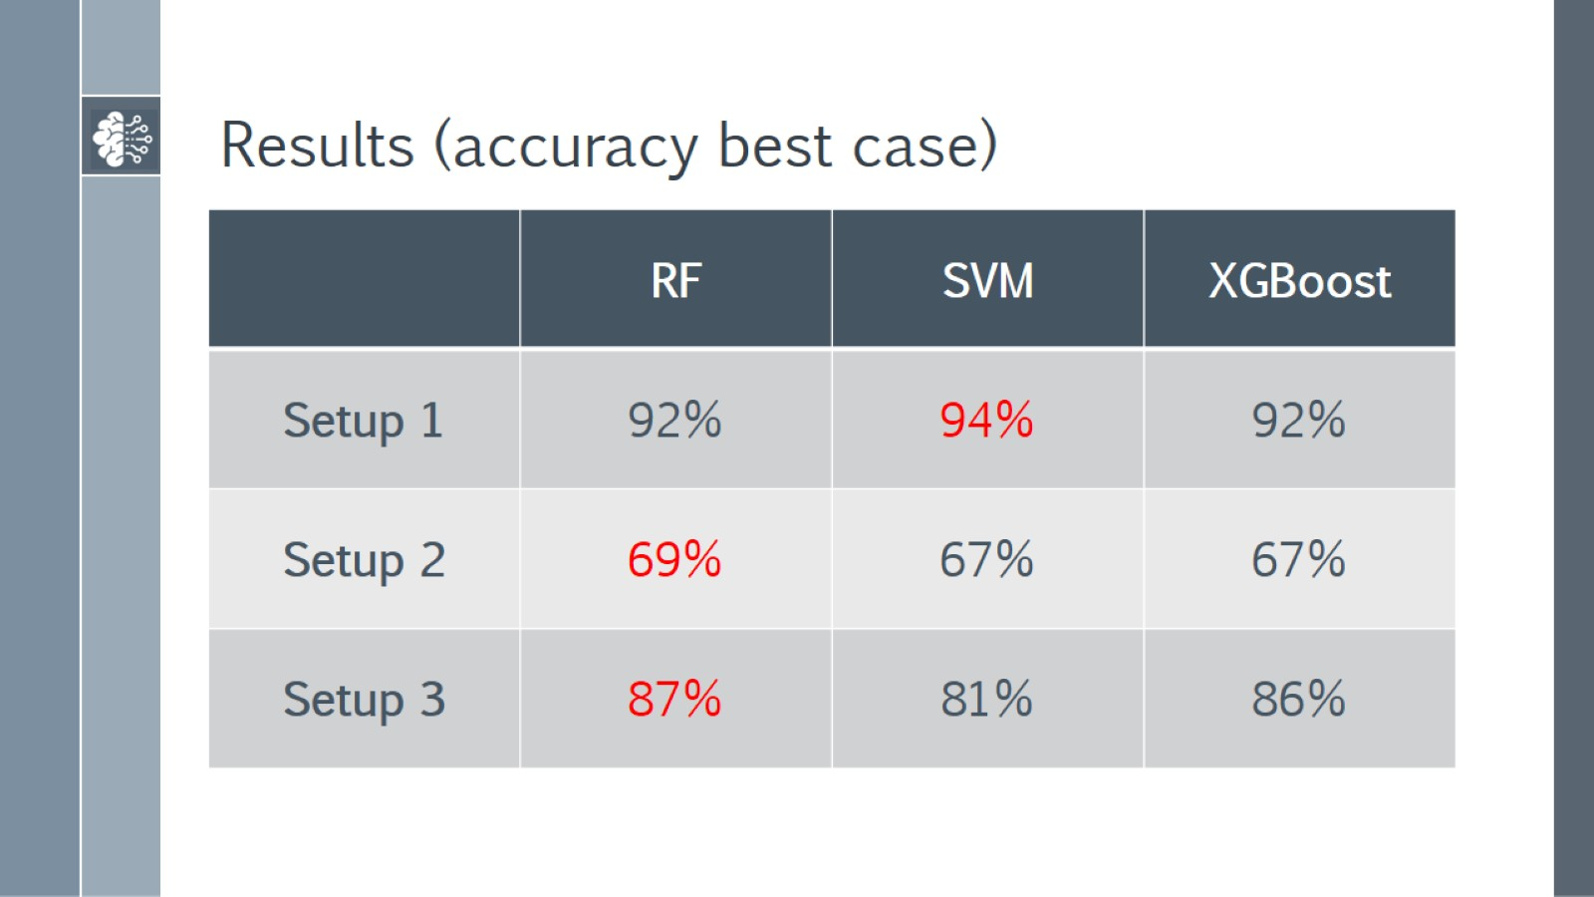
Results (accuracy best case)

Slide 9

Conclusion…
While not fully reliable for definitive diagnoses, this approach aims to exclude individuals who show no apparent risk of lung cancer, thus streamlining the focus on higher-risk cases.
…Future Work
Dataset Expansion: Incorporating lung X-ray images
Algorithm Optimization: Implementing deeper preprocessing and feature engineering steps
Model Exploration: Experimenting with advanced models, such as neural networks

Slide 10

The end

