Slide 1
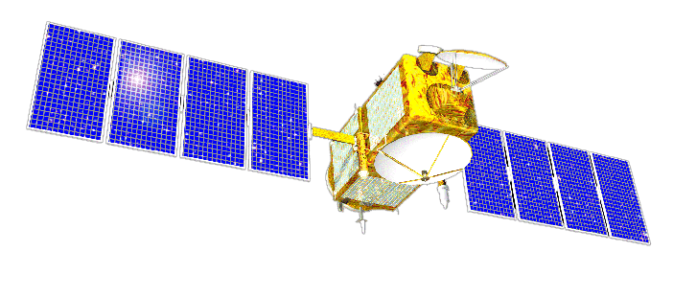
Satellite assembly
Multilingual application example

Slide 2
Assembly
Assembly is the smallest unit of deployment of a .net application. It can be a dll or an exe. There are mainly two types to it:
Private Assembly: The dll or exe which is sole property of one application only. It is generally stored in application root folder
Public/Shared assembly: It is a dll which can be used by multiple applications at a time. A shared assembly is stored in GAC i.e Global Assembly Cache.
Notes:
Un ansamblu este de fapt o bucata de cod, precompilat, ce va fi executat la lansarea unei aplicatii .net. O aplicatie .NET poate fi compusa din unul sau mai multe ansamble.

Slide 3
Satellite Assembly? (I)
A satellite assembly is a compiled library (DLL) that contains (“localizable”) resources such as strings, bitmaps, etc. You are likely to use them when creating a multilingual (UI) application. Satellite assemblies provide you with the capability of designing and deploying your solution to multiple cultures, rather than hard coding strings, bitmaps, etc., into your main application. Satellite assemblies are used to deploy applications in multiple cultures (not languages), with 1 satellite assembly per culture - this is the default behavior, but you can obviously have more granular control if you handle the build process manually.
Notes:
Dynamic-link library care contine resursele aferente unei anumite “culturi”/zone. Se folosesc pentru creearea de aplicatii cu suport multilingvistic, un ansamblu satelit pentru o cultura.

Slide 4
Satellite Assembly? (II)
By definition, satellite assemblies do not contain code, except for that which is auto generated. Therefore, they cannot be executed as they are not in the main assembly. However, note that satellite assemblies are associated with a main assembly that usually contains default neutral resources (for example, en-US). A big benefit is that you can add support for a new culture or replace/update satellite assemblies without recompiling or replacing the application’s main assembly.

Slide 5
Satellite Assembly? (III)
Resource files have the extension .resx and are stored in folders matching the culture. Once compiled, .resources files are created. These are binary representations of the .resx files. Once the satellite assembly is generated, the resources will be stored in a .dll file.

Slide 6
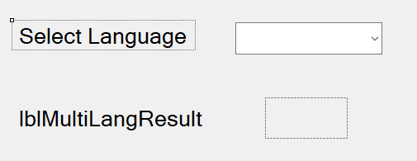
Steps in developing satellite assembly example (I)
1. Create a new Windows Form project (SatelliteAssemblyExample)
2. Add items to design:
ComboBox for select the language, with coresponding label (text: Select Language)
Label for display the result (lblMultiLangResult)
PictureBox for display the right flag

Slide 7
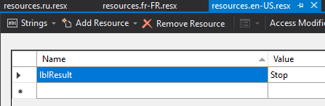
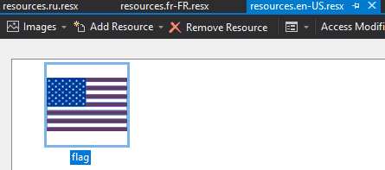
Steps in developing satellite assembly example (II)
3. Add the Resx files (resources.en-US.resx, resources.fr-FR.resx, resources.it.resx, resources.ja.resx, resources.ru.resx for English, French, Italian, Japanese and Russian, respectively)
For ex. resources.en-US.resx: Strings
Images

Slide 8
Steps in developing satellite assembly example (III)
4. Create the object for the resource manager
Here in the first parameter: SatelliteAssemblyExample is the name of the Windows Application and resources is the name of the Resource file part before the language code. Second parameter is the Main Assembly for the resources

Slide 9
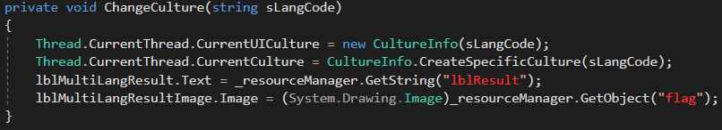
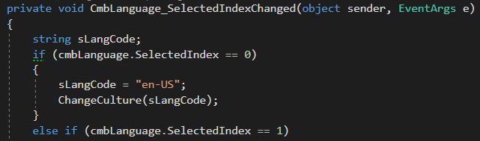
Steps in developing satellite assembly example (IV)
5. Write the function for the culture:
6. On the ComboBox item change event, add the following code (ex for US):
7. On page load, add the following line of code:
8. Run application.

Slide 10
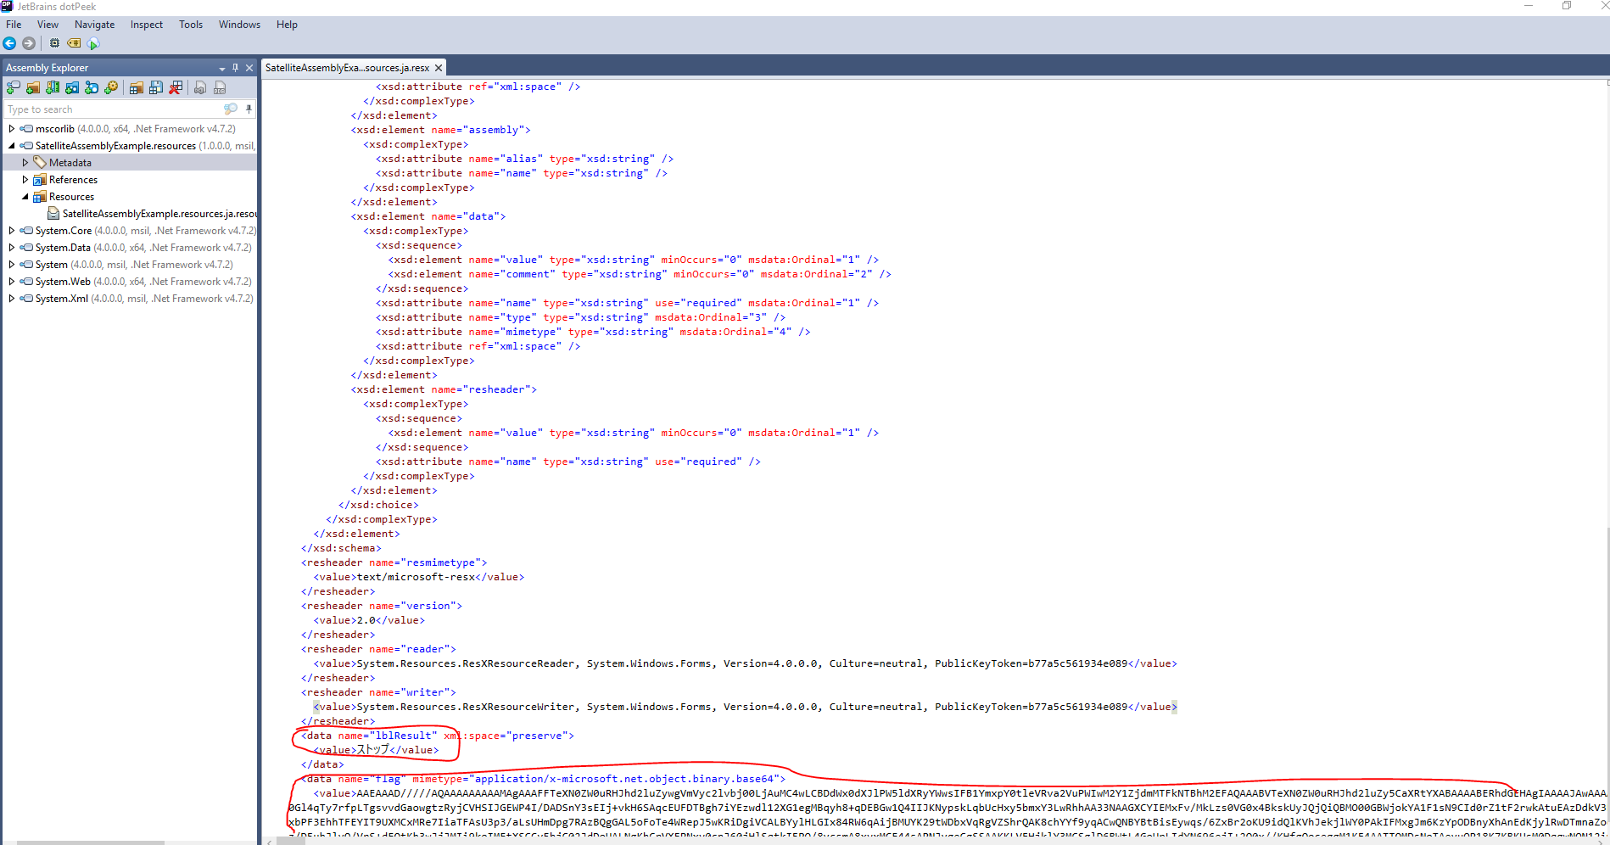
Show assembly in decompiler

Slide 11
Bibliography
https://blogs.msdn.microsoft.com/global_developer/2011/07/22/introduction-to-satellite-assemblies/
https://www.codeproject.com/Articles/352105/Satellite-Assembly-Example-in-Csharp-Step-by-Step
http://www.lingobit.com/help/retrieving_resources_in_satellite_assemblies.htm

Slide 12
Thank you

