Slide 1
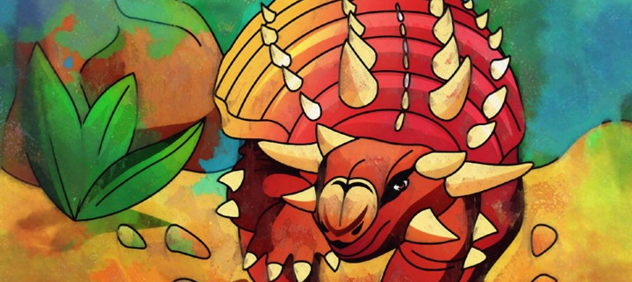
Dinosaurs
Ms. Wagner’s Second Grade
Notes:
Today we are going to start our study of dinosaurs.

Slide 2
Fun Facts on Dinosaurs
Dinosaurs lived on all continents
Dinosaurs ruled the Earth for over 160 million years
Scientists believe that the event leading to the extinction may have been a massive asteroid impact or huge volcanic activity
A person who studies dinosaurs is known as a paleontologist
Dinosaur means “Terrible Lizard”

Slide 3
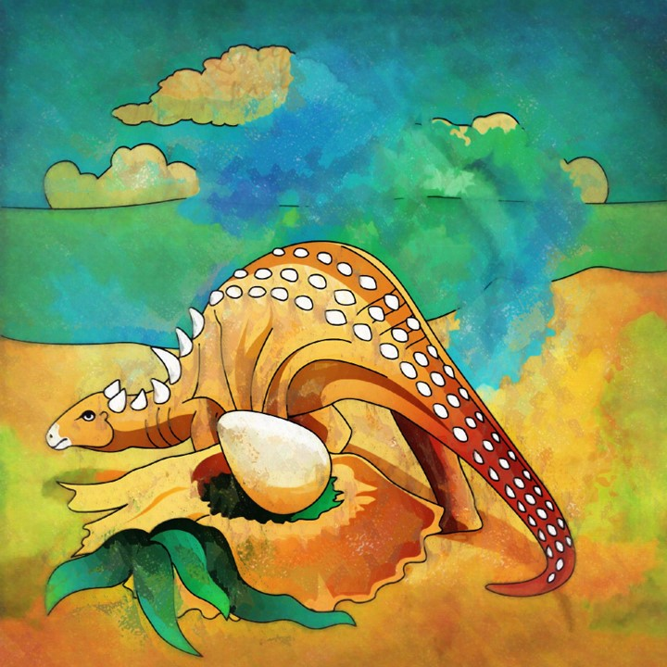
Ankylosaurs
Ankylosaurs is one of the largest armor plated dinosaurs ever discovered.
They were approximately 30 feet long, 6 feet wide, 4 feet tall and weighed right around 4 tons.
They lived during the Cretaceous Period.

Slide 4
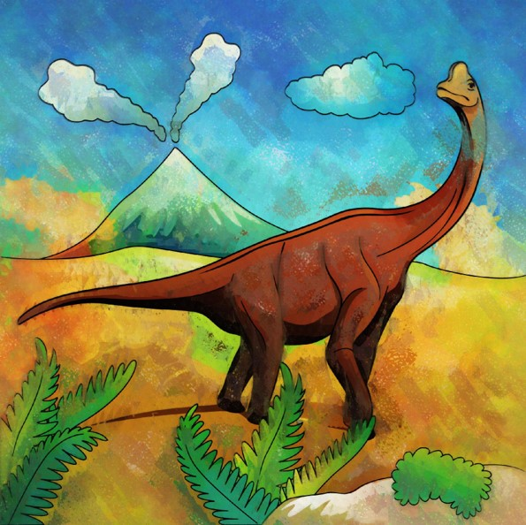
Brachiosaurus
Brachiosaurus were known to be herbivores.
They lived during the Jurassic Period.
They were massive animals that stood about 23 feet high, were 85 feet long and weighed between 30 through 80 tons.

Slide 5
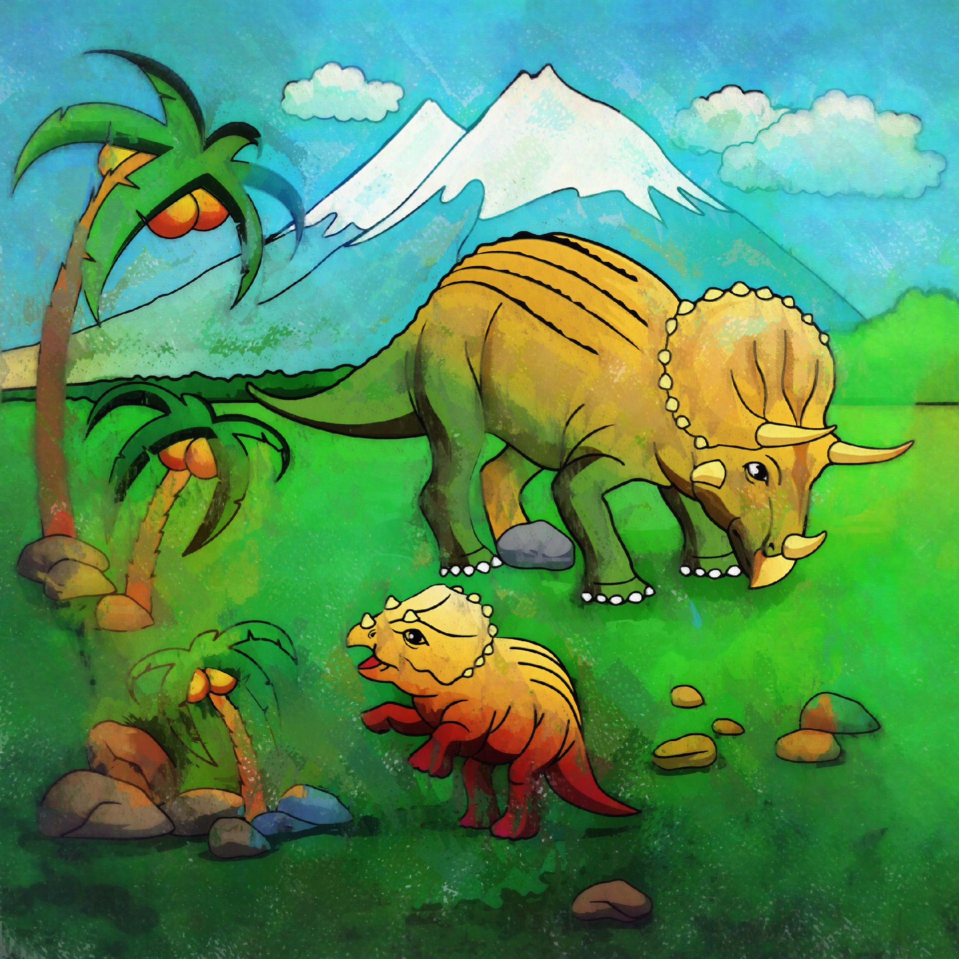
Triceratops
Triceratops was a herbivore.
They lived in the Cretaceous period and inhabited North America.
They could weigh anywhere between 6 and 12 tons. Which is about the weight of a modern diesel truck.
They measured over 10 feet in height.

Slide 6
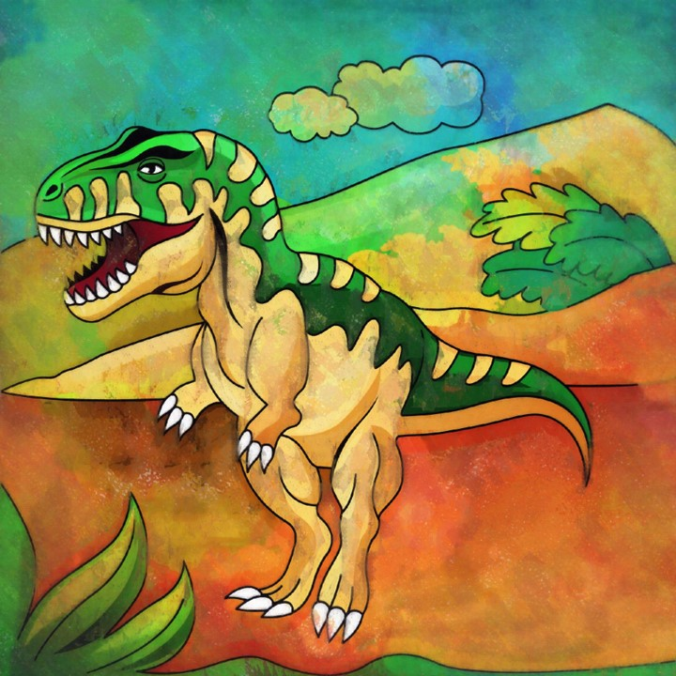
Tyrannosaurus
They were considered to be one of the largest carnivorous dinosaurs to have ever walked the Earth and its very name means “tyrant lizard”.
They lived during the late Cretaceous Period.

Slide 7
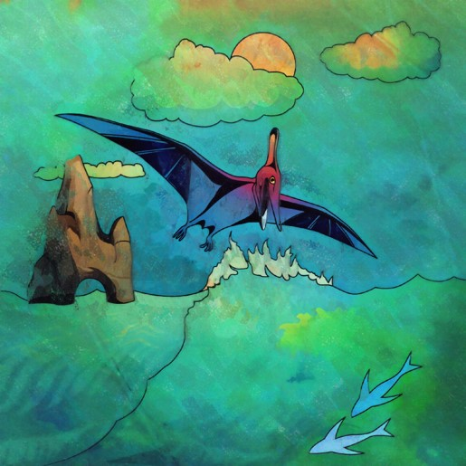
Pterosaur
They were carnivores and scavengers.
They first appeared in the late Triassic Period and roamed the skies until the end of the Cretaceous Period.
They lived among the dinosaurs and became extinct around the same time, but they were not dinosaurs. Rather, pterosaurs were flying reptiles.

Slide 8
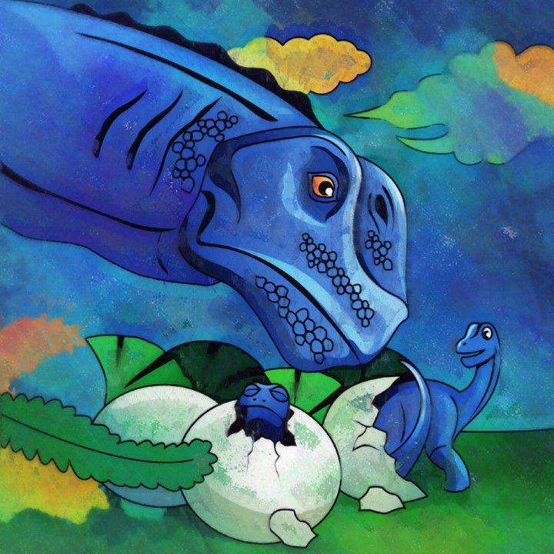
Questions?

