Slide 1


DTA301 - PROJECT
GROUP 6
IN-DEPTH ANALYSIS OF
Data Professions

Slide 2



1. INTRODUCTION
2. METHODOLOGY
3. DATA TRANSFORMATION
MAIN
CONTENTS
4. ANALYSIS
WITH R
5.VISUALIZATION
WITH
POWER-BI

Slide 3
Introduction To Project
BASIC INFORMATION
OBJECTIVE
This report analyzes key trends in the data profession based on a survey of 630 professionals from various regions, including the U.S., U.K., Canada, and India.
It focuses on average salaries by job title, favorite programming languages, and the challenges of entering the field.
The goal is to provide insights into the data profession landscape, helping professionals and organizations understand career trends and challenges.

Slide 4
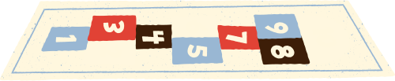


Methodology
Data Collection Methods | Data Analysis Methods | Tools and Software
The Home of the U.S. Government's Open Data | Key statistical techniques and visualizations, such as bar charts, pie charts, and linear regression were utilized to illustrate insights from the survey | R programming language: Used for data processing, statistical analysis, and visualization.
 | Key statistical techniques and visualizations, such as bar charts, pie charts, and linear regression were utilized to illustrate insights from the survey | Microsoft Power BI: Used to create interactive visualizations of data.

Slide 5
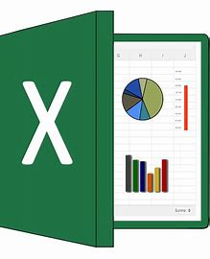
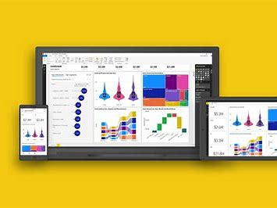
Data Transformation
For R Analysis | For Power-BI Analysis
Manually perform by executing functions and calculation methods | Power Query Editor
Manually perform by executing functions and calculation methods | Power Query Editor

Slide 6
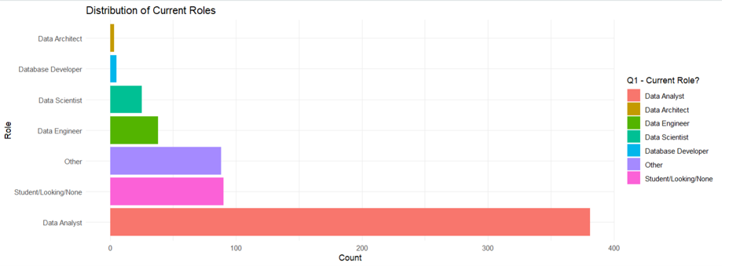
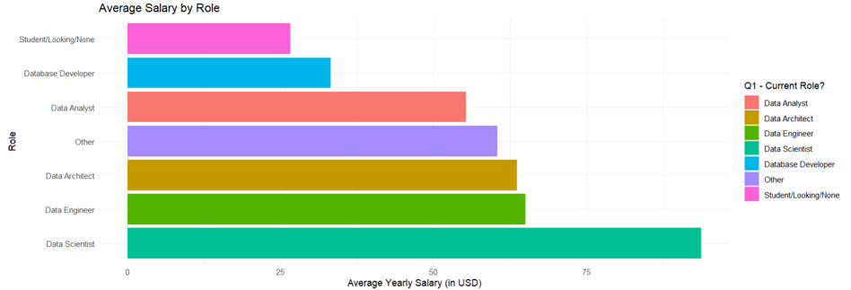
Visualization with R
General
Distribution of Current Roless | Salary Distribution by Role
This presents an overview of the job market in the data industry, with high demand for data analysis and data science professionals. | Clearly illustrates the relationship between salary and roles in the data field. Specialized skills and market demand are the key factors influencing the salary for each role.
This presents an overview of the job market in the data industry, with high demand for data analysis and data science professionals. | Clearly illustrates the relationship between salary and roles in the data field. Specialized skills and market demand are the key factors influencing the salary for each role.

Slide 7
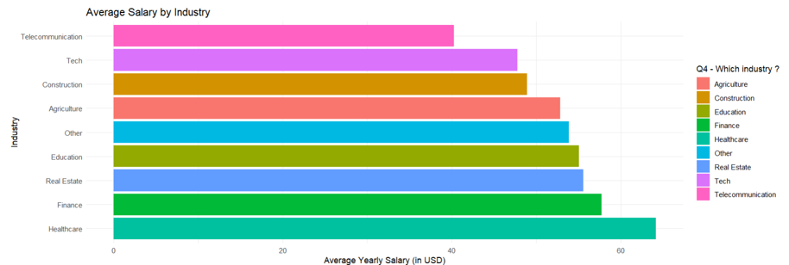
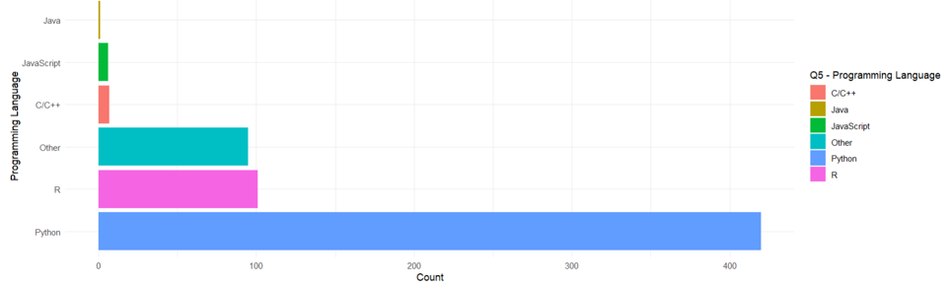
Visualization with R
General
Salary Distribution by Industry | Common Programming Languages
The chart illustrates the salary disparity across industries, with the tech sector leading. Factors such as market demand, data complexity, and the importance of analytics in each industry affect salaries. The salary gap could motivate data professionals to further develop their careers. | The chart shows Python's dominance in the data space, but other languages ​​like SQL, R, JavaScript, Scala, and Java still have important roles to play. Data professionals need to master the right languages ​​to meet market demands and project requirements
The chart illustrates the salary disparity across industries, with the tech sector leading. Factors such as market demand, data complexity, and the importance of analytics in each industry affect salaries. The salary gap could motivate data professionals to further develop their careers. | The chart shows Python's dominance in the data space, but other languages ​​like SQL, R, JavaScript, Scala, and Java still have important roles to play. Data professionals need to master the right languages ​​to meet market demands and project requirements

Slide 8
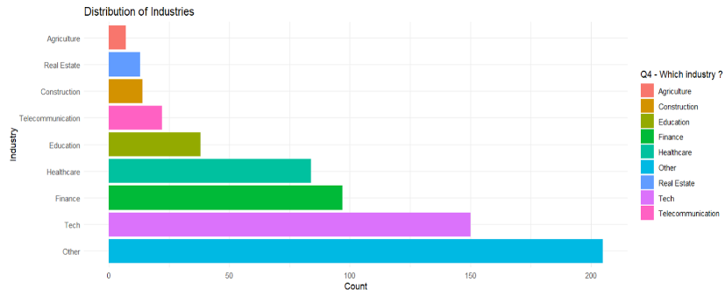
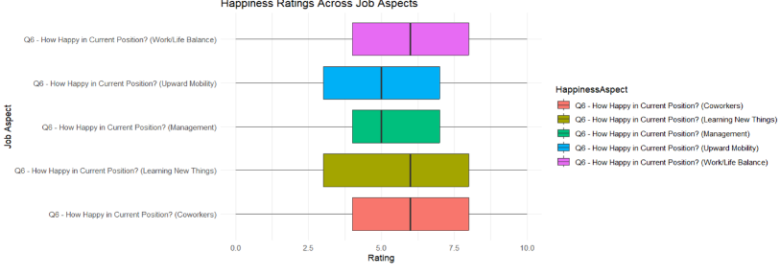
Visualization with R
General
Distribution of Industries | Happiness Ratings
 | (Work/Life Balance, Coworkers, Management, Upward Mobility, Learning New Things)
The chart shows the diversity of industries using data, with technology and banking and finance leading the way. Traditional industries are gradually transforming digitally and increasing their use of data. | Employee satisfaction ratings show that the data industry has a positive work environment and good growth opportunities. However, management needs to be improved and career paths need to be clearer to increase satisfaction and retain talent.
The chart shows the diversity of industries using data, with technology and banking and finance leading the way. Traditional industries are gradually transforming digitally and increasing their use of data. | Employee satisfaction ratings show that the data industry has a positive work environment and good growth opportunities. However, management needs to be improved and career paths need to be clearer to increase satisfaction and retain talent.
(Work/Life Balance, Coworkers, Management, Upward Mobility, Learning New Things)

Slide 9
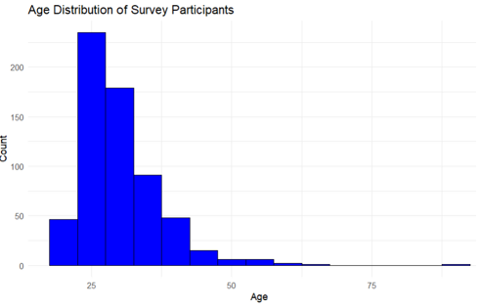
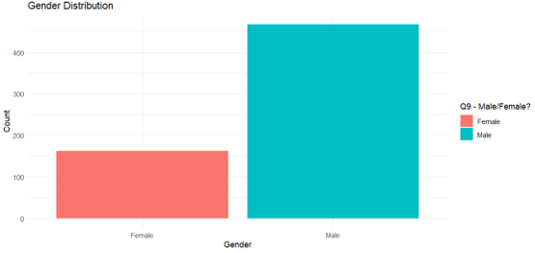
Visualization with R
General
Gender Distribution | Age Distribution
The chart shows a serious gender imbalance in the data industry. Policies and initiatives are needed to attract women to the industry and increase gender diversity. Gender diversity can bring many benefits to the industry, such as increased creativity and team effectiveness. | The chart shows an age imbalance in the data industry, with younger generations in the majority. Supportive policies are needed to help older adults transition successfully and integrate experience. The age distribution may change as the industry matures
The chart shows a serious gender imbalance in the data industry. Policies and initiatives are needed to attract women to the industry and increase gender diversity. Gender diversity can bring many benefits to the industry, such as increased creativity and team effectiveness. | The chart shows an age imbalance in the data industry, with younger generations in the majority. Supportive policies are needed to help older adults transition successfully and integrate experience. The age distribution may change as the industry matures

Slide 10
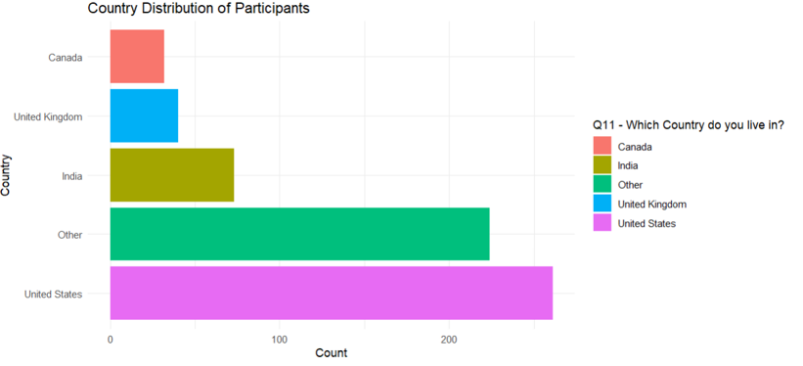
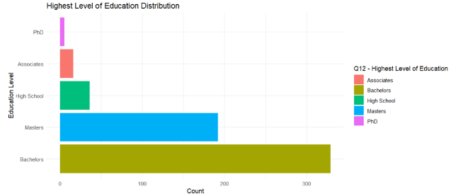
Visualization with R
General
Country Distribution | Education Level Distribution
The chart shows the uneven distribution of data professionals globally, with the US and India leading the way. Other regions such as Asia are emerging as potential markets. Regional differences could create opportunities for remote work and influence companies’ global hiring strategies | The chart shows that the education requirements for the data industry are relatively high, with a master’s degree being the most common. However, bootcamps and self-paced programs are emerging as alternatives to traditional education, opening up many opportunities for those without a master’s or doctorate
The chart shows the uneven distribution of data professionals globally, with the US and India leading the way. Other regions such as Asia are emerging as potential markets. Regional differences could create opportunities for remote work and influence companies’ global hiring strategies | The chart shows that the education requirements for the data industry are relatively high, with a master’s degree being the most common. However, bootcamps and self-paced programs are emerging as alternatives to traditional education, opening up many opportunities for those without a master’s or doctorate

Slide 11
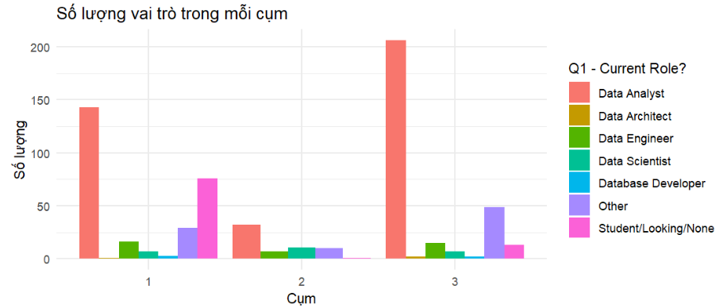
Visualization with R
In-depth
1.Clustering Algorithm (k-means) | Clustering job roles based on average salary and programming languages.
K-means is a clustering algorithm used to divide a set of data into k groups (clusters) based on the features of the data. The purpose of this chart is to help users better understand the distribution and relationships between clusters in the data space
INSIGHTS | Cluster 1 & Cluster 3 primarily consist of Data Analyst roles, with more than 150 people in each cluster. Cluster 2 has a more balanced distribution of roles, with a significant number of roles such as Student/Looking/None, Data Engineer, and Data Architect.
INSIGHTS | Cluster 1 & Cluster 3 primarily consist of Data Analyst roles, with more than 150 people in each cluster. Cluster 2 has a more balanced distribution of roles, with a significant number of roles such as Student/Looking/None, Data Engineer, and Data Architect.

Slide 12
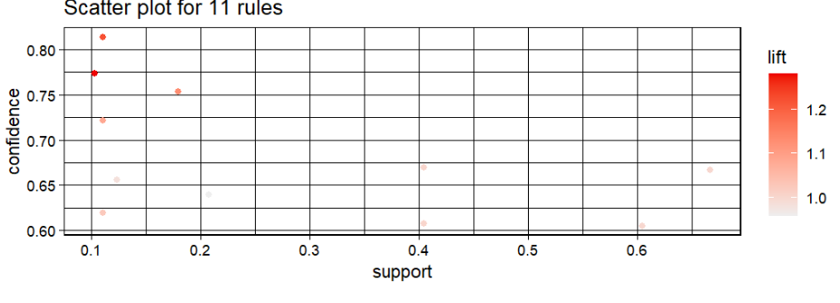
Visualization with R
In-depth
2.Association Rules (Apriori) | Analyzing the association of three attributes - Discovering rules or relationships such as "People working in industry A with role B often use programming language C."
The main purpose of Association Rule Analysis is to discover relationships or hidden patterns between attributes in the data.
INSIGHTS | Rules with low support but high confidence Lift not too high, indicating that these association rules are not very strong Dispersion of rules
INSIGHTS | Rules with low support but high confidence Lift not too high, indicating that these association rules are not very strong Dispersion of rules

Slide 13
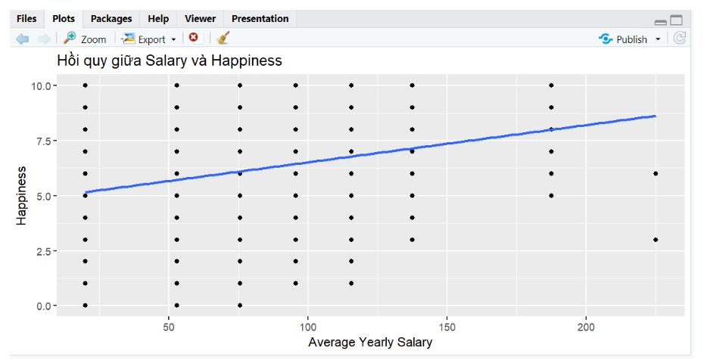
Visualization with R
In-depth
3.Linear Regression Model | Utilize multiple independent variables to assess their combined impact on the dependent variable. This helps identify the factors that strongly affect the target.
Linear Regression is a statistical method used to model the relationship between a dependent variable (target variable) and one or more independent variables (predictor factors). Linear regression aims to find the best-fitting straight line (regression line) that describes the relationship between these variables.
INSIGHTS | The chart shows a positive relationship between average yearly salary and job satisfaction levels. This means that as salary increases, job satisfaction also tends to increase.
INSIGHTS | The chart shows a positive relationship between average yearly salary and job satisfaction levels. This means that as salary increases, job satisfaction also tends to increase.

Slide 14

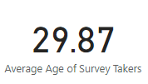


Visualization with Power-BI
1.Total number of survey takers | 2.Average age of survey takers

Slide 15
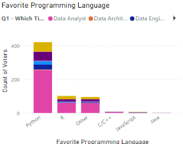
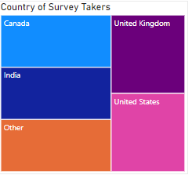
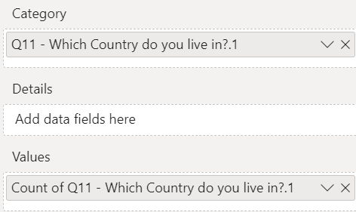
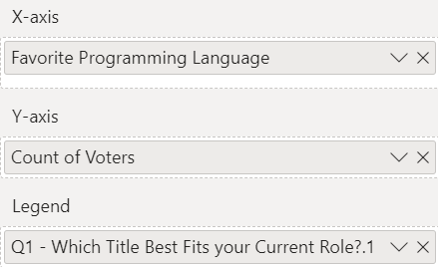
Visualization with Power-BI
3.Country of survey takers | 4.Favorite programming Language

Slide 16
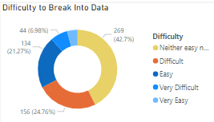
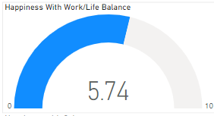
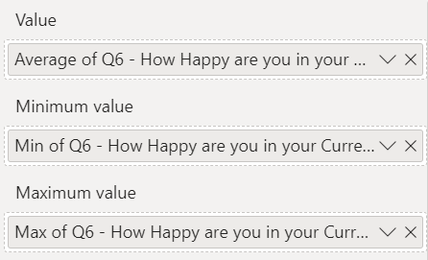
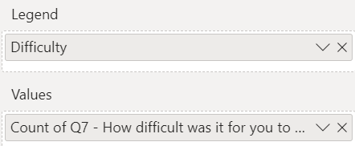
Visualization with Power-BI
5.Difficulty to break into data profession | 6.Happiness with Work/Life Balance

Slide 17
THANK YOU

