Slide 1
JustAsk!
By Cristiano Firmani and Justin Saborouh

Slide 2
The Problem
Ever run out of things to say to keep a conversation going?
Ever in need of a fun, but not too edgy nor zany icebreaker?
Would you like to annoy Rene German with random questions?

Slide 3
The Solution
Similar concept to ask.fm or /r/AskReddit
Able to see top questions submitted by people
Able to give answers to top questions that will show on your profile
Rating system

Slide 4
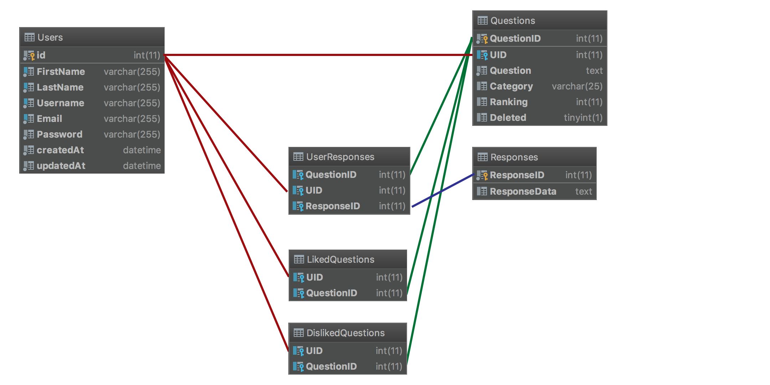
Schema Data Diagram

Slide 5

Demo

