Slide 1
A smart strategist for Risk
ARI2201 - Individual Assigned Practical Task
Cristina Cutajar

Slide 2

Introduction
Proposal offered by Dr Ingrid Vella and Dr Kristian Guillaumier.
The aim for this project is to implement the game of Risk and develop a smart strategist for it.
The smart strategist should be able to learn and suggest which actions should be taken in order to maximise its chances of achieving the goal which is winning the game.
It focuses on Machine Learning.

Slide 3
Objectives
Correctly implement the game of Risk with all its features and rules.
Develop an agent for the game.
The implementation of a reinforcement learning algorithm is a must for the agent to effectively learn which actions it should take for each state by interacting with the environment.
The agent should be able to choose the best actions that should be taken during gameplay for each player state based on its learnt state action values.

Slide 4
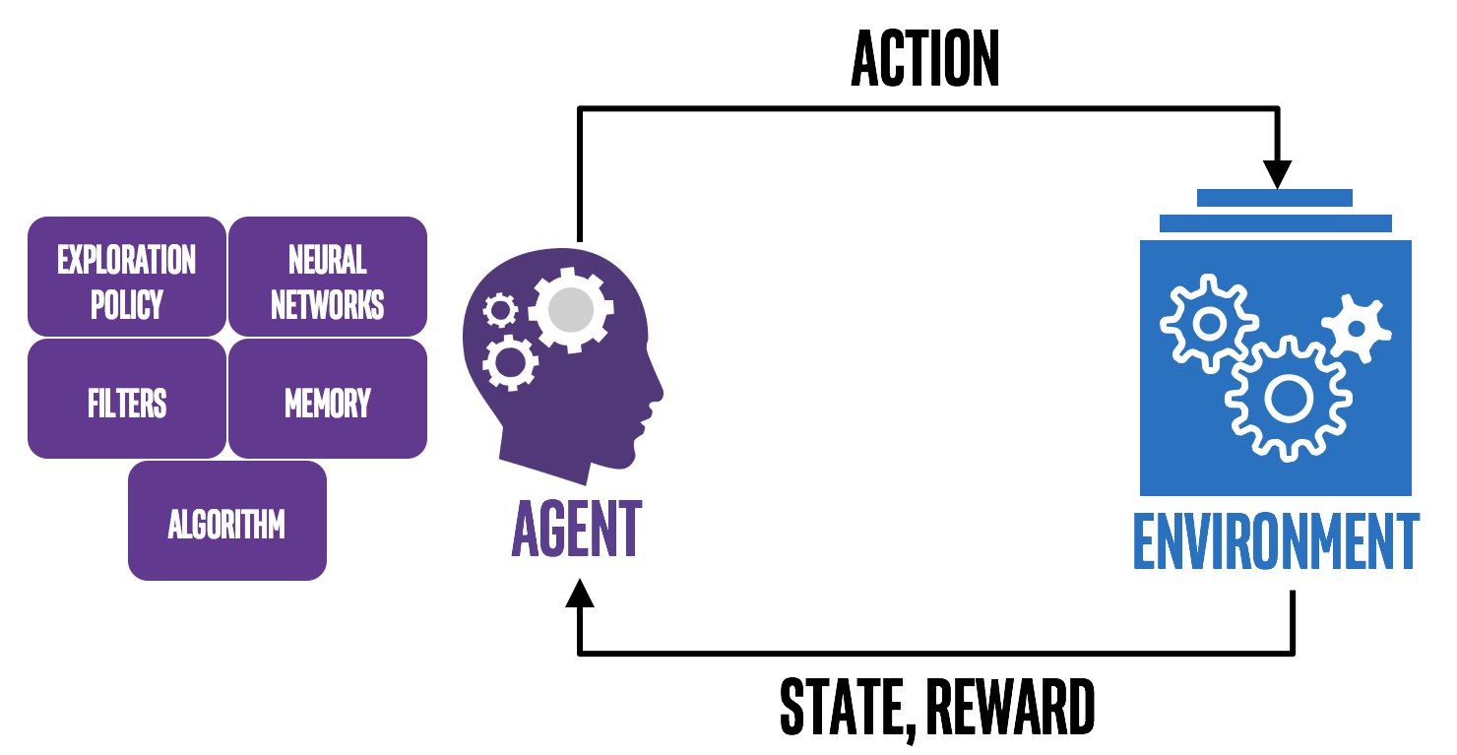
Implementation
Before starting the implementation, research about the game of Risk, all its rules and requirements was made.
Afterwards, research about different reinforcement learning algorithms was performed to choose the best algorithm for the agent to be able to learn and play the game.
Finally, I decided to start the implementation in Python.

Slide 5
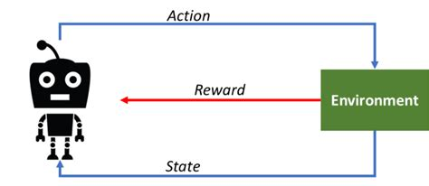

Implementation
On-Policy Monte Carlo reinforcement learning algorithm was chosen.
Agent was developed to learn attack and defend moves:
Choosing whether to attack and with how many dice:
Based on attacker number of troops and defender number of troops
Choosing the number of dice to defend with
Based on defender number of troops and attacker number of dice

Slide 6
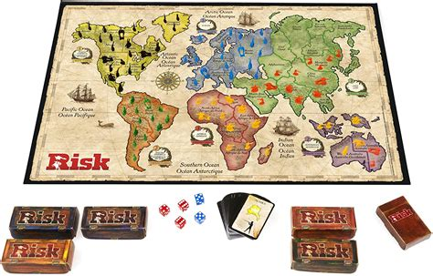
Implementation
In order to fully implement all the requirements of this proposal, the following classes were implemented:
Territories class,
Continents class,
Map class,
Player class,
Cards class,
Risk class.
The main function was also implemented.

Slide 7
Implementation
The Territories, Continents, Player and Cards classes are used to create the needed objects to keep important information used during gameplay.
Such as the territories, continents and cards owned by a player.
The game of Risk contains 42 cards, each having a territory and either an Infantry, a Cavalry or an Artillery, as well as an additional 2 wild cards. This was implemented in the Cards class.

Slide 8
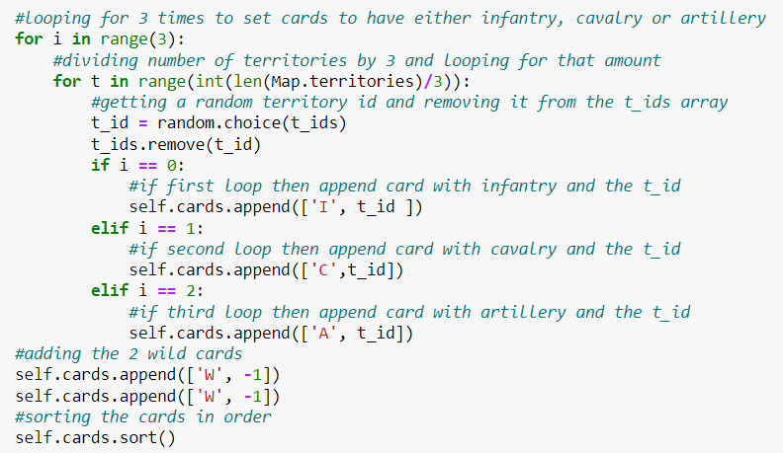
Cards class

Slide 9
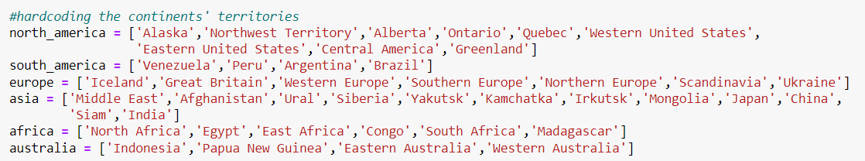
Map Class
The Map class is hardcoded to create the map containing the continents with the given 42 territories.
It also appends the adjacent territories for each territory and set the bonus of each continent.
This information is all according to the specifications of the game of Risk.

Slide 10

Risk class
The Risk class contains the following functions:
__init__(),
roll_dice(),
claim_continents(),
check_continents(),
choose_new_territory(),
claim_territories(),
choose_territory(),
place_army(),
calculate_new_armies(),
check_for_sets(),
place_card_armies(),
check_for_attack(),
attack() and
move_troops().
All these functions were implemented to develop all the rules and specifications of the game of Risk.

Slide 11
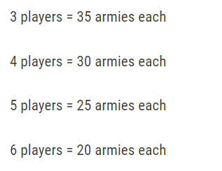
Risk Class
The __init__() function will first check if the given number of players is between 2 and 6, both included.
The Map and Cards classes are then called, and the cards are shuffled.
Depending on the number of players, the number of initial troops is set according to the rules of Risk.
For 2 players, the set up can either be 50 armies each or 40 armies each and another neutral player with 40 armies.
I chose to implement 50 armies each.

Slide 12
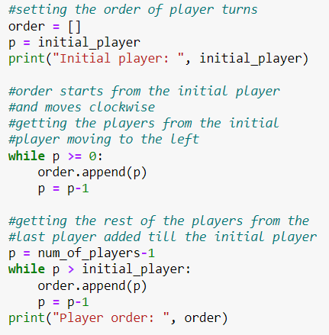
Risk class
The playing order will then be established by calling the roll_dice() function for each player.
The player who rolls the highest dice will be set as the initial player. According to the rules of Risk, the player order starts from the initial player and then moves clockwise.
To do this, the function starts from the initial player id and loops to append the player ids until it reaches -1. Then it will loop from the last player id to append the player ids until it reaches the initial player id.

Slide 13
Risk class
When the order has been established, the players will take turns to place one troop down on a territory until all troops have been placed.
If there are unclaimed territories:
the players will claim a territory by placing a troop on an unclaimed territory.
This is done by calling the choose_new_territory() function which chooses a territory and then calling the claim_territory() function to claim the chosen territory.
Otherwise, if all territories have been claimed:
the players will place 1 troop on one of their own claimed territories by calling the choose_territory() function and then calling the place_army() function with the given territory id.

Slide 14
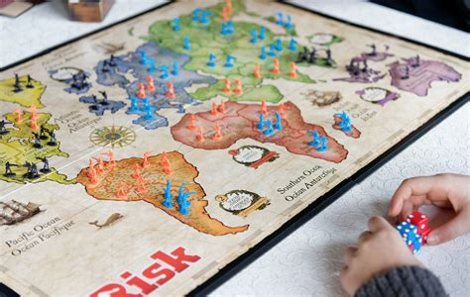
Risk class
When all initial troops have been placed, the function will loop to simulate the player turns until a player wins the game.
Each turn has 3 steps:
Calculating and placing new troops
Attacking
Moving troops

Slide 15
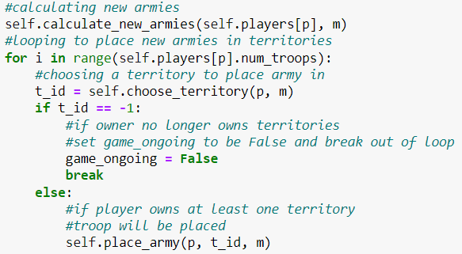
Risk class
The calculate_new_armies() function is called to calculate the number of new troops that the player should receive at the start of their turn. The troops are calculated according to the rules of Risk.
The new troops are then placed on the player’s owned territories by calling the choose_territory() and place_army() functions.

Slide 16
Risk class
The check_for_attack () function will then be called to start the second step of the turn.
There is no limit to the number of attacks that a player can perform even on the same territory.
However, the player can only attack from adjacent territories which have at least 2 troops.
The player can roll 1, 2 or 3 dice however they must always have at least one more troop, than the number of dice rolled, in their territory.

Slide 17
Risk class
The function will loop through all the player’s territories. If the territory has more than 1 troop and has adjacent opponent territories, the agent will make use of the On-Policy Monte Carlo algorithm to choose whether to attack and with how many dice.
In order to do this, a random number is generated between 1 and 0 and epsilon is calculated to be 1 divided by the number of episodes performed so far including the current one
If the random number is less than epsilon, a random action will be chosen provided that the number of dice rolled does not exceed 3 and is always one less than the number of troops on the territory.

Slide 18
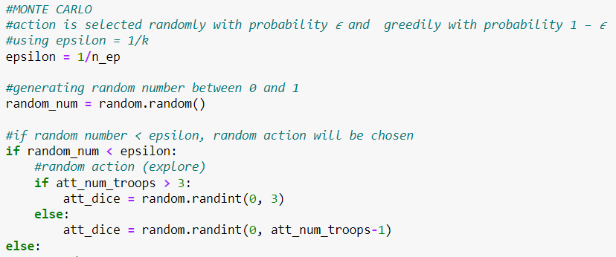
Risk class
Otherwise, the function will search through the Q table and select the action with the highest value.
If the values are equal, a random action will be chosen.

Slide 19
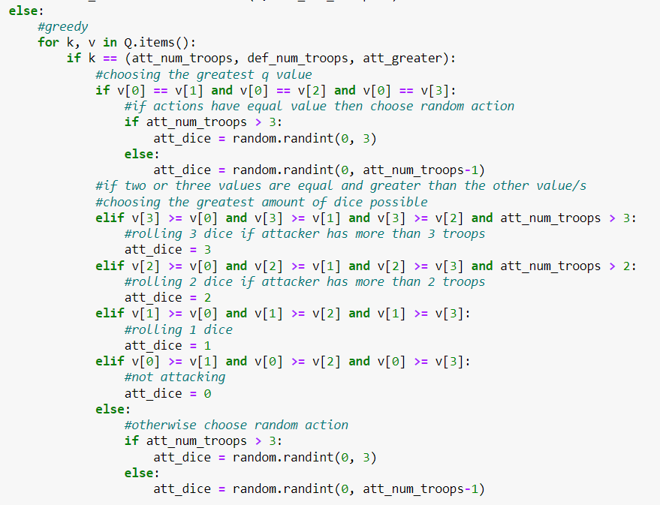

Slide 20
Risk Class
If the attacker decides to attack, the defender will choose whether to defend with 1 or 2 dice with the On-Policy Monte Carlo algorithm.
Another random number will be generated and if the number is greater than epsilon, then the action with the highest value will be chosen provided that defending with 2 dice is only chosen if the player has at least 2 troops.
If the values in the Q table are equal or if the random number is less than epsilon, the number of dice is chosen randomly; either 1 or 2.

Slide 21
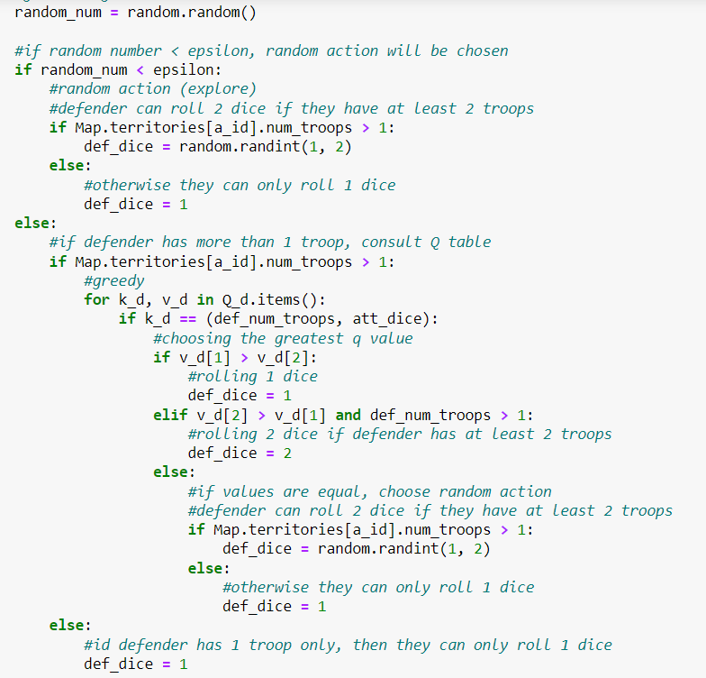

Slide 22
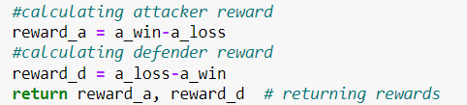
Risk class
The attack() function is then called to perform the attack by rolling the dice for the attacker and defender and comparing the pairs, highest value dice first.
The rewards are calculated as the number of troops that the player won minus the number of troops that the player lost.

Slide 23
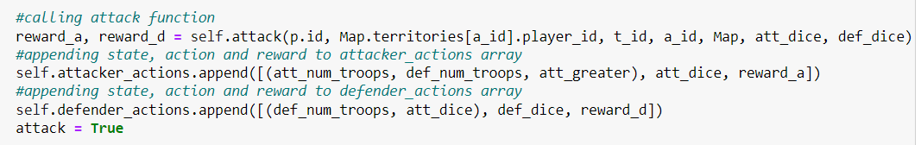
Risk class
After the attack() function terminates, the rewards are returned, and the actions and their rewards will be appended to the ‘attacker_actions’ and ‘defender_actions’ arrays.
These arrays will be used at the end of the episode to calculate the Q-table values for the attack and defend options.

Slide 24
Risk class
The final step of the turn is to move troops.
To do this, the move_troops() function is called which loops through the player’s territories.
If the territory does not have adjacent opponent territories, then all the troops but 1 will be moved from this territory to an adjacent territory which has adjacent opponent territories.
If the territory has adjacent opponent territories, then the troops in that territory will not be moved.

Slide 25
Risk class
The __init__() function will then loop through all the players to check if any of the players have been defeated by the current player.
If so, the current player will take the cards of the defeated player and the defeated player will be removed from the game.
The function will also check if the continents are all owned by the same player and if so, the game ends as the player who owns all the continents has won.

Slide 26
Main() function
The main function initialises the two Q and N tables as dictionaries for the On-Policy Monte Carlo algorithm to use for the attack and defend state-action values.
The dictionaries for the attacker actions, contain the state as the number of troops in the attacker territory, the number of troops in the defender territory and either True, if the attacker territory has more troops than the defender territory, or False if otherwise.
The dictionaries for the defender actions, contain the state as the number of troops in the defender territory and the number of dice that the attacker chose to roll.

Slide 27
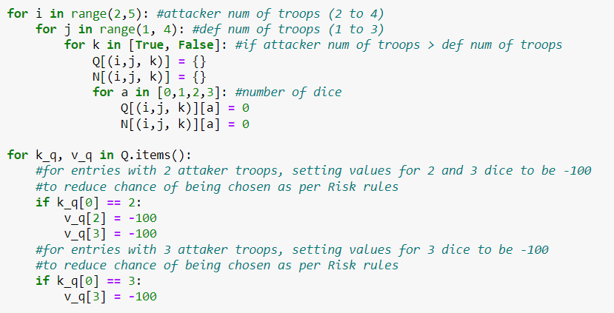
Attacker dictionary

Slide 28
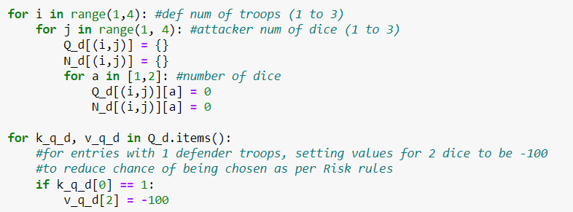
Defender dictionary

Slide 29
Main() function
The function will then loop according to the specified number of episodes to call the Risk class.
After a game terminates, the function will loop through the attacker_actions and defender_actions arrays to update the values of the respective Q dictionary for each state-action pair with the reward.
The state-action pair value stored in the respective N dictionary will be increased by 1.

Slide 30
Main() function
Then, the function will update the Q values of the attacker and defender Q dictionaries with the equation:
Q(s,a) = Q(s,a) + ((1/N(s,a)) * (G-Q(s,a)))
G is the discounted cumulative reward with the discount factor y but since y is taken as 0 in my implementation, G is the reward of the state-action pair itself.

Slide 31
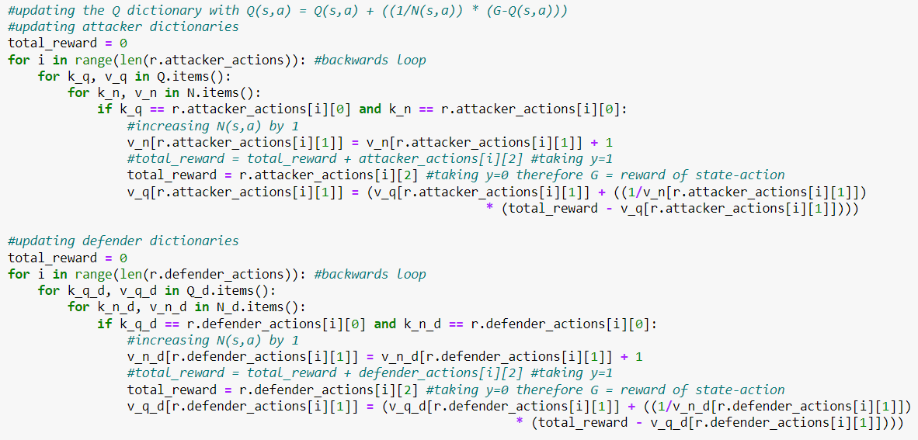

Slide 32
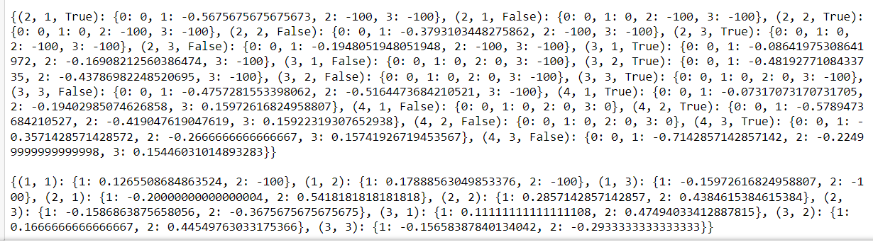
Main() function
When all the episodes have been executed, the function will display the attacker and defender Q-tables.

Slide 33
Evaluation and critical analysis
With a large number of episodes, for example 1000 episodes, the algorithm would sometimes get stuck in a loop where both players kept winning the same few territories from each other and hence kept drawing cards.
Because of this, they kept getting full sets and the card bonus kept increasing to a very large number.
This is because the risk rules specify that after 5 sets are returned, the next set will always be 5 more troops added to the number received from the previous set bonus.
This problem was fixed by limiting the number of troops taken from the card bonus to 30. Therefore, the players can never take more than 30 new troops no matter how many sets are returned in the game.

Slide 34
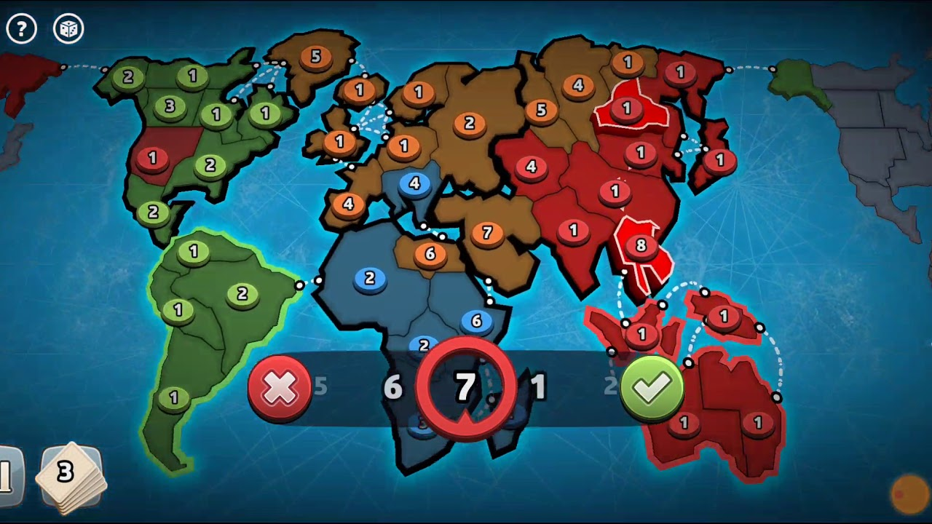
Evaluation and critical analysis
This implementation can be mainly improved by:
Adding graphics for the Map, territories, troops and cards.
Adding sound effects
Adding user interaction where the player could play against the smart strategist.
These will all further enhance the experience and immerse the player into the game.

Slide 35
Evaluation and critical analysis
Another improvement would be to add reinforcement learning for both the troop placement and troop movement.
This would have to be done by using an algorithm which is able to adapt online to a dynamic environment as the agent would have to adapt its policy to different opponent playing styles and moves.
An example of this algorithm would be the Monte Carlo Tree Search algorithm.

Slide 36
Thank you for your attention!

