Slide 1

SoA by Arrowhead Chemical Use-case
Oystein.Haugen@hiof.no

Slide 2
The Norwegian Use-case (excerpts)

Slide 3
Use-case simplified and updated
Arrowhead Core services
Asynchronous communication with Signals
Synchronous communication with Operations
Direction of the actual information

Slide 4
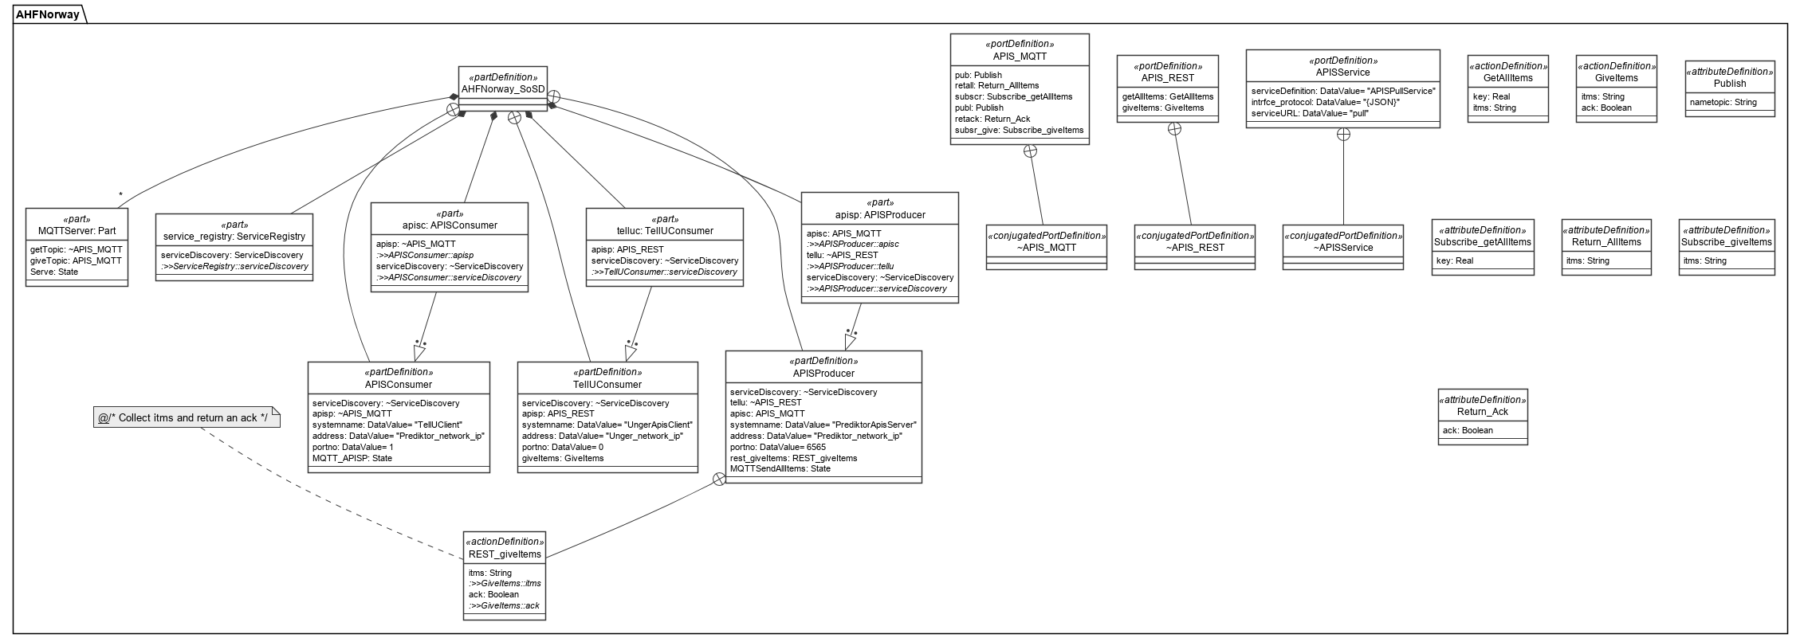
The Arrowhead SoA in SysML v2 on public release June 2020

