Slide 1
Distributed Mobility Management (DMM) WG Forwarding Path & Signaling Management (FPSM) draft-ietf-dmm-fpc-cpdp-07.txt L. Bertz, S. Matsushima, M. Liebsch, S. Gundavelli, D. Moses, C. Perkins IETF98, Chicago
2017-03-27

Slide 2

What is this work about..?
Enable the separation of a mobility network‘s Control-Plane function from its Data-Plane function
Enable distributed deployment of Control- and Data-Plane functions by abstracted Data-plane model and protocol messages
Support multi-tenancy on a single real deployed D-plane network and multiple domains within a tenant
Mobility Control-Plane
FPC Client
D-plane model
Protocol messages
FPC Agent
DPN(s) Configuration API

Slide 3
Executive Summary of Update Since IETF97
2 revisions before IETF98
Addressed comments (clarification, terms, editorial)
C. Perkins added as co-author
Aligment of data model with core specification
Resolved Yang conflicts
Few open items to resolve and to clarify
Model and operational details

Slide 4

Model Principles – Overview
MN session data:
MN IP
tunnel
Configuration of Data-Plane Topology
Pre-configured
Configuration/Creation of Forwarding Policy (e.g. filters, QoS and traffic steering, etc)
Pre-configured, or created on demand
Per context or shareable
Creation of Context, which represents a mobility session (tunnel endpoints, meters)
Creation of virtual Port (vPort), which groups instances of Policy and binds the group to Context
Context
vPort
Rule
Rule
Policy
Rule
DPN
DPN
DPN
Topology
DPN
DPN group

Slide 5
v06/07 Updates

Slide 6
1. Add Domain-reference to Topology model
Regarding discussions about netslice, a Domain of FPC model could refer to a set of partitioned resources for the domain, such as nodes, links with certain bandwidth, etc.
They call it a “slice”. But we may not need to know what it is called.
The important thing is that it could be a way to indicate a set of concrete or abstracted partitioned resources which could be dedicated to the Domain.
Adding just one reference to Domain but it looks very handy and powerful to relate mobile overlay with underlay networks.

Slide 7
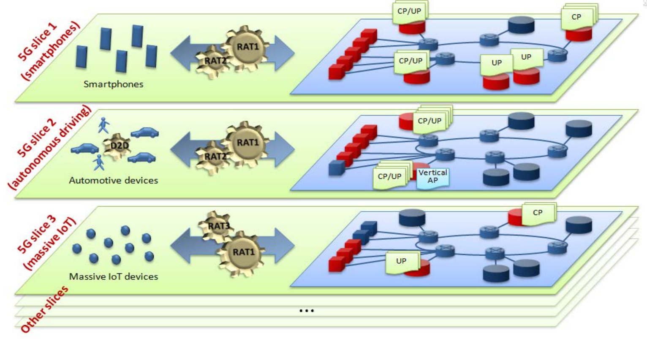
Domain-reference Points a Set of Data-Plane Resources (a.k.a network-slice)
Abstracted Data-Plane on FPC-Agent
Set of Data-Plane Resources
Tenant A
Domain
Reference
DPN-Group(MAG)
DPN-Group(LMA)
Domain 1a
DPN-Group(SGW)
DPN-Group(PGW)
Domain 2a
DPN-Group(SGSN)
DPN-Group(GGSN)
Domain Na
Source: NGMN white-paper

Slide 8
2. Add some text to Node-reference
When a DPN need to be a software instance on a NFV-like platform,
FPC agent may send message or command to instantiate DPN on the platform prior to configuring it.
Text has been added to version 07 for this purpose.

Slide 9
Node reference points both real or virtual DPN
DPN-Group (e.g, MAG)
DPN-Group (e.g, LMA)
DPN-Group-peer
Abstracted D-Plane on a FPC-Agent
Abstracted DPN1
Abstracted DPN2
Abstracted DPN3
Abstracted DPN4
Node
Reference
Node
Reference
Node Reference
Node Reference
Real Deployed D-plane NW of an Operator
Virtual DPN4
Virtual DPN1
Real DPN2
Real DPN3
Virtualization Platform
Virtualization Platform

Slide 10
3. Miscellaneous
Add some NSH and Segment Routing (SR/SRv6) drafts as references to next-hop attribute in Mobility model.
s/envelope protocol/interface protocol/.
Remove text which limit instantiation in attribute applicability section, since agent need to instantiate DPN on a NFVI prior to context.
Text describing multi-tenancy in architecture section has been improved.
Clarified that all FPC model should be configurable in architecture section.
Clarified that pre-configuration could save number of over-the-wire exchange in attribute application section.
Clarified the case where a client directly sets runtime attributes and its risk, on IM section of context and attribute application section.

Slide 11
Remaining Discussion Points

Slide 12
1. Change Port to Vport
As we agreed on Charlie's suggestion, now Port is changed to Vport
The original intention of Port is that it should be policies from which the agent renders configurations to each DPN.
But Vport was intended to slightly change the original semantics with the concept of which it is per DPN configurations for Contexts
For now text describing Vport has been kept as for previous for v06.
Goal: Find another name that expresses the above more clearly.

Slide 13
2. Next-hop and tunnel attribute
Currently it is treated from tunnel information between DPNs. The next-hop attribute is used to point next-hop of outside of mobility tunnel.
However the tunnel to destination DPN in general could be also a next-hop. Clarify if tunnel information can be merged as part of next-hop attribute.
That would allow emerging technologies like SFC, SR/SRv6 and also MIPv6 to be mobility data-plane.

Slide 14
3. Agent’s features and capabilities discovery
It was in the context of how a client finds the agent whether it is single or multiple DPN agent.
But it looks quite obvious when the mobile apps of the client defines multiple DPNs on the agent. Text has been dropped.
However, we may need to define generic way for discovery of features and capabilities on agent.

Slide 15
4. Monitor event reference
As Charlie suggested that there could be references which already define events to be monitored in other SDOs.
Proposed exampled from 3GPP
TS 32.106, Telecommunication management; Configuration Management (CM)
TS 32.111, Part 2: Alarm Integration Reference Point (IRP)
More references to be added.
Details of Monitor operation may be in a separate document
Compatibility/Alignment of multiple FPC documents to be ensured

Slide 16
FPC Implementation Update

Slide 17
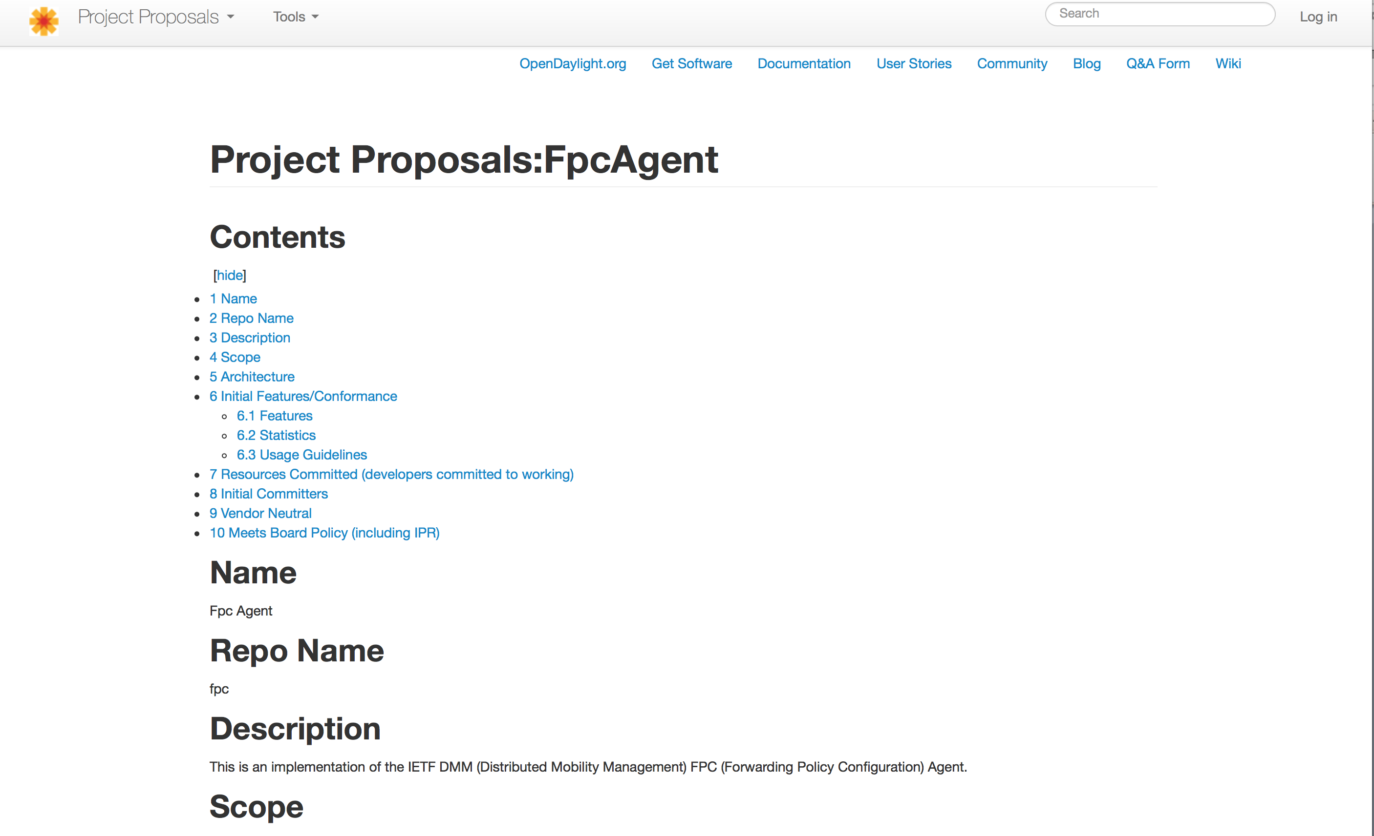
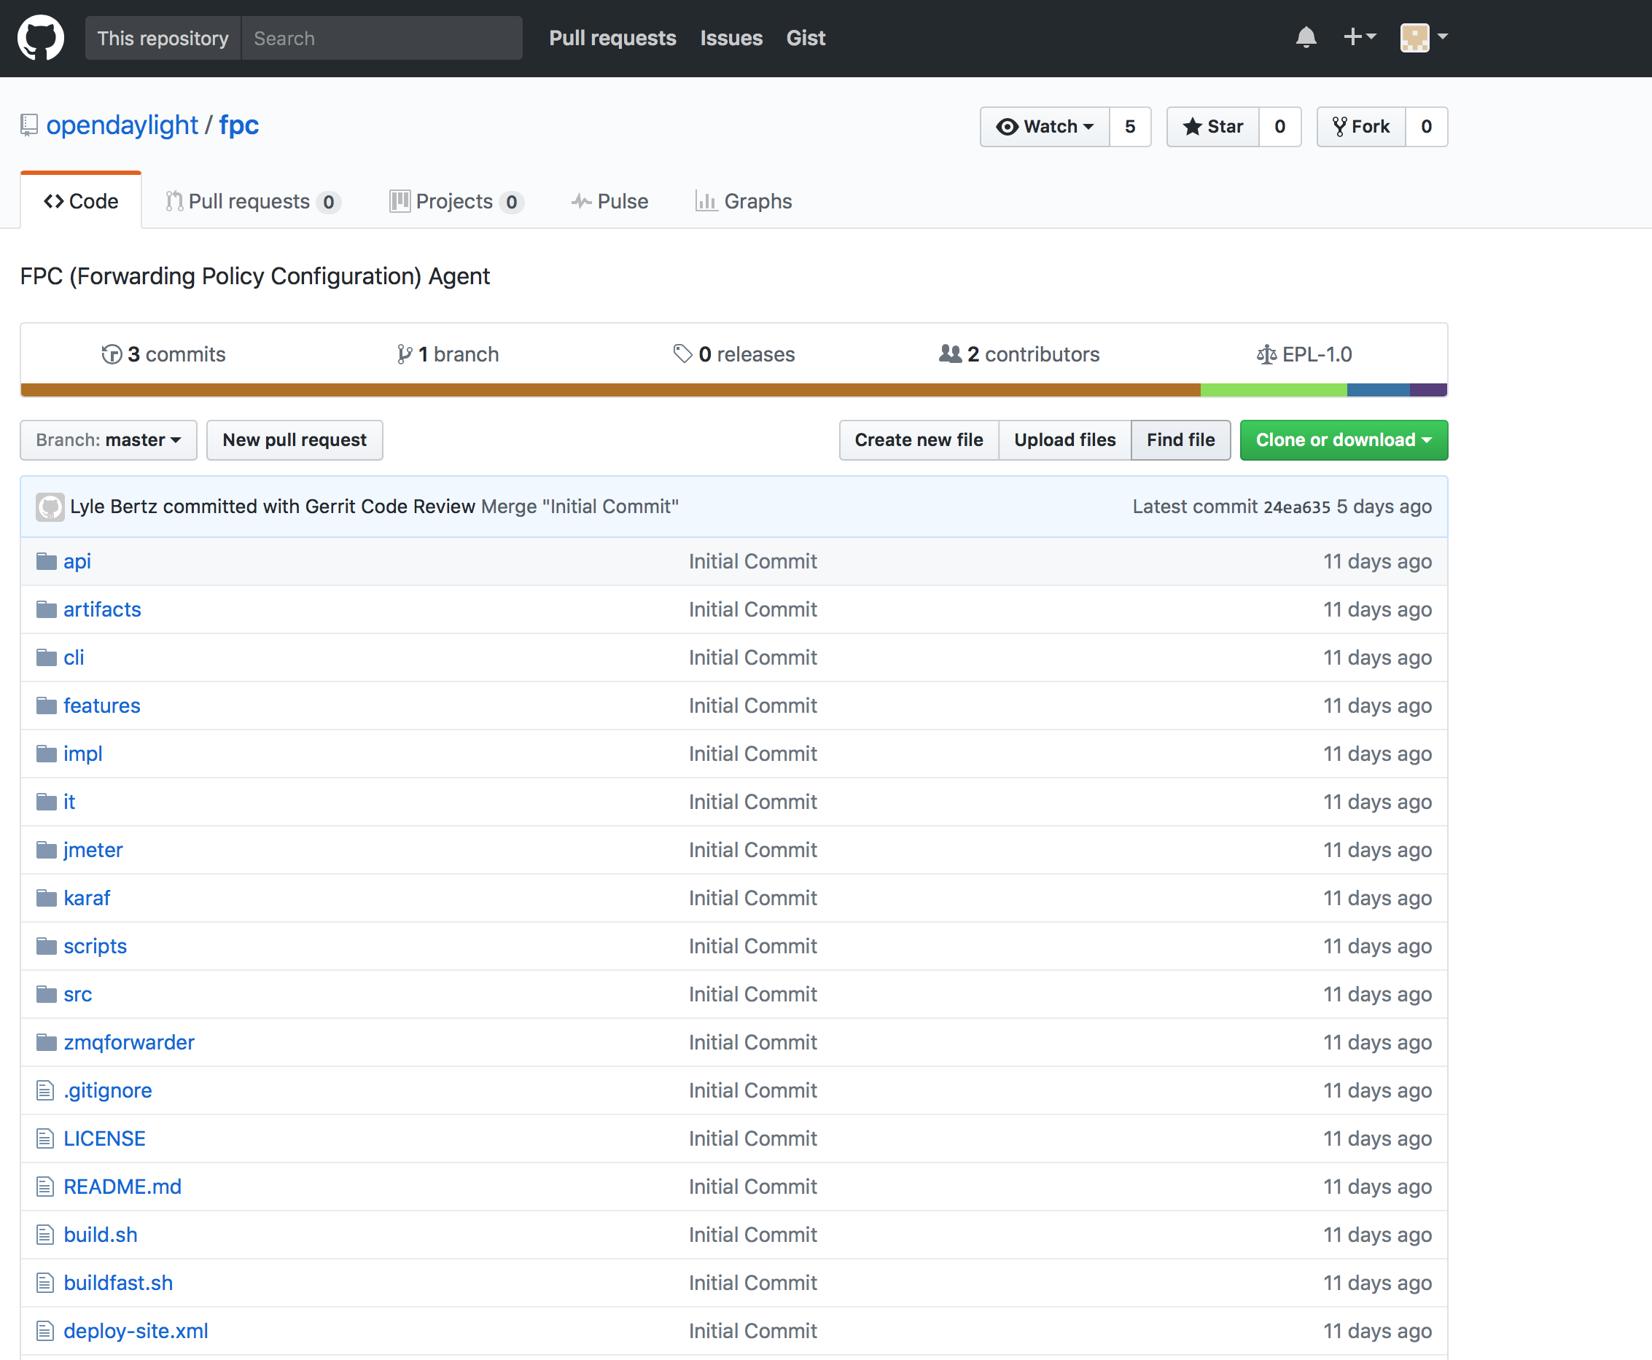
FpcAgent has been an ODL Project
https://wiki.opendaylight.org/view/Project_Proposals:FpcAgent
https://github.com/opendaylight/fpc

Slide 18
Next
More reviews needed
Resolve and clarify remaining open items
Target WG last call before IETF99 ?

