Slide 1
Xavier de Foy, Akbar Rahman IETF-98 (Chicago), March 2017 https://tools.ietf.org/html/draft-defoy-netslices-3gpp-network-slicing-00
5G Network Slicing 3GPP Use Case

Slide 2
NS in 3GPP: Introduction
Goal: provide context/requirements to IETF Netslices
Work on NS in 3GPP:
In previous releases:
R13 and R14 – Dedicated Core Networks (DCN)
Ongoing (our topic here):
Release 15 (5G Phase 1)
Focus on Requirements and Architecture
(5G Use Cases)
(DCN)
(requirements)
TR22.891
TS23.401
TS22.261

Slide 3
NS in 3GPP: Requirements
Requirements for NS in 5G Phase 1
Provisioning
create/modify/delete NS, provision NFs, define NS caps
Managing the association between devices/services and slices
Configure association of devices and services to NS, device-NS association can change dynamically
Interoperating
NS interop for roaming, device interop with multiple slices
Supporting performance and isolation
Elasticity, performance isolation at multiple stages (normal and elastic operation, at creation/modification/deletion time)
APIs for trusted 3rd party to manage NS
(requirements)
TS22.261

Slide 4
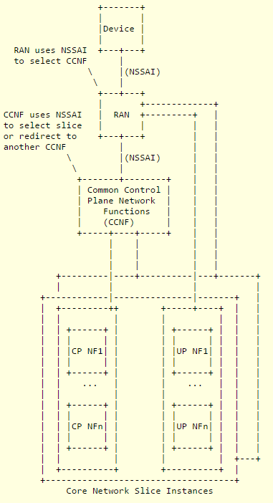
NS in 3GPP: Logical Architecture 1/2
A slice is a complete logical network providing telecom services and network capabilities
Slice = RAN Slice + Core Network Slice
Multiple slices can be accessed through 1 RAN
Device sends a Network Slice Selection Assistance Information (NSSAI) to the network
NSSAI = collection of SM-NSSAI
SM-NSSAI = Slice Service Type + Differentiator
How a RAN slice is selected is TBD. RAN selects a Common Control Plane Network Function (CCNF), which is common to multiple CN slice instances
CCNF then selects a Core Network Slice Instance
CN Slice Instances have dedicated Control Plane and User Plane functions
CCNF can redirect towards another CCNF
(Report)
(Specs)
TR23.799
TS23.501/2

Slide 5
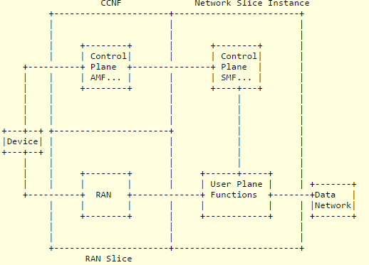
NS in 3GPP: Logical Architecture 2/2
CCNF composed of (at least) Network Slice Selection Function, Access and Mobility Management Function (AMF)
Each PDU session is over one slice, and associated with one SM-NSSAI.
Application is associated with an SM-NSSAI, and the device will associate its traffic with a compatible PDU session.
Early work on RAN indicates RAN slices will be pre-configured and isolated, but the actual method to achieve this is left to implementation.
(Architecture)
(RAN)
TR23.799
TR38.801

Slide 6
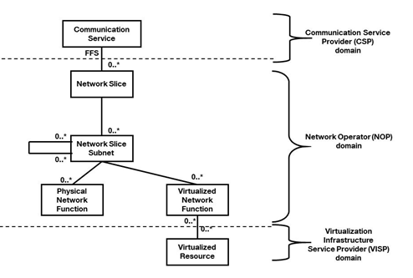
NS in 3GPP: Other Aspects
NS Management study
Information model, NS lifecycle, use cases & key issues
Virtual Infrastructure Management
Integrates 3GPP management system with NFV-MANO architecture defined by ETSI
Security Aspects
(NS Management)
(Virtual Infrastructure)
(Security)
TR28.801
TS28.500
TR33.899

Slide 7
NS in 3GPP: Conclusion
Discussion points collected during this review (mostly potential requirements):
Need for common functions: slice selection and user authentication
Need for multiple modes of association between slices, devices and services
Need for control of inter-slice interoperation: for extension, or (wanted or unwanted) through shared functions and end points
Need for QoS differentiation between users or services inside slices
Need for partial exposure of management to 3rd party (MVNOs, SPs)
Need for NS security: performance isolation, per-slice security policies…
Network Slice Subnet is a potential building block, as a (single domain) unit of composition and sharing
…any advice on what to do next with this draft? (Merge? Other suggestions?)

