Slide 1
Challenge.ME
Karen Alarcon
Phoenix/Eric Ehmann
Daniel Michael
Cristina Sahoo
Kristina Timkova

Slide 2
Problem Statement
Solution Statement
The COVID-19 pandemic has affected many of us. With depression and social isolation on the rise, and with many businesses closing affecting employment negatively, we are looking for solutions to lift up the mood and bring in an element of fun and togetherness. We need an outlet to combat feelings of loneliness and lack of motivation due to COVID-19. In this project, we aim at helping a specific group of people who have been affected negatively by the pandemic: bartenders. Bars have been closing, leaving bartenders out of work. They need a way to maintain socializing with people that share their trade, motivation, and continue to practice their skill. How do we maintain the fun of the bar scene, while bars are closed?
Challenge.ME connects users with challenges that allows users to practice or test their unique skills against others.

Slide 3
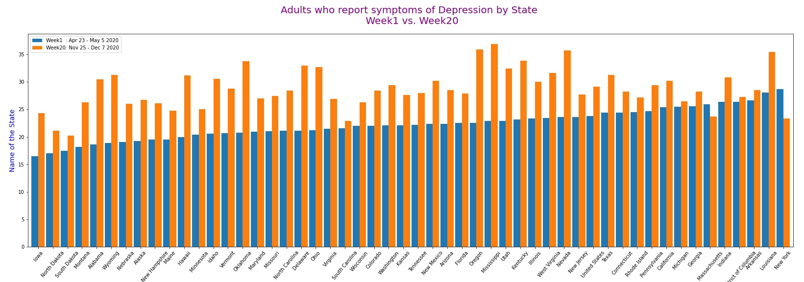
Are we observing an increase in depression among adults since the pandemic?
In the most recent week compared to the beginning of the pandemic, all states, except Massachusetts and New York, record an increase in reports of depression symptoms among adults.

Slide 4
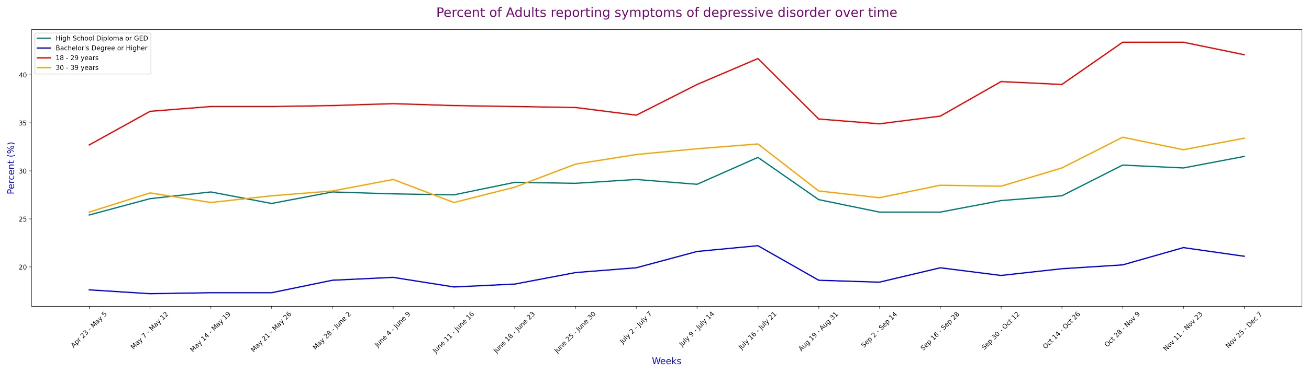
How has the pandemic affected adults in various groups?
Reports of depression in adults have been increasing over time, since April and through the rest of the year.
Average age of bartenders is 35. Link.
Most bartenders have a high school degree. Link.

Slide 5
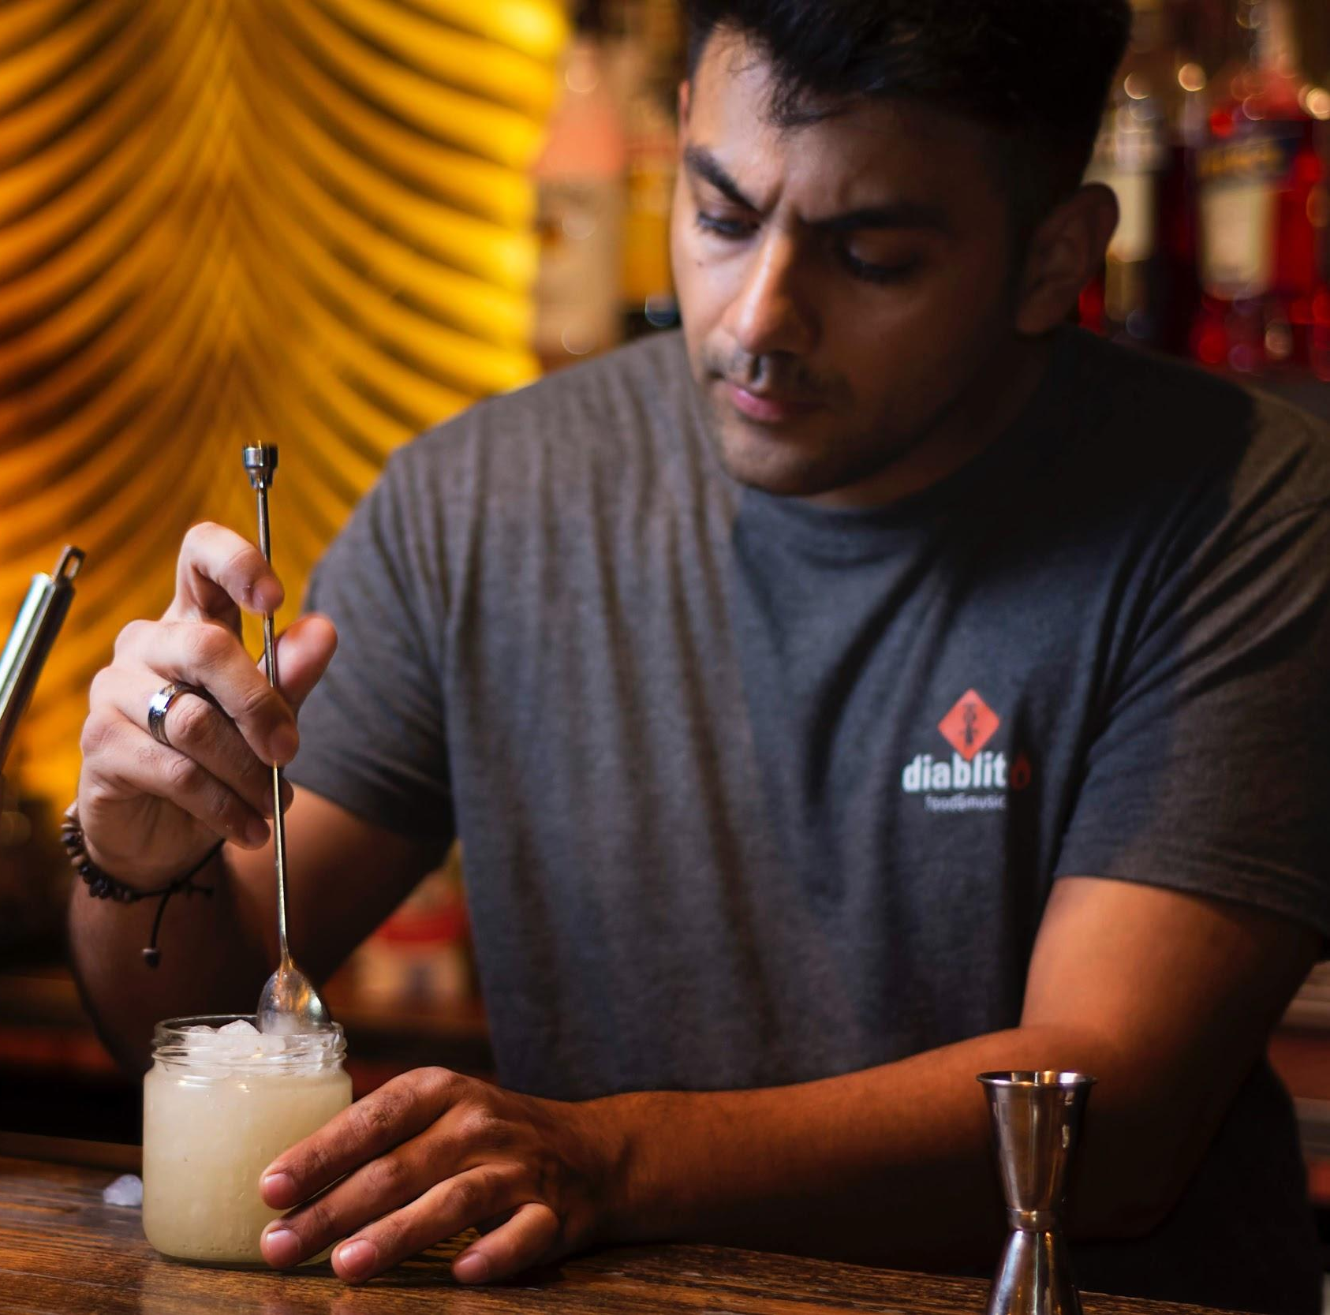
Competitor Charles
Frustrations
Bar he worked at is closed due to Covid-19 and he has been laid off
Feels depressed because he doesn’t see his customers everyday
Feels anxious and uninspired to do anything because he is unsure of the future
Goals
He wants to connect with people again and share his love for cocktails with others
Wants to keep his bartending skills sharp for when he can return to work
Wants to do something productive with his time instead of binge watching shows

