Slide 1
Challenge.ME
Created and Presented by:
PCKKD (Team Pecked)
Karen Alarcon - UXDI
Phoenix Ehmann - UXDI
Daniel Michael - SEI
Cristina Sahoo - DSI
Kristina Timkova - SEI
Notes:
Hello everybody. I would like to introduce our team: Karen and Phoenix, our team’s designers. Daniel and Kristina, our team’s engineers. And myself, Cristina, our team’s data scientist. Together we will present and demo the Challenge.ME app and the research behind the app.

Slide 2
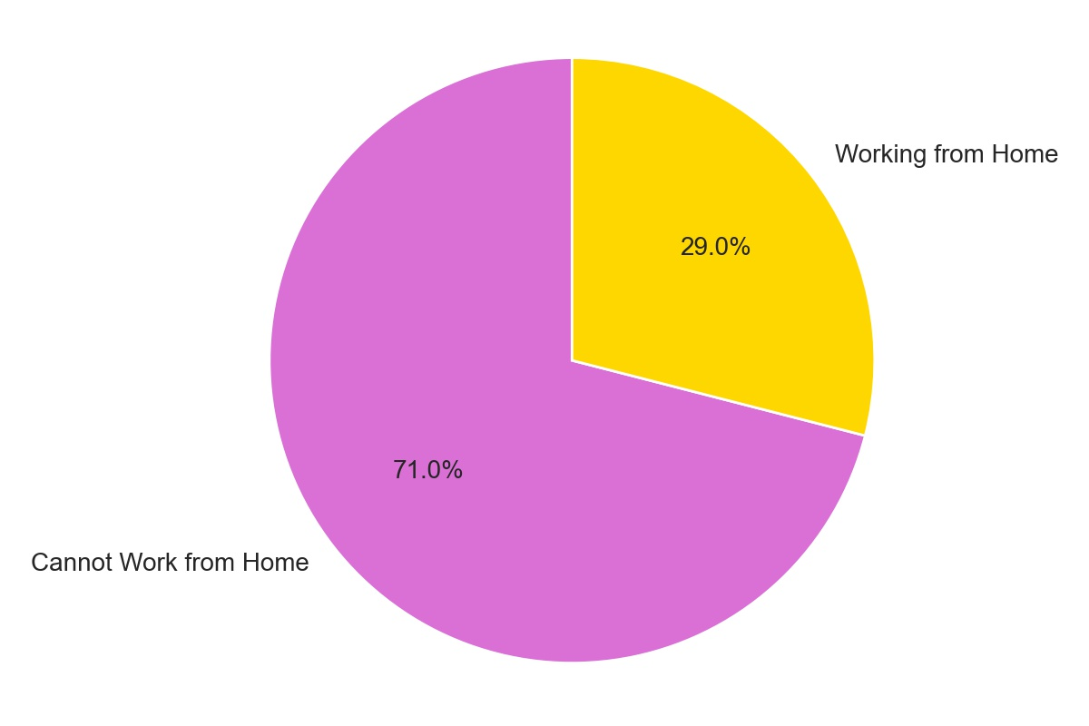
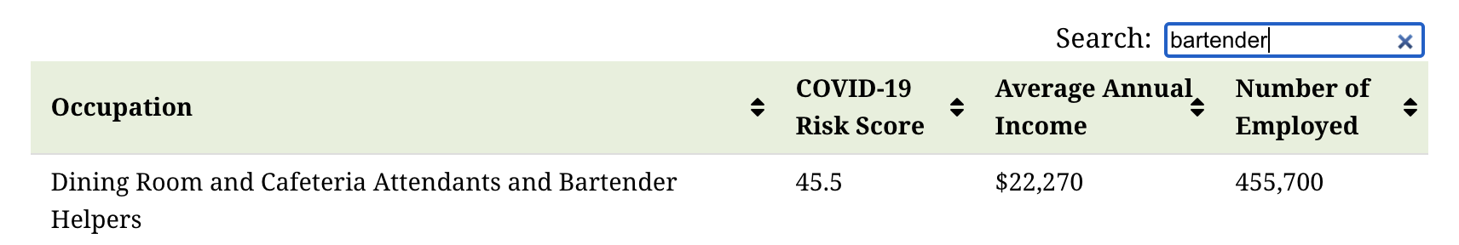
The pandemic has affected employment negatively
Even though 29% of the population was able to continue working safely from home, for the remaining 71% the situation remained uncertain, with some losing their jobs due to business shutdowns and mandated lockdown orders.
[source: Visual Capitalist/Department of Labor]
Notes:
The pandemic has affected employment negatively across the country, with 71% of the employed population unable to work from home. Bartenders are part of this demographic, as many have lost their jobs due to business shutdowns or mandated lockdown orders.

Slide 3
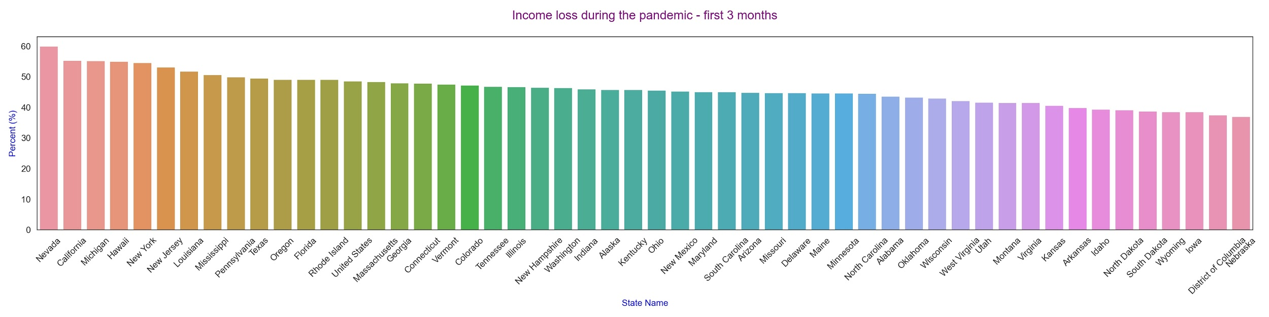
What does loss of income look like across the country during the pandemic?
Income loss has been experienced across the country during the pandemic, with Nevada being affected the most.
Notes:
Current data backs this up, and in this graph we can see income loss has been experienced across all states in the country during the pandemic.

Slide 4
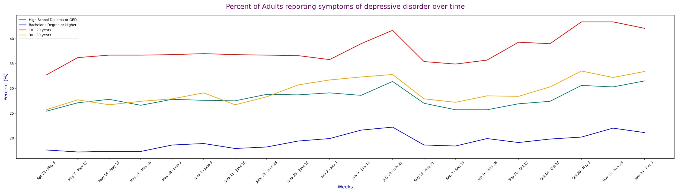
How has the pandemic affected adults in various groups?
Reports of depression in adults have been increasing over time, since April and through the rest of the year.
[data source: CDC]
Average age of bartenders is 35. Link.
Most bartenders have a high school degree. Link.
Notes:
In addition to employment and income loss, data shows an increase in reports of depression in adults, since the start of the pandemic. Adults between 18-29 years old who have a high school diploma or GED have been affected the most.

Slide 5
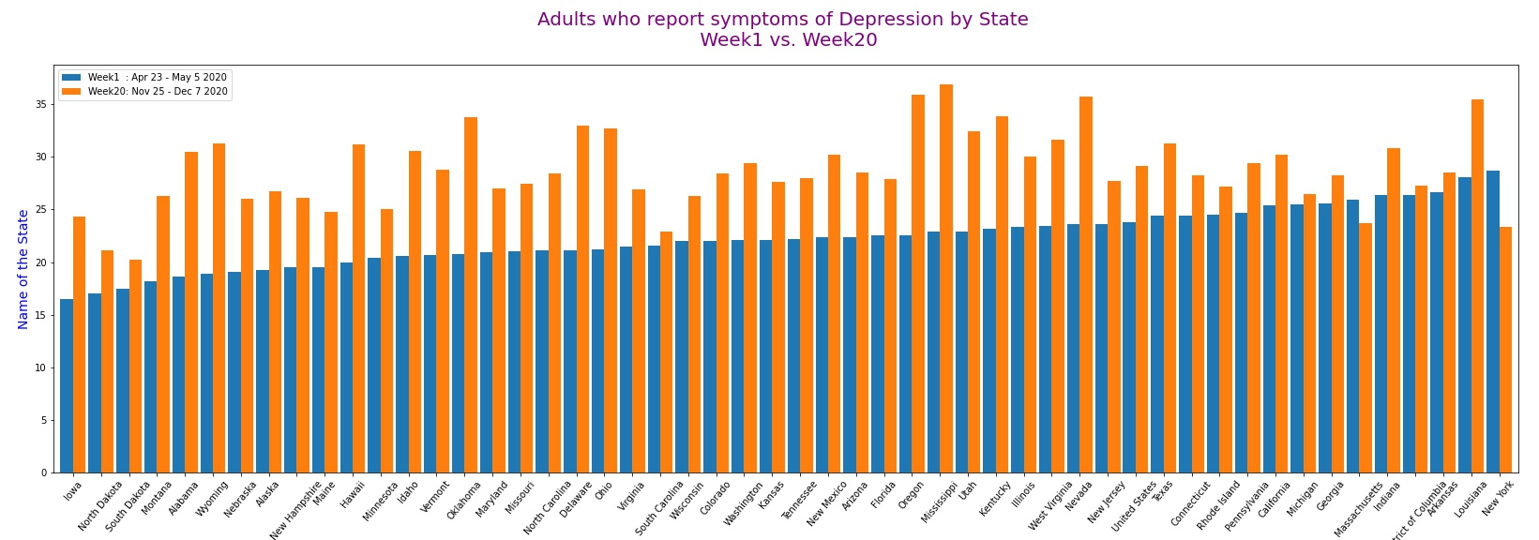
Are we observing an increase in depression among adults since the pandemic?
In the most recent week compared to the beginning of the pandemic, all states, except Massachusetts and New York, record an increase in reports of depression symptoms among adults. [data source: CDC]
Notes:
We also observe an increase in reports of depression symptoms among adults in the most recent weeks compared to the beginning of the pandemic.

Slide 6
Isolation has negative impacts on mental health
Perceived social isolation during the COVID-19 pandemic significantly has had an extraordinary global impact, with significant psychological consequences. Changes in our daily lives, feeling of loneliness, job losses, financial difficulty, and grief over the death of loved ones have the potential to affect the mental health of many. [source: National Institute of Health]
Notes:
According to the National Institute of Health, social isolation during the COVID-19 pandemic has had a negative impact on mental health. Unemployment, isolation, and depression are real current issues, and they affect bartenders who have experienced hardship during the pandemic. With our app, we are trying to combat isolation and help them connect through friendly competition. Furthermore, with donations and sponsorships, we can help with the unemployment problem as well.

Slide 7
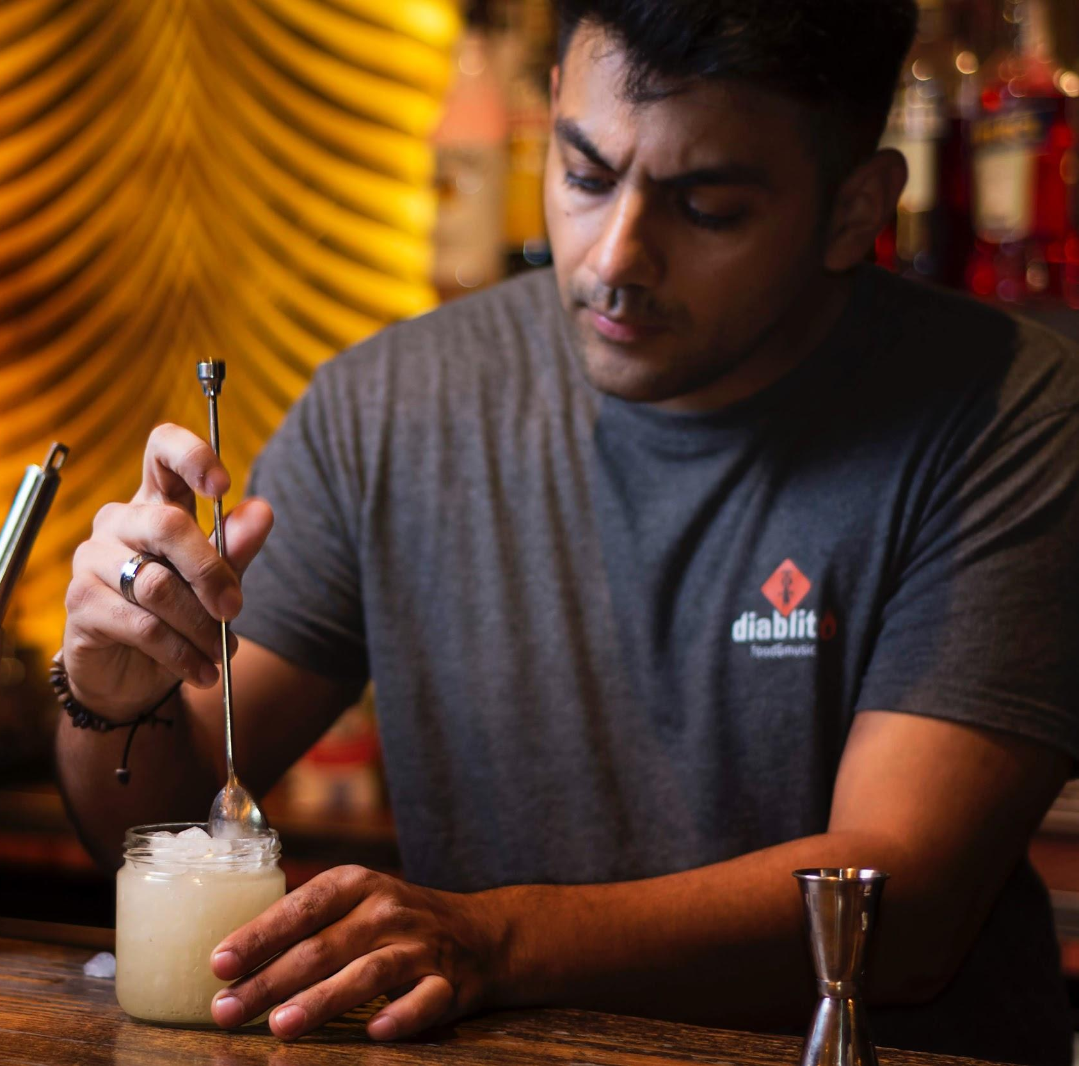
Competitor Charles
Frustrations
Bar he worked at is closed due to Covid-19 and he has been laid off
Feels depressed because he doesn’t see his customers everyday
Feels anxious and uninspired to do anything because he is unsure of the future
Goals
He wants to connect with people again and share his love for cocktails with others
Wants to keep his bartending skills sharp for when he can return to work
Wants to do something productive with his time instead of binge watching shows
Notes:
From our research our persona Charles was created. He is a bartender who was laid off due to Covid-19. He enjoyed his job and his interactions with his co-workers and customers. He is not able to work from home and is feeling anxious to return to the work force. He feels uninspired to and seeks to do something productive with his time.

Slide 8
Problem Statement
The COVID-19 pandemic has affected many of us. With depression and social isolation on the rise, and with many businesses closing affecting employment negatively, we are looking for solutions to lift up the mood and bring in an element of fun and togetherness. We need an outlet to combat feelings of loneliness and lack of motivation due to COVID-19. In this project, we aim at helping a specific group of people who have been affected negatively by the pandemic: Bartenders.
Bartenders need a way to maintain socializing with people that share their trade, motivation, and continue to practice their skill.
How might we maintain the fun of the bar scene, while bars are closed?

Slide 9



Solution Statement
Challenge.ME connects bartenders with contests that allow them to practice or test their unique skills against others.
Challenge.ME Features
Communicate: Promotes Remote Togetherness by allowing you to chat with other Bartenders in each contest page
Create: Upskill your craft by competing in drink-related challenges
Compete: A little competition to get the blood flowing! The more people you beat in a competition you move up in our Challenge.ME Leaderboard!

Slide 10
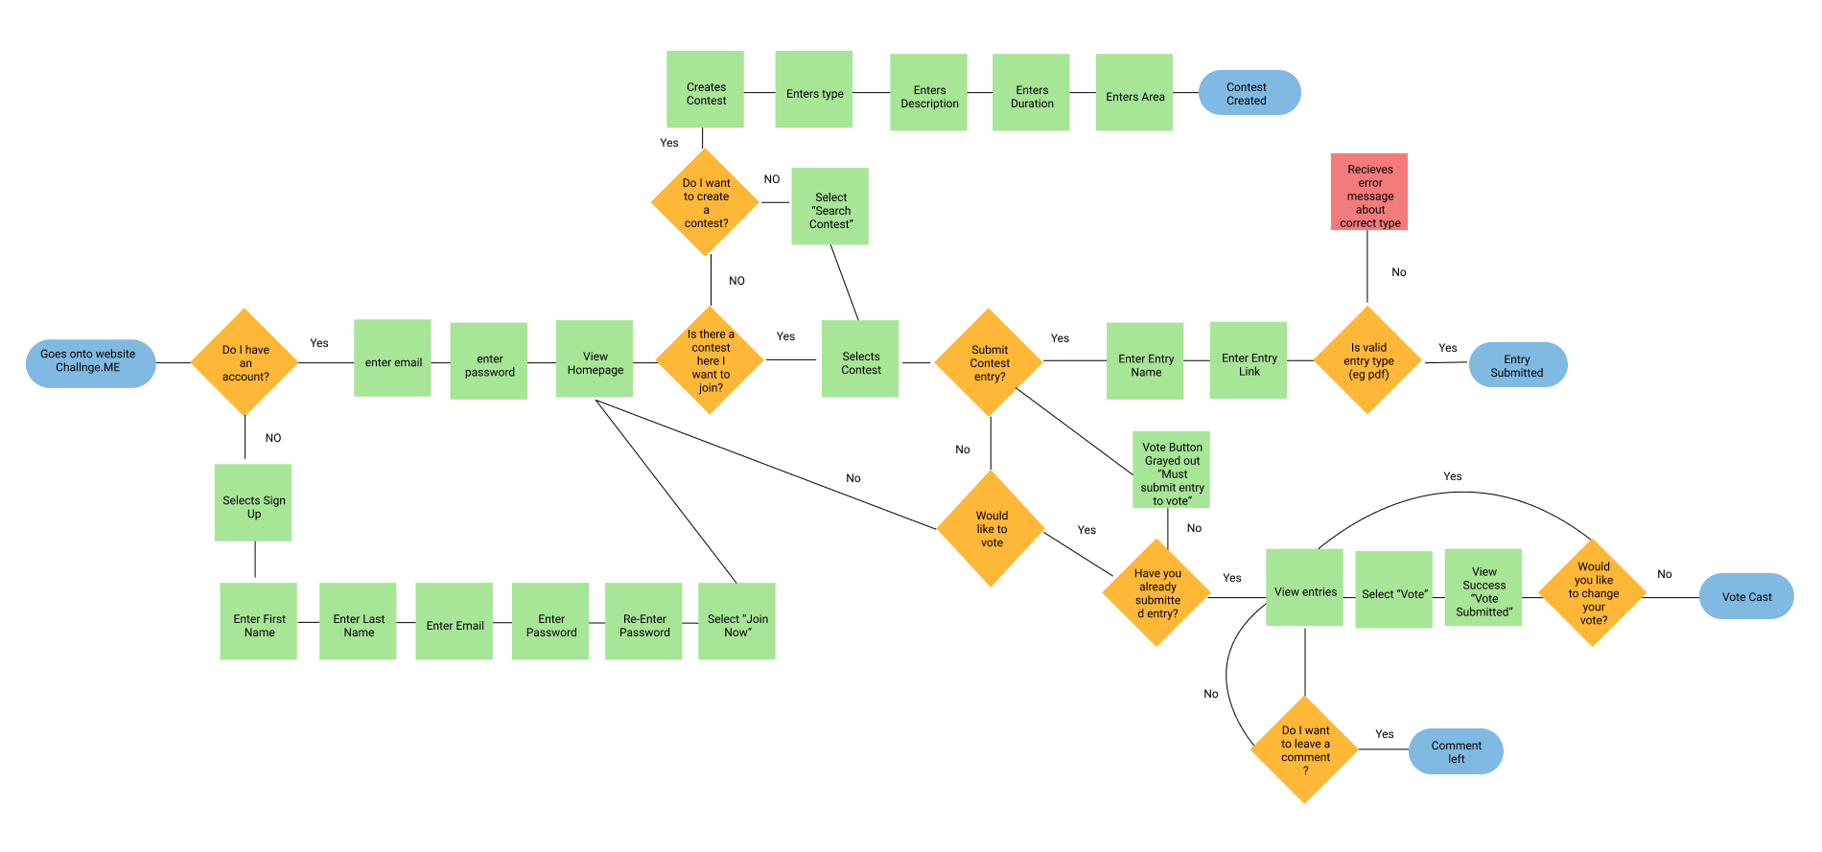
User Flow 1.0
Notes:
The first thing we did as a team was map out the flow of the website - Here you can see the main tasks a user can complete which is sign/up - login Create, compete

Slide 11
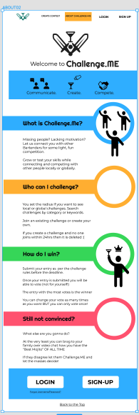
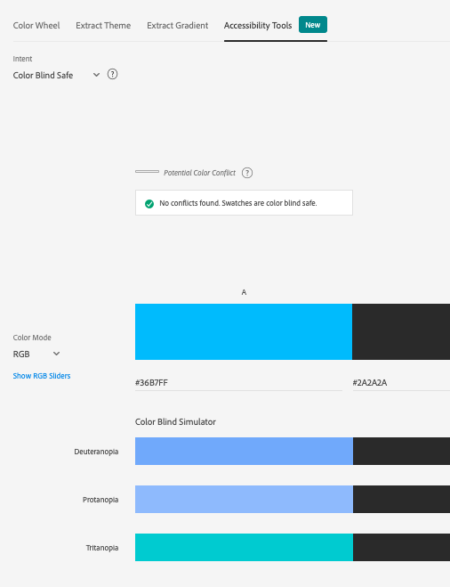
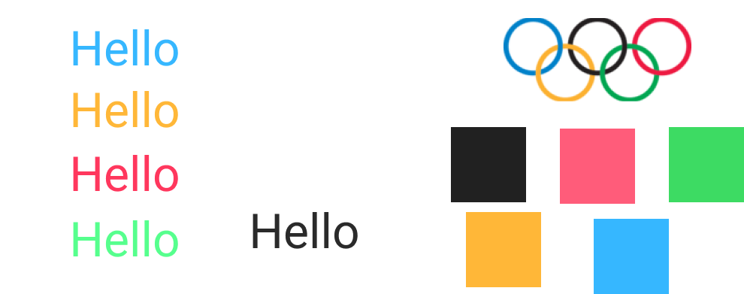
Original Color Scheme
Notes:
In the initial design stage we thought about challenges and were inspired by the Olympic colors of blue, yellow, green, red...we ran the color palette through adobe accessibility checker and we fine-tuned the colors - When we ran our usability tests users did not like the bright pastel colors and felt it didn’t represent bartenders.

Slide 12
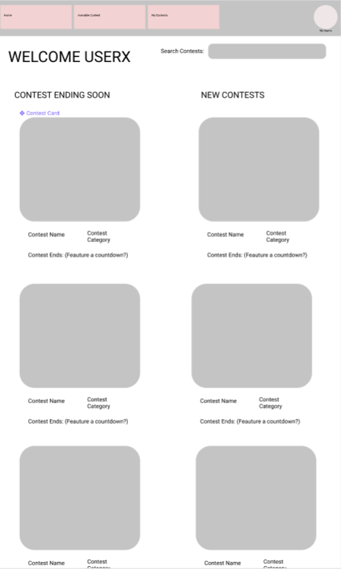
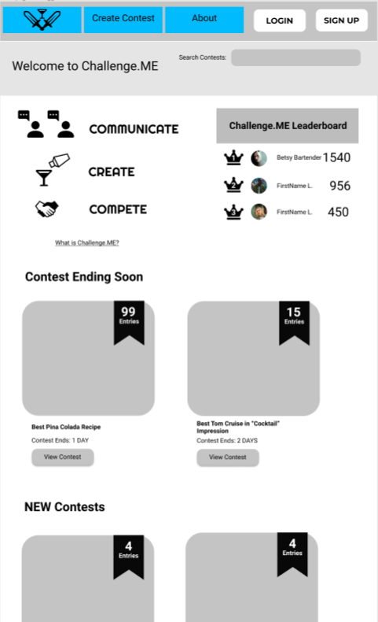
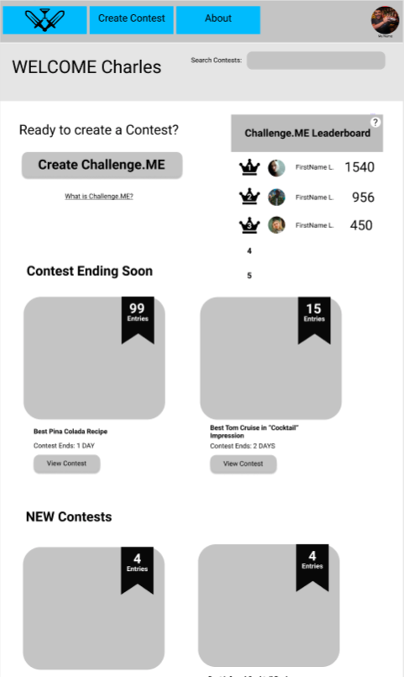
Homepage Wireframe
Homepage Logged Out
Homepage Logged In
Notes:
From our initial wireframe we realized we would need 2 seperate homepages - one where is user is not logged in but still able to see the site and get a taste of what it’s about. A login/signup button to the top right - In our logged in vesion those buttons are replaced with the image of person logged in and a “sign out” button and they are promoted to create a contest with an option to view more information if they need it.

Slide 13
Usability Test Results
Open Prototype
Learn what Challenge.ME is
Sign up for an account
Create a challenge
Once challenge is created submit your entry
Add a comment in the “Join a Discussion” section
View all Contest Entries
Look at the recipe for the drink “ La Piniña Maria”
Vote for this drink
Go to main contest page
See the winner of the contest
Good
- Users were able to complete the tasks set before them
- Labeled the site intuitive with minimal frustrations
Bad
Leaderboard was initially confusing
Breadcrumbs that lead you back to the main page were
Ugly
Olympic color scheme was not received well

Slide 14

UX Demo
https://www.figma.com/proto/XiisazSWg3pD4KoFVjdkLC/Untitled?node-id=362%3A1359&scaling=min-zoom

Slide 15
Software Demo
https://5fece52cff27ad1322bc46cd--challenge-me.netlify.app/

Slide 16
Summation
Problem: Bartenders becoming unemployed and going into isolation
Possible Solution: A trade tool to test and discuss their artform, while having another form to build credibility. (We are more loyal to bartenders than to restaurants after all)

Slide 17
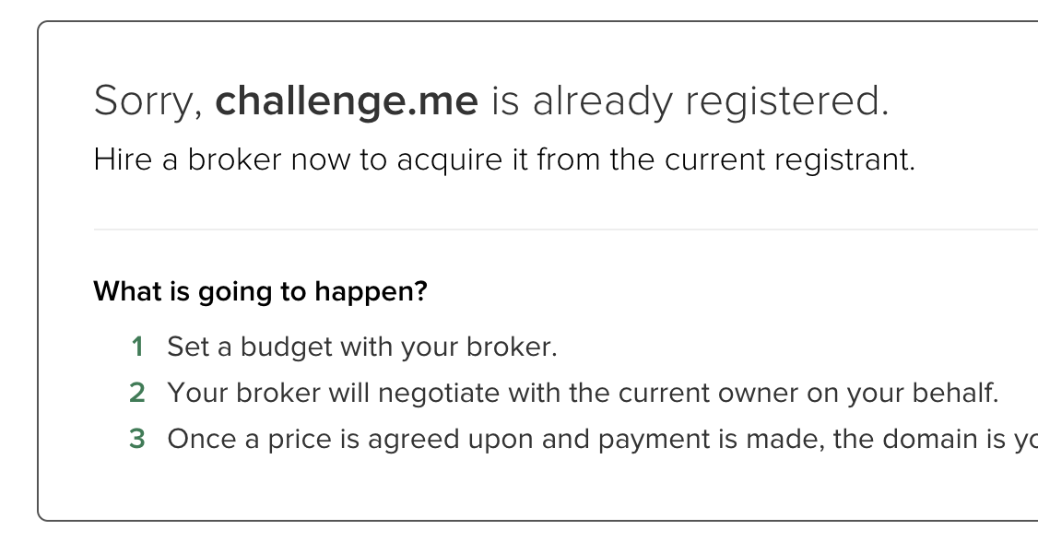
Next Steps
Must Do
Should Do
Won’t Do
Finish the mid fidelity prototype
Usability tests with Bartenders
Iterations based on feedback
Research more design inspirations to create a more pleasing UI
Implement an incentive for Bartenders to get paid on the website
Limit # of entries per personal contest
Consult UX copywriter
Scale the app to anyone with a hobby and create categories ( Ex. Music, Art, Food..)
Include after contest socializing aspect
Stay up till 3AM prototyping (this is a lie)
Beat up whoever already registered challenge.me (half lie)

