Slide 1
Challenge.ME
Karen Alarcon - UXDI
Phoenix Ehmann - UXDI
Daniel Michael - SEI
Cristina Sahoo - DSI
Kristina Timkova - SEI

Slide 2
Problem Statement
The COVID-19 pandemic has affected many of us. With depression and social isolation on the rise, and with many businesses closing affecting employment negatively, we are looking for solutions to lift up the mood and bring in an element of fun and togetherness. We need an outlet to combat feelings of loneliness and lack of motivation due to COVID-19. In this project, we aim at helping a specific group of people who have been affected negatively by the pandemic: Bartenders.
Bartenders need a way to maintain socializing with people that share their trade, motivation, and continue to practice their skill.
How might we maintain the fun of the bar scene, while bars are closed?

Slide 3
Solution Statement
Challenge.ME connects bartenders with contests that allow them to practice or test their unique skills against others.
Challenge.ME Features
Communicate: Promotes Remote Togetherness by allowing you to chat with other Bartenders in each contest page
Create: Upskill your craft by competing in drink-related challenges
Compete: A little competition to get the blood flowing! The more people you beat in a competition you move up in our Challenge.ME Leaderboard!

Slide 4
Isolation has negative impacts on mental health
Perceived social isolation during the COVID-19 pandemic significantly has had an extraordinary global impact, with significant psychological consequences. Changes in our daily lives, feeling of loneliness, job losses, financial difficulty, and grief over the death of loved ones have the potential to affect the mental health of many. [source: National Institute of Health]

Slide 5
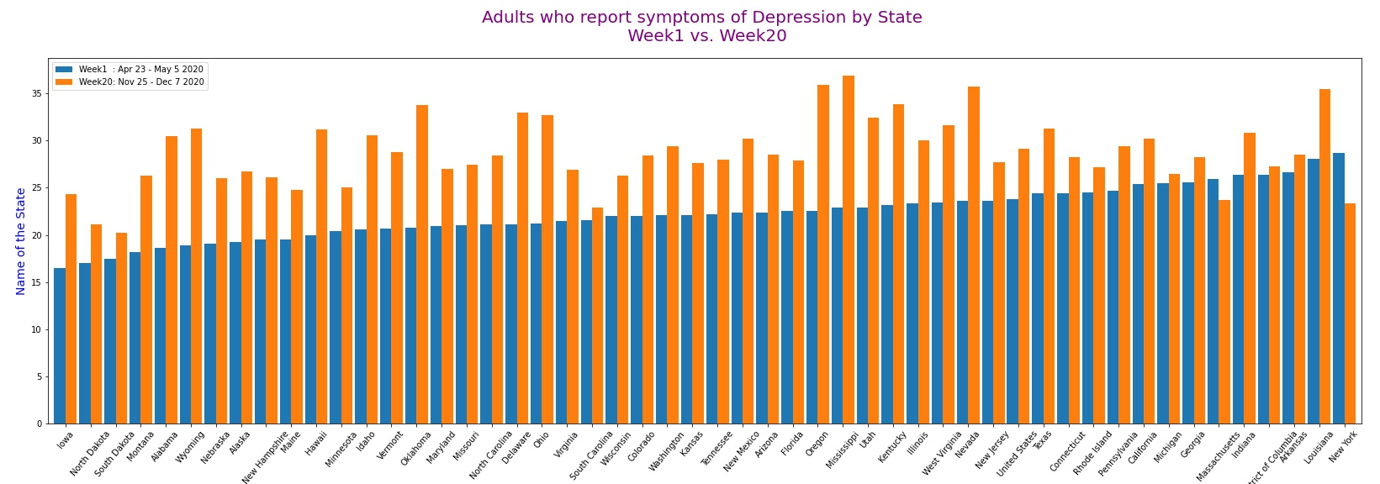
Are we observing an increase in depression among adults since the pandemic?
In the most recent week compared to the beginning of the pandemic, all states, except Massachusetts and New York, record an increase in reports of depression symptoms among adults. [data source: CDC]

Slide 6
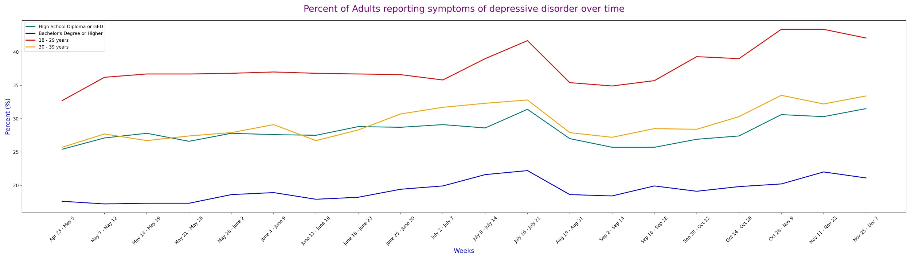
How has the pandemic affected adults in various groups?
Reports of depression in adults have been increasing over time, since April and through the rest of the year.
[data source: CDC]
Average age of bartenders is 35. Link.
Most bartenders have a high school degree. Link.

Slide 7
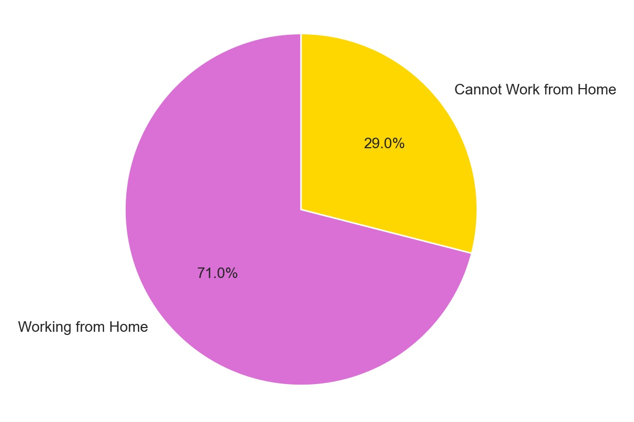
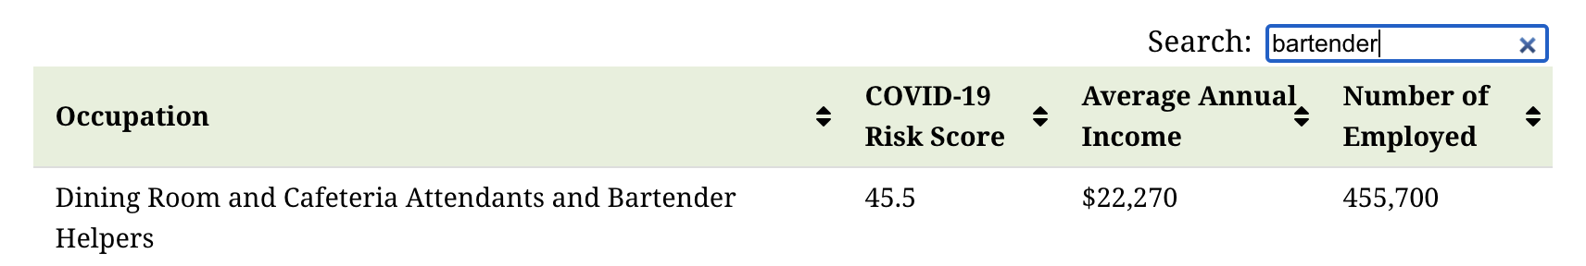
The pandemic has affected employment negatively
Even though 29% of the population was able to continue working safely from home, for the remaining 71% the situation remained uncertain, with some losing their jobs due to business shutdowns and mandated lockdown orders.
[source: Visual Capitalist/Department of Labor]
Notes:
Many individuals have been practicing social distancing by working from home in recent weeks. While this arrangement can be a great way to reduce one’s exposure to COVID-19, it’s a luxury that’s available to just 29% of Americans. [source: Visual Capitalist/Department of Labor] The situation for the remaining 71% is uncertain, to say the least. A significant portion of the population has lost their jobs due to business shutdowns and mandated lockdown orders. Others employed in “essential services” have continued working as usual, but may face a higher risk of potential exposure to the virus.

Slide 8
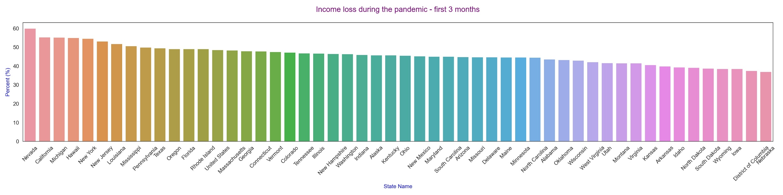
What does loss of income look like across the country during the pandemic?
Income loss has been experienced across the country during the pandemic, with Nevada being affected the most.

Slide 9
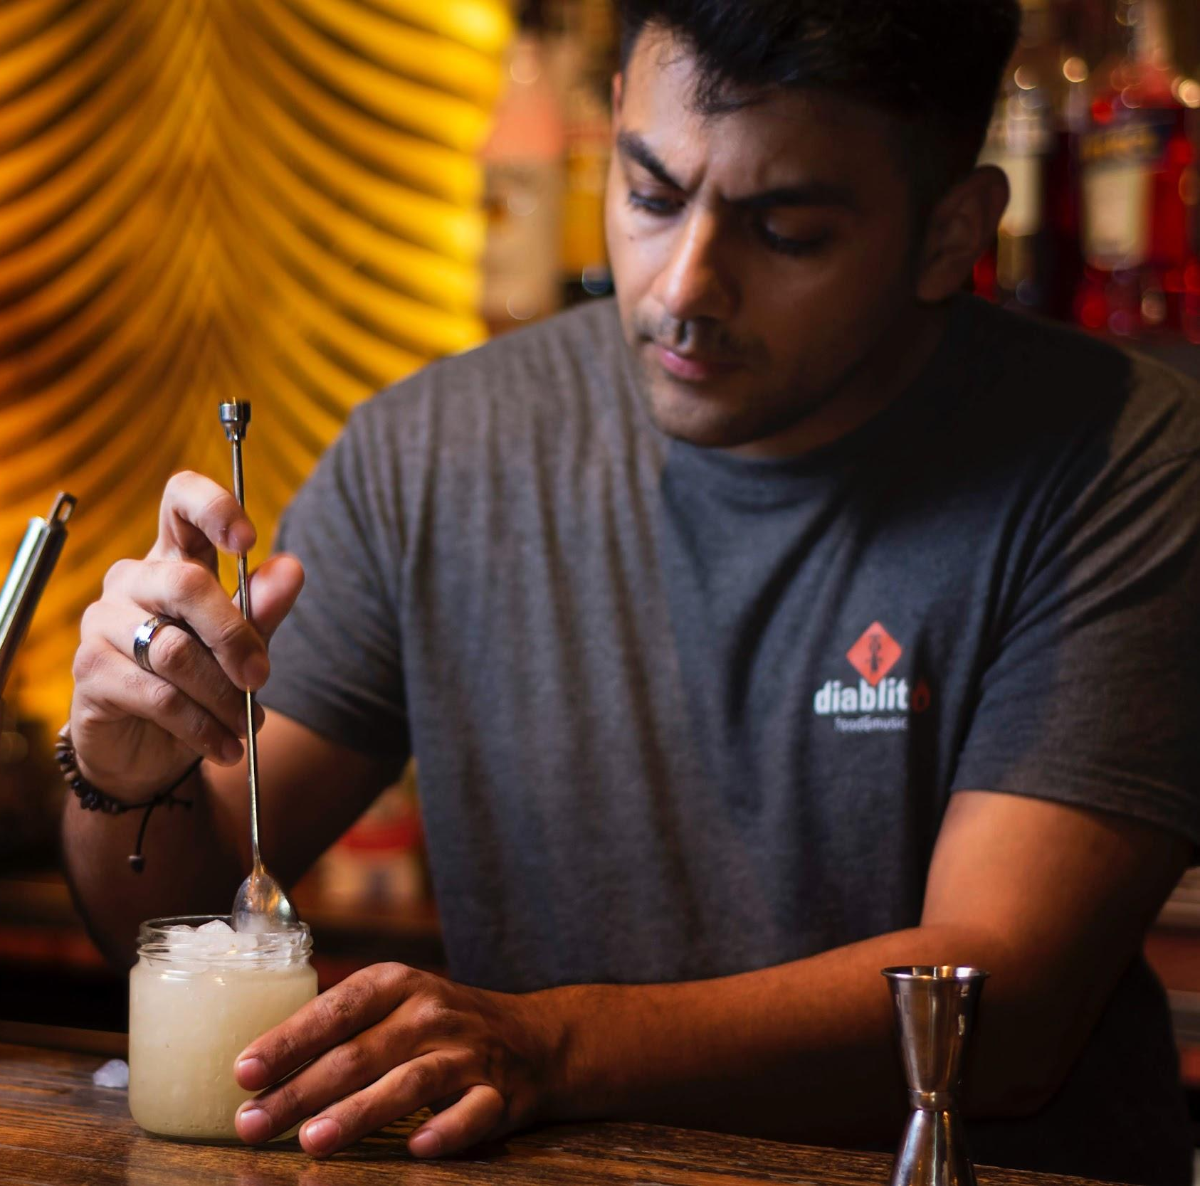
Competitor Charles
Frustrations
Bar he worked at is closed due to Covid-19 and he has been laid off
Feels depressed because he doesn’t see his customers everyday
Feels anxious and uninspired to do anything because he is unsure of the future
Goals
He wants to connect with people again and share his love for cocktails with others
Wants to keep his bartending skills sharp for when he can return to work
Wants to do something productive with his time instead of binge watching shows

Slide 10
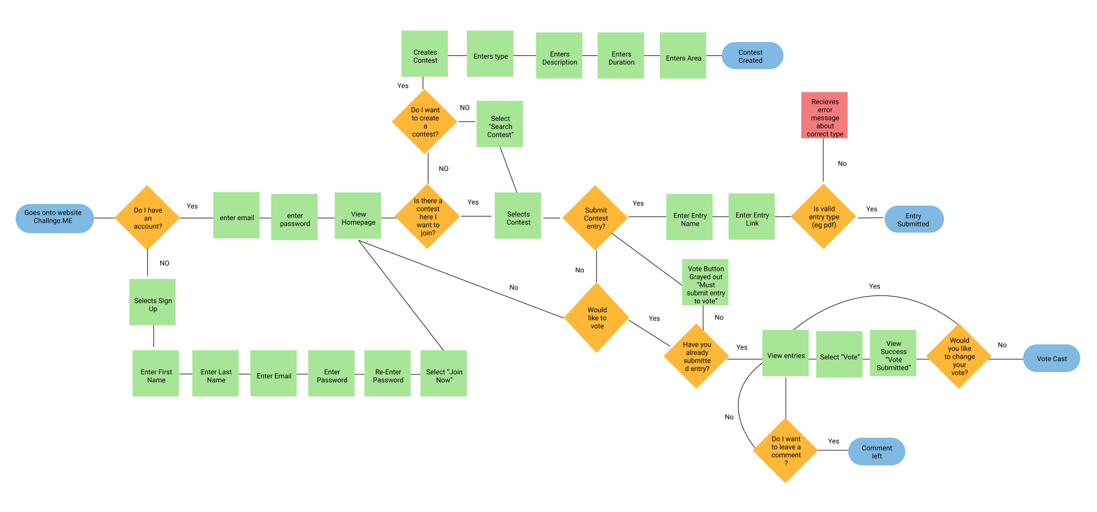
User Flow 1.0

Slide 11
App Demo

Slide 12
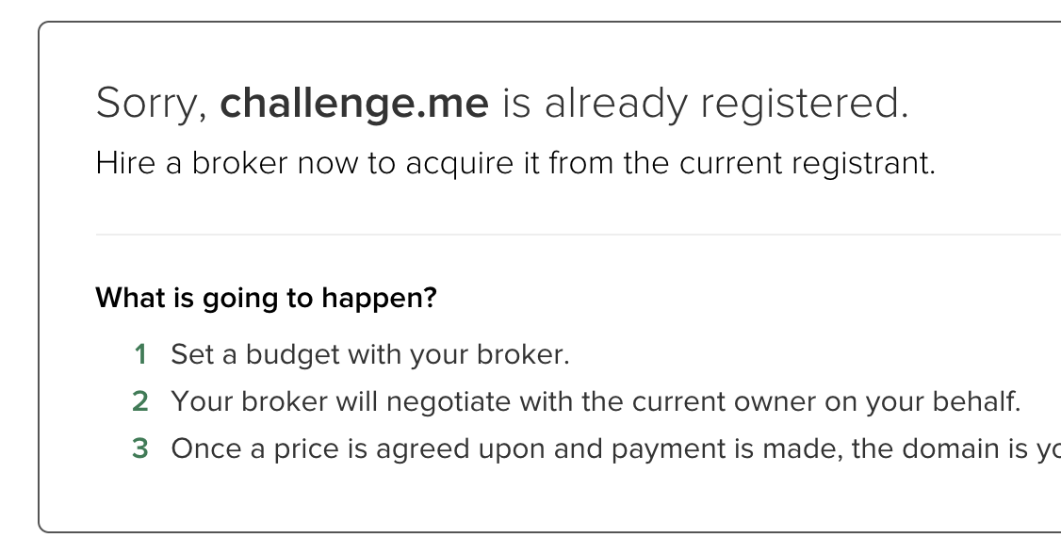
Next Steps
Must Do
Should Do
Won’t Do
Finish the mid fidelity prototype
Usability tests with Bartenders
Iterations based on feedback
Research more design inspirations to create a more pleasing UI
Implement an incentive for Bartenders to get paid on the website
Limit # of entries per personal contest
Consult UX copywriter
Open the app to not just Bartenders but anyone with a hobby and create categories ( Ex. Music, Art, Food..)
Stay up till 3AM prototyping (this is a lie)
Beat up whoever already registered challenge.me (half lie)

