Slide 1
Data Sources.
Data was collected from the OECD and Data Catalog websites.
http://www.oecd.org/els/soc/PF1_1_Public_spending_on_family_benefits.xlsx
http://www.oecd.org/els/soc/PF2_1_Parental_leave_systems.xlsx
http://www.oecd.org/els/family/PF2-2-Use-childbirth-leave.xlsx
http://www.oecd.org/els/soc/PF2_3_Additional_leave_entitlements_of_working_parents.xls
https://stats.oecd.org/viewhtml.aspx?datasetcode=HEALTH_PROT&lang=en
https://worldpopulationreview.com/country-rankings/maternity-leave-by-country
https://stats.oecd.org/index.aspx?queryid=54760
http://www.oecd.org/social/family/CO_1_4_Childhood_vaccination.xlsx
http://www.oecdkorea.org/resource/download/2019/eng/CO_1_4_Childhood_vaccination.xlsx
http://www.oecd.org/social/family/43136973.xls
http://www.oecd.org/social/family/CO_1_3_Low_birth_weight.xlsx
http://www.oecdkorea.org/resource/download/2019/eng/CO_1_3_Low_birth_weight.xlsx
http://www.oecd.org/els/soc/LMF_1_2_Maternal_Employment.xlsx
http://www.oecd.org/els/soc/LMF_1_3_Maternal_employment_by_partnership_status.xlsx
https://datacatalog.worldbank.org/dataset/gender-statistics
http://www.oecd.org/social/family/CO_1_1_Infant_Mortality.xlsx
http://www.oecdkorea.org/resource/download/2019/eng/CO_1_1_Infant_Mortality.xlsx
http://www.oecd.org/els/soc/CO_1_2_Life_expectancy_at_birth.xlsx
http://www.oecdkorea.org/resource/download/2019/eng/CO_1_2_Life_expectancy_birth.xlsx
https://stats.oecd.org/Index.aspx?DataSetCode=GENDER_EMP
http://www.oecd.org/els/family/CO3_1_Educational_attainment_by_gender.xlsx
http://www.oecdkorea.org/resource/download/2019/eng/CO_3_1_Educational_attainment_by_gender.xlsx
https://stats.oecd.org/Index.aspx?DataSetCode=GIDDB2019
https://datacatalog.worldbank.org/dataset/world-development-indicators

Slide 2
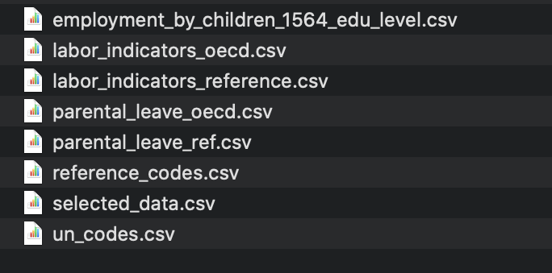
Data Cleaning.
Data was collected from the OECD and Data Catalog websites.

Slide 3
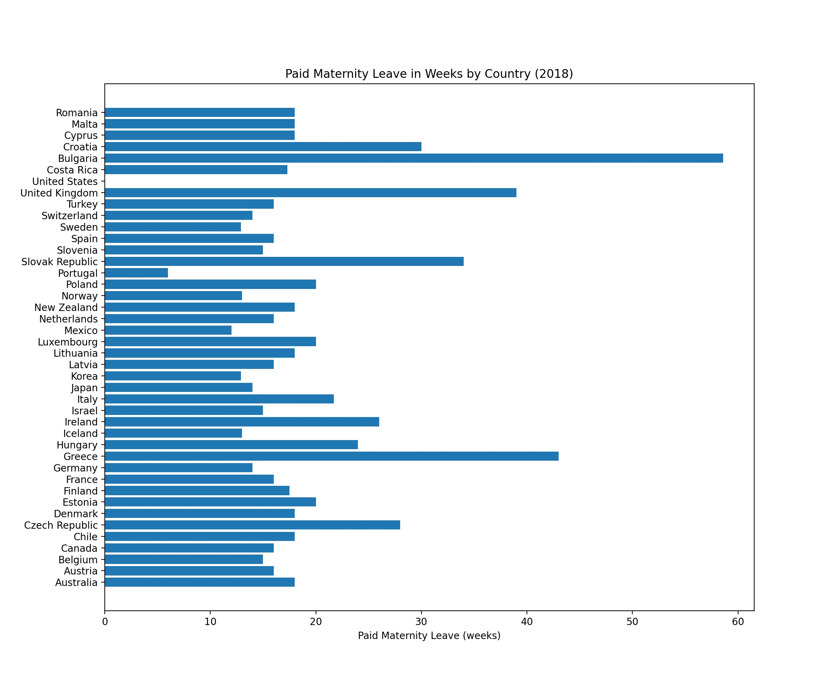
Notes:
At a Federal/Government policy level, Bulgaria offers 1+ year of Paid Maternity Leave, while United States of America does not offer any. United Kingdom and Greece provide 40+ weeks.
For the United States,
there is no federal paid maternity leave — it’s left to the states to figure out.
The only states with an active policy are California, Rhode Island, and New Jersey.
Source: https://www.healthline.com/health/pregnancy/united-states-maternity-leave-facts#Maternity-leave-facts-in-the-United-States

Slide 4
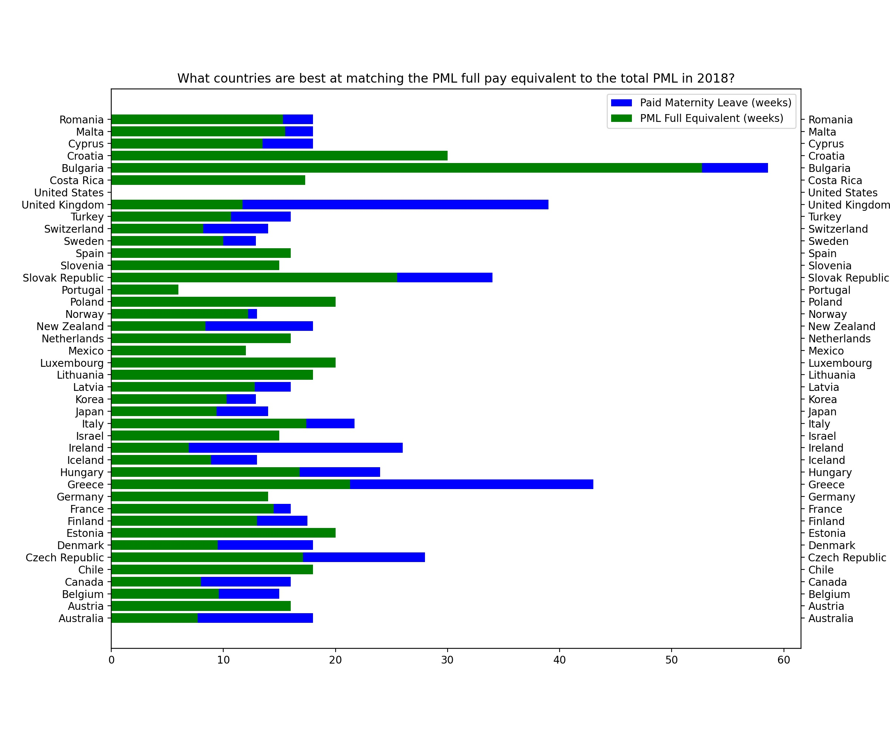
Notes:
How do countries do in matching the pay rate during Paid Maternity Leave to the actual pay outside PML?
For example, while Portugal offers less number of weeks in PML, they do match at 100%. However, Bulgaria offers more weeks, but does not match the full pay rate. Croatia offers 30+ weeks and matches 100% of the pay rate.

Slide 5
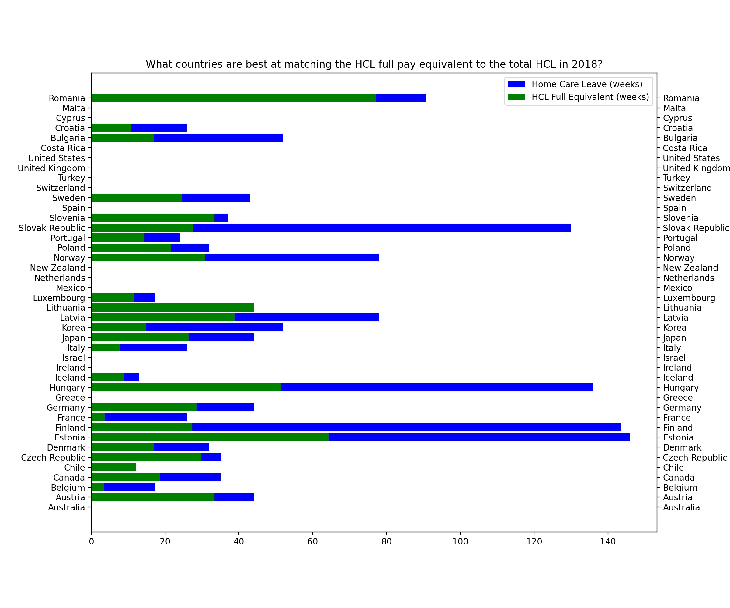
Notes:
How do countries do in matching the pay rate during Home Care Leave to the actual pay?
There are several countries who do not have Home Care Leave policies in place. If they do, they do not match the pay rate as well as they do for paid maternity leave.
For example, Austria (previous slide) matches PML 100%, but does not match HCL at the same rate. They do provide 48 weeks of HCL, but in terms of pay, this only amounts to 36.

Slide 6
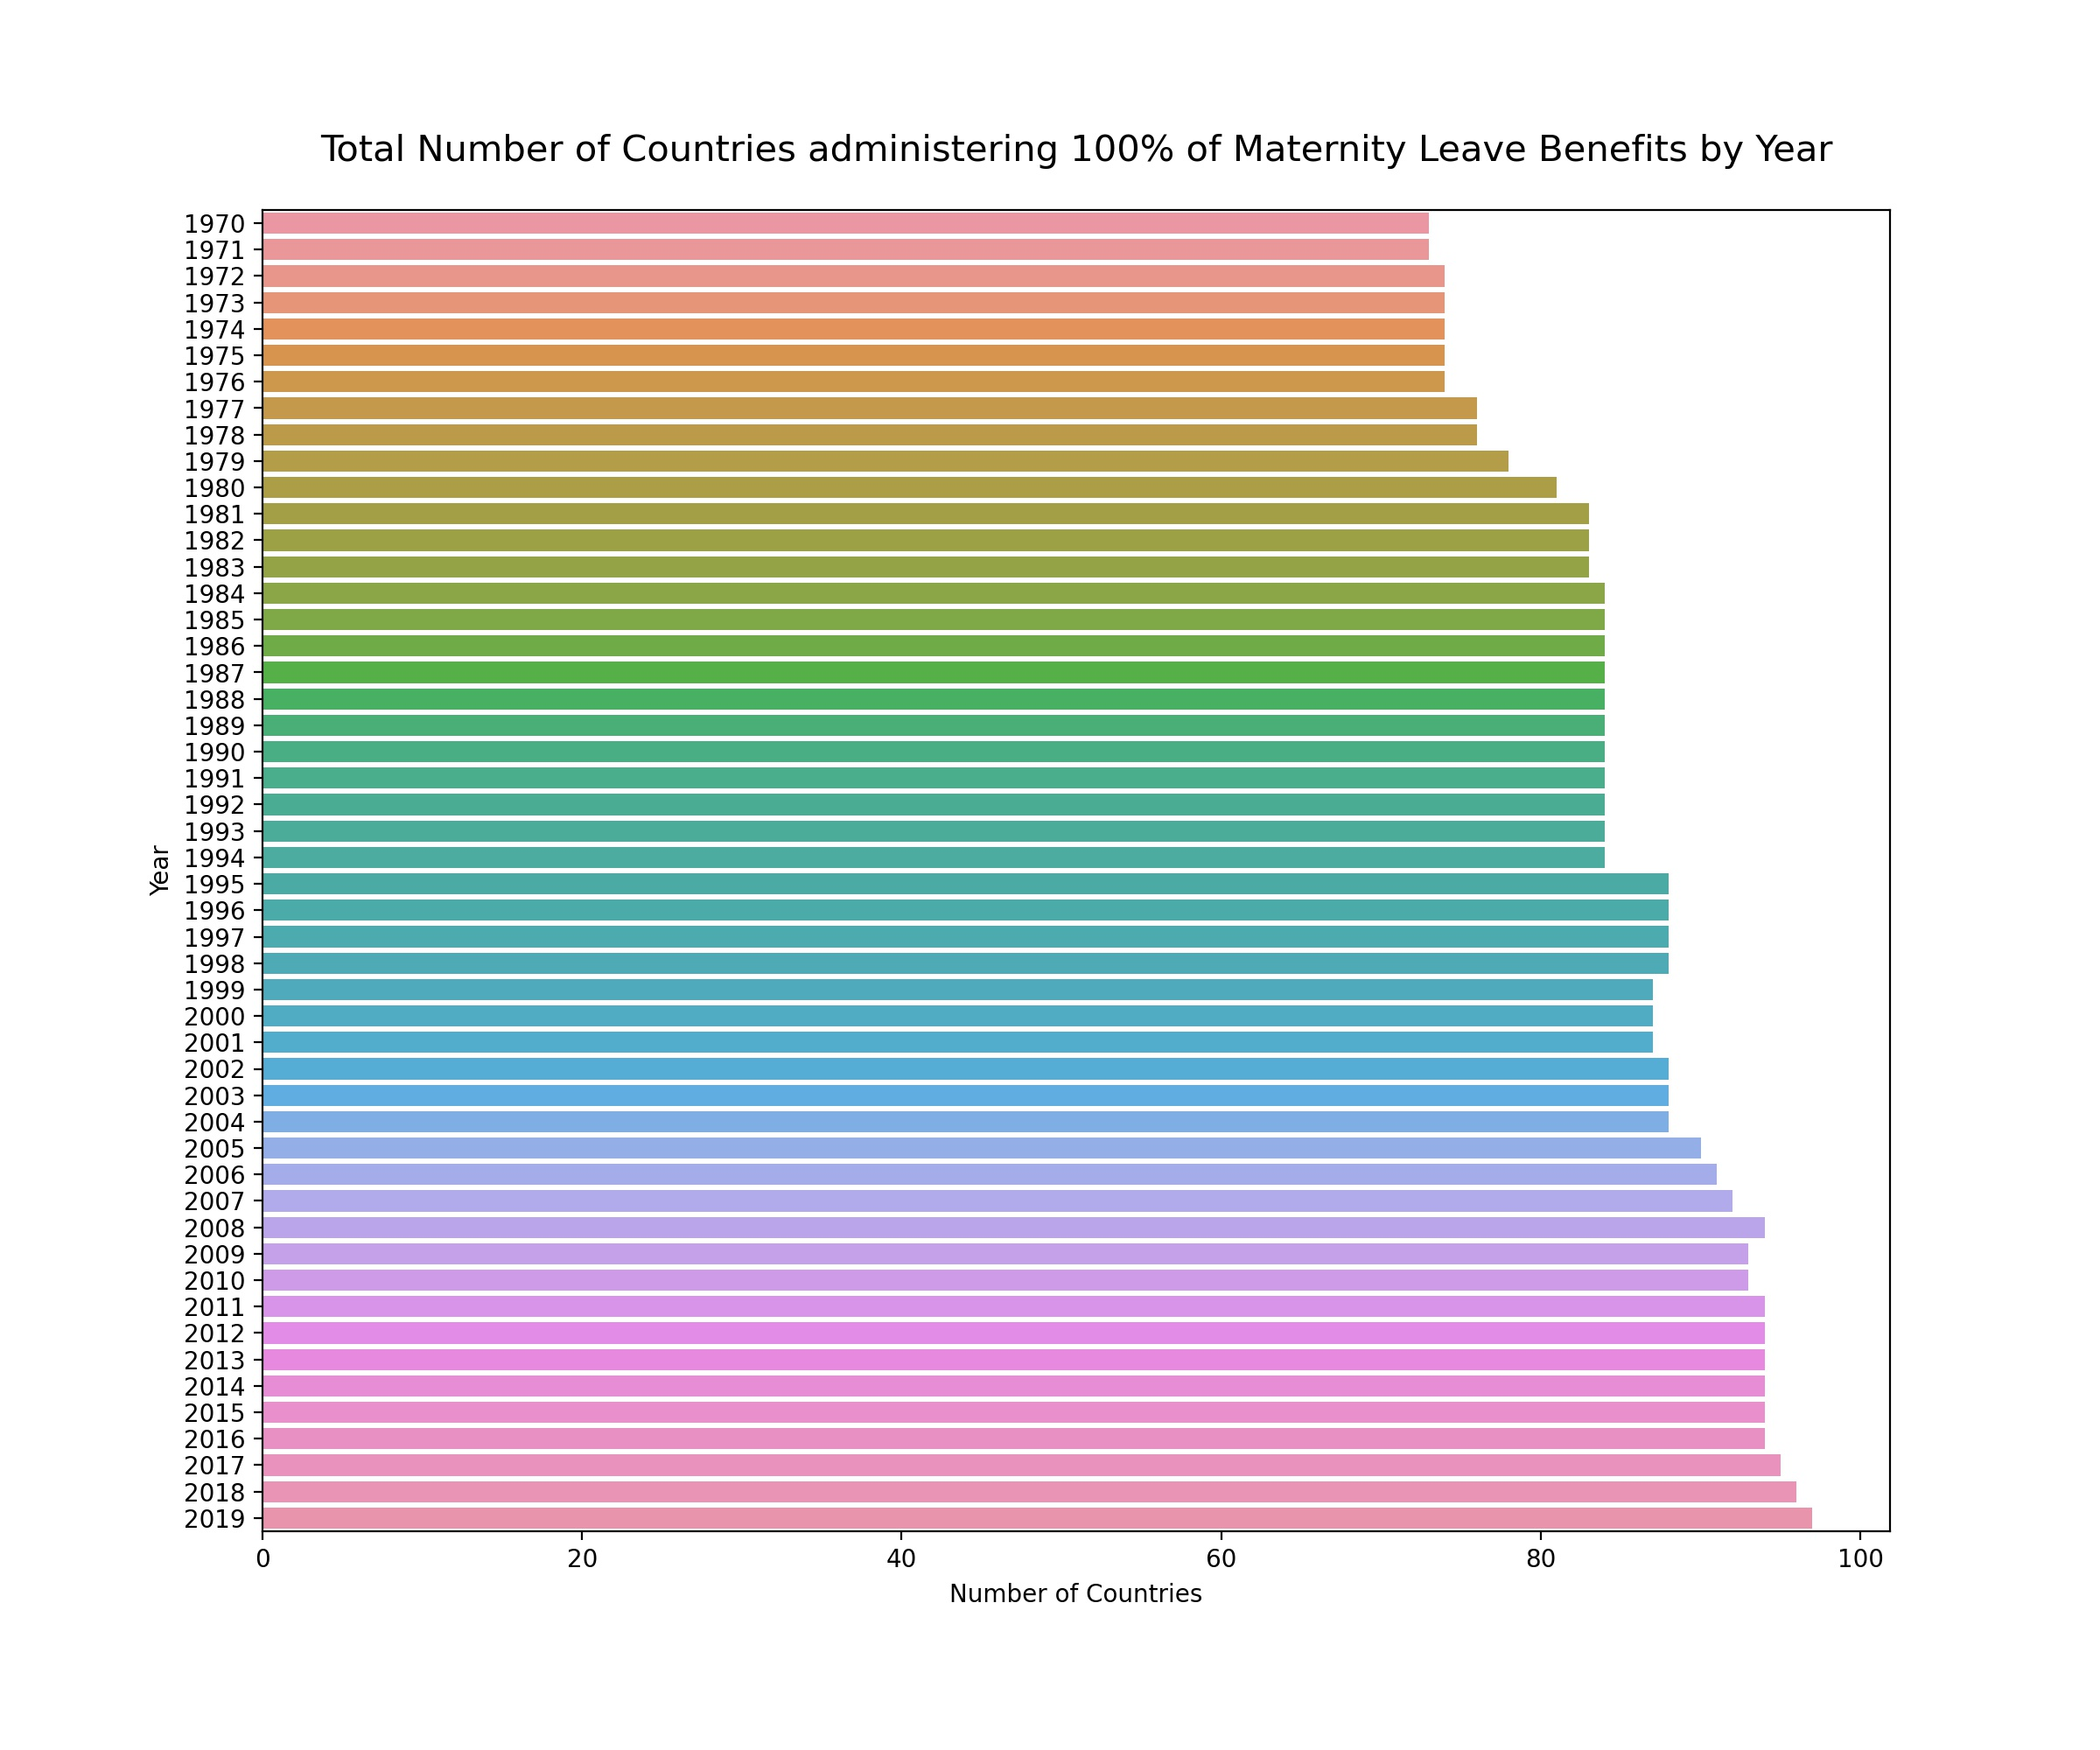
Notes:
Overall, we are moving in the right direction. The number of countries providing maternity leave benefits and policies has gone up over the years. In 2019, we observe the largest number, which is promising.

Slide 7
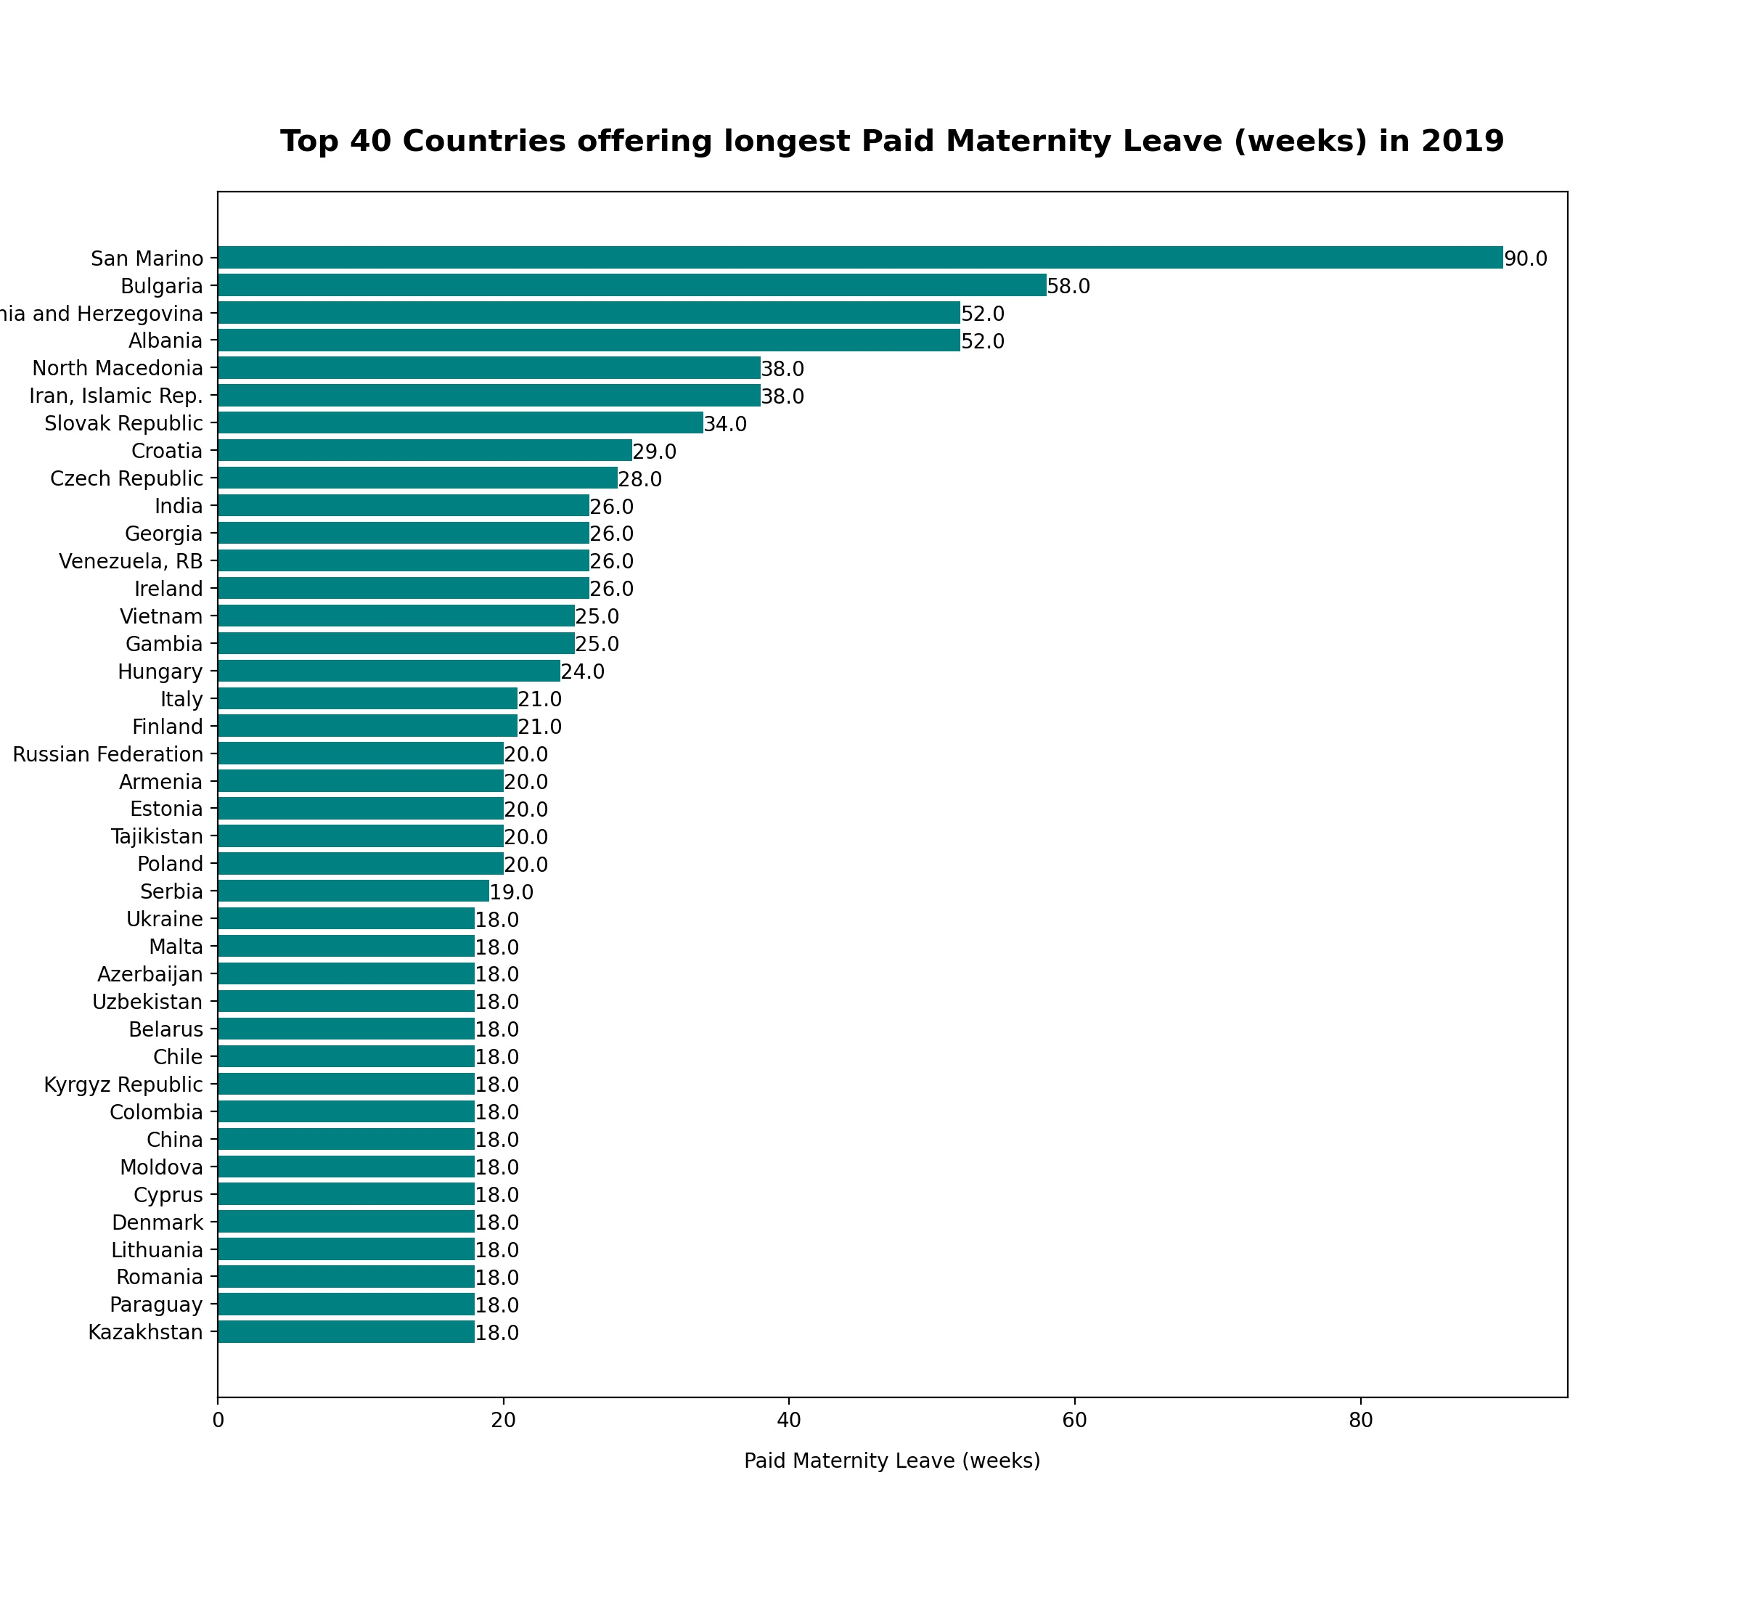
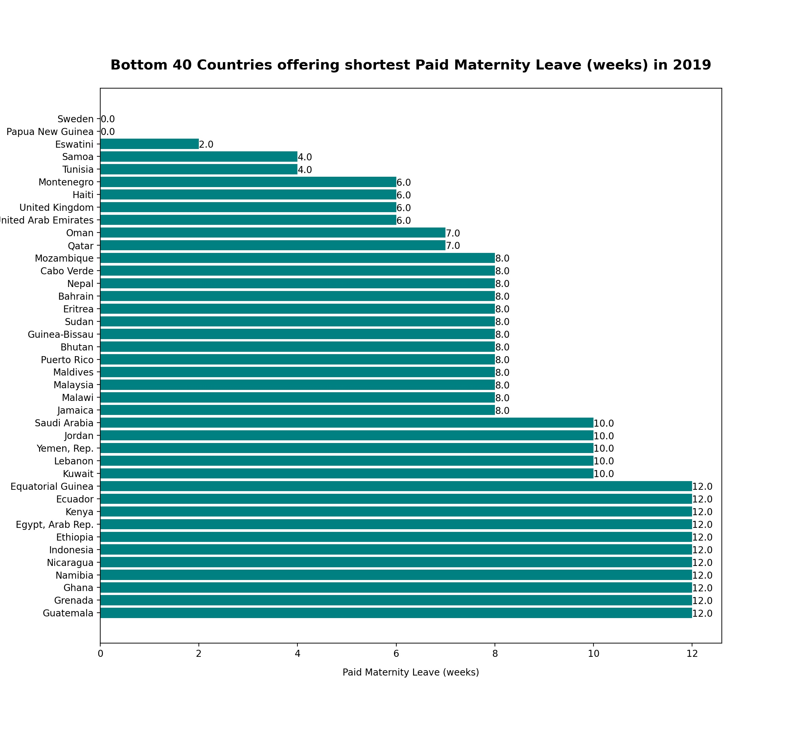
The contrast across the world is high, with Paid Maternity Leave ranging from 90 weeks to 0.

Slide 8
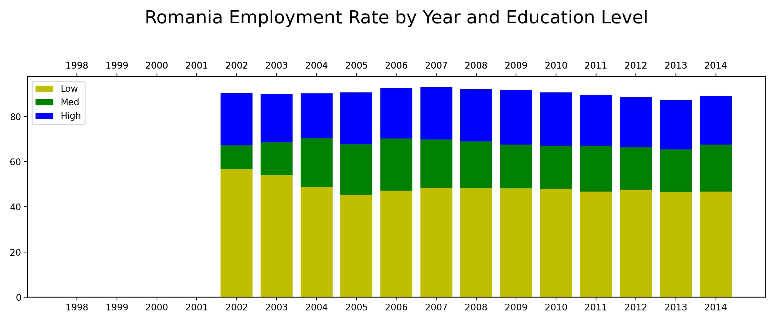

Slide 9
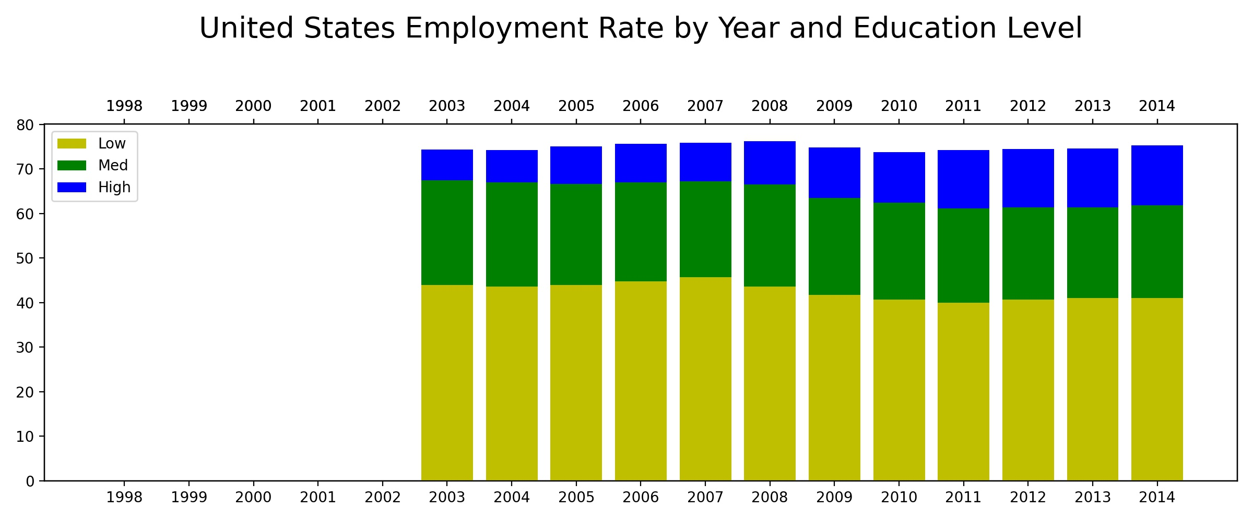

Slide 10
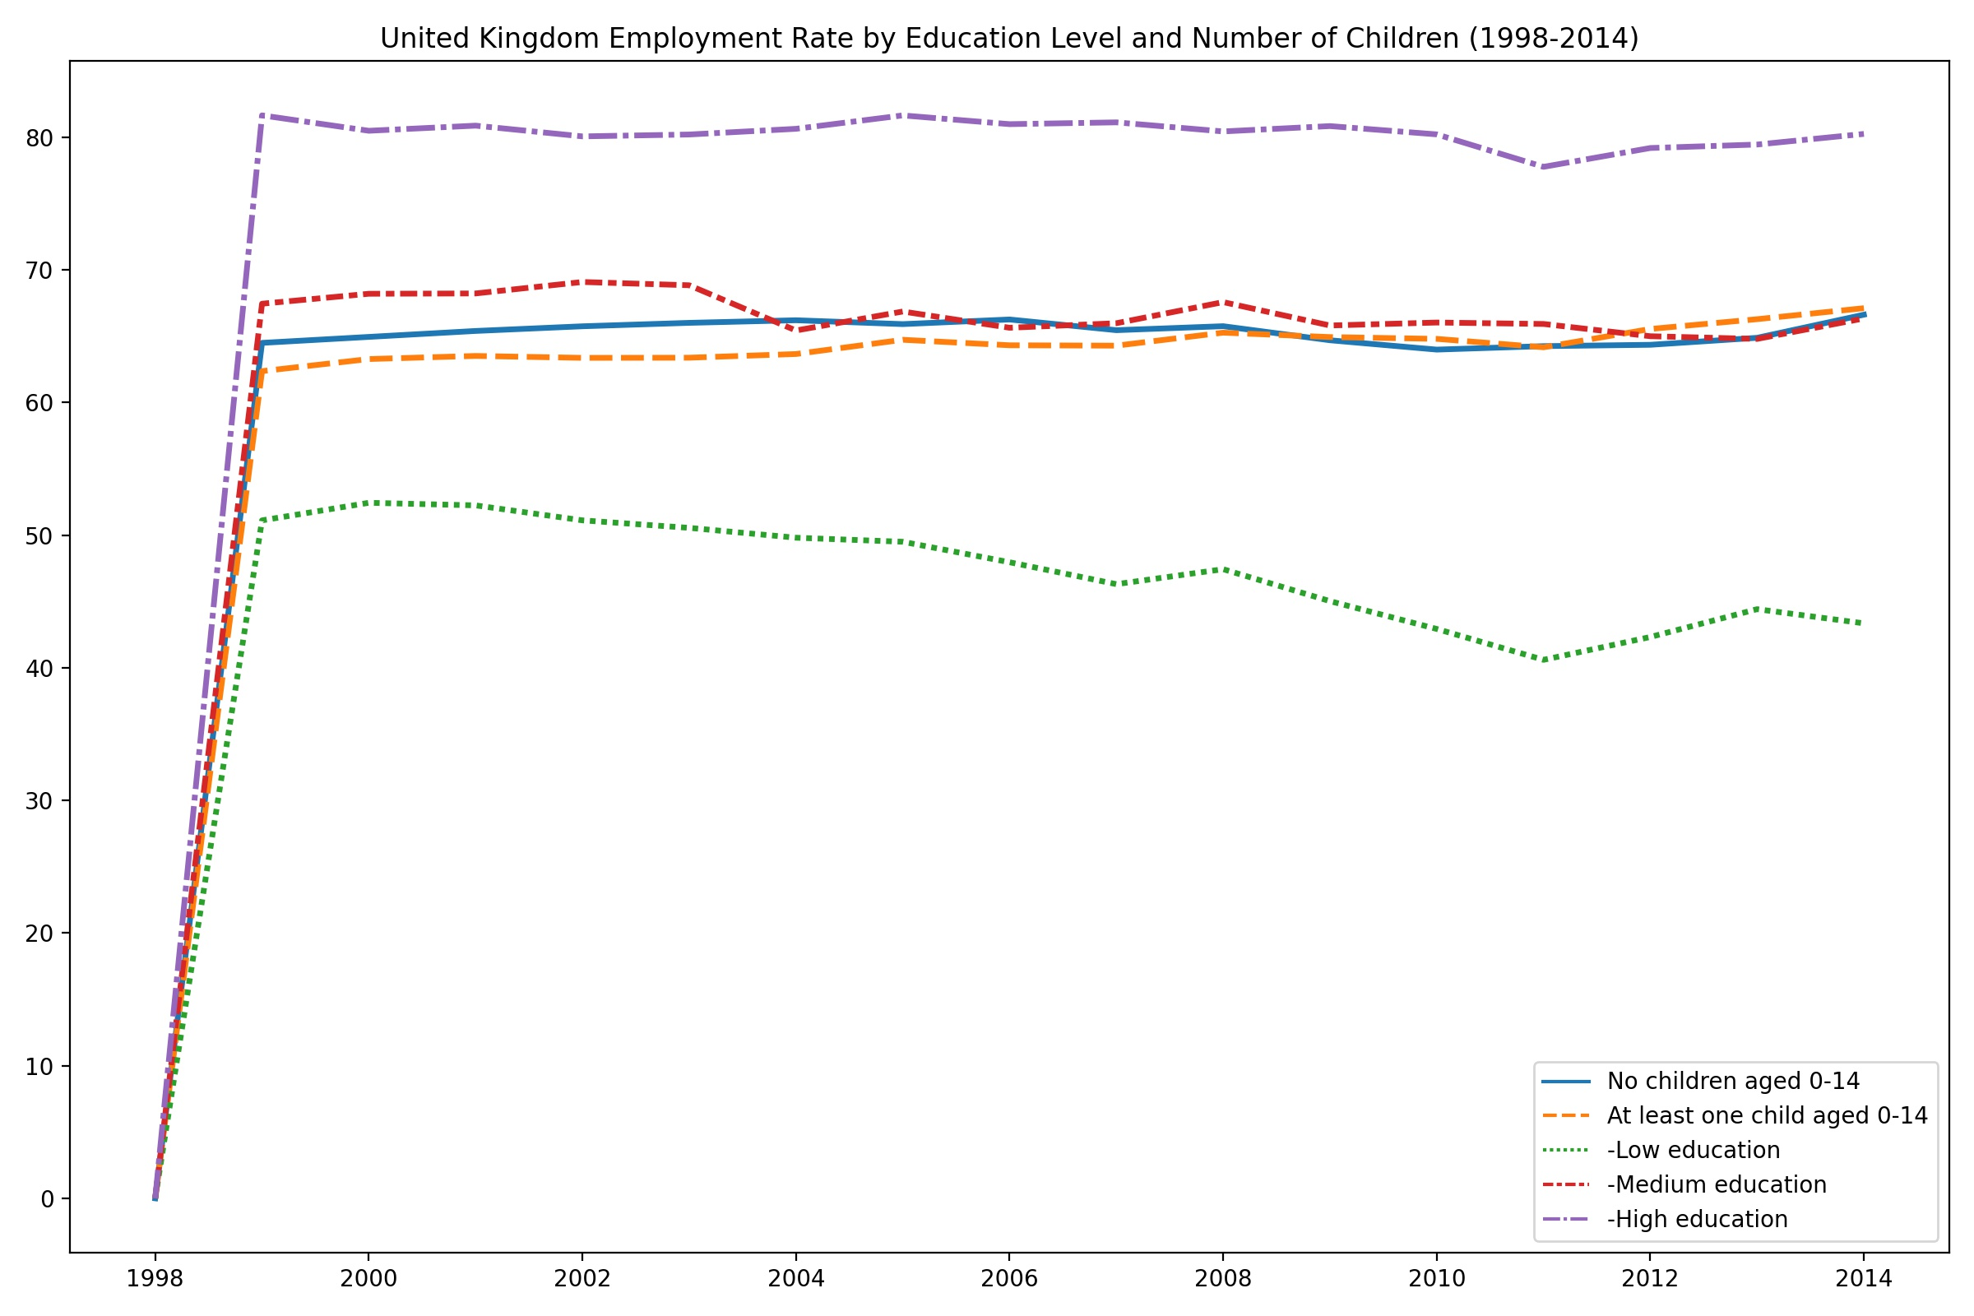

Slide 11
