Slide 1

UW-Madison Grade Distributions
Investigating Time of Day and STEM Classification

Slide 2
Does time of day have a statistically significant correlation with the number of A’s earned in courses?
Data:
Created A-Ratio data from grade distribution
Created Time of Day data:
Convert minute start time to hours
Categorized data as follows:
Morning: 6:00 AM - 9:30 AM
Noon: 10:00 AM - 1:30 PM
Afternoon: 2:00 PM - 5:00 PM
Evening: 5:30 PM - 9:00 PM
Random samples of size 2,500 were taken from each category

Slide 3
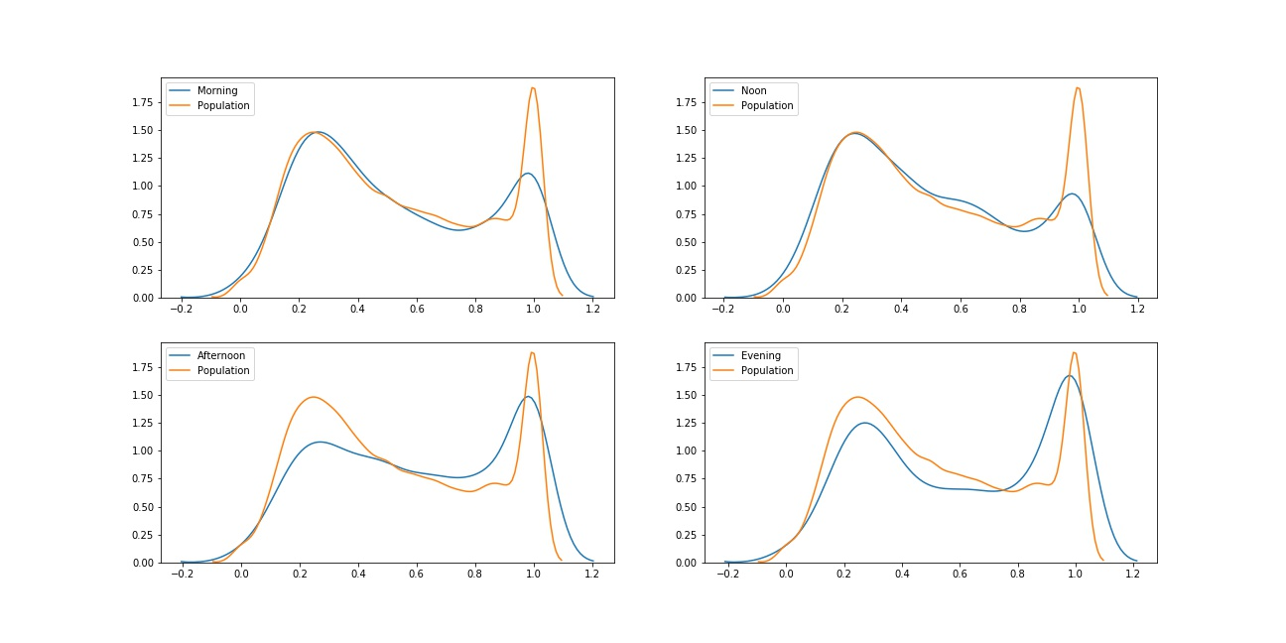
Does time of day have a statistically significant correlation with the number of A’s earned in courses?

Slide 4
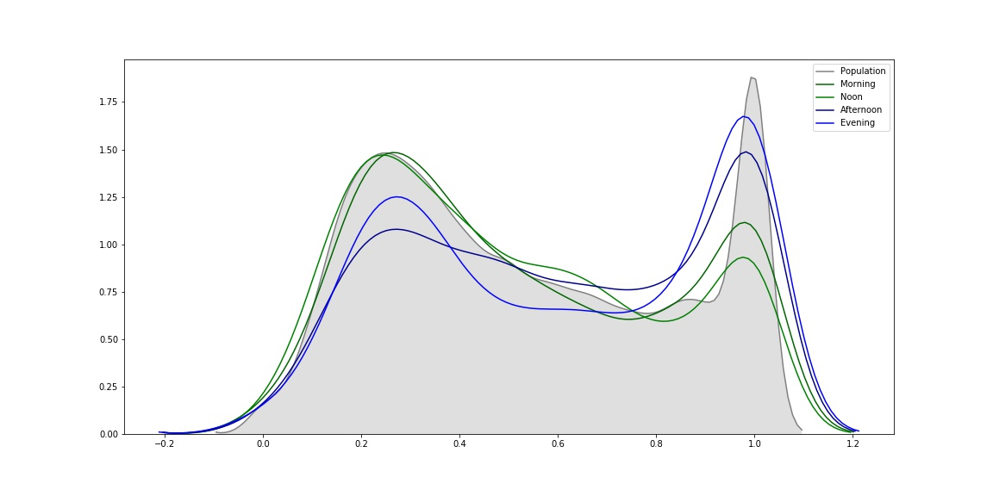
Does time of day have a statistically significant correlation with the number of A’s earned in courses?

Slide 5
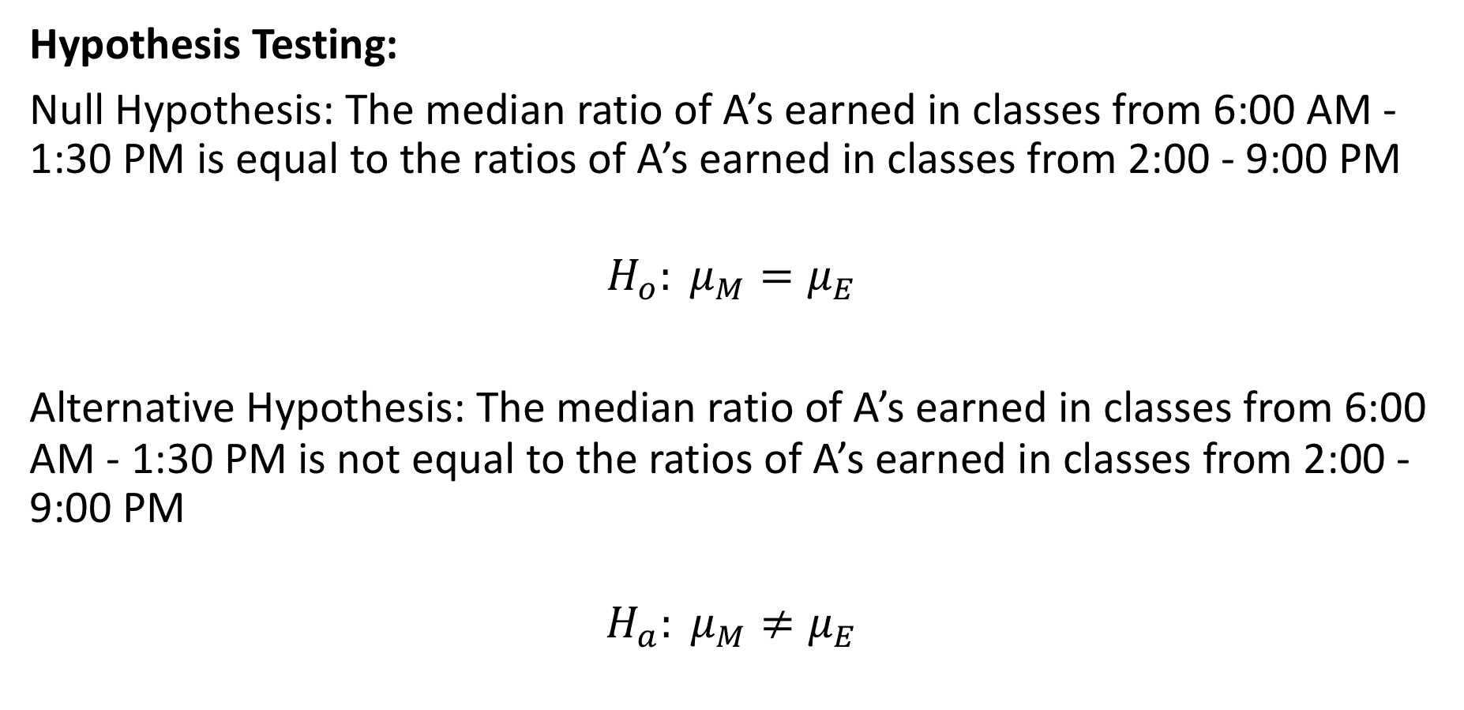
Does time of day have a statistically significant correlation with the number of A’s earned in courses?
Hypothesis Testing:
Null Hypothesis: The median ratio of A’s earned in classes from 6:00 AM - 1:30 PM is equal to the ratios of A’s earned in classes from 2:00 - 9:00 PM
$$H_{o}: μ_{M}=μ_{E}$$
Alternative Hypothesis: The median ratio of A’s earned in classes from 6:00 AM - 1:30 PM is not equal to the ratios of A’s earned in classes from 2:00 - 9:00 PM
$$H_{a}: μ_{M}≠μ_{E}$$

Slide 6
Does time of day have a statistically significant correlation with the number of A’s earned in courses?
Wilcoxon Rank Sum Test:
Test statistic: -13.856
Probability of test statistic: 1.166e⁻⁴³
Conclusion:
The median ratio of A’s earned in classes from 6:00 AM - 1:30 PM is not equal to the ratios of A’s earned in classes from 2:00 - 9:00 PM

Slide 7
Is there a relationship between time of day and if the course is STEM or not?
Data:
Created STEM categorical data from subject names
Categorized time data as follows:
Morning: 6:00 AM - 1:30 PM
Afternoon: 2:00 PM - 9:00 PM

Slide 8
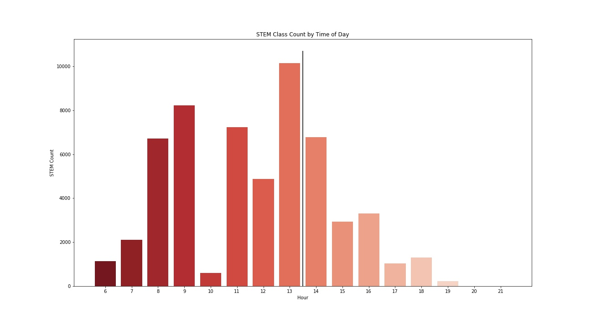
Is there a relationship between time of day and if the course is STEM or not?

Slide 9
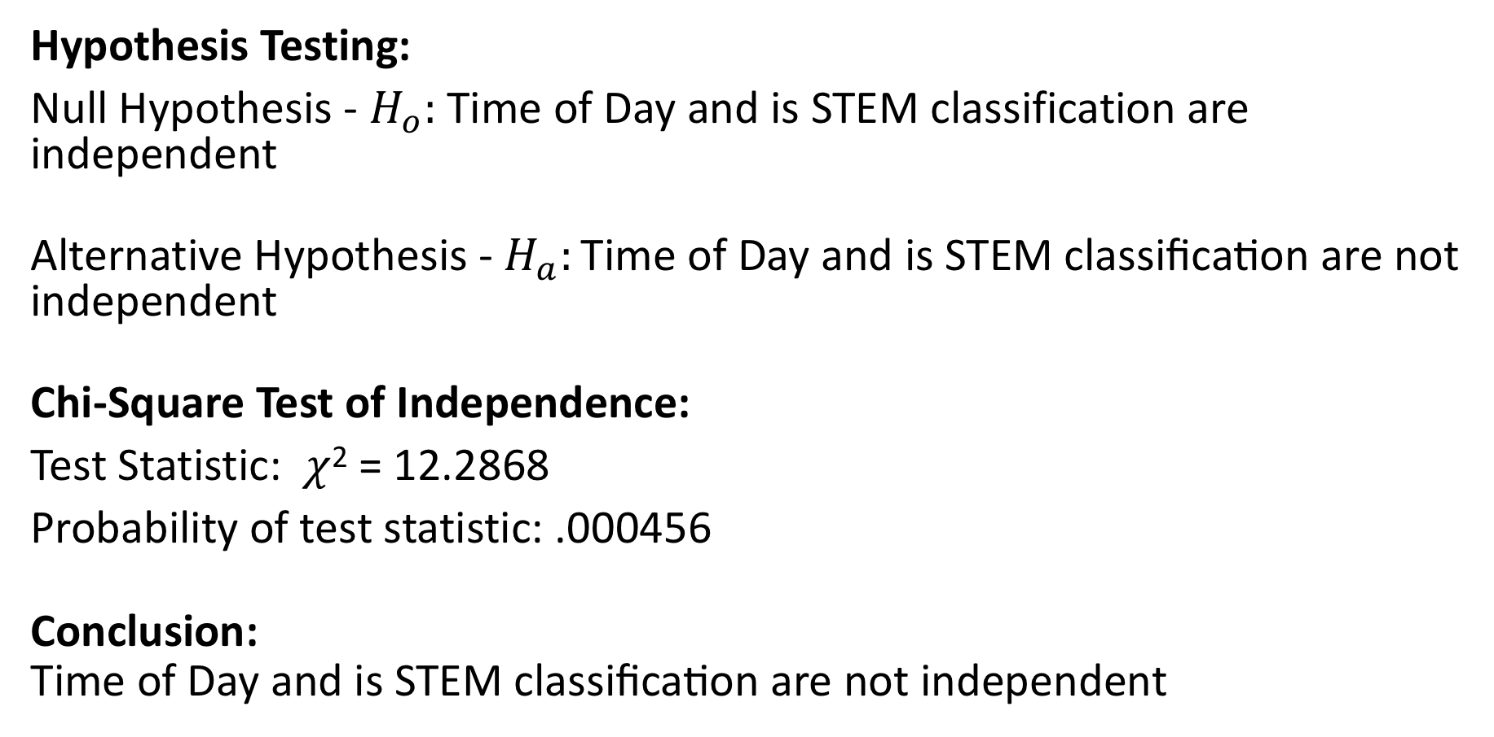
Is there a relationship between time of day and if the course is STEM or not?
Hypothesis Testing:
Null Hypothesis - $H_{o}:$Time of Day and is STEM classification are independent
Alternative Hypothesis - $H_{a}:\text{Time} \text{of} \text{Day} \text{and} \text{is} \text{STEM} \text{classification} \text{are} \text{not} \text{independent}$
Chi-Square Test of Independence:
Test Statistic: $χ$² = 12.2868
Probability of test statistic: .000456
Conclusion:
$$\text{Time} \text{of} \text{Day} \text{and} \text{is} \text{STEM} \text{classification} \text{are} \text{not} \text{independent}$$

Slide 10
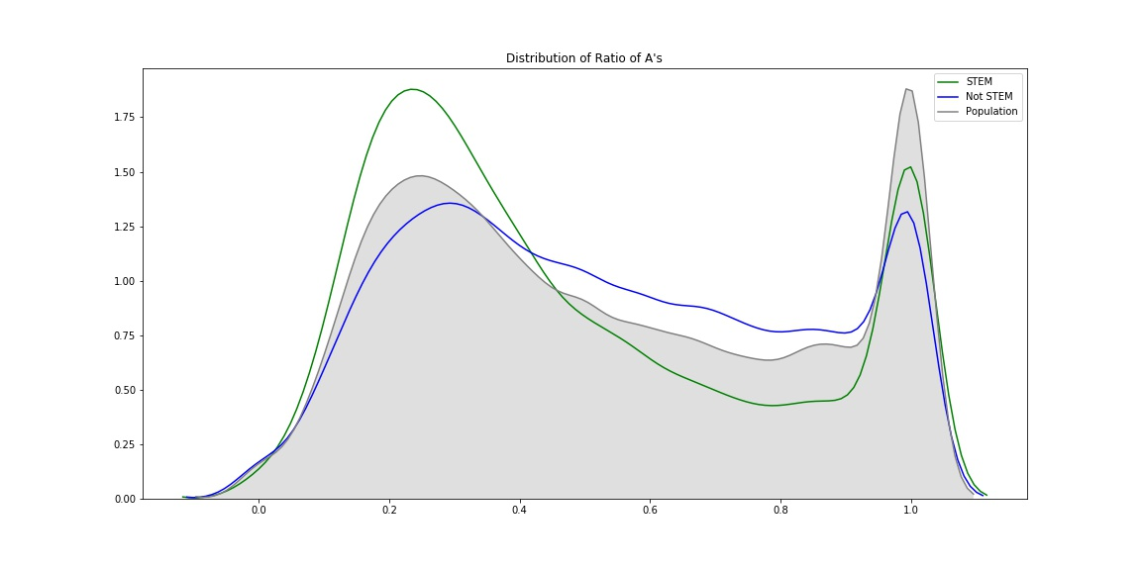
Are STEM courses significant given the time of day?

Slide 11
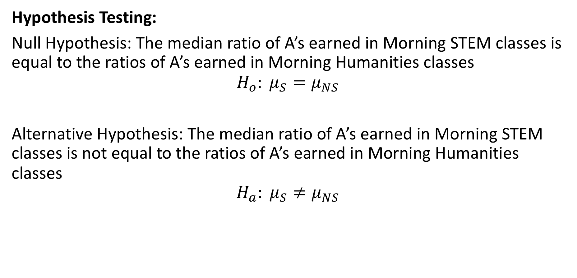
Are STEM courses significant given the time of day?
Hypothesis Testing:
Null Hypothesis: The median ratio of A’s earned in Morning STEM classes is equal to the ratios of A’s earned in Morning Humanities classes
$$H_{o}: μ_{S}=μ_{NS}$$
Alternative Hypothesis: The median ratio of A’s earned in Morning STEM classes is not equal to the ratios of A’s earned in Morning Humanities classes
$$H_{a}: μ_{S}≠μ_{NS}$$

Slide 12
Are STEM courses significant given the time of day?
Wilcoxon Rank Sum Test:
Test statistic: -28.061
Probability of test statistic: 2.904e⁻¹⁷³
Conclusion:
The median ratio of A’s earned in Morning STEM classes is not equal to the ratios of A’s earned in Morning Humanities classes

Slide 13
Conclusion
Morning courses in STEM fields have a statistically significant difference in the ratio of A’s earned compared to morning courses in Humanities.
Further Investigation:
Analyze ratio of A’s earned in STEM courses by other factors such as:
Instructor
Class Size
Level of course
Subjects

