Slide 1
Raster to Vector Representation

Slide 2
What is a Raster Graphic
What is a Vector Graphic
A raster image is a type of dot matrix data structure that general is made up of rectangular grid of pixels
A vector graphic is a format in which the image is represented with lines, strokes, curves, and shapes so that it keeps the same quality all around

Slide 3
Goal:
The goal of this project is to convert a raster type image segmentation to a Vector type of image while keeping the integrity of the original image
This will be done by using algorithms to calculate uncertainty so that it will have better quality and still contain the uncertain values
When the image is converted to vector format it will have have the same quality as if it was not zoomed out

Slide 4
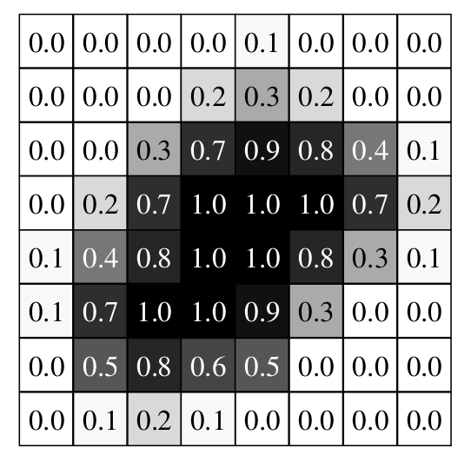
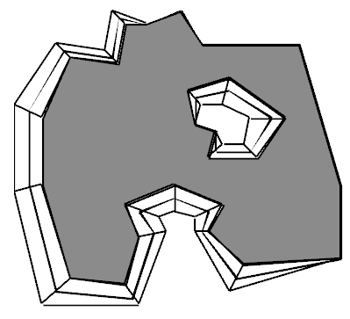
How will it be done
Using the specifications from “A Medium Complexity Discrete Model for Uncertain Spatial Data” we will be able to extract an image such as the one below by taking the raster graphic and turning it into a vector graphic

