Slide 1
Converting Image Rasters to Vectors in the Presence of Uncertainty
Cristobal Guerrero
James Schaffer
Department of Electrical and Computer Engineering, Summer 2012

Slide 2
Raster
Vector
A raster is a type of dot matrix data structure that is generally made up of a rectangular grid of pixels
A vector is a type of data structure represented with points, curves, and regions

Slide 3
Goal:
The goal of this project is to convert a raster image segmentation to a Vector data structure while minimizing the error in the region represented
This will be done in the presence of uncertainty
Vector representations will have a reduced memory footprint and will speed up some query operations

Slide 4
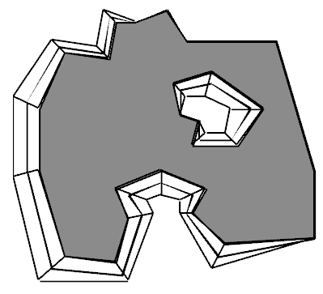
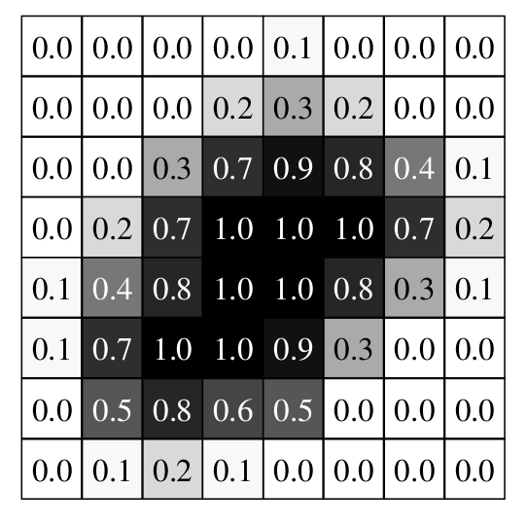
How will it be done
Utilize vector models from “A Medium Complexity Discrete Model for Uncertain Spatial Data,” use uncertain Astrocyte segmentation data
Initial approaches: gradient descent, maximum likelihood fit, simulated annealing

