Slide 1
Week 1 Completions and Week 2 expectancies
Cristobal Guerrero
James Schaffer
Department of Electrical and Computer Engineering, Summer 2012

Slide 2
First Week
First week consisted of reading papers from Tøssebro and understanding the concept of the overall project
Downloaded images from the Bisque server
Did various Java tutorials and began to do some implementation for the project

Slide 3
First Iteration
The results expected by the end of second week is to have a very basic raster to vector image implementation in only black and white
Another key feature is either searching through files or simply inputing a string for the specific file location

Slide 4
What is completed
After attempting various Java tutorials and searching for information about the libraries in Java I have completed a raster to raster image conversion
When converting a raster to raster image it changes pixel values depending on their RGB values in order to make it a crisper image
This threshold range for the RGB values will be altered depending on the image that is being converted(later iteration)

Slide 5
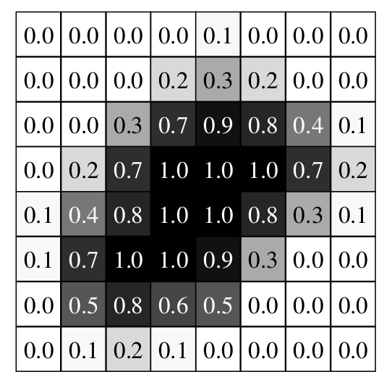
How it was done
So far the language that has been used is Java
The process reads in the RGB values by each pixel and then converts them to either black or white depending on the threshold of the values
This is only for testing and will change. It will changed so that it may calculate the uncertain values for each pixel and then that will be threshold that will determine the pixel color

Slide 6
