Slide 1
AI Recruiter Assistant 🤖
Intelligent Pre-Screening Automation

Slide 2
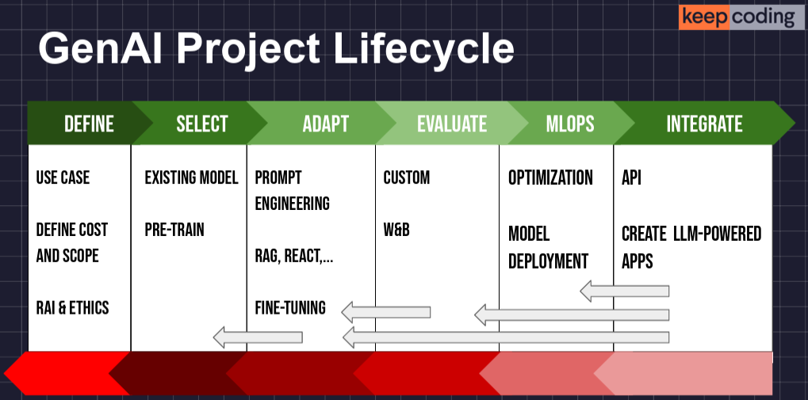
Methodology

Slide 3
Stage 1 - Define the Scope
The Problem: Manually screening recruiter messages on LinkedIn is inefficient, time-consuming, and prone to inconsistencies. A professional can receive dozens of offers, many of which are not relevant to their profile.
The Solution: Develop a conversational chatbot that acts as a personal assistant. This bot:
Classifies messages based on their relevance.
Analyzes job offers automatically.
Responds coherently and professionally.
Project Goal:
To create a robust, private, and efficient system using open-source language models and the RAG (Retrieval-Augmented Generation) technique to deliver a high-performance, personalized AI assistant.
Notes:
Se parece a un CASO DE USO que estoy planteando para una compañía de seguros en Chile, para revisión de casos confidenciales
> modelo OPEN SOURCES
Muchos mensajes en LinkedIn y poco tiempo para responder > Tengo un Gem en Gemini para responder esto casos (CV, requerimientos)

Slide 4
Stage 2 - Benchmarking & Model Selection
Data-Driven Selection of the Optimal Model
Objective: To identify the model with the best balance between performance (speed, quality) and resource usage (memory).
Methodology:
4 open-source models were evaluated: Mistral-7B, Llama-3-8B, Phi-3-mini, and gemma-3-4b.
Each model was tested against 3 recruitment scenarios (Perfect Match, Generic, Wrong Match).
Key metrics were measured: load time, average inference time, and memory.
Notes:
Proceso de Benchmarking entre distintos modelos Open Source “pequeños” (4B-7B paràmetros)

Slide 5
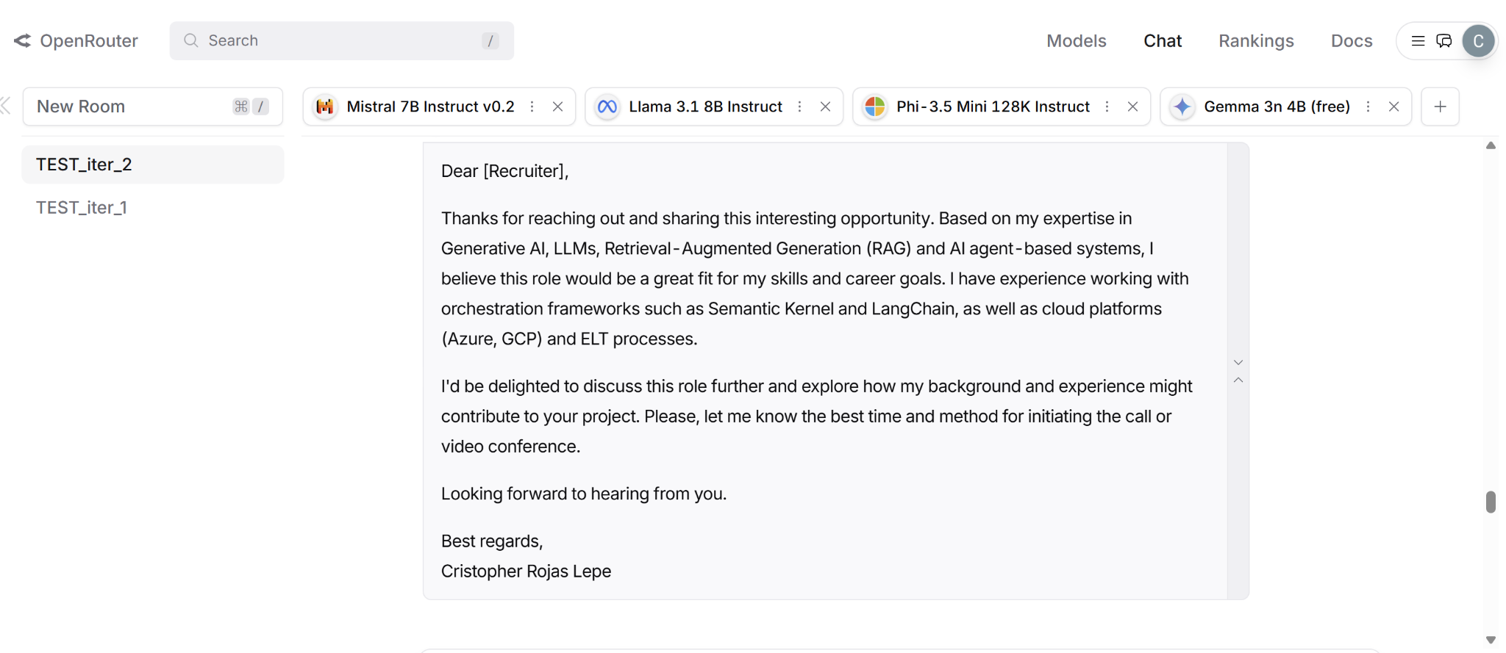
Stage 2 - Benchmarking & Model Selection
Data-Driven Selection of the Optimal Model
Notes:
Proceso de Benchmarking entre distintos modelos Open Source “pequeños” (4B-7B paràmetros)

Slide 6
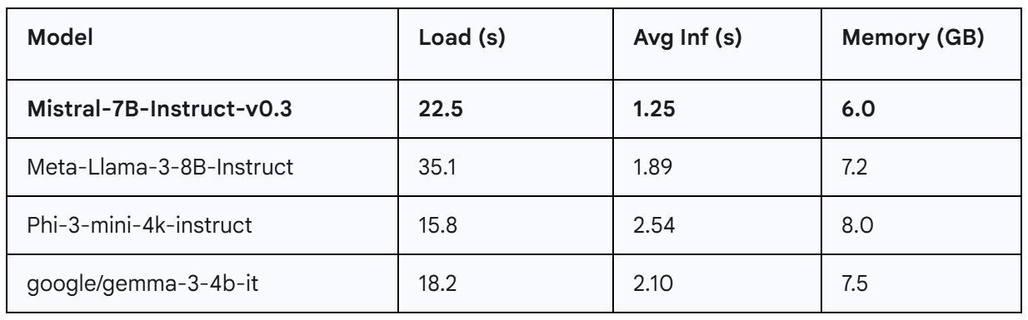
Stage 2 - Benchmarking & Model Selection
Data-Driven Selection of the Optimal Model

Slide 7
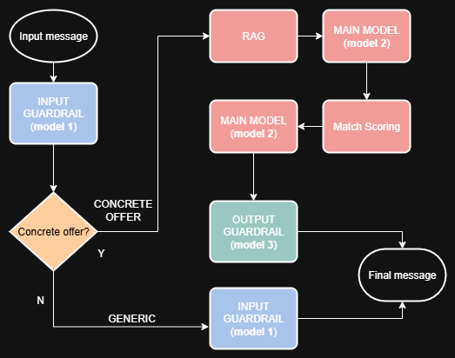
Stage 3 - Building the AI Assistant with RAG

Slide 8
Stage 3 - Building the AI Assistant with RAG
Key Components of the Object
RAG Knowledge Base:
Uses sentence-transformers to create embeddings of the CV and job expectations.
Stores these vectors in a FAISS index, an ultra-fast vector database that allows for real-time similarity searches.
Input/Output Guardrails:
Dedicated instances of the Phi-3-mini model for input classification and output validation, ensuring predictable and safe behavior.
Structured Prompts:
A system of prompts loaded from external files that guide each model in its specific task (classification, analysis, response, validation).

Slide 9
Stage 3 - Building the AI Assistant with RAG
Architecture & Process Logic
This system utilizes a multi-model pipeline to ensure accuracy and safety at every step.
Input Guardrail (microsoft/Phi-3-mini):
Function: Intent Detection.
Logic: Classifies if the message is a "Concrete Offer" or "Generic." If it's generic, it automatically responds asking for more details and ends the flow.
Main Model (mistralai/Mistral-7B-Instruct-v0.3 + RAG):
Function: Analysis and Generation.
Logic: For concrete offers, the RAG system retrieves context from the CV. The main model uses this context to calculate a match_score and generate a draft response.
Output Guardrail (microsoft/Phi-3-mini):
Function: Validation and Refinement.
Logic: Reviews the response to ensure it's in the first person and has a natural tone. It corrects it iteratively if necessary.

Slide 10
Stage 4 - Gradio Deployment and Demo
From Notebook to Interactive Application
Objective: To create a functional user interface to demonstrate the project's value and allow for real-time interaction.
Implementation:
The Gradio library was used, which is ideal for the rapid prototyping of Machine Learning applications.
A wrapper function was created to connect the chat interface with the .process_recruiter_message() method of our ai_assistant object.
The interface was designed to be intuitive, with a title, description, and usage examples.
The application runs directly from the notebook, generating a public URL for the live demo.

Slide 11
Stage 4 - Gradio Deployment and Demo

